Slide 1
Creating a State FTECE Strategic Plan

Slide 2
Georgia’s Context
FTECE, Child Care, Agriculture, Equity

Slide 3
Georgia Farm to Early Care and Education

Slide 4
Child Care Deserts - Rural Disparities

Slide 5
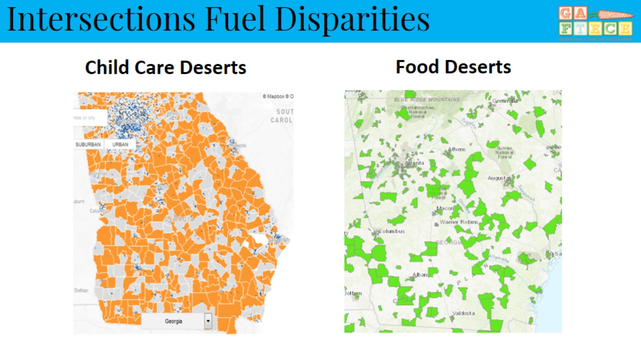
Intersections Fuel Disparities

Slide 6
Obesity Rates (WIC)

Slide 7
Obesity Rates (WIC)

Slide 8
Vision and Partners

Slide 9
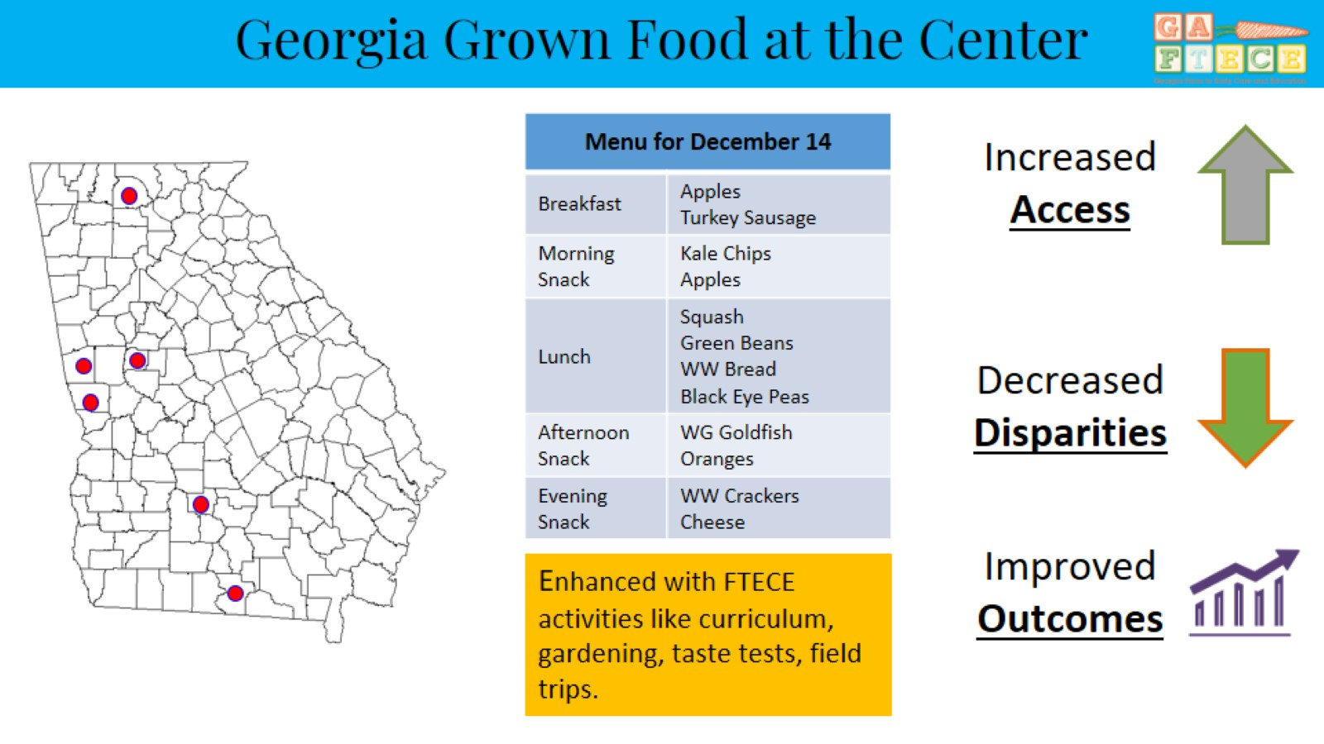
Georgia Grown Food at the Center

Slide 10
The Power of Bringing Cali and Georgie Together

Slide 12
Accomplishments

Slide 13
GAFTECE Overview and Strategy 2017-2020

Slide 14
GA F2ECE Strategy: Purpose

Slide 15
CDC Spectrum of Opportunities and FTECE

Slide 17
GAFTECE Strategy: Georgia’s Context

Slide 18
GAFTECE Strategy: Vision and Mission

Slide 19
GAFTECE Strategy: Goals

Slide 20
GAFTECE Strategy: Appendices

Slide 21
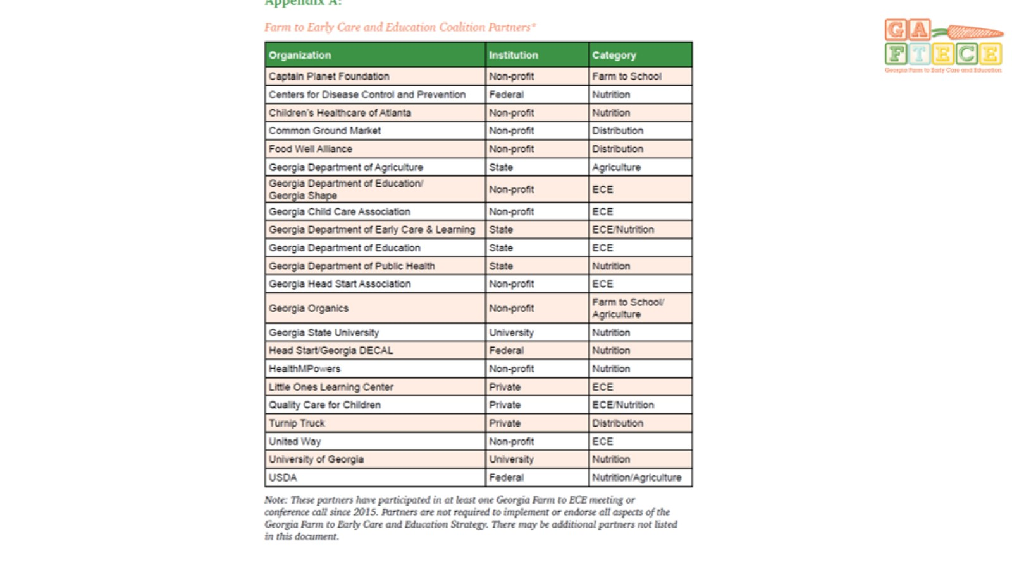

Slide 22
Getting it Right

Slide 23
Procurement in Action

Slide 24
Next Steps

Slide 25
Questions?

