Slide 1
Funder Approaches to Obesity Prevention
Elizabeth G. Love, MPH
Senior Program Officer
Houston Endowment

Slide 3
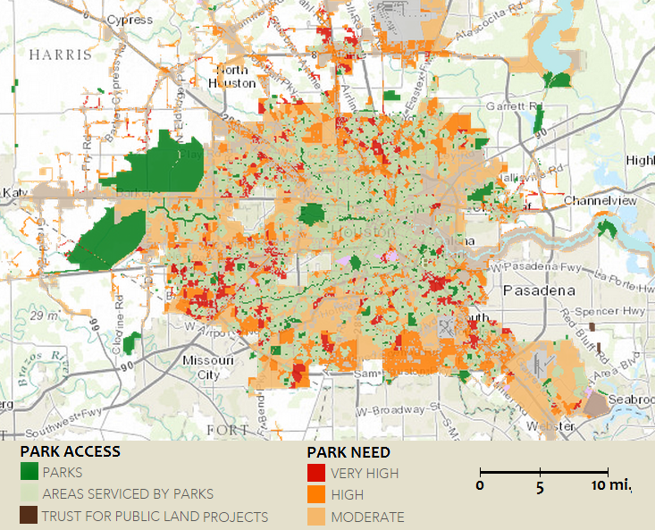

Slide 4
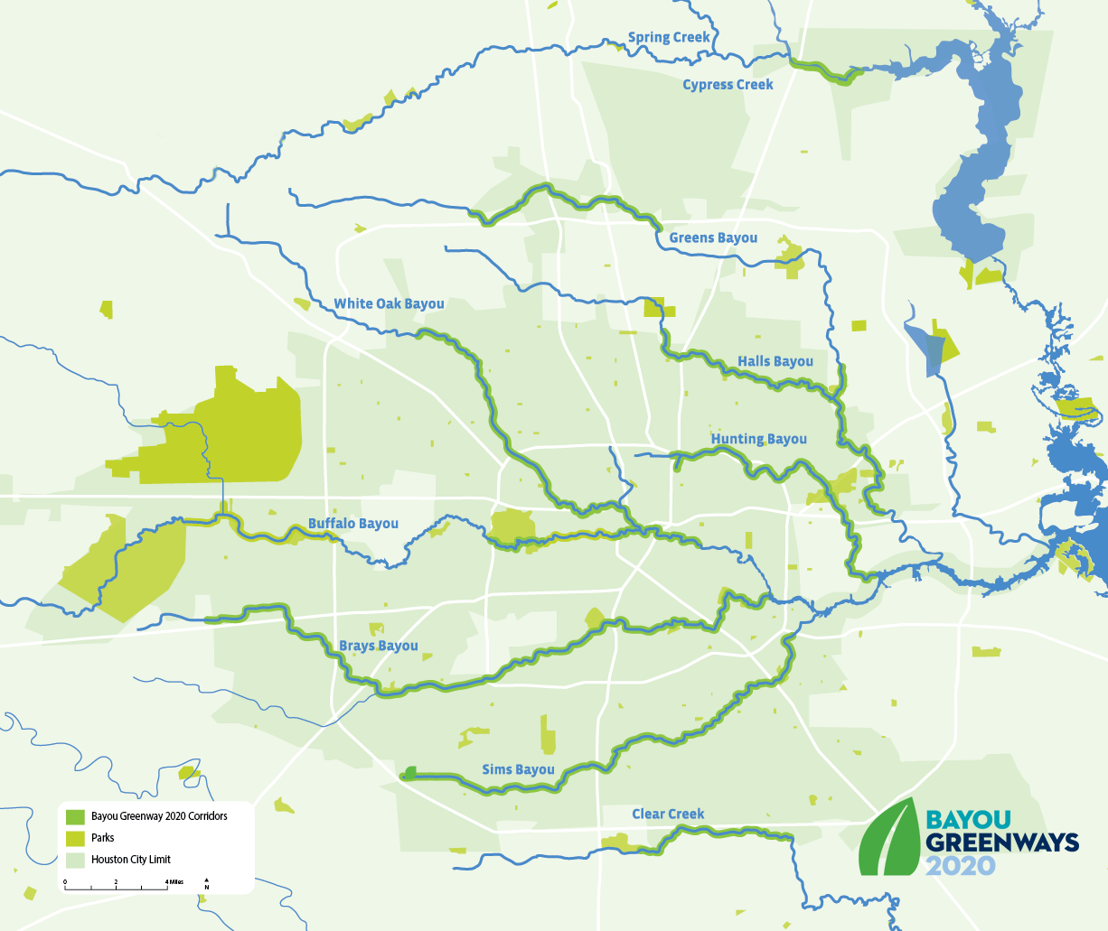

Slide 5
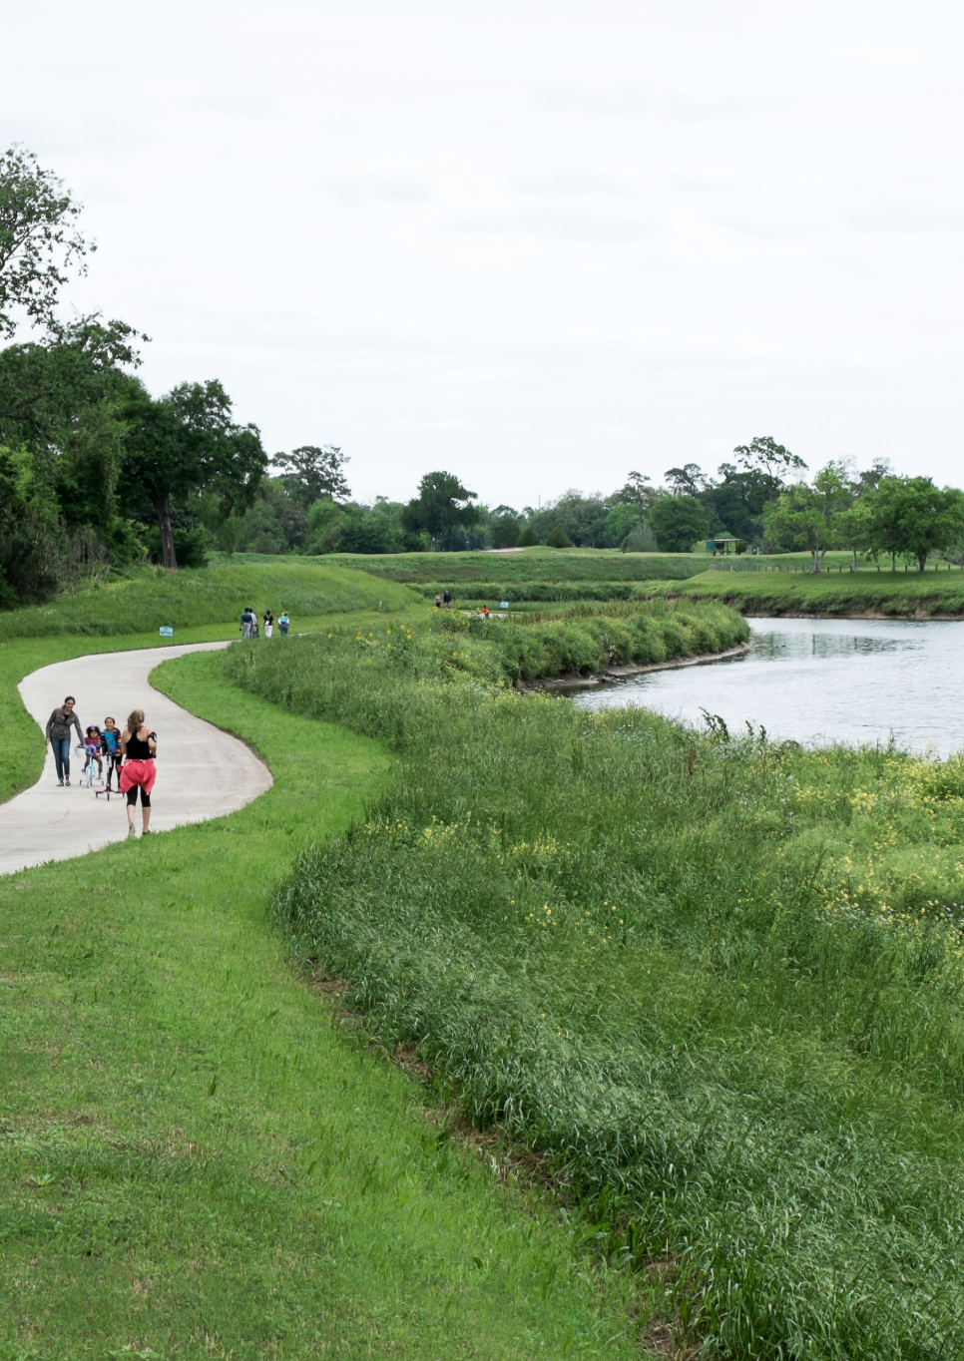

Slide 7
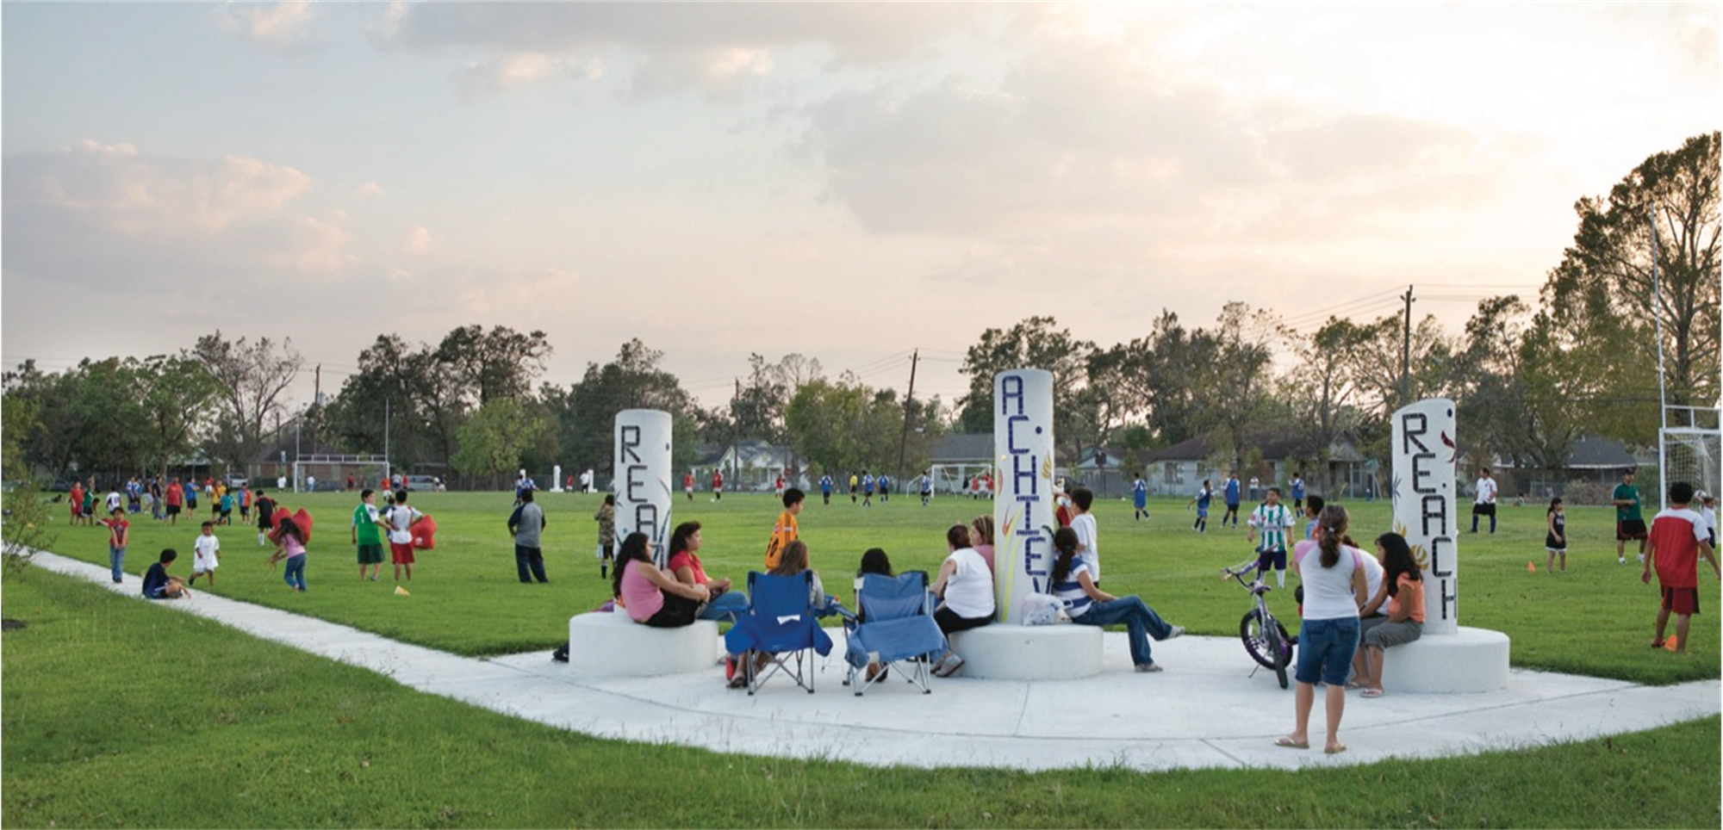

Slide 8
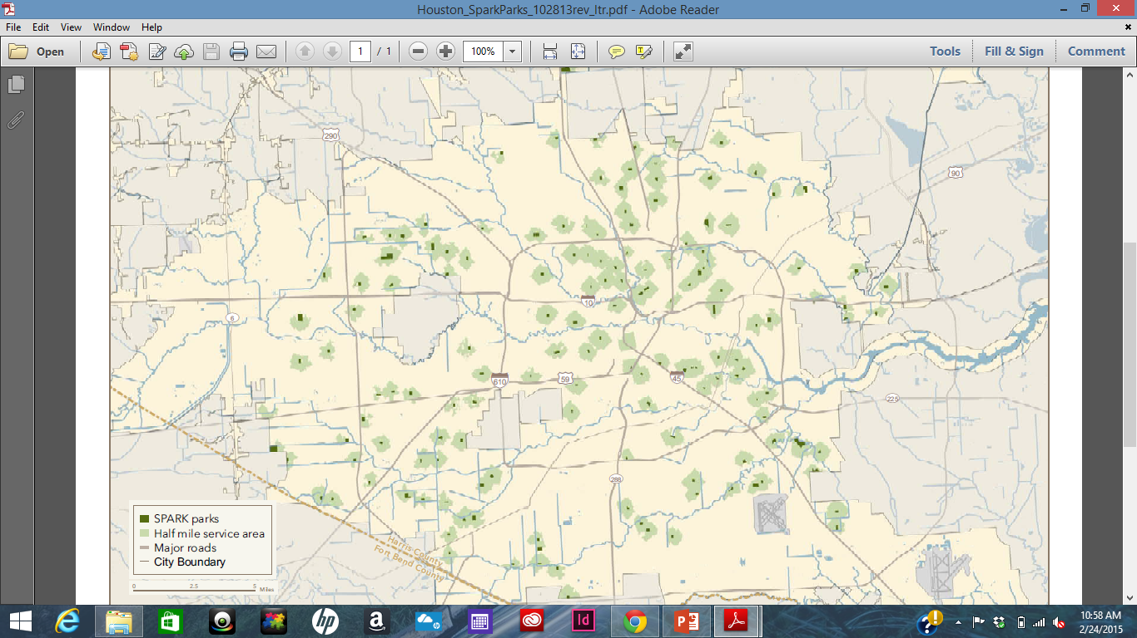

Slide 11
Questions?
elove@houstonendowment.org
713.238.8132

