Slide 1
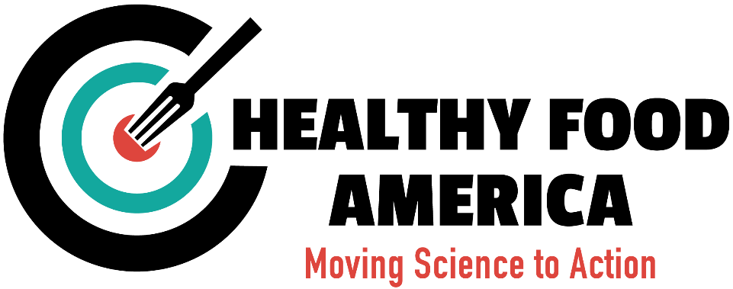
Reducing Sugar – Improving Health: State of play and best practices
Jim Krieger, Md, MPH
November 15, 2016

Slide 2
Epidemics of diabetes and obesity
1 out of 3 children born in the year 2000 will develop diabetes
Prevalence of Obesity - US Adults 1960 - 2010
Prevalence of Diagnosed Diabetes - US Adults 1980 - 2011
Action for Healthy Food
Notes:
Crude and Age-Adjusted Rate per 100 of Civilian, Noninstitutionalized Population with Diagnosed Diabetes, United States, 1980–2011 http://www.cdc.gov/diabetes/statistics/prev/national/figage.htm
Age-adjusted prevalence of overweight, obesity, and extreme obesity among U.S. adults aged 20–74
NHANES 1960-2010

Slide 3
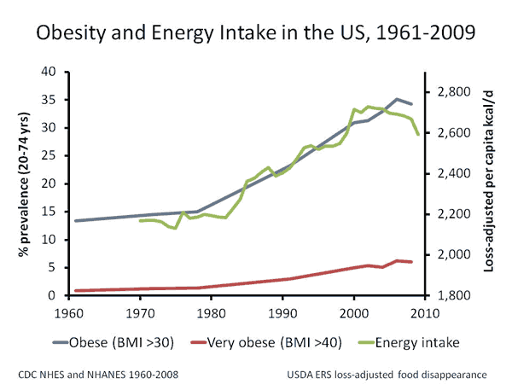
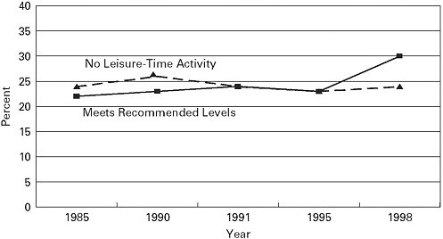
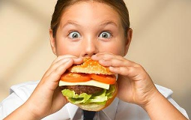
Eating more calories is driving obesity and diabetes epidemics
Calories in US food supply
278 calories
Energy balance
Reported physical activity by US adults
HEALTHY FOOD AMERICA
Notes:
http://www.ahrq.gov/professionals/education/curriculum-tools/population-health/sallis.html
Source: Physical Activity Guidelines Advisory Committee¹; Healthy People 2020²¹
http://www.nap.edu/read/11203/chapter/5#61 (1985-1998)

Slide 4
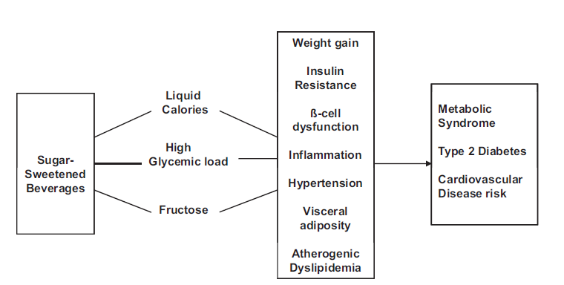
Metabolic effects: A calorie is not a calorie
2 sodas/day for just 2 weeks
20% LDL cholesterol & triglycerides.
2 sodas/day for 6 months
Visceral fat, fatty liver disease.
HEALTHY FOOD AMERICA
Notes:
Malik, Popkin, Bray, Després, Hu. Circulation, 2010

Slide 5
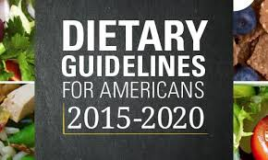
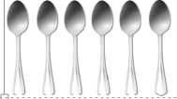
Added sugars intake guidelines
10 % of total daily calories (12 tsp/day)*
0 tsp/day
6 tsp/day
6 tsp/day
9 tsp/day
0
Everyone
Children <2y
Children 2-18y
Adult Women
Adult Men
*WHO has a ‘conditional recommendation’ to reduce this by half
Notes:
The recommendation to further limit free sugars intake to less than 5% of total energy intake is based on very low quality evidence from ecological studies in which a positive dose–response relationship between free sugars intake and dental caries was observed at free sugars intake of less than 5% of total energy intake.

Slide 6
Americans consume too much added sugars
WHO and Dietary Guidelines for Americans
White children and black adults are most likely to consume at the highest level
NHANES 2011-2012 data
Powell et al. Added Sugars Intake Across the Distribution of US Children and Adult Consumers: 1977-2012. J Acad Nutr Diet 2016.

Slide 7
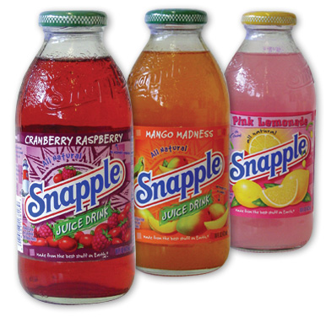
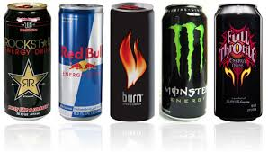
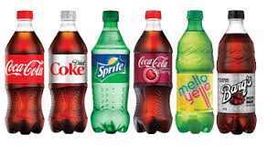
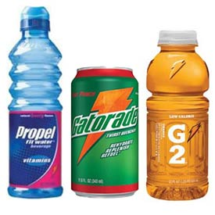
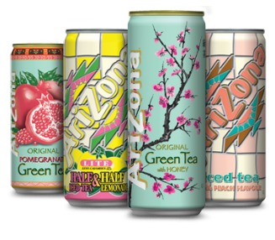
Sugary drinks
Energy Drinks
Fruit Drinks
Sports Drinks
Sweet Iced Tea & Coffee
Soda

Slide 8
Why worry about sugary drinks?
Primary source of added sugar in U.S. diet.
Major source of added calories fueling the obesity epidemic.
Consumption higher among low income and minority populations.
Cause obesity, diabetes, dental decay, liver, and heart disease.
Cause metabolic disturbances that lead to chronic diseases.
No nutritional benefits and lack protective nutrients.
Displace healthier foods from diet.
Poor calorie compensation.
Heavily marketed (and youth and minorities targeted).

Slide 9
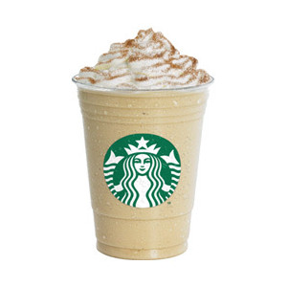
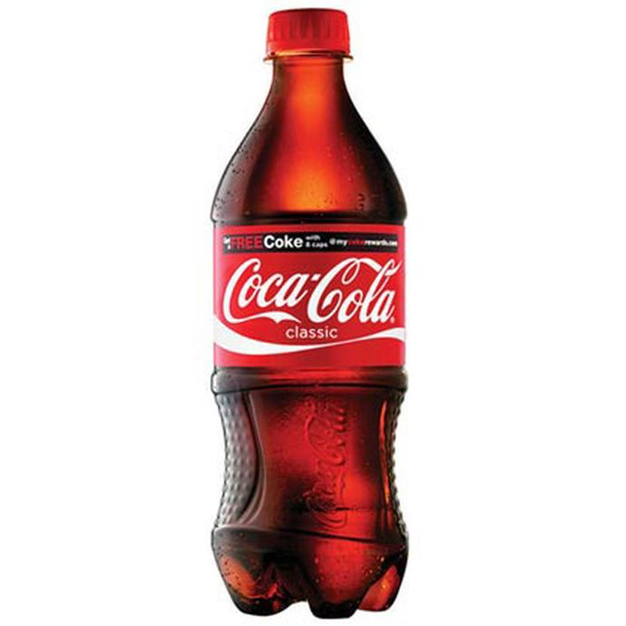
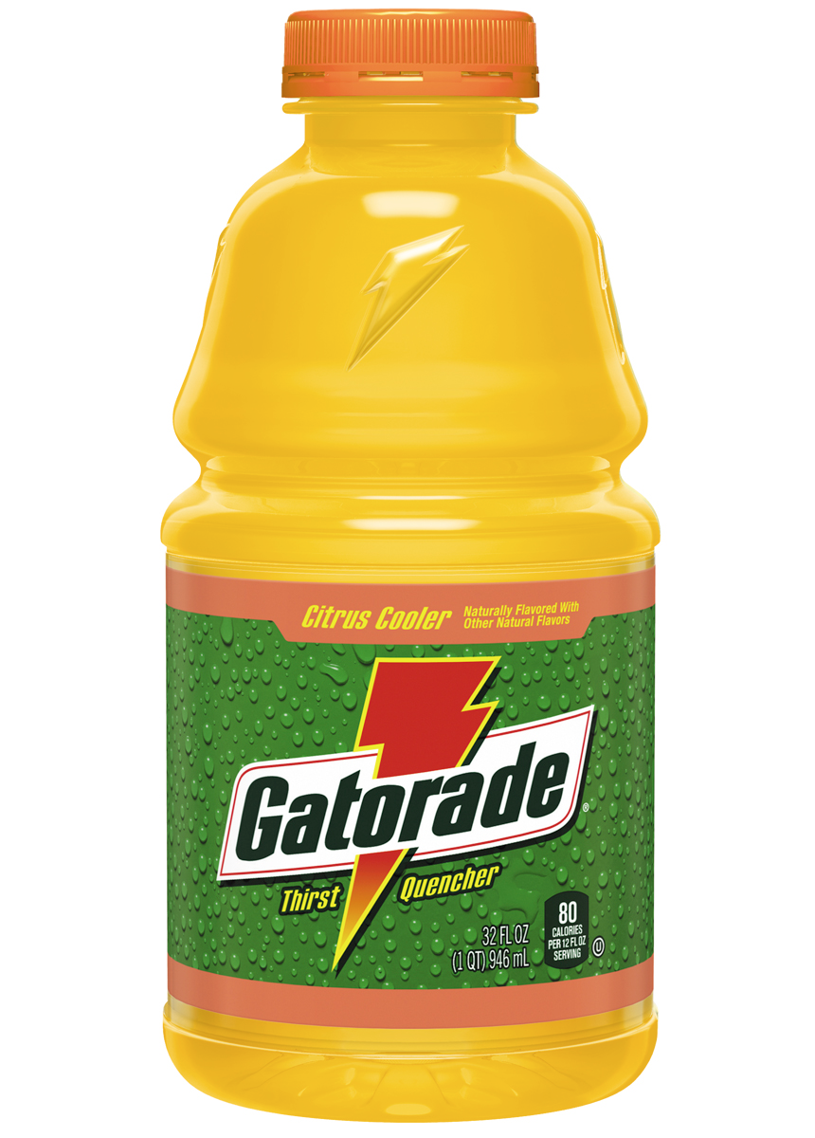
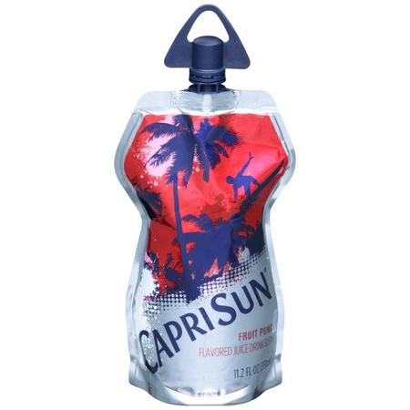
How much sugar is in that drink: QUIZ TIME!
And for a bonus:
What is the recommended daily limit for sugar intake?
16 oz
20 oz
32 oz
11 oz
11 tsp
15 tsp
13 tsp
8 tsp
<10% daily calories, ~12 tsp/day for adults and 6 tsp for children
Notes:
Coffee Frappuccino Blended Beverage Serving size: 16 fl oz Sugar: 50g (3.56 tbsp)
9

Slide 10
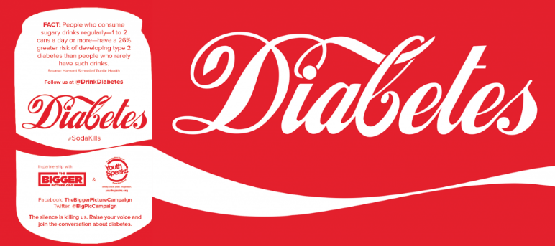
Sugary drinks cause chronic diseases
1 soda/day:
Risk of overweight/obesity by 55% (children).
Risk of diabetes by 26%.
Risk of dying from heart disease by almost 1/3.
Risk of stroke by 22%.
Action for Healthy Food
Notes:
Malik, Popkin, Bray, Després, Hu. Circulation, 2010
Stroke is for 16 oz (AHA summary statetment)

Slide 11
Sugary drink availability peaked in 1998 –
And still much too high
Availability triple what it was 60 years ago
Sources: (1954-2003): Beverages Table. United States Department of Agriculture, Economic Research Service Food Availability (Per Capita) Data System Website.
Updated February 1, 2015. Accessed September 9, 2015. (2004-2014): Beverage Digest annual estimates; Caloric CSDs based on estimate that 70% of CSDs are caloric and 30% are non-caloric/diet.
Notes:
One reason for our increase in added sugar consumption, is increasing sugary drink consumption.
Per capita availability of regular soft drinks
Gallons per year 1954-2014

Slide 12
Higher consumption among Black youth
Percent consuming 2 or more sugary drinks a day
High School Youth Risk Behavior Survey 2007-2013: 38 states
Notes:
These numbers reflect only soda consumption – they do not capture the growing number of sports drinks, fruit drinks, vitamin waters, and energy drinks that are increasing in popularity.
During 2007–2013, a significant linear decrease occurred overall in the prevalence of having drunk soda or pop one or more times per day (33.8%–27.0%).

Slide 13
Higher consumption in low income communities
BRFSS 2013, 24 States
Notes:
Sugar-Sweetened Beverage Intake among U.S. Adults in 24 States: Behavioral Risk Factor Surveillance System, 2013 Sohyun Park, PhD; LipingPan, MD, MPH; Heidi M. Blanck, PhD Division of Nutrition, Physical Activity, and Obesity, Centers for Disease Control and Prevention, Atlanta, GA
N=157,668 US adults
Two questions in an optional module were used to estimate frequency of SSB intake (regular soda, fruit drinks that are not 100% juice, sweet tea, and sports or energy drinks).
Daily SSB consumers were more likely to be young adults, males, non-Hispanic blacks or Hispanics, adults with lower education, adults with lower household income, adults with poorer self-rated health, and current smokers.
Fewer than half of U.S. states currently used the SSB module in 2013.

Slide 14
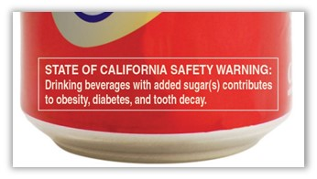
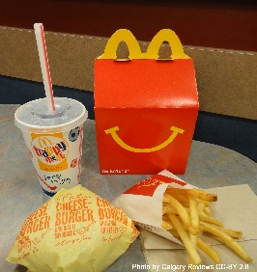
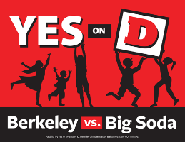
Reducing sugary drink consumption
↓ Acceptability/Appeal
↓ Availability
↓ Affordability

Slide 15
Acceptability & Appeal

Slide 16
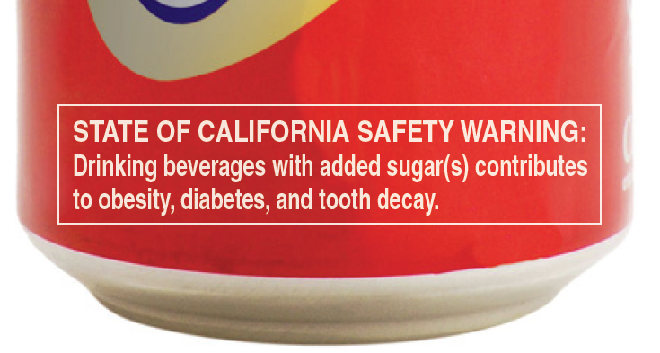
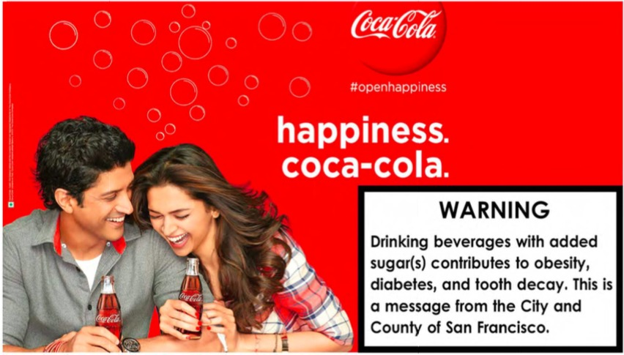
Health information at point of purchase
Consumers lack information on the health effects of sugary drinks.
Require health warnings on sugary drinks
Require health warnings on ads
Post health information signs on
shelves where sugary drinks are sold
Cities are acting to require warning labels
San Francisco, CA (passed)
Baltimore, MD (effort underway)
Action for Healthy Food

Slide 17
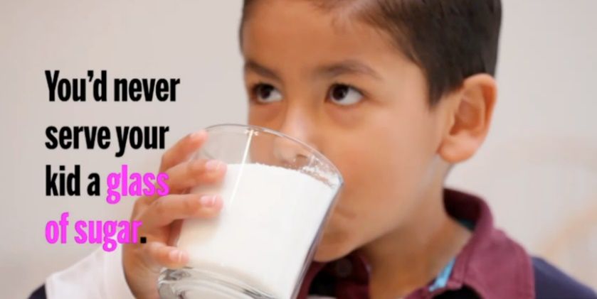
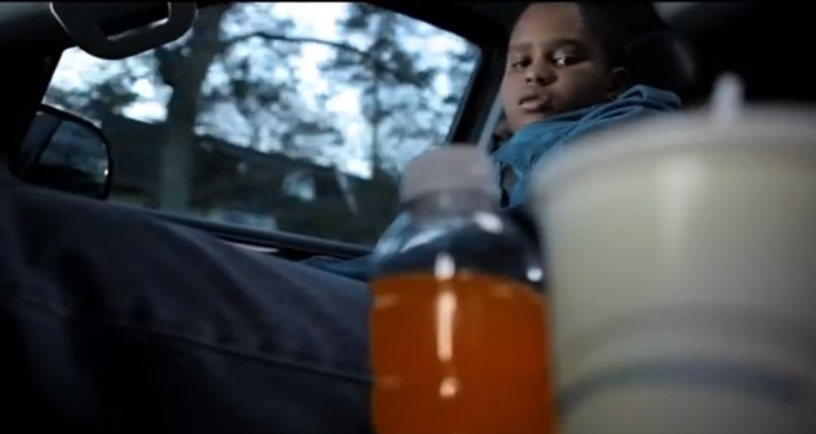
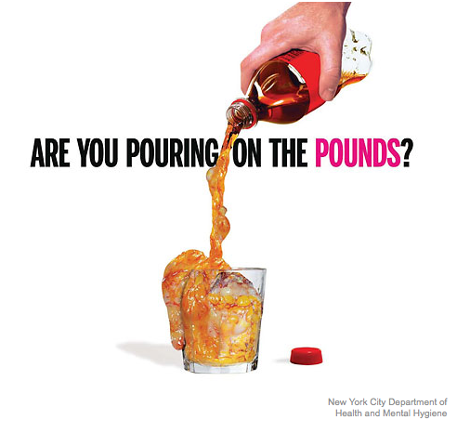
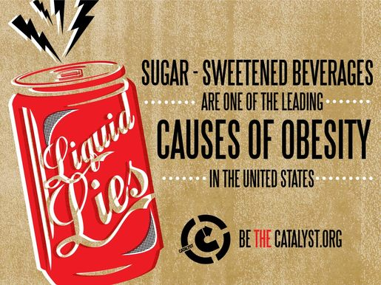
Media campaigns

Slide 18
Increasing awareness of sugary drinks
Notes:
https://www.youtube.com/watch?v=-F4t8zL6F0c

Slide 19
Availability

Slide 20
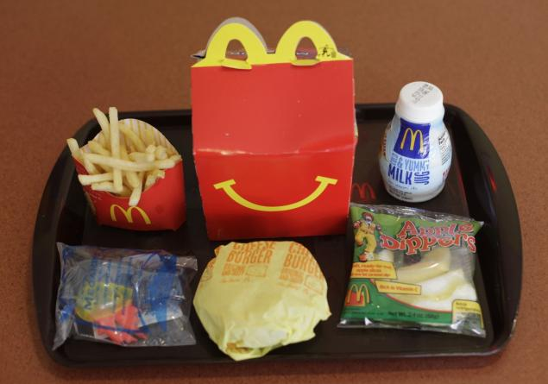
Kids’ meals
A third of all US children and adolescents aged 2–19 consumed fast food on a given day.
Ban soda as default beverage option or ban completely.
Nutritional standards for kids meals.

Slide 21
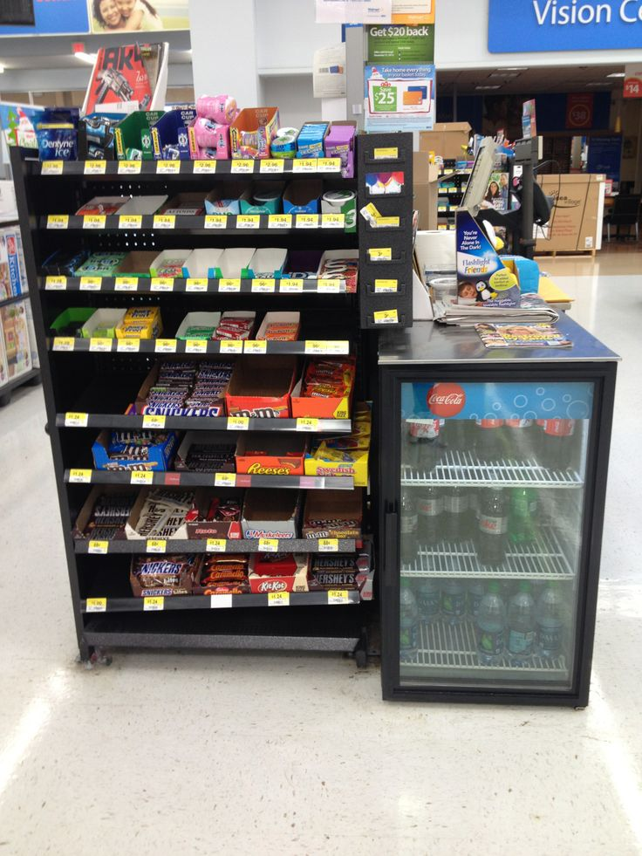
Healthy retail
Replace sugary drinks with healthier products
Endcaps and displays
Shelf location
Checkout aisles
Promote healthier beverages
Sell healthier beverages
Notes:
Checkout sales of gum, candy, sugary drinks, and other products represent 46% of all supermarket sales of these products.

Slide 22
Organization Policy Solutions
Institutional Policies
Government
Cities
State
Business
Public Housing
Healthcare
Hospitals
Health Centers
Community
Aquarium
Faith
CBOs
Schools & Early Learning
Meal service
Vending
Contracts
Events and meetings
Sponsorships
Advertising
Healthy Food AMERICA

Slide 23
Affordability

Slide 24
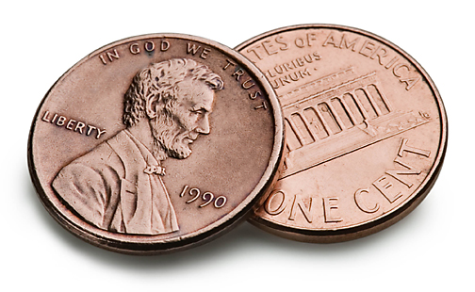
Sugary drink tax
Reduce consumption
Reduce disease
Diabetes: 2.6% decrease in new cases over 10 years
Obesity:
1% decrease (adults)
1.4% decrease (children)
Increase awareness about adverse health effects
Generate revenue to support community health and well-being
Reduce national health care costs by $23 billion over 10 years
Healthy Food America
Notes:
Notes:
Cut costs: Even greater savings if considering heart disease and diabetes
Mekonnen 2013 for DM and HD stat
Long for obesity state
Powell et al 2013: The new evidence presented herein suggested that SSBs are price elastic and that a tax that raises prices by 20% would reduce SSB consumption by 24% (elasticity of −1.21). As expected, narrower categories of SSBs were found to be more price elastic with elasticity estimates for regular carbonated soda, sports drinks and fruit drinks of −1.25, −2.44, and −1.41, respectively. Soft drink demand was estimated to be less price elastic (−0.86), consistent with previous available estimates.
Finkelstein 2015: Our main findings are that a 20% price increase on SSBs would result in a decrease in energy purchased in stores of 24.3 kcal per day per household member across the 19 included food and beverage categories. This equates to a roughly 4.7% reduction. Following the recent methodology proposed by Lin et al. (2011), this would translate into an average weight loss of 1.6 pounds during the first year of implementation and a cumulated weight loss of 2.9 pounds over 10 years.
Dharmasena 2011: The reduction in the body weight as a result of a 20% tax on SSBs is estimated to be between 1.54 and 2.55 lb per year. If demand interrelationships among non-alcoholic beverages are not considered, this range of weight loss is 2.01–3.21 lb per capita per year.
Long 2015: At full effect, this change would reduce BMI by an average of 0.08 (95% UI¼0.03, 0.20) among adults and 0.16 (95% UI¼0.06, 0.37) among youth, and lead to an estimated 0.99% decrease in obesity prevalence among adults and a 1.38% decrease among youth.

Slide 25
US: Active and enacted sugary drink taxes
More on the way! At least 6 more states and over a dozen cities are actively considering
sugary drink taxes
Albany
Bay Area
Philadelphia
San Francisco
Oakland
Berkeley
Cook County
Illinois
Boulder
Alabama
November 2016 Ballot
Enacted
Under consideration
Active statewide legislation
HEALTHY FOOD AMERICA

Slide 26
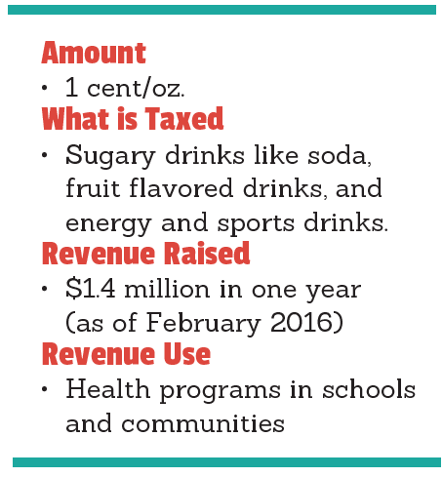
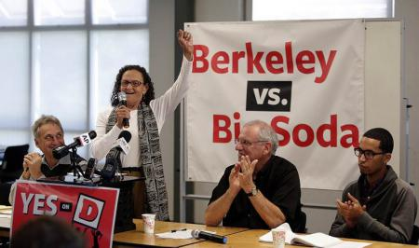
Berkley: November 2014
Healthy Food America

Slide 27
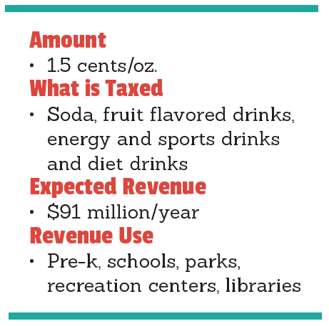
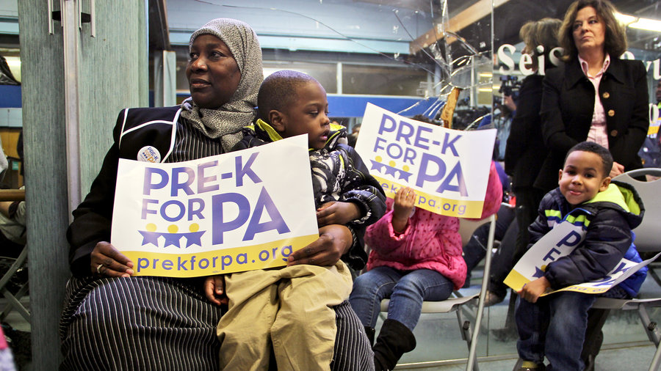
Philadelphia: June 2016
Healthy Food America

Slide 28
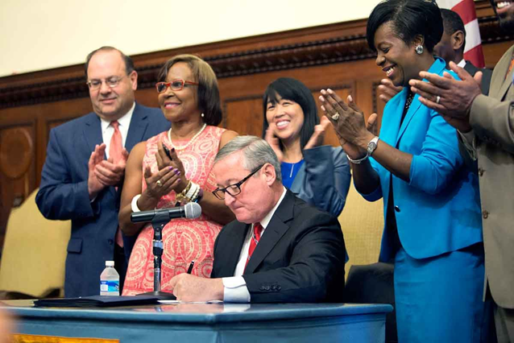
Philadelphia Mayor Jim Kenney
"What we're looking to do is to take some of that profit, to put it back into the neighborhoods that have been their biggest customers, to improve the lives and opportunities for the people who live there."
Healthy Food America
2) http://www.npr.org/sections/thesalt/2016/04/08/473548273/philly-wants-to-tax-soda-to-raise-money-for-schools

Slide 29
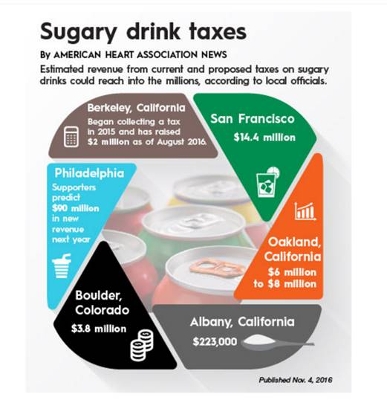
Taxes raise revenue for community needs
Healthy Food America

Slide 30
Taxes decrease sugary drink consumption Impact of taxes in Berkeley and Mexico
Berkeley
Mexico Overall
Mexico Low SES
After 5 months
After 1 year
Healthy Food America

Slide 31
Taxes will reduce diabetes and obesity
ALABAMA 1 cent/oz. on sugary drinks
Philadelphia: 1.5 cents/oz. on sugary & diet drinks
~$91 million
~$218 million
14,340
968
40,000
8%
Fewer Cases of Diabetes*
1.5
1
$76.8 Million
$164 Million
Healthy Food America

Slide 32
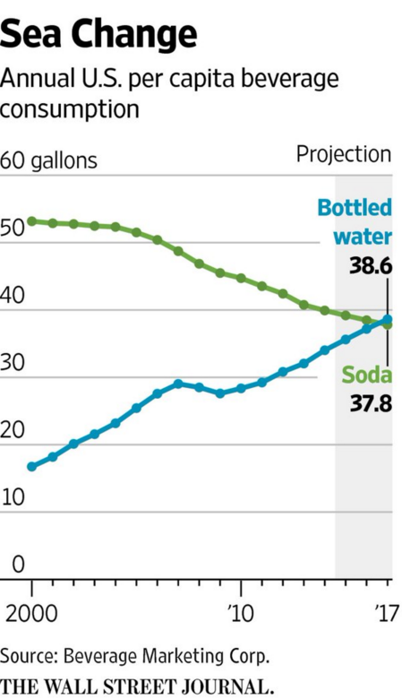
Progress – and more to do
Consumption down 23% since 1998 – and still too high
Sources: (1954-2003): Beverages Table. United States Department of Agriculture, Economic Research Service Food Availability (Per Capita) Data System Website.
Updated February 1, 2015. Accessed September 9, 2015. (2004-2014): Beverage Digest annual estimates; Caloric CSDs based on estimate that 70% of CSDs are caloric and 30% are non-caloric/diet.
Notes:
One reason for our increase in added sugar consumption, is increasing sugary drink consumption.
Per capita availability of regular soft drinks
Gallons per year 1954-2014

Slide 33
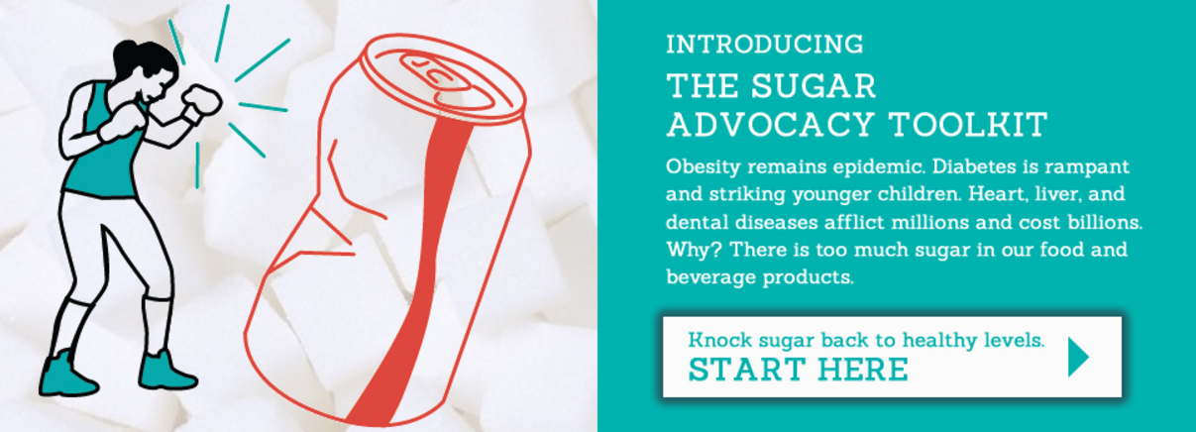
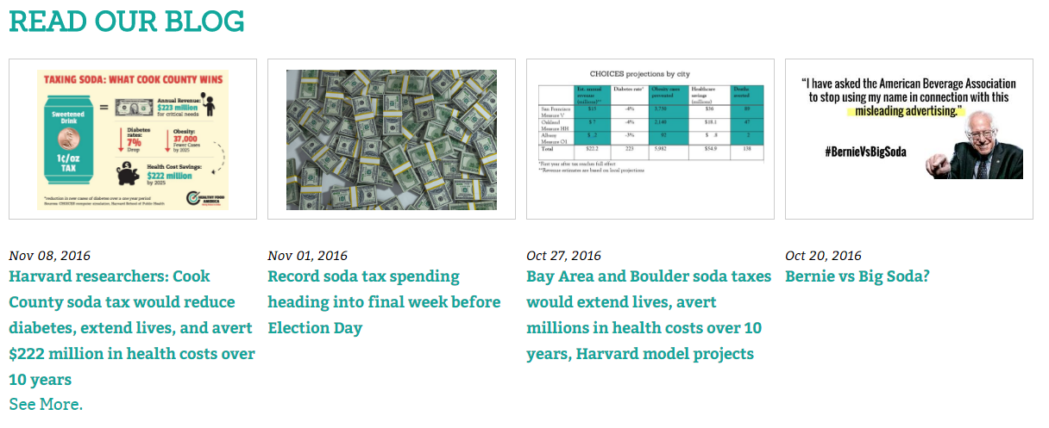
Contact us!
Get answers to your questions
Technical assistance and support
Tools and resources
Media and communications help
Healthy Food America

Slide 34
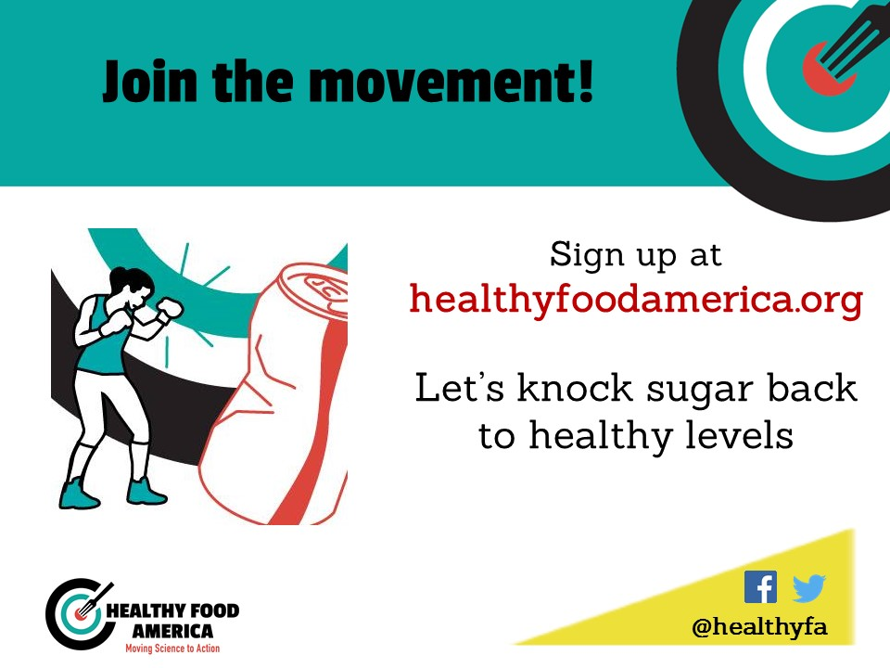
Healthy Food America

