Slide 1
Innovations in School Health:
Unique Partners, Unique Impacts Southern Obesity Summit October 23, 2018
Rachel Campos
Georgia Health Policy Center
rcampos1@gsu.edu

Slide 2
Objectives
Application of an evidence-based technical assistance approach
Strategies for developing unique partnerships to achieve school health outcomes
Articulate concrete action steps for accomplishing partnership goals considering local context

Slide 3
Technical Assistance approach
INDIVIDUALIZED TECHNICAL ASSISTANCE Relationship-based coaching and consultation provided by an assigned technical assistance team that works with each grantee for the duration of the grant period.
GENERALIZED TECHNICAL ASSISTANCE
Generalized Technical Assistance achieves efficiencies where grantee support and training needs are similar and content can be effectively delivered to large groups.
PEER LEARNING TECHNICAL ASSISTANCE
Peer Learning connects grantees communities to share successes, lessons learned and best practices and other tools and resources.
Continuous assessment of grantee needs, funder feedback, TA provider field experience and environmental scans.

Slide 4
Some common clichés about collaboration and partnerships
Find the “win-win”
“Too many cooks in the kitchen…”
“You are only as strong as your weakest link”
“The whole is more than the sum of its parts.”
Notes:
As we were thinking about how to frame our experiences around collaboration, and describe why and how partnerships strengthen your program and position your efforts for long term sustainability, we kept throwing out these phrases and truisms that sounded so much like cliches-
…And we kept trying to come up with a new angle on this- but as we shared stories of work that we have done with networks and consortia in rural areas and across the country- How partners have played a part in sustaining programs and services when grant dollars go away, how partners have collaborated to change the way services are delivered and improve health outcomes…. When resources are limited and the needs are so great, and so complex- the issues you are working to address in your communities cannot be solved in isolation.

Slide 5
Some clichés are true…
Notes:
And the truth is…. the cliches are often true- both the good and the bad

Slide 6
Turn to a partner
Reflecting on your work on this in your program(s)(or another community health initiative), what cliché about partnerships and collaboration have you found has some truth to it ?
Notes:
So let’s each take a minute to reflect on your own experiences with collaboration and partnerships –
Then take 2-3 minutes to share- ask for a couple of volunteers to share back
Which of these would be easy to work on with your partners starting tomorrow?

Slide 7
GHPC Sustainability Framework
Strategic Vision
Stakeholders are included in program planning and implementation
Partners play an integral role and have a shared interest in the outcomes
Positioning for
Collaboration
Leadership
Relevance & Practicality
Evaluation/Return on Investment
Communication
Efficiency & Effectiveness
Capacity
Sustainability

Slide 8
Our Experience: How Programs Sustain
In-kind support and absorption of program components by partners are the most common ways that programs continue beyond the grant period
Notes:
Grants, reimbursement, client fees, etc. The most common way that programs are sustained beyond the grant period is not through an infusion of outside cash, but through in-kind resources provided by partners agencies as well as by those partners absorbing programs, or components of programs into their regular scope of practice.
(This only happens if partners know about the programs and have been active in the implementation of grant-funded services and activities. )

Slide 9
Strategies for Partnering
No playbook or set of “best practices”
Well-defined vision for working together
Shared vision and understanding of roles
Use grants as a means to an end versus being an end unto itself

Slide 10
Shared Vision

Slide 11
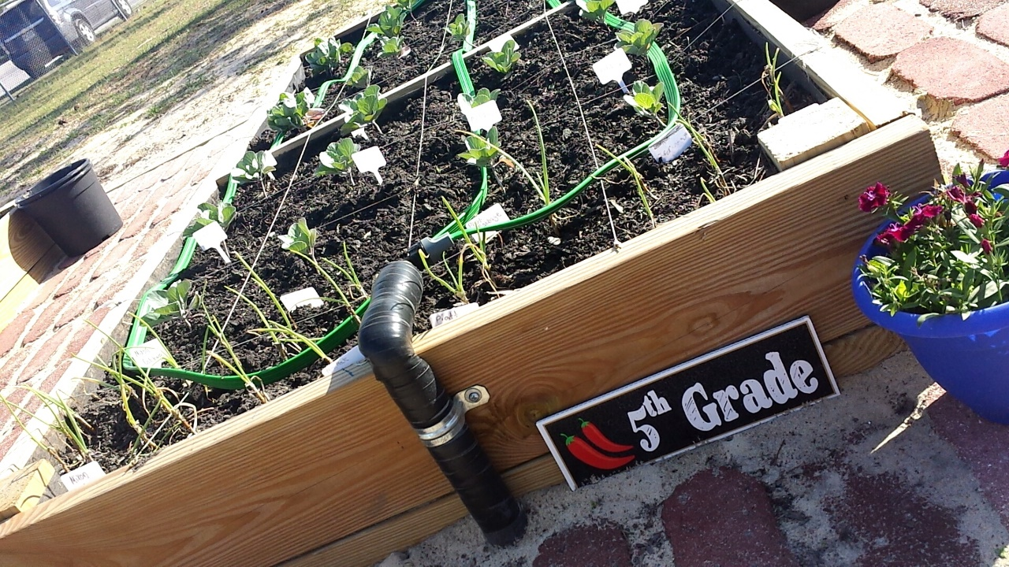
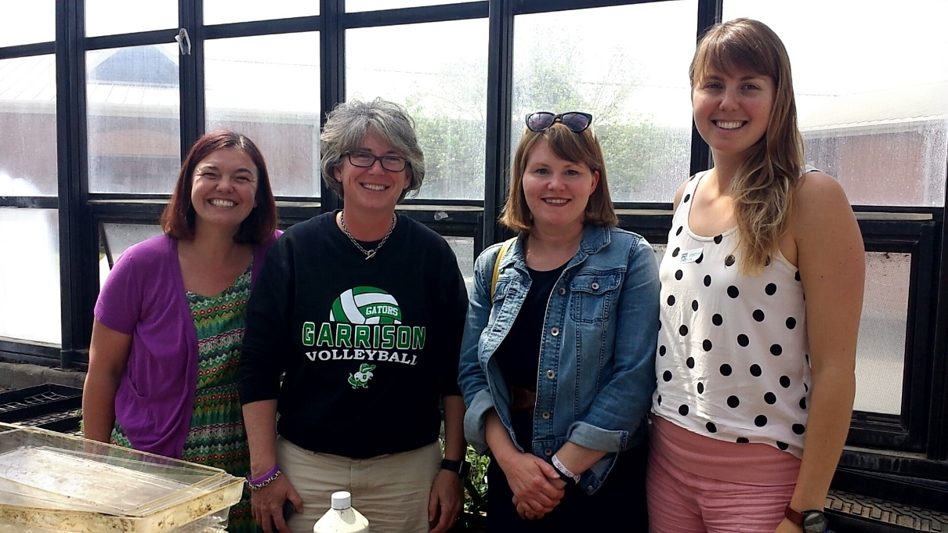
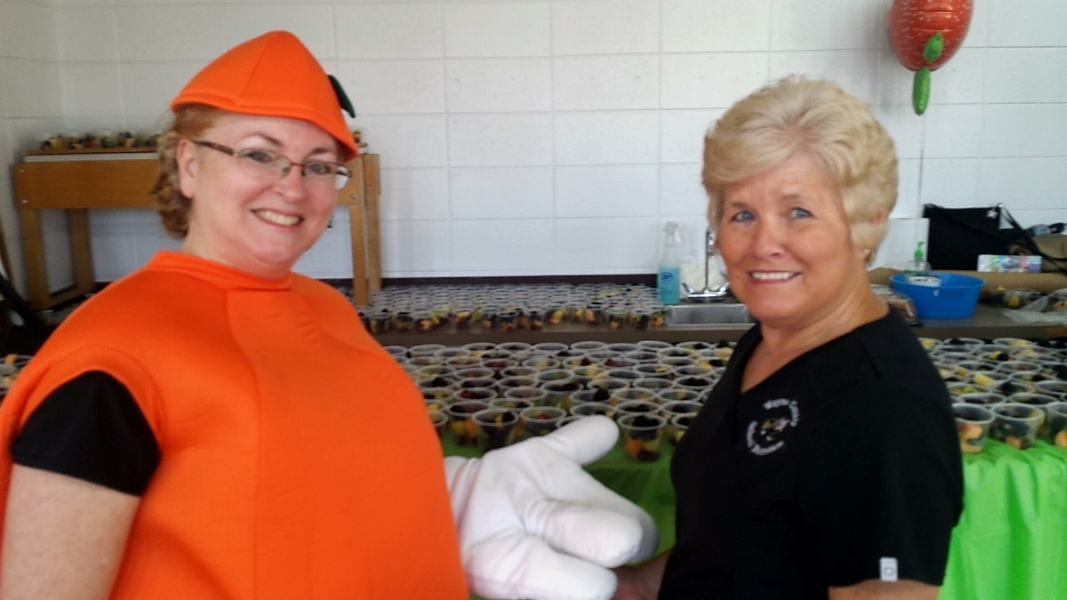
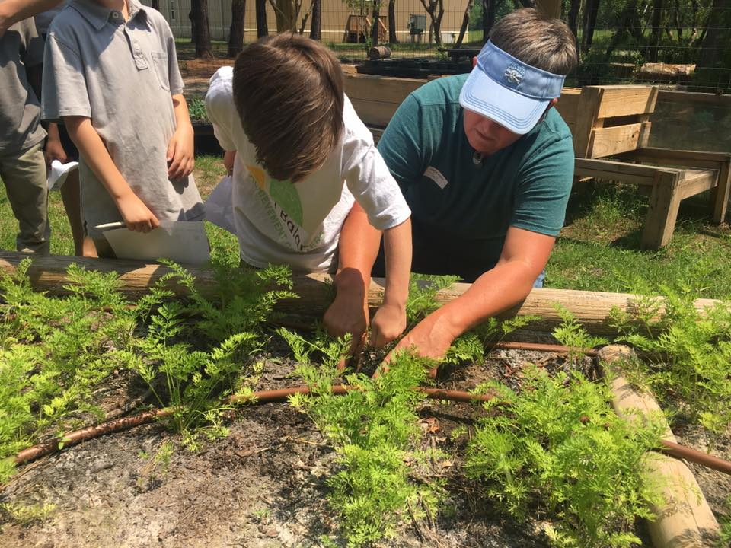
Examples of Shared Vision & Mission
Local Partners:
Farmers / Farm Bureaus,
Master Gardeners Clubs & Extension Agents
School District - Maintenance & School Nutrition Depts.,
Local Foundations,
Police Dept.
Art Museums
Non-profit organizations
Savannah Children’s Museum, Open Hand Atlanta & Garrison School for the Arts

Slide 12
Shared Responsibility

Slide 13
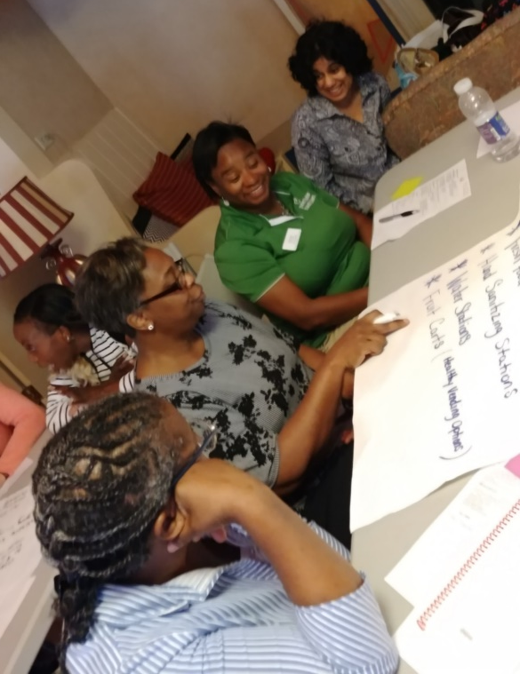
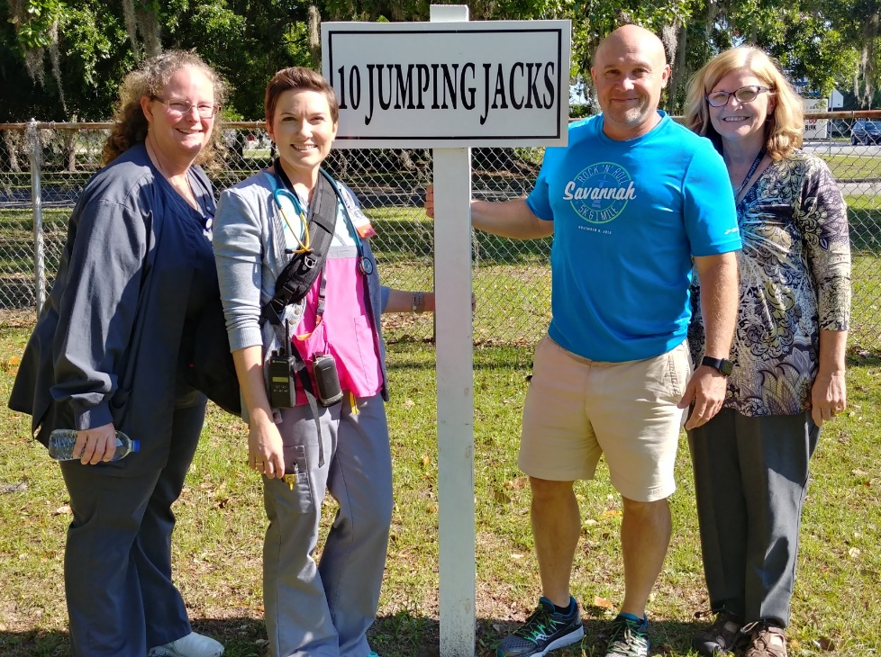
Shared Responsibility
Urban Schools engage with
Local Parks & Recreation Depts.
Shared Decision-Making
School health leaders prioritizing PSE changes
Integrating Partner Assets: Local sign company donates & installs all 10 signs for outdoor activity stations

Slide 14
Shared Resources
Funding
Distribution of grant resources
Incentivizing/appreciating time commitment
Opportunities to build capacity
Including partner staff in trainings, certifications
Sharing equipment, facilitating access to infrastructure

Slide 15
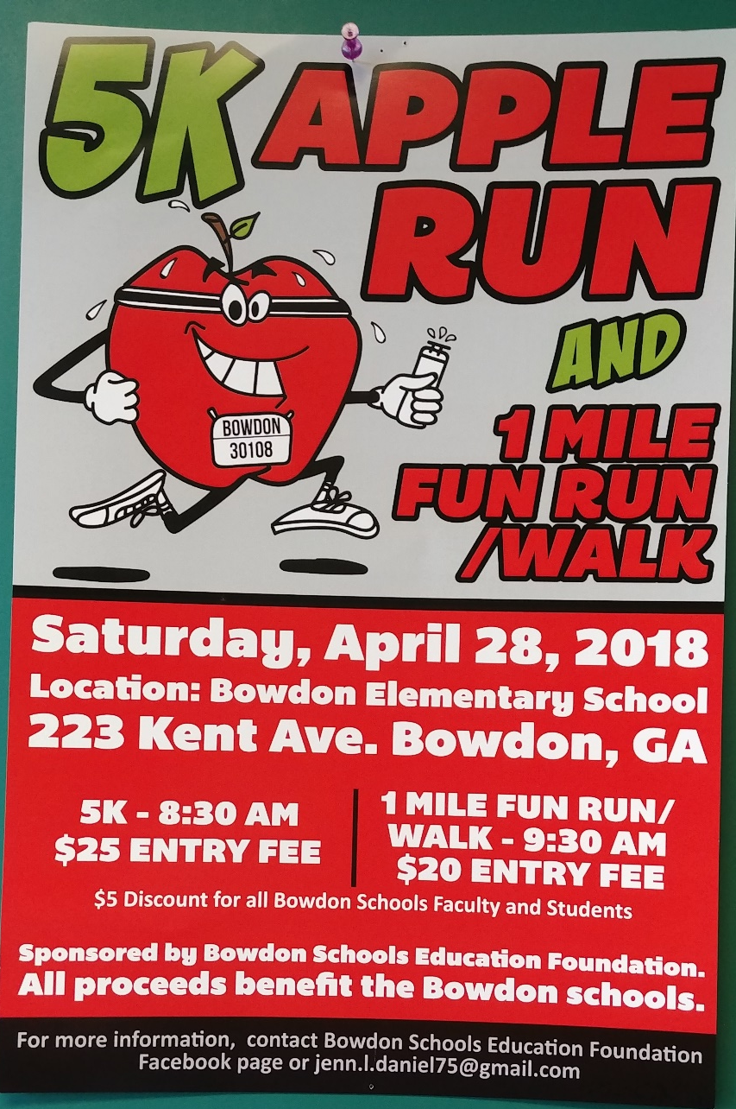
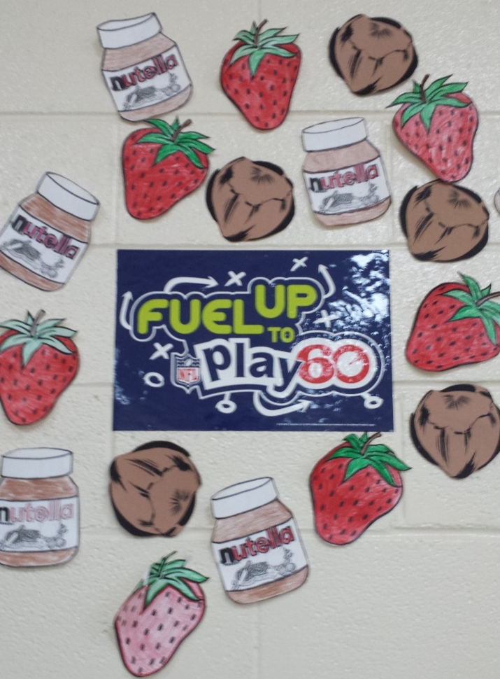
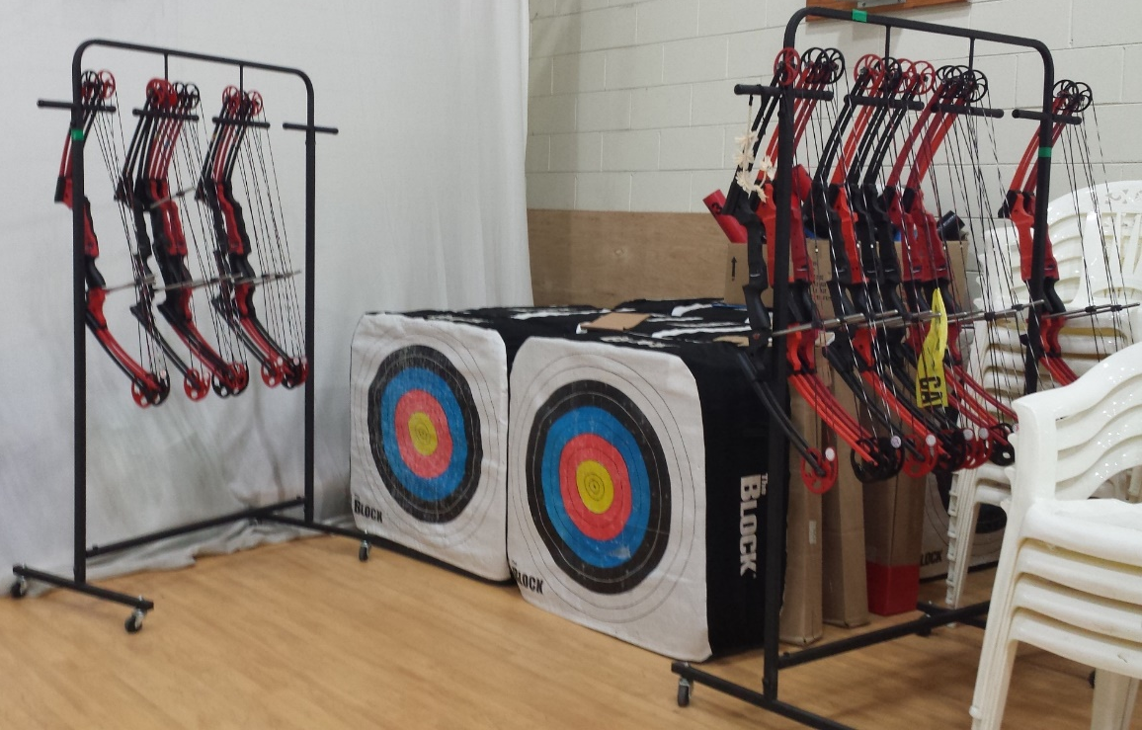
Shared Resources
Let’s keep the Clichés coming!
Sharing is caring
Win/Win Opportunities
Using grant $ for Healthy Fundraisers to sustain efforts
Pairing grant $ and free resources from non-profits
Leveraging grant $ to get funds for other equipment & tools
Notes:
When we review grant applications at the kick off – most of us go to the budget to see how resources are allocated. If all of the funding is staying with one organization- to be honest, that is a red flag.

Slide 16
In Summary:
Shared Vision
+ Shared Resources
+ Shared Responsibility
= Shared Commitment to the work & ultimately,
Sustainability
Notes:
Give you the ending at the beginning.

Slide 17
Partnership Pulse Check
Review progress and challenges thus far
Do you need to engage current partners in a different way to meet program goals?
Do you need to engage new partners to be effective?
Do you have the people engaged who have the influence and authority to commit resources? (Sustainability)

Slide 18
Unique Partnerships Can make for unique impacts
Donna Hines-Newton, The Health Enrichment Network, Eat Move Grow
Jeff Franklin, Southern Illinois University, Illinois CATCH® Onto Health Consortium

Slide 19
EPODE Fleurbaix Laventie Ville Santé (FLVS) study
Childhood obesity rate (%)
CT
FLVS
20
EPODE:
A community-based intervention approach prompting a lifestyle change at the local level (2 regions of France)
( validated by the FLVS experts committee)
17.8%
15
P<0.0001 / FLVS 2004
14.3
12.6
10
11.4
NS
8.8%
NS; p= 0.7
P<0.012 / FLVS 2000
5
From education to education + city involvement
1992
2000
2004
Years
NOTE: LONG-TERM INVESTMENT – over 12 yrs!
Notes:
Mention because this was longer intervention and after 12 years saw results!!!
Feasibility
Target: The family
Key: The city leadership / The local "political will"
A local project manager
Actions in schools are a 1st step but a multi-stakeholders approach is necessary for better & sustainable efficiency
Public/private partnerships are critical
Regular communication
Quantitative evaluation: children BMI measurement
Long-term actions & commitment are necessary…
IT TAKES TIME TO GET RESULTS!

Slide 20
So, have you ever had a partnership that did not work, why?
Or, what do you think that you could immediately start working on with your partners or potential partners?

Slide 21
Questions?

Slide 22
Thank You
Georgia Health Policy Center
Georgia State University
404.413.0314
www.gsu.edu/ghpc ghpc@gsu.edu

