Slide 1
SUPPORTING and CONNECTING YOUR ORGANIZATION , CITY and STATE
IN HEALTH and WELL BEING
Programs Include:
October
April
millionmilemonth.org

Slide 2
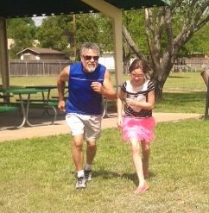
HealthCode’s Million Mile Month
THE ISSUE:
“Sitting is the new smoking”. One in three children and 70% of USA adults are overweight or obese, resulting in over $190 billion in annual health care costs.* Plus, individuals, organizations and communities are looking to be more connected.
Million Mile Month™ challenges people to complete one million miles of physical activity, together as one community, throughout the month of April. Participants are then considered are inspired year-round to become “Fitness Millionaires™”.
WHY SUPPORT MILLION MILE MONTH:
Motivates people to get active and healthy in a fun, simple way.
Engages people in a supportive community, focused on accomplishing a collective goal (1 million miles).
Delivers a 12 month engagement to support support employees, kids and families.
*Cawley J, Meyerhoefer C. The medical care costs of obesity: an instrumental variables approach. Journal of Health Economics. 31(1):219-230. 2012.
Ogden CL, Carroll MD, Kit BK, Flegal KM. Prevalence of childhood and adult obesity in the United States, 2011-2012. Journal of the American Medical Association 2014;311(8):806-814.

Slide 3
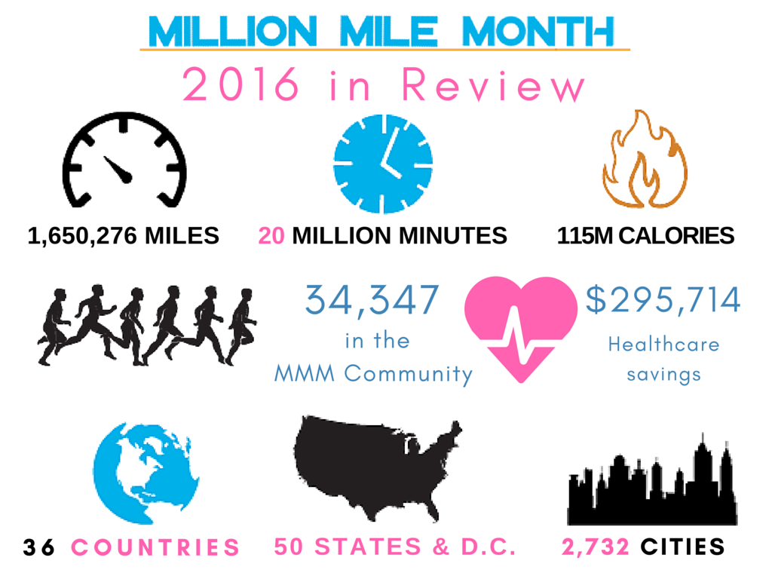

Slide 4
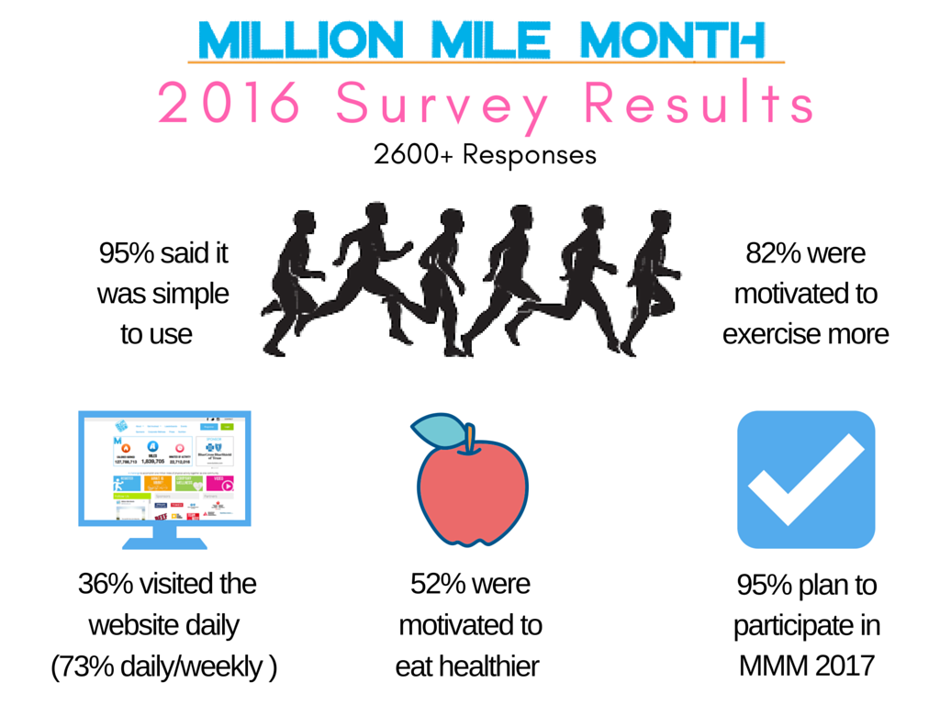

Slide 5
Million Mile Month - Community Wide Involvement 200+ Organizations

Slide 6
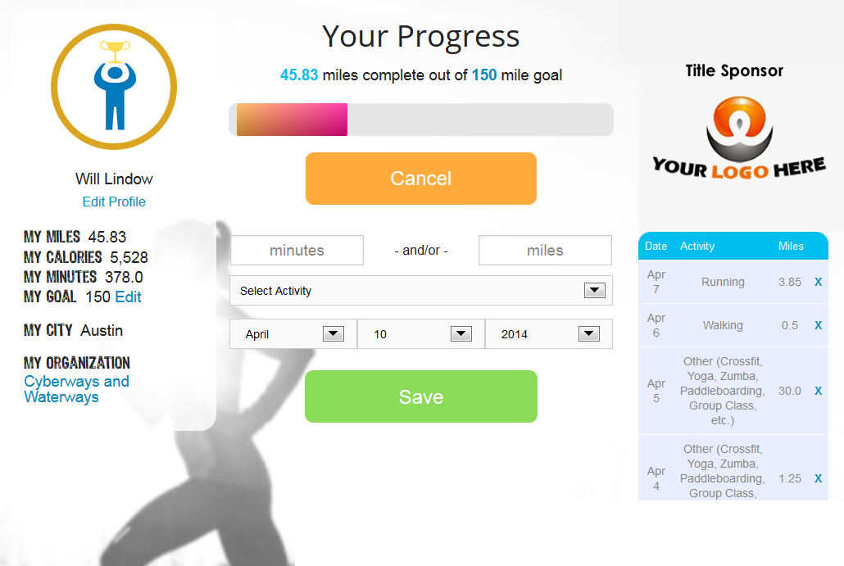
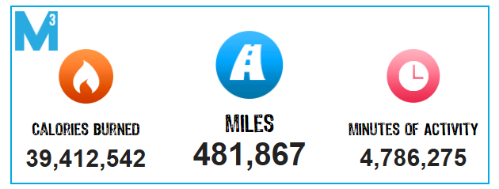
How Million Mile Month Works
LOGGING MILES (Personal Profiles)
Each person has a personal profile to log their physical activity and track their personal stats and goals.
COMMUNITY MILEAGE TICKER (Homepage)
Individual stats are added to the community-wide mileage ticker on the homepage as we work move toward 1 million miles together in April.
LEADERBOARDS
Leaderboards promote competition
and recognition (top organizations, top individuals, top cities, etc.)

Slide 7
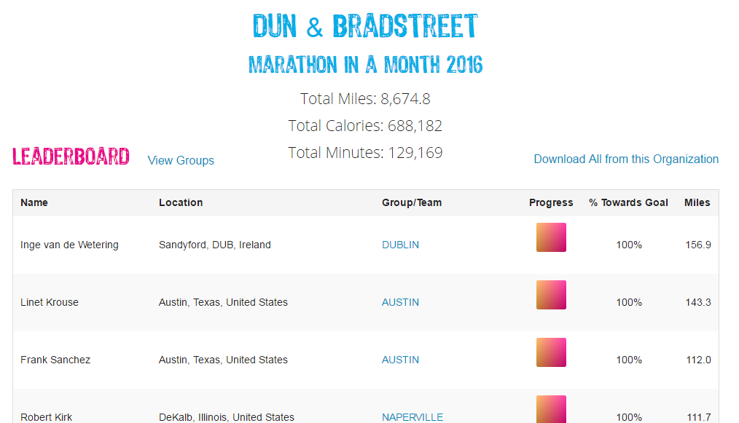
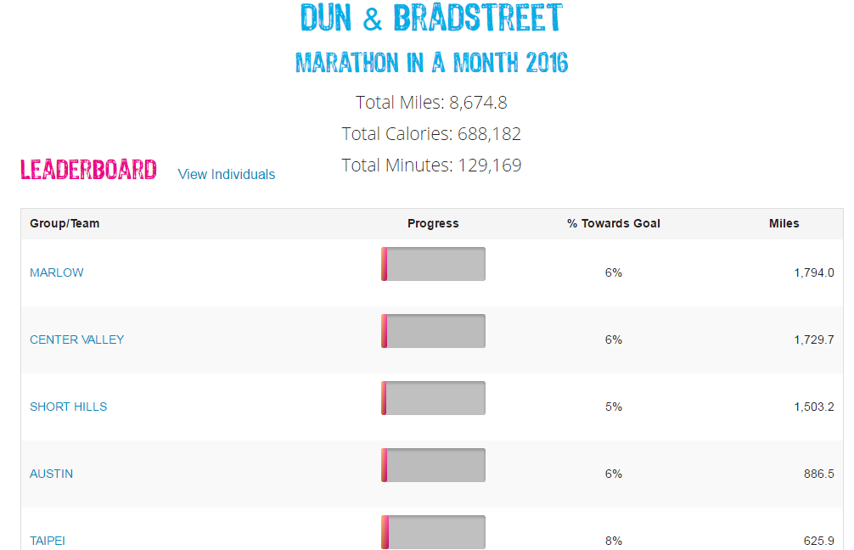
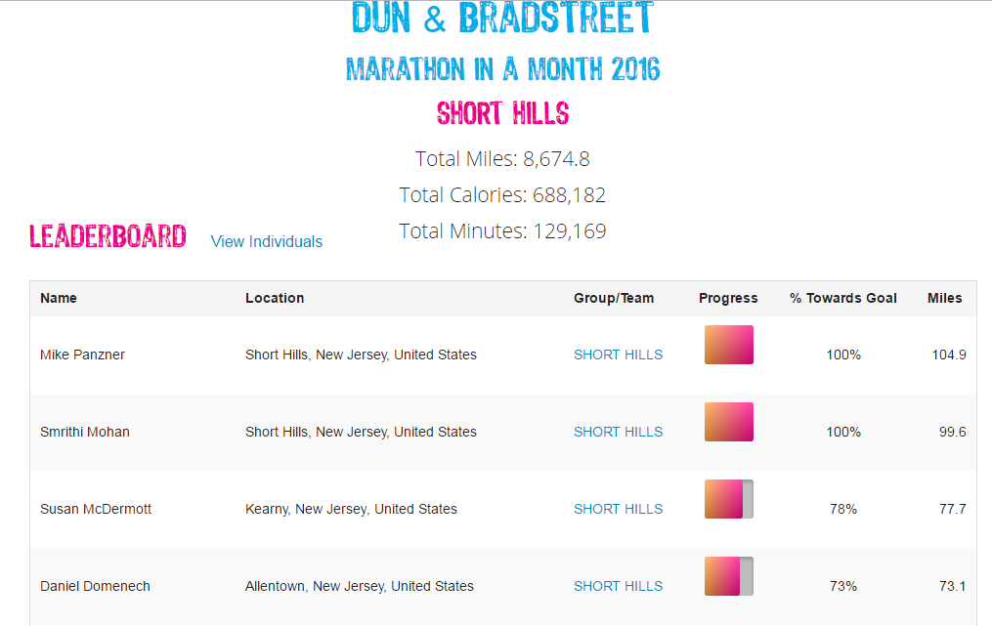
Organizations/Companies
Each organization receives their own private “ORGANIZATION PAGE”, which provides:
An organization leaderboard, including “sub groups”
stats for your organization with on-demand metric reports
a source of friendly competition and mentorship; from global corp challenges like
Dun & Bradstreet to school district Superintendent challenges

Slide 8
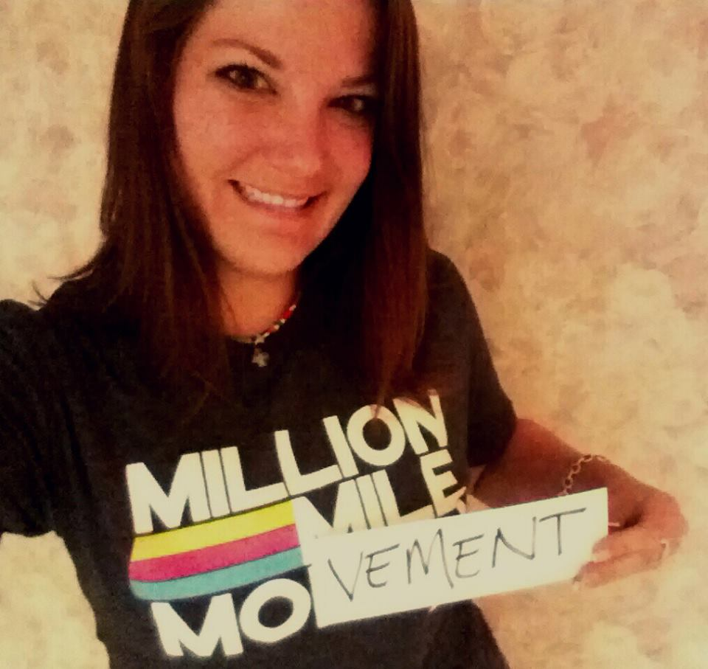
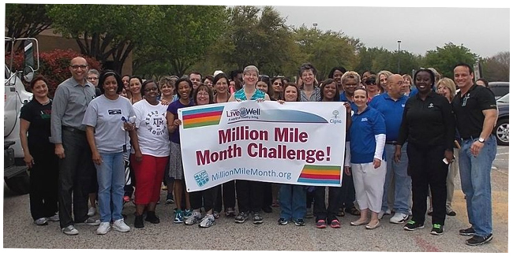
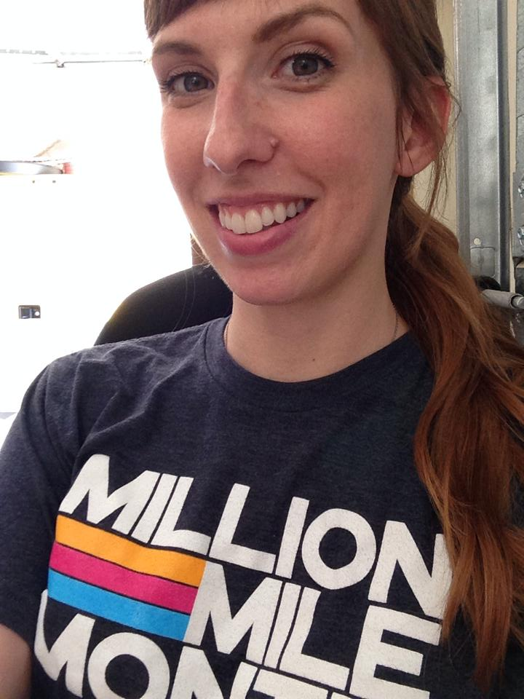
Million Mile Month
MILLION MILE MONTH is a fun program that motivates people through:
a month-long event , with year-round engagements – to help establish healthy habits and routines … Changing Lives …. Connecting Communities
flexibility – participants log miles when and where it meets their schedule
simple web tools – easy to log miles, mobile device compatible, syncs to Fitbit
the ability to track personal and company progress and goals
supports a variety of physical activities (running, biking, yoga, CrossFit…)
Sign-up at MillionMileMonth.org/wellness

Slide 9
HealthCode, a 501 c3 nonprofit, unites people in fun, healthy activities, so they enjoy the benefits of happier, healthier more connected life.
HealthCode’s vision is that everyone should enjoy the benefits of a healthy life, free from chronic, preventable diseases. Our focus areas are activity, nutrition and the environment.
The Million Mile Month is HealthCode’s first program addressing activity. Piloted in April 2014, 34,000+ participants have achieved 3.1 million miles of activity, burning 219 million calories, with potential health care costs savings of over half a million dollars, $564,000.
In addition, HealthCode provides Marathon in a Month during October, and K-12 STEM education programs, such as Healthivores and Green Ribbon Schools.
If your organization shares these values and vision, please contact:
Steve Amos, Founder/Executive Director
Steve@HealthCode.org 512 970 7443

