Slide 1
working well

Slide 2
background
South Carolina Hospital Association is a private, not-for-profit trade association made up of 100 member hospitals and health systems
Working Well was born out of population health arm of SCHA, starting in hospitals and expanding to businesses and state agencies
Began through a partnership with Prevention Partners, a nonprofit that builds healthier communities
Funded primarily through grants from the Duke Endowment and CDC
Transitioning to a self-sustaining model

Slide 3
working well
effective cross-sector strategy implementing key components of healthy eating & active, tobacco free living in worksites, establishing cultures of wellness where the healthy choice is the easy choice
organizational commitment to integrate wellness into strategic plan, changing the employee experience
investment in human capital; most valuable asset
seamless integration with programming and chronic condition management
aligns policy and environment with desired health behaviors, creating support for and likelihood of healthy choices
PSE implementation impacts all employees whereas programming only impacts those who choose to participate, often missing those who need it most
creates consistent message throughout org that healthy behaviors are supported and expected

Slide 4
current committed worksites - 62
hospitals – 33
state agencies – 20
16 cabinet agencies
Department of Administration
Department of Education
Department of Health
Department of Mental Health
businesses – 19
various sizes and sectors including manufacturers, higher education, healthcare, municipalities, insurance, etc.

Slide 5
working well
core elements
executive leadership
strategic partnerships
detailed & tailored technical assistance
mapping of progress & success
celebration & recognition
key components
tobacco free people and places
delicious and affordable healthy food environments
access and opportunity for physical activity during the workday
expanding to emotional/mental wellbeing and financial wellbeing

Slide 6
New Worksite Wellbeing Web Platform
Owned by SCHA and built by University of SC
Worked with worksite wellbeing consultant to develop content
Customizable and affordable for any employer in any state
Partnership with Oklahoma Hospital Association
Includes 9 dimensions of wellbeing:
culture of wellness
nutrition/weight management
physical activity
Tobacco
emotional/mental wellbeing
financial wellbeing
risk assessment/outreach
incentives and communication
evaluation

Slide 7
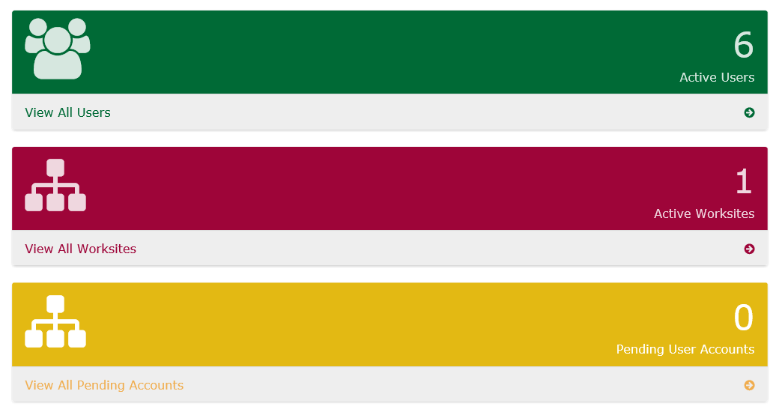
New Worksite Wellbeing Web Platform
Helps employers assess how they are implementing evidence-based best practices for effective wellness programs
Questions developed based on content identified in evidence-based best-practice wellness program assessment instruments and findings from relevant research studies
The weightings and scoring of responses are based on scientific evidence
The instrument and scorecard have been field-tested for validity and reliability
The tool will be continuously reviewed and revised as new evidence on best practices and outcomes for worksite wellness programs are reported

Slide 8
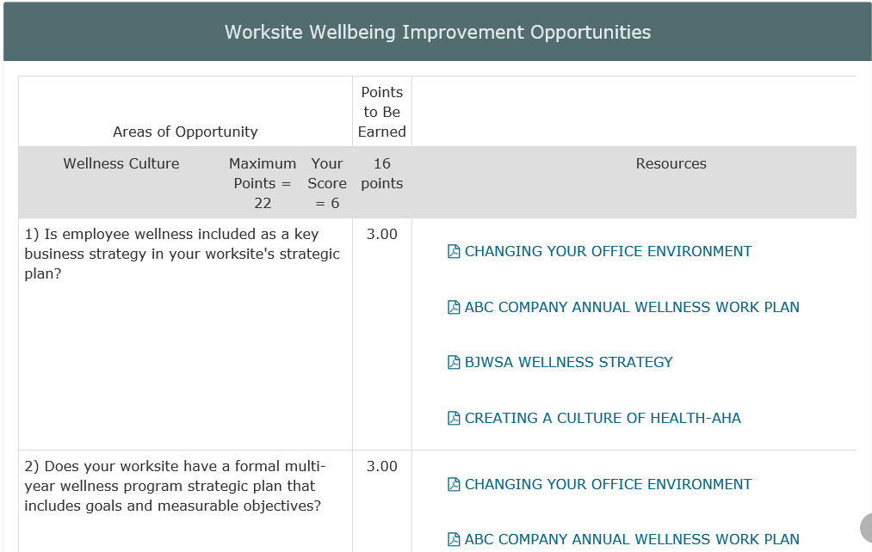
Scorecard and Improvement Opportunities

Slide 9
Outcomes
Have worked with over 110 worksites, impacting 125,000+ employees in SC
Culture of Wellness
10 Excellence Recognitions
Above the national average in 45% of the reported indicators
95% of organizations communicate wellness policies, programs, and benefits to employees
21% increase from the baseline in having a wellness committee that meets on a regular basis
Tobacco
25 Gold Star Recognitions
Above the national average in 69% of the reported indicators
92% of organizations offer FDA-approved Rx cessation medications and 87% of offer
in-depth counseling/coaching
Nutrition
17 Gold Apple Recognitions
Above or on par with the national average in 70% of the reported indicators
40% increase in organizations that report offering nutrition counseling and/or medical nutrition therapy
Almost 80% of organizations make healthy food and beverages available to employees during all hours of operations
Physical Activity
13 Gold Medal Recognitions
Above the national average in 63% of the reported indicators
90% of organizations provide easy access to bike racks, showers, changing facilities, or locker rooms and offer a discount to a local or onsite exercise facility

