Slide 1
ArCOP IS GROWING HEALTHY COMMUNITIES
ATTRACTIVE | WALKABLE | SUCCESSFUL | APPEALING | EFFICIENT
HEALTHY | VIGOROUS | POSITIVE | ENJOYABLE | MEMORABLE

Slide 2
FINI Food Insecurity Nutrition Incentive
To increase access to fresh fruits and vegetables among low-income Arkansans in at-risk communities by doubling the spending power of SNAP recipients at participating Farmers' Markets in an effort to create a statewide sustainable system that provides affordable access to fresh fruits and vegetables and helps sustain the local farmer.
Notes:
USDA grant $90,000
Arkansas Increases Access To Fresh Fruits And Vegetables Among Snap Participants With Double Up Food Bucks

Slide 3
DOUBLE UP FOOD BUCKS Win/win/win
Families bring home more healthy food
Farmers make more money
More food dollars stay in local economy, strengthening
communities
Notes:
Double Up Food Bucks does exactly this. It is FFN’s flagship program and Michigan’s statewide healthy food incentive program. The program doubles the value of federal nutrition benefits at participating farmers markets and grocery stores, helping people bring home more locally grown fruits and vegetables.
How does Double Up work?
Double Up provides SNAP-Recipients with a one-to-one match to purchase healthy, Michigan-grown fruits and vegetables when they use their Bridge Card at participating locations.
Double Up makes it easier for low-income consumers to eat more fruits and vegetables while supporting family farms and growing local economies. We like to call it a win/win/win because families bring home more healthy food; farmers gain new customers and make more money; and more food dollars stay in the local economy.
And we also see a ripple effect of benefits from increased access to healthy food.
3

Slide 4
Working with Customers
SNAP purchases can be matched up to $20 per market day
DUFB tokens each have a $2 value
DUFB tokens can only be used to purchase Arkansas-grown, fresh fruit and vegetables or plants that grow food
Encourage customers to purchase SNAP tokens in even increments to optimize the match
DUFB tokens can be used at any participating market from June 1 through October 31, 2016

Slide 5
HEALTHY FOOD INCENTIVES
DOUBLE UP FOOD BUCKS
What you can buy for $20 in SNAP benefits at a farmers market
What you can buy for $40 when SNAP is matched with Double Up Food Bucks
Notes:
I love these images because it helps provide a visual for the impact of the program by showing on the left, what consumers can by for $20 in SNAP benefits at a farmers market.
Compared to the one on the left, showing what can be purchased when a purchase is matched with an additional $20 in Double Up Food Bucks.
This means that consumer can bring home $40 worth of healthy food for $20.
5

Slide 6
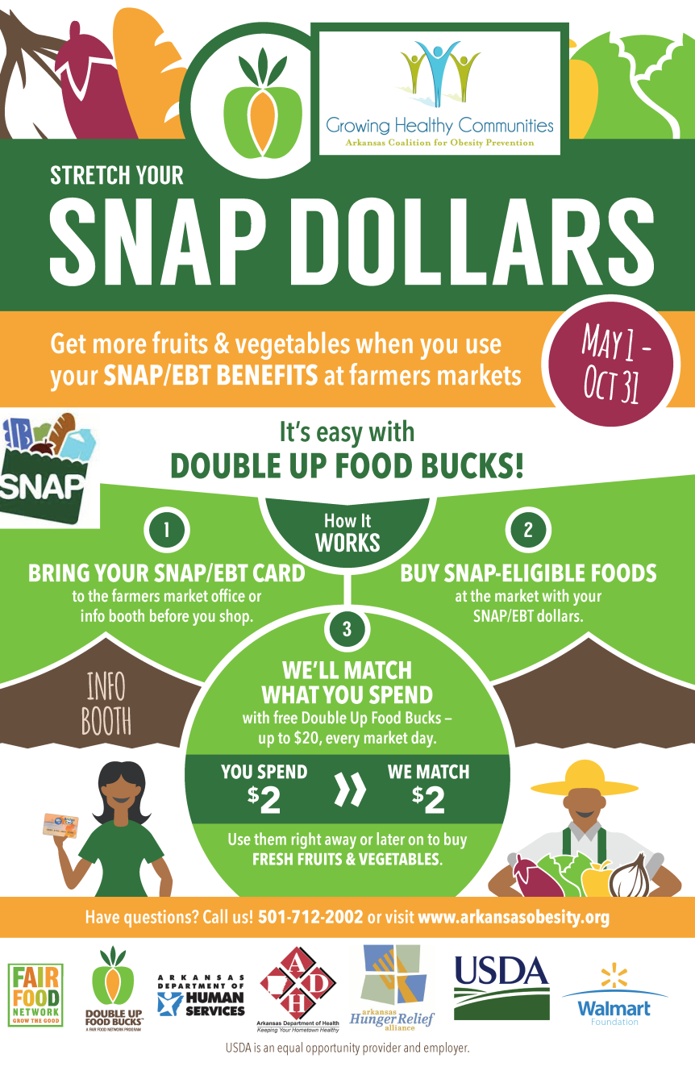
DOUBLE UP Communications
Conducted 6 Regional Trainings in April 2016
Outreach Materials
Flyers & Posters
Tokens
Double Up Website
Social Media
Partner Engagement
Notes:
Investment in an integrated and dynamic communications campaign utilizing a variety of strategies.
We design a variety of outreach materials including a outreach campaign to consumers centrally coordinated by Fair Food Network and engage in a wide network of partnering agencies including statewide networks and local community organizations.
6

Slide 7
Double Up Food Bucks Assessment Surveys
3 direct DUFB evaluation components
Customer, Vendor, Market Manager
Use provided DUFB surveys to maintain consistency for data analysis
Additional funding incentive for SNAP customers available
$25 per customer; 1 time only
FM Nutrition Education Classes or Cooking Demonstrations
DUFB Customer Survey

Slide 8
DUFB Assessment Surveys- Evaluation
Protocol for Administering the DUFB Customer Survey
Provides training for survey access and administration
Evaluation Tool
Short questionnaire to evaluate Protocol legibility and ease of use
6 questions on 5-point Likert scale
2 open-ended questions
Evaluation Question Example:
After reading the Protocol for Administering the DUFB Customer Survey, I feel that I can successfully administer the DUFB Customer Survey at a Farmers’ Market on my own.
Strongly Agree
Somewhat Agree
Neither Agree nor Disagree
Somewhat Disagree
Strongly Disagree

Slide 9
DUFB Expansion
Targeted Grocery Pilot with goal of expansion
Working to encourage SNAP participation at markets that don’t currently accept
Educating markets that chose not to participate on the impact of DUFB.

Slide 10
KATRINA BETANCOURT, RCEP, AGM, CPM
ArCOP President
Katrina.Betancourt@arkansasobesity.org
501-712-2002
Notes:
Arkansans are working hard to make the healthy choice the easy choice – there’s no way to cover all of it in one presentation. Please check out ArCOP’s website: arkansasobesity.org to learn even more.

