Slide 1
Salud America!
Utilizing Role Model-Based Change
and an Online Network to
Affect Latino Childhood Obesity Prevention Policy
Eric Moreno
Research Area Specialist-Senior
Institute for Health Promotion Research
The University of Texas Health Science Center at San Antonio
Program Funder:
Program Team:
Dr. Amelie G. Ramirez, Kip Gallion (Deputy Director), Cliff Despres (Communications), Rosalie Aguilar (Project Coordinator), Lisa Ellis-Veraza, Amanda Merck

Slide 2
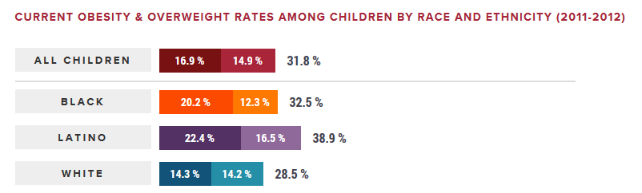
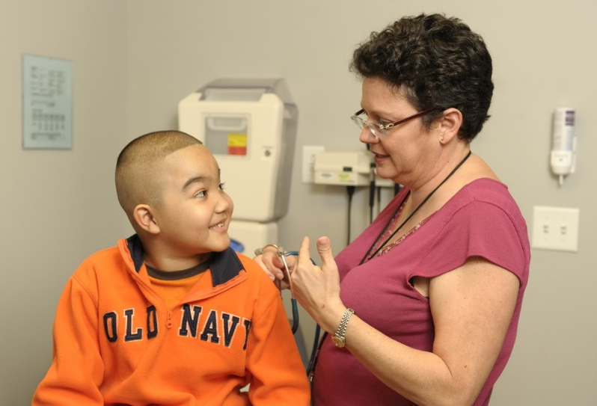
Salud America! Mission
Childhood Obesity: Nearly 40% of Latino children are overweight or obese (higher rates than both white and black children), placing a significant burden on the current and future state of Latino health.
Who We Are: Salud America! is a university-based nonprofit launched in 2007 that develops multimedia communications to educate and motivate our national online network take action to reduce Latino childhood obesity and build a culture of health.
Notes:
—kids and parents, teachers, academics, and community leaders—to

Slide 3
Salud America! Overview
Research from 6 topic areas on website.
salud.to/saludamerica
Notes:
Share numbers

Slide 4
Latinos & Social Media
Latinos are very connected and engaged on social media.
91% of U.S.-born Latinos utilize the Internet.
6 out of 10 millennials (<35 years old) are on social media.
80% of Latino adults say they access the internet via a mobile device such as a cellphone or tablet at least occasionally.

Slide 5
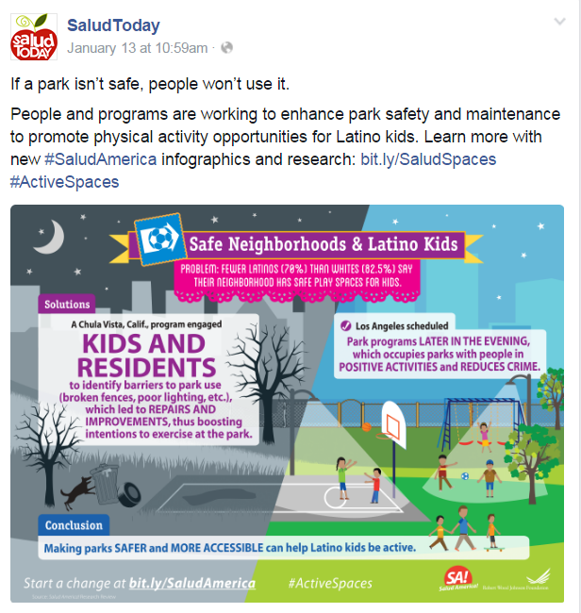
Salud America! Social Media Posts

Slide 6
Salud America! Curated Content
Network Channels
Latino Health Content, Research, Campaigns,
& Videos
Our
Website
Our Blog &
Social Media
88% Desktop
12% mobile/tablet
Promote content + website + interaction/engagement
36,946
Unique Visitors in 2016
7,933
Unique Visitors in 2016 (+ 842 Salud Leaders)
20,752 Fans
Curated External Latino Health News & Research
50,000 E-Subscribers
13,400
8,000
270
255
37

Slide 7
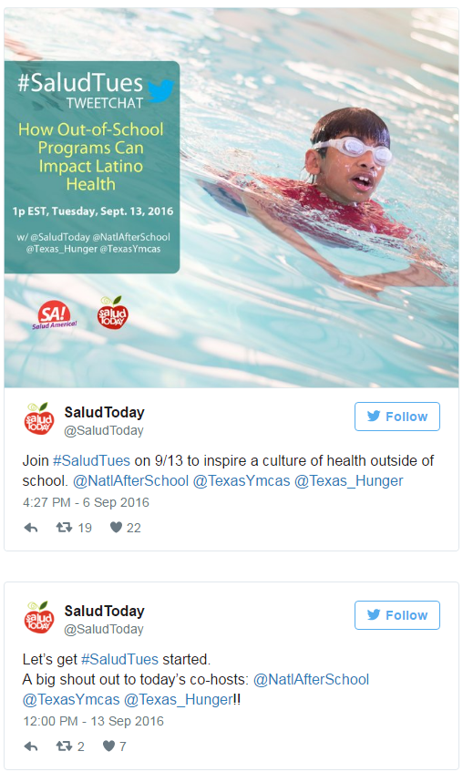
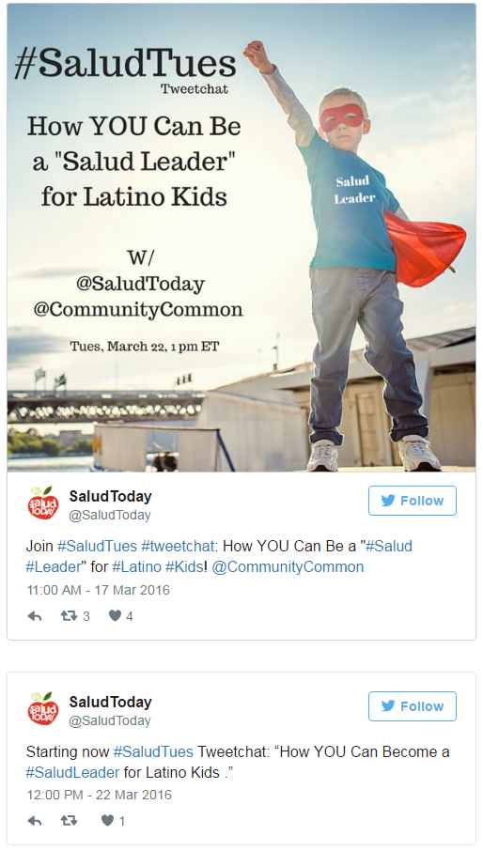
#SaludTues Tweetchats

Slide 8
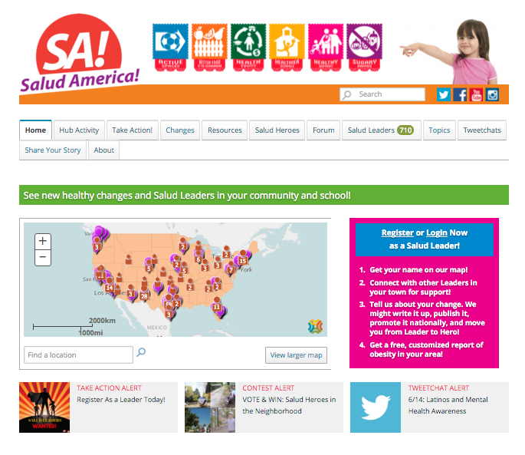
How You Can Take Action!
1. Register & log in!
2. Choose a topic.
3. Keyword search
(orange search bar).
4. Learn, share, connect, & discuss.
5. Engage in network events/activities.
salud.to/saludamerica
Notes:
Sign up for our platform/website and you’ll get updates on all our latest news, research, videos, petitions, etc.
Choose from one of our six policy topics and you’ll find resources, policy changes, and our “Salud Heroes,”
Search for topics using keywords, such as sugary beverages/drinks, built environments, playgrounds, health insurance, and more.

Slide 9
Questions?
Contact me: morenoe5@uthscsa.edu
Follow us on social media: @SaludToday
Visit us online at: salud.to/saludamerica

