Slide 1
Southern Obesity Summit
Lieutenant General (Ret.) Steven Hummer, U.S. Marine Corps
November 14, 2016
Notes:
Your intro: They have your bio, but most people won’t understand the magnitude of your service so share whatever personal bio information you’d like here such as the number of countries you’ve served in, number of soldiers you’ve commanded, best memory, worst memory….I’m sure you’re very humble like our other members, but any information that would really get their attention would be great.

Slide 2
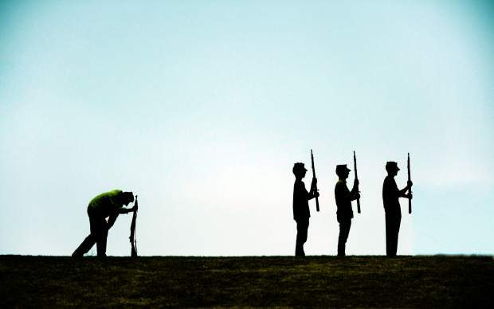
In 2006-11, according to the U.S. Military Processing Exam, 62,000 new recruits to the military were turned away because of their weight.

Slide 3
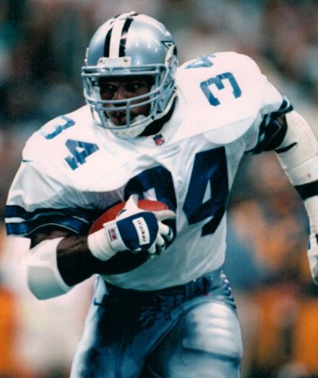

Slide 4
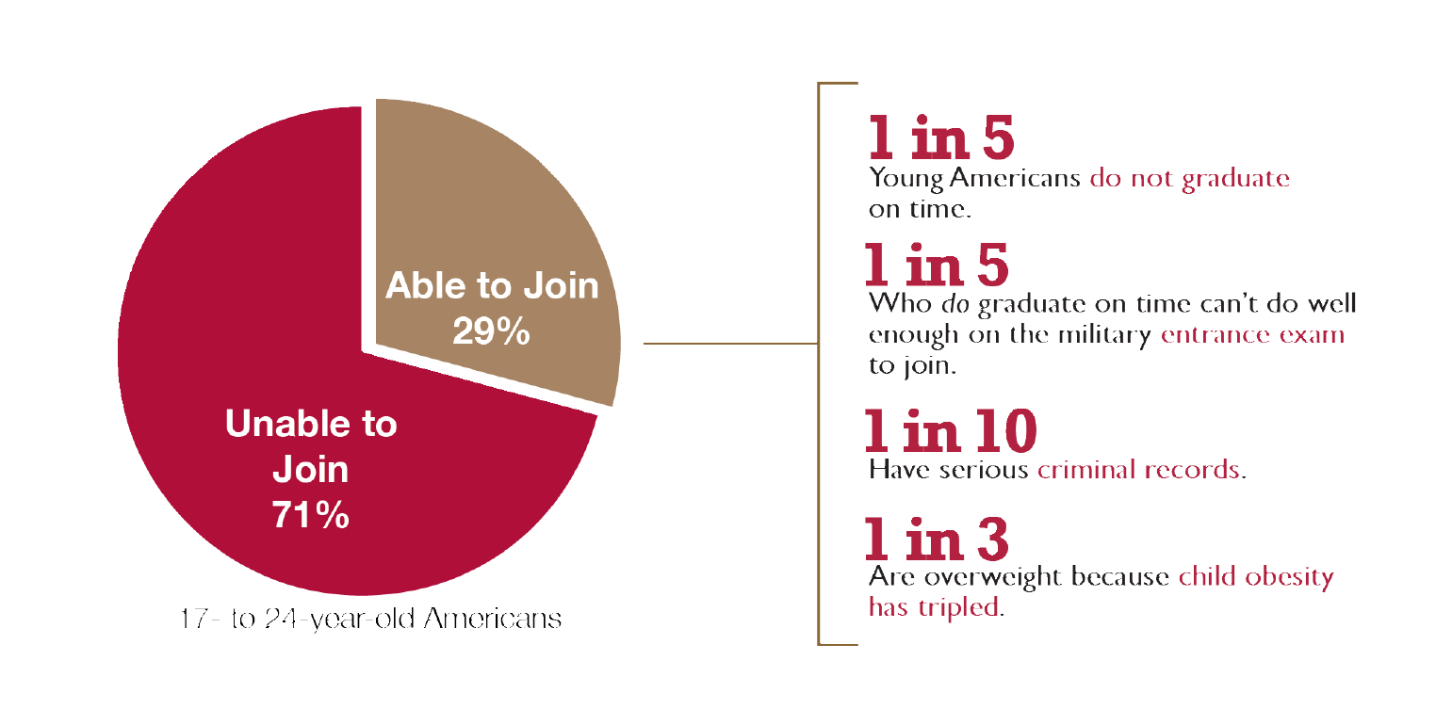
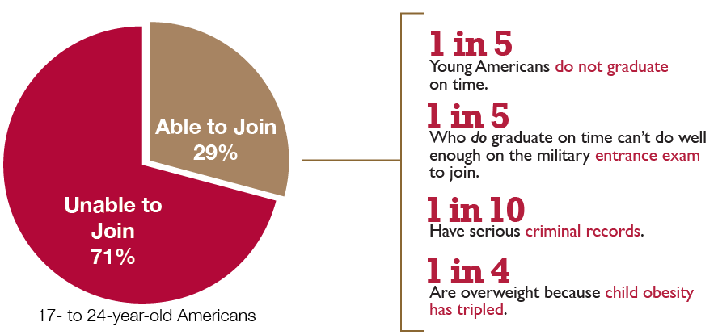
71% of 17-24 Year Olds Cannot Join the Military

Slide 5
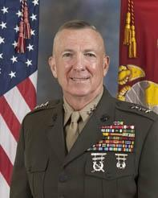
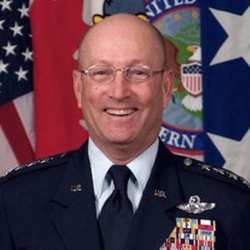
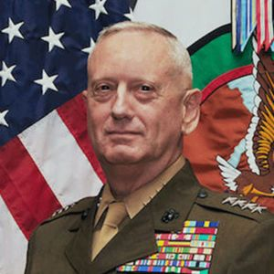
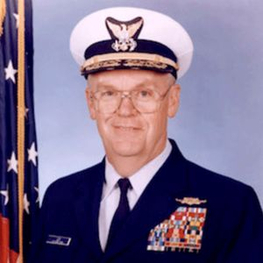
More Than 650 Retired Generals & Admirals in 49 States
Notes:
I know many of you have heard other members of Mission:Readiness speak before, but for those of you who are not familiar with us, we are an organization of more than 650 retired admirals, generals, and other top military leaders in 49 states working to strengthen national security by ensuring kids stay in school, stay fit, and out of trouble.
Our organization is based out of Washington, D.C., but we have a physical office in ten states.

Slide 6
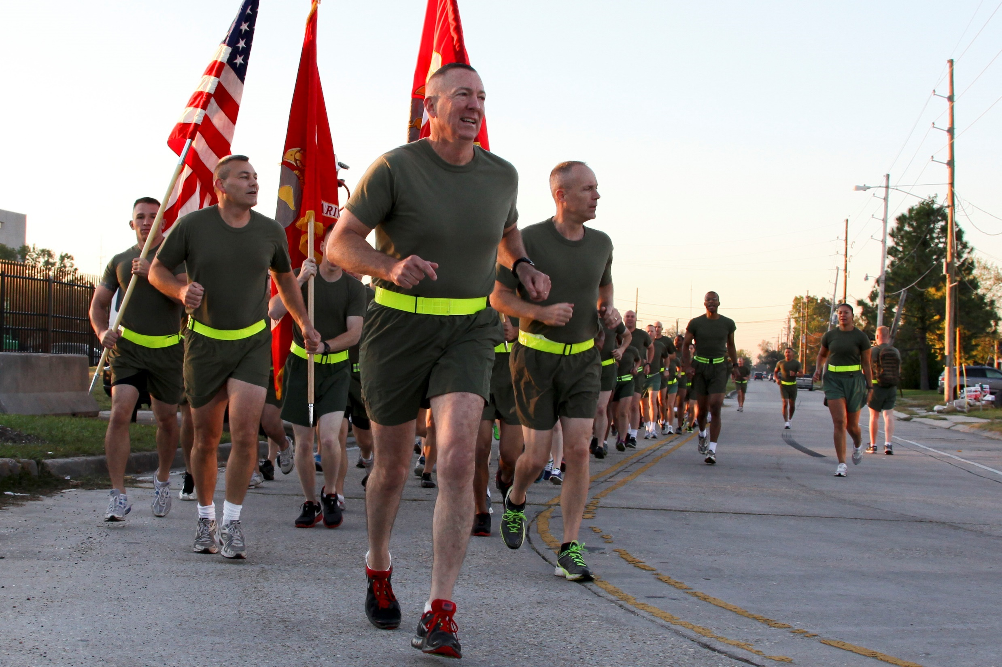

Slide 7
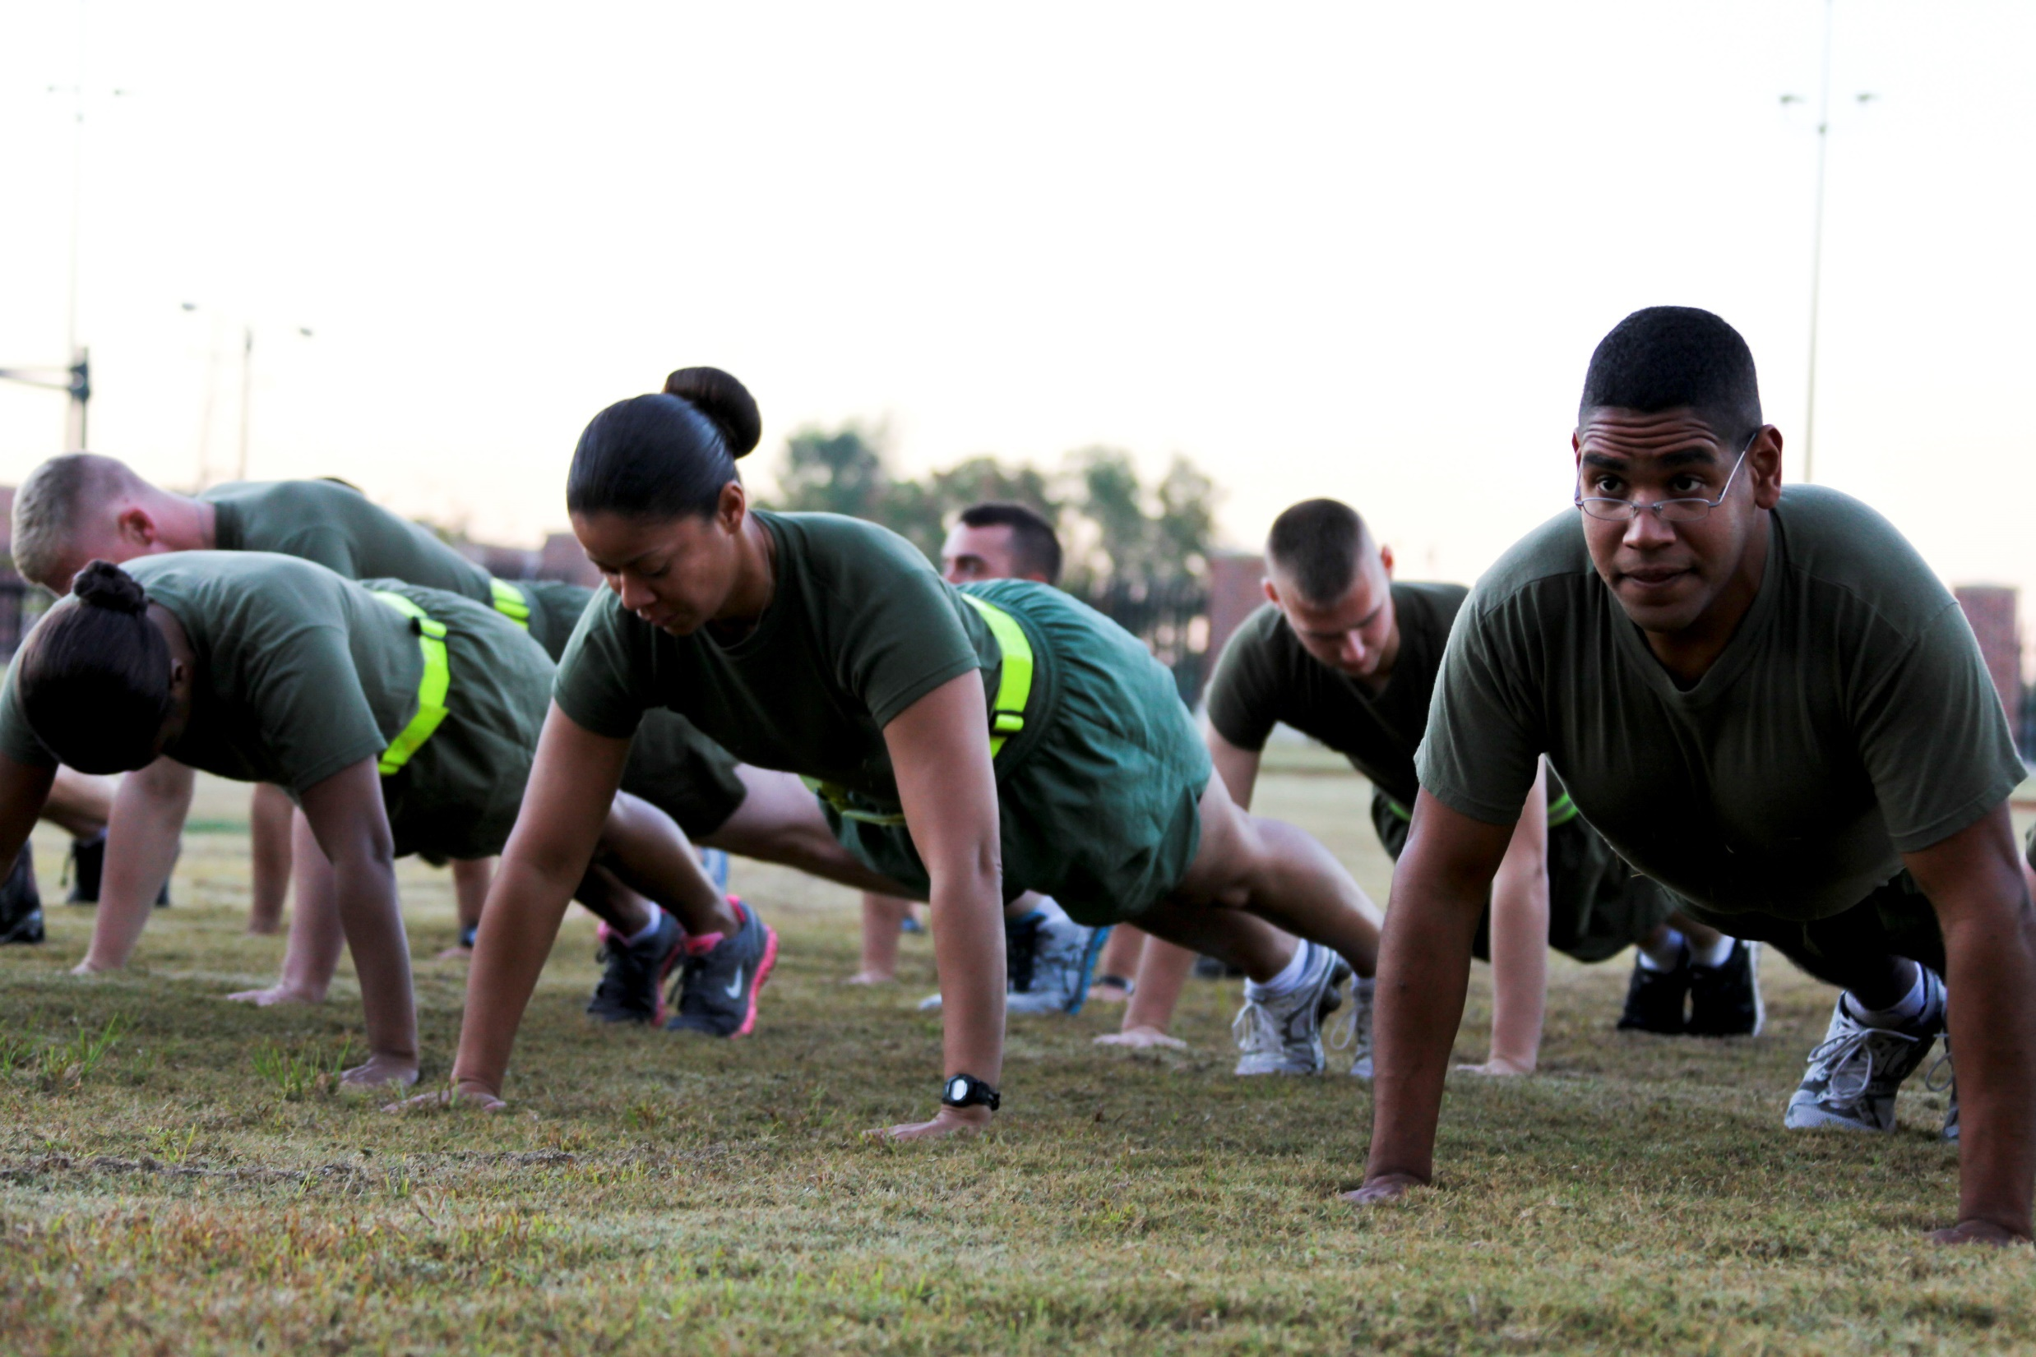

Slide 10
Physical Activity is a Must

Slide 11
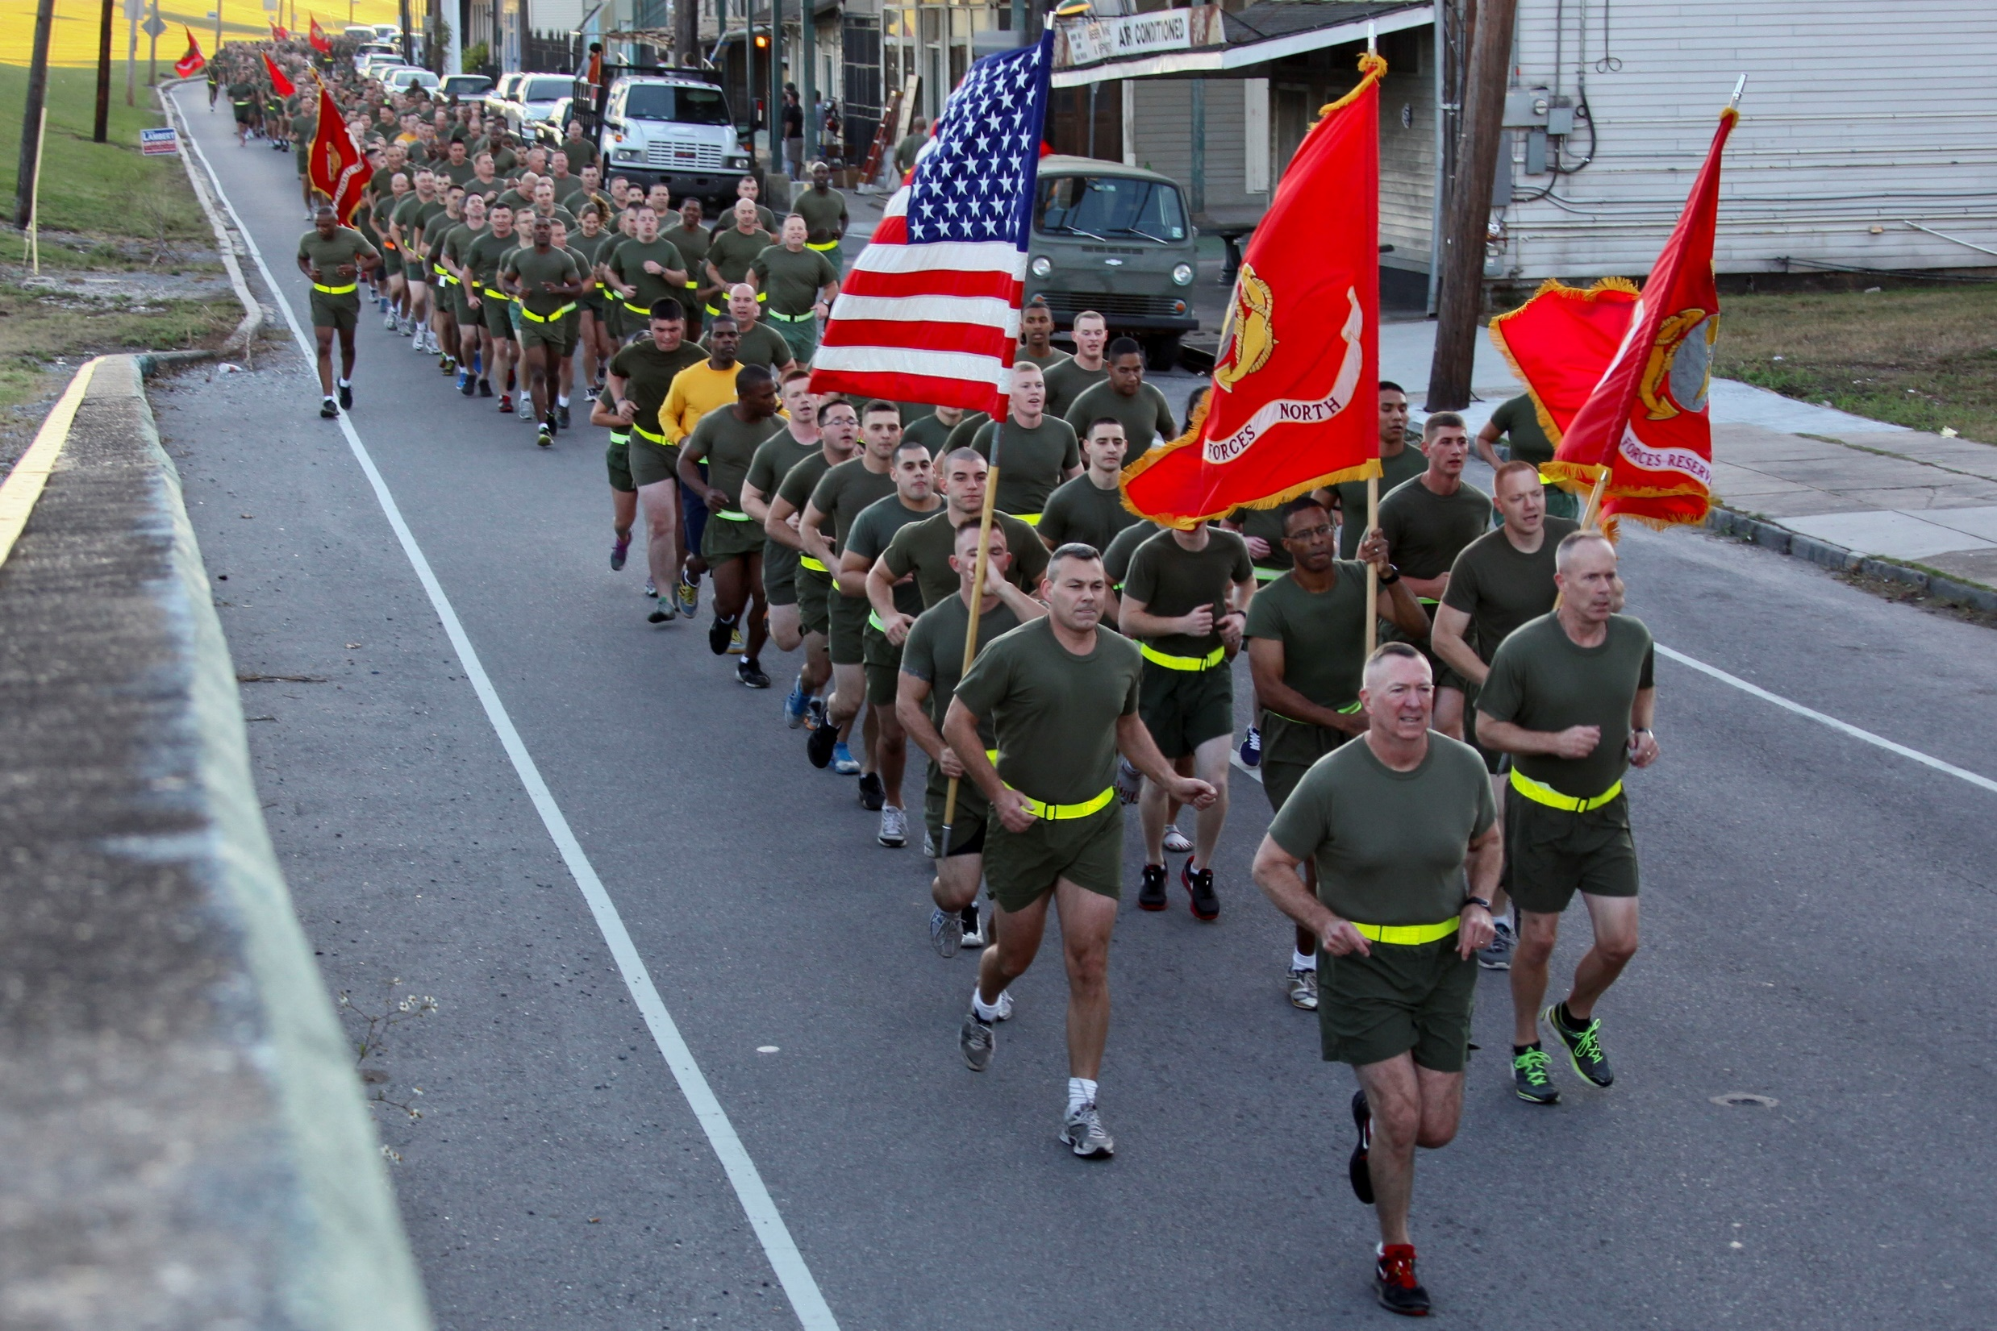
Thank you, and Semper Fidelis

