Slide 1
Equity in the 2018 Farm Bill: How to Educate Policymakers on the Importance of the Food Environment and Health
Lindsey Haynes-Maslow, PhD, MHA Assistant Professor and Extension Specialist Department of Agricultural and Human Sciences NC State University Lhaynes-maslow@ncsu.edu
Department of Agricultural and Human Sciences
Notes:
My name is Lindsey Haynes-Maslow, and I’m an Assistant Professor and Extension Specialist in the Department of Agricultural and Human Sciences. My degrees are actually in Health Policy, but for more than a decade, I have focused on obesity prevention through access to healthy foods, among lower-income and diverse populations, especially among people enrolled in the Supplemental Nutrition Assistance Program, also known as SNAP and formerly referred to the Food Stamp Program. At NC State, I also lead the SNAP-Education program. This is the education arm of the SNAP program --- but today, we’re going to focus on SNAP.

Slide 2
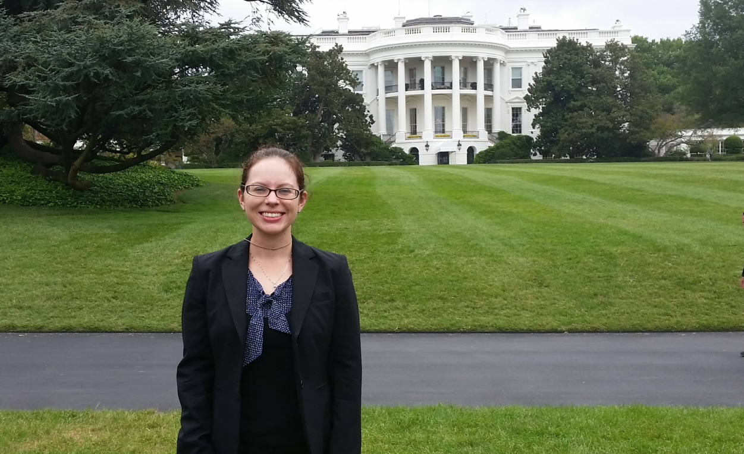
What is Policy?
Policies are “laws, regulations, formal and informal rules and understandings that are adopted on a collective basis to guide individual and collective behavior”
Dan E. Beauchamp & Bonnie Steinbock. New Ethics for the Public Health. Oxford University Press: 1999.
Department of Agricultural and Human Sciences

Slide 3
What is the Farm Bill?
Photo Credit: Carolina Farm Stewardship Association.
Department of Agricultural and Human Sciences
Notes:
How does one describe a $100 billion dollar per year piece of legislation that covers a broad range of topics and includes many complex pieces? As President Obama said in 2014, “It’s like a Swiss Army knife.”

Slide 4
What is the Farm Bill?
Law that governs agricultural, nutrition, and food assistance programs
Passed every 5 years by Congress (known as the “Reauthorization process”) – next reauthorization is NOW!
Administered by the U.S. Department of Agriculture
Topics include food assistance programs, commodity crop prices, conservation, research, rural development, bioenergy & foreign food aid
Department of Agricultural and Human Sciences
Notes:
To be more specific than just calling the Farm Bill a Swiss Army Knife, in the United States, the farm bill is known as the primary agricultural and food law run by the federal government. The comprehensive bill is passed every 5 years by the U.S. Congress. This is referred to as the reauthorization process and deals with both agriculture and all other affairs that is overseen by the U.S. Department of Agriculture. Every five years, the farm bill expires and is updated: proposed, debated, and passed by Congress and then signed into law by the President.
Topics in the Farm Bill include food assistance programs, farm commodity crop prices and income supports, conservation, farm credit, trade, research, rural development, bioenergy, and foreign food aid.

Slide 5
Farm Bill Reauthorization Process
Farm Bill Hearings
Conference Committee Approves Bill
President Vote
Approve
Veto
Referred to Ag Committees
Yes
No
House Ag Committee Drafts Bill
Senate Ag Committee Drafts Bill
Full Congress: Floor consideration
Passed w/ amendments
Passed w/o amendments
Floor consideration
Floor consideration
Reconciled between both bodies
Vote “Yes”
Vote “No”
Yes
No
Referred to Conference Committee
Department of Agricultural and Human Sciences
Notes:
How does the Farm Bill become law? That’s also a long and complicated process, but I will try and break it down to the very basic parts. The first begins with Farm Bill hearings (in Washington, DC and across the country). Hearings are essentially listening sessions where members of Congress take input from the public, industry, and advocates about what they want to see in a new bill. After the hearings, the House and Senate Agriculture Committees each draft, debate, amend and change (referred to as “marking up”) their own bill. These House and Senate Ag committees often work on separate bills that can have substantial differences. Once each Ag Committee is ready for the House or Senate to vote on their bill, it will go up for a full “floor vote”. That means, the entire House or Senate members debate the bill, make amendments, and vote on it again. After both the full House and Senate have passed their version of the farm bill – which can take a while, and may require a bill being sent back to committee for more work – the two separate bills (House and Senate) go to a smaller group of Senators and Representatives called a “conference committee.” In conference committee, members will work to combine the two separate bills (the House Bill and Senate Bill) into one. The combined version of the conference committee’s farm bill then goes back to the House and Senate floors to be debated – and potentially passed. Once the House and Senate approve a final farm bill, the bill goes to the President, who can veto it or sign it into law!

Slide 6
Farm Bill Spending by Major Programs
Source: CRS, using USDA data, including USDA Farm Service Agency, “Table 35,” Agricultural Outlook; USDA Risk Management Agency, “Program Costs and Outlays by Fiscal Year”; J. Glauber, “Crop Insurance Reconsidered,” American Journal of Agricultural Economics, 2004; USDA Farm Service Agency, “Output 3,” Commodity Estimates Book; USDA Natural Resources Conservation Service, “Soil and Water Conservation Expenditures, 1935-2010,” 2011; and USDA Food and Nutrition Service, “National Level Annual Summary, Participation and Costs.”
Department of Agricultural and Human Sciences
Notes:
Food and nutrition assistance programs have always been the largest programs in The Farm Bill. Over the past 30 years, the cost of the farm bill has increased. Since the 1990s you can see that food assistance programs in The Farm Bill have continued to grow and rose sharply after the recession in 2009, in which President Obama approved stimulus funding to increase aid to families suffering in the economic downturn, but has begun to decline more slowly during the recovery.

Slide 7
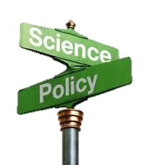
What Policymakers Do
Policymakers are individuals elected or appointed to office at some level of government
Includes executive branch chiefs of staff and staff assistants
Sell, argue, and advocate for specific interest issues
Interests are often shorter term and keyed to election cycles
Make decisions that are often the result of compromise
Brownson et. al. Researchers and policy makers: travelers in parallel universes. Am J Prev Med 2006
Department of Agricultural and Human Sciences

Slide 8
What Do Policymakers Want From You?
Policymakers want answers to the following questions:
Is there a problem (what fuels it)?
Do we know how to fix it (intervention)?
How much will it cost (financially, politically)?
Brownson et. al. Researchers and policy makers: travelers in parallel universes. Am J Prev Med 2006
Department of Agricultural and Human Sciences

Slide 9
How Can You Educate Policymakers?
Testifying at public hearings
9
Department of Agricultural and Human Sciences

Slide 10
How Can You Educate Policymakers?
Speaking with media
Department of Agricultural and Human Sciences
Notes:
Lastly, because I believe that research should be shared with the public and policymakers, I intentionally speak with the media to try and disseminate my work and comment on upcoming policy proposals. Now, more than ever, is an important time for researchers to speak up and discuss our work with stakeholders. If we don’t, who will?

Slide 11
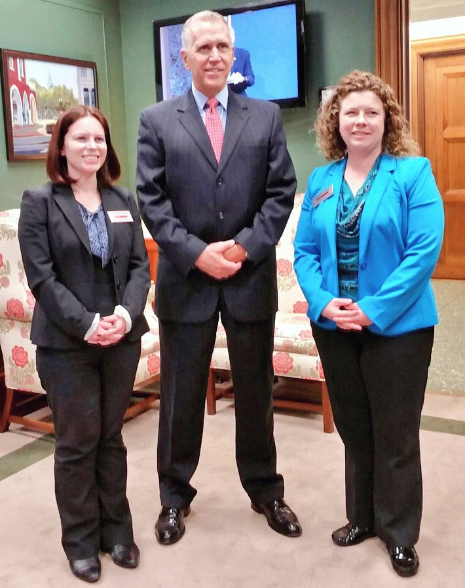
How Can You Educate Policymakers?
Speaking with legislators on Capital Hill (“Hill visits”)
Speaking with policymakers
11
Department of Agricultural and Human Sciences

Slide 12
Policymaker Visits 101
Before the meeting
What to bring to the meeting
What to expect in the meeting
After the meeting
12
Department of Agricultural and Human Sciences
Notes:
Important Tips for Capital Hill Visits
What to Pack
Suits and basic business attire. Comfortable shoes.
Business cards
Handouts from your organization
Photos of your farm/projects/gardens/community members if you have a few handy
Your own camera if you like to take photos
What to Expect on the Hill
Approximately a 20-minute meeting with your legislator
Most likely, a meeting with your legislator’s staffer
Interest in what the legislator can do to champion this issue –
Remember, what is your ask? CONTINUE TO SUPPORT SNAP-ED
Before the meeting:
Know where you are going and who is going with you
Have a game plan for who is going to say what
Know the main points you want to convey
Arrive 5 minutes early at the office
Allow plenty of time for walking and security lines
In the meeting:
Introduce yourselves, use your “flirty in thirty”
Exchange business cards
Establish a connection – explain that you are a constituent?
Explain why you are there
Make your case for S
Ask for their support/ invite them for a site visit to see your program
Don’t forget:
Remember to ensure everyone gets a chance to speak.
Emphasize your home district
Focus on stories and examples from back home that directly relate to the issues at hand.
Don’t be partisan
All of these issues need bipartisan support, and every legislator we’ll meet has the opportunity to be our champion!
Take a photo!
Let them know up front that you’d
After the Meeting:
Send a thank you email to the person with whom you met
Keep the message brief, thank the office for their time, and remind the legislator the issue at hand
Leave a link to your website/more information
Provide any follow-up information that was asked for
Share photos and stories from your trip!
Future:
Pass along new information about SNAP-Ed as it is released
Communicate with your legislator in a respectful and informative manner to gain the representative’s respect—for you and your points of view

Slide 13
Policymaker Visits 101: Before the Meeting
Do your research on them
Know their views
Know how they voted on bills that relate to your issue
Know where you are going and who is going with you
If going in a group: have a plan for who is going to say what
Know the main points you want to convey
Arrive 10-15 minutes early at each office
Allow plenty of time for walking and/or security lines
13
Department of Agricultural and Human Sciences
Notes:
Before the meeting:
Do you research on them
Know where you are going and who is going with you
Have a game plan for who is going to say what
Know the main points you want to convey
Arrive 5 minutes early at the office
Allow plenty of time for walking and security lines

Slide 14
Policymaker Visits 101: What to Bring
Suits and basic business attire
If walking a lot: bring comfortable shoes
Business cards
Handouts from your organization or clinical practice
Photos of your programs, clinic, or projects
Your own camera so you can take photos
14
Department of Agricultural and Human Sciences
Notes:
Important Tips for Capital Hill Visits
What to Pack
Suits and basic business attire. Comfortable shoes.
Business cards
Handouts from your organization
Photos of your farm/projects/gardens/community members if you have a few handy
Your own camera if you like to take photos

Slide 15
Policymaker Visits 101: What to Expect in the Meeting
Leave your business card at the front desk
Approximately a 15-20 minute meeting
Most likely, a meeting with the policymaker’s staffer or legislative aide
Meeting locations vary!
Meetings can often start early or late
Department of Agricultural and Human Sciences
Notes:
What to Expect on the Hill
Approximately a 20-minute meeting with your legislator
Most likely, a meeting with your legislator’s staffer
Interest in what the legislator can do to champion this issue –
Remember, what is your ask? CONTINUE TO SUPPORT SNAP-ED
In the meeting:
Introduce yourselves, use your “flirty in thirty”
Exchange business cards
Establish a connection – explain that you are a constituent?
Explain why you are there
Make your case for S
Ask for their support/ invite them for a site visit to see your program
Don’t forget:
Remember to ensure everyone gets a chance to speak.
Emphasize your home district
Focus on stories and examples from back home that directly relate to the issues at hand.
Don’t be partisan
All of these issues need bipartisan support, and every legislator we’ll meet has the opportunity to be our champion!
Take a photo!
Let them know up front that you’d
After the Meeting:
Send a thank you email to the person with whom you met
Keep the message brief, thank the office for their time, and remind the legislator the issue at hand
Leave a link to your website/more information
Provide any follow-up information that was asked for
Share photos and stories from your trip!
Future:
Pass along new information about SNAP-Ed as it is released
Communicate with your legislator in a respectful and informative manner to gain the representative’s respect—for you and your points of view

Slide 16
Policymaker Visits 101: During the Meeting
Introduce yourself and explain why you are there
Remember: what is your ask?
Establish a connection between you and the policymaker/staffer/aide
Make your case quickly and succinctly; allow time for questions
Educate them about your issue and invite them for a site visit to see your program/research
Focus on stories that directly relate to the issue(s) at hand
Don’t be partisan!!!
Take a photo after your meeting and post it on social media!
Department of Agricultural and Human Sciences
Notes:
In the meeting:
Introduce yourselves, use your “flirty in thirty”
Establish a connection – explain that you are a constituent?
Explain why you are there
Make your case for S
Ask for their support/ invite them for a site visit to see your program
Don’t forget:
Remember to ensure everyone gets a chance to speak.
Emphasize your home district
Focus on stories and examples from back home that directly relate to the issues at hand.
Don’t be partisan
All of these issues need bipartisan support, and every legislator we’ll meet has the opportunity to be our champion!
Take a photo!
After the Meeting:
Send a thank you email to the person with whom you met
Keep the message brief, thank the office for their time, and remind the legislator the issue at hand
Leave a link to your website/more information
Provide any follow-up information that was asked for
Share photos and stories from your trip!
Future:
Pass along new information about SNAP-Ed as it is released
Communicate with your legislator in a respectful and informative manner to gain the representative’s respect—for you and your points of view

Slide 17
Policymaker Visits 101: After the Meeting
Send a thank you email to the person you met with:
Keep the message brief
Thank them for their time
Remind them about your ask or issue
Leave a link to your website/more information
Provide any follow-up information that was asked for
Future communications:
Send new information about your program/practice as it is released
Department of Agricultural and Human Sciences
Notes:
After the Meeting:
Send a thank you email to the person with whom you met
Keep the message brief, thank the office for their time, and remind the legislator the issue at hand
Leave a link to your website/more information
Provide any follow-up information that was asked for
Share photos and stories from your trip!
Future:
Pass along new information about your program as it is released
Communicate with your legislator in a respectful and informative manner to gain the representative’s respect—for you and your points of view

Slide 18
Questions?

