Slide 1
Safe Routes in Pasadena: A collaborative approach to safe neighborhoods
Katie Chennisi, MPH
Harris County Public Health
Southern Obesity Summit
October 23, 2018

Slide 2
Objectives
Attendees will:
Identify key stakeholders to include when working on Safe Routes to Schools
Review examples of successful strategies for each pillar of SRTS
Review lessons learned from our work developing the SRTS plan and implementing practices around the 5 E's

Slide 4
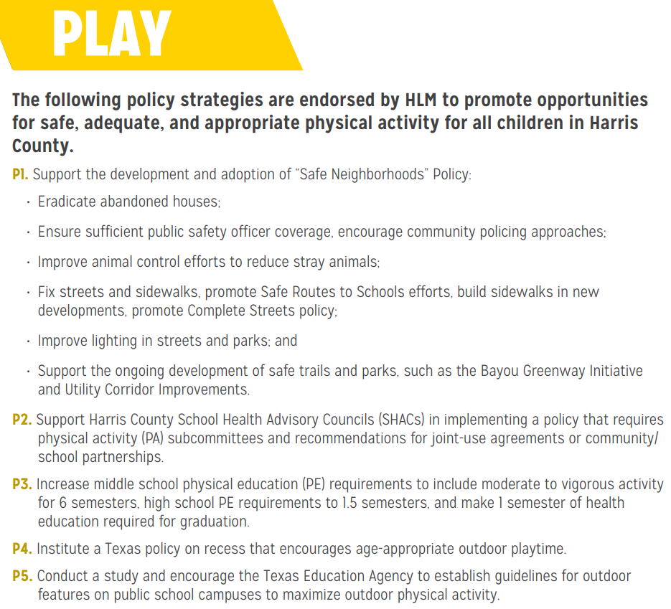
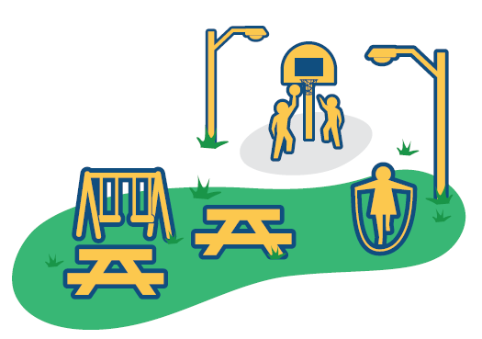

Slide 5
Why SRTS?
The Pasadena SRTS program aims achieve the following outcomes:
Increase the number of children walking and biking to school
Increase physical activity in children
Increase the number of safe street segments in school zones
Foster safer neighborhoods
Increase knowledge about and support for SRTS
Decrease the likelihood of pedestrian fatalities and injuries
Ultimately reduce childhood obesity in the long term
Notes:
Katy O
The Pasadena Safe Routes to School (SRTS) initiative aims to create safe, convenient, and fun opportunities for children to bicycle and walk to and from school. The overall goal is to increase the number of children actively commuting to schools, increase kids’ safety, and reverse the nationwide trend toward childhood obesity and inactivity. The Pasadena SRTS Plan provides recommendations to improve safety and increase active transportation at 15 priority schools in Pasadena ISD.
Studies also show that physical activity has positive effects on attention, memory, and academic performance. Children who walk or bicycle to school arrive ready to learn, have increased focus and problem-solving, and perform better on tests.
The SRTS plan aims to create safe, convenient, and fun opportunities for children to bicycle and walk to and from school within the Pasadena Independent School District (Pasadena ISD) catchment area. The Pasadena SRTS plan was designed to

Slide 6
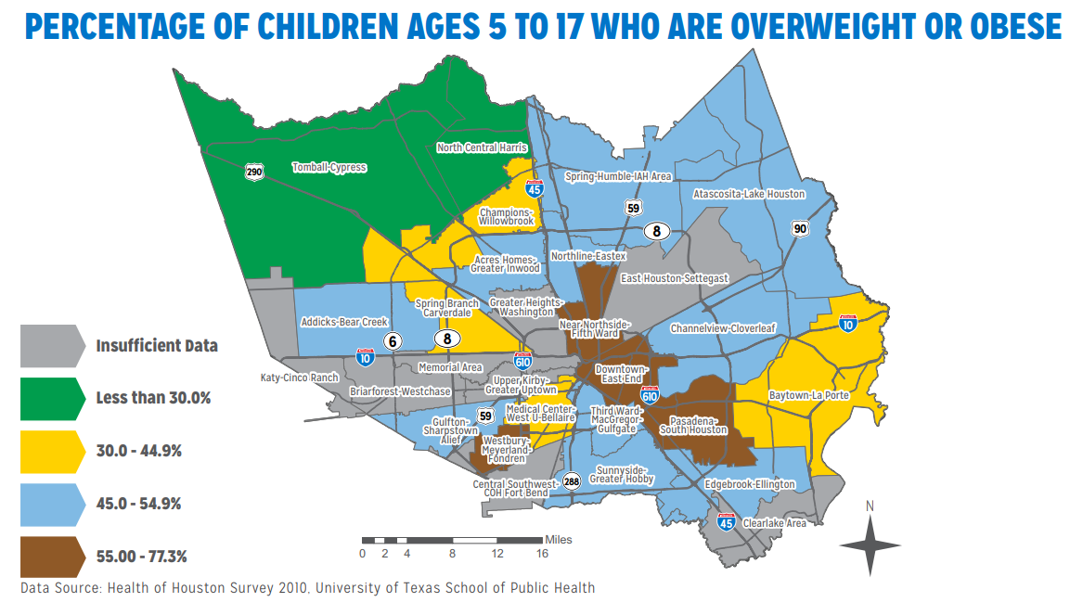
Why SRTS in Pasadena?
Notes:
Katy O
According to the 2010 Health of Houston/Harris County Survey, 65% of children ages 12 and over in the Pasadena/South Houston area are overweight or obese, which is the highest rate in Harris County. Walking and bicycling to school are opportunities for students to incorporate physical activity into their daily routines, helping them lead active, healthy lives.

Slide 7
The E’s
Engineering
Education
Engagement
Enforcement
Evaluation
Equity
Notes:
Katy O
No slide for equity – mention that equity is embedded in all the steps

Slide 8
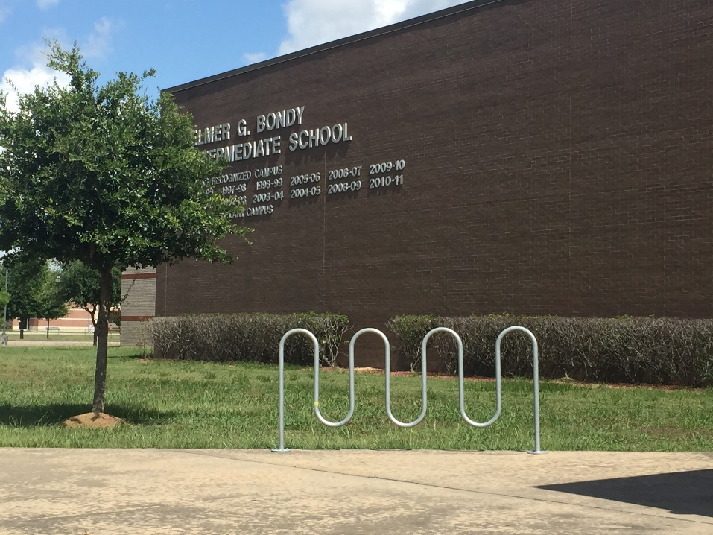
Engineering
Notes:
Katie C
Environmental changes – bike rack installation

Slide 9
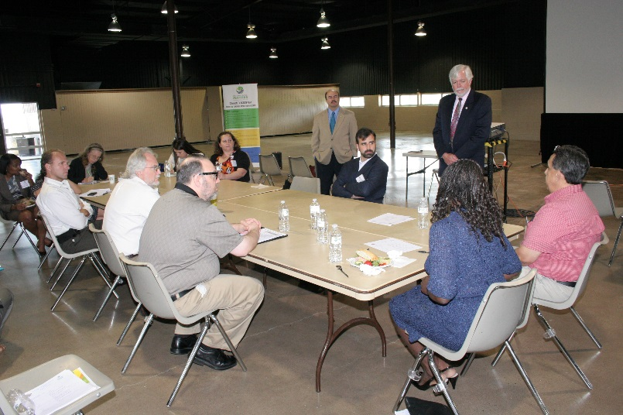
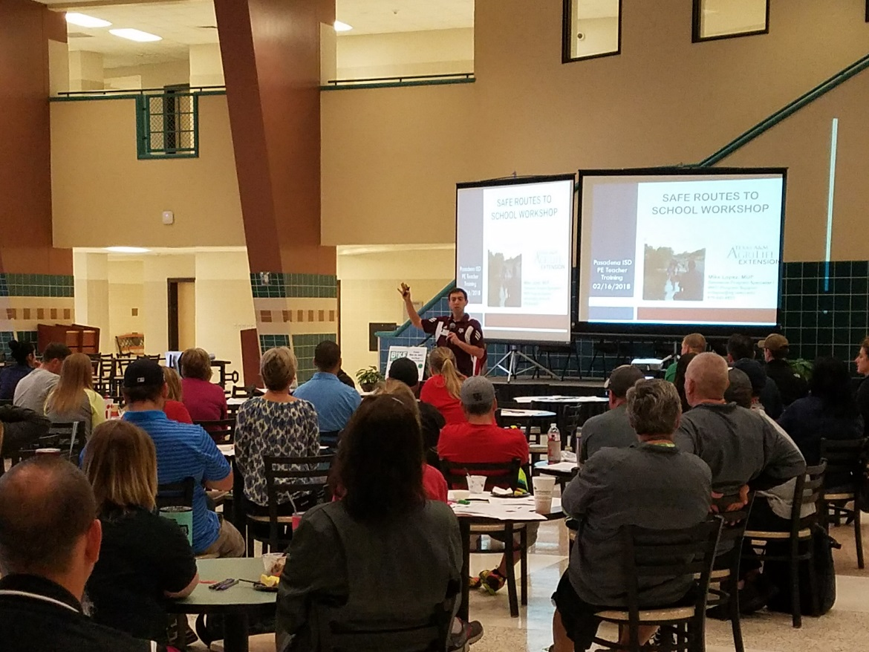
Education
Notes:
Katie C

Slide 10
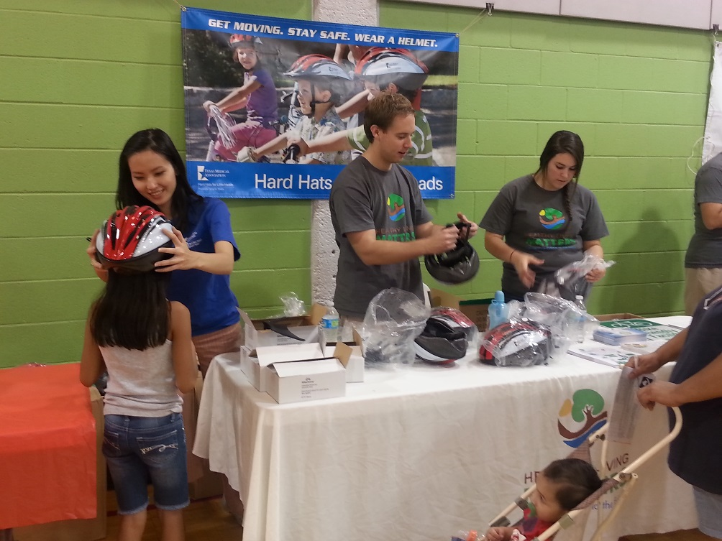
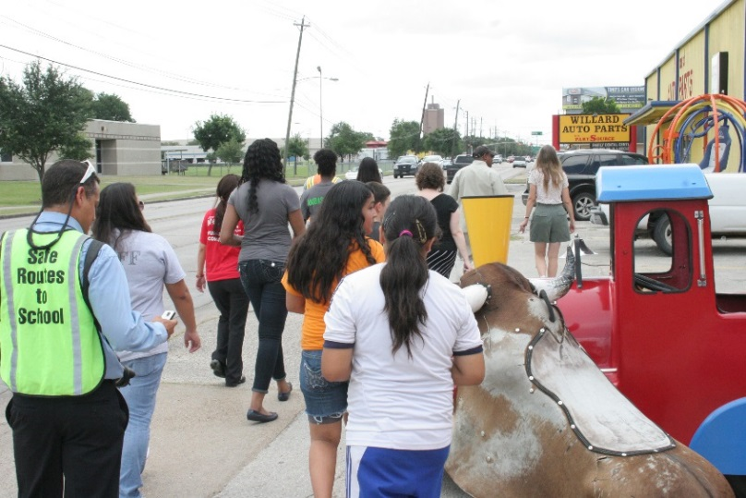
Education
Notes:
Katie C

Slide 11
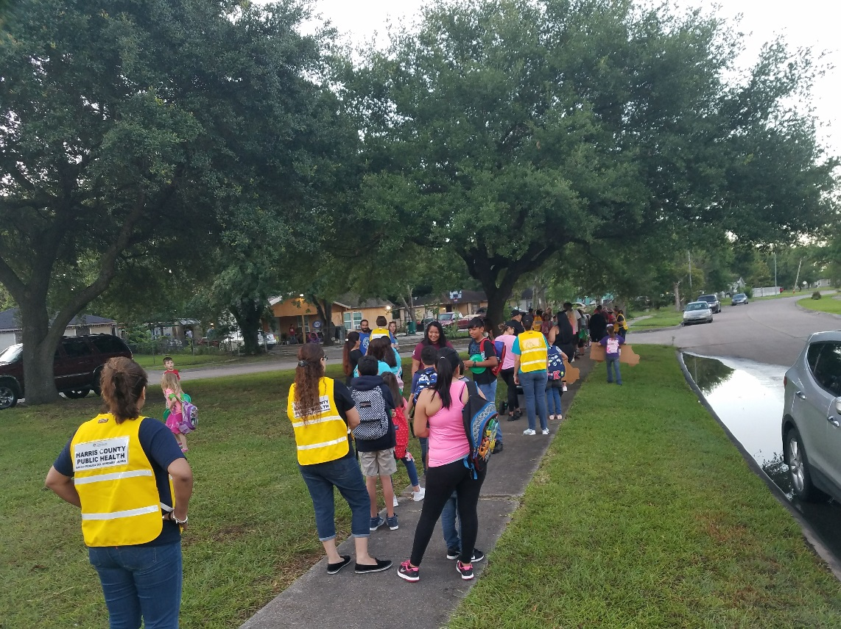
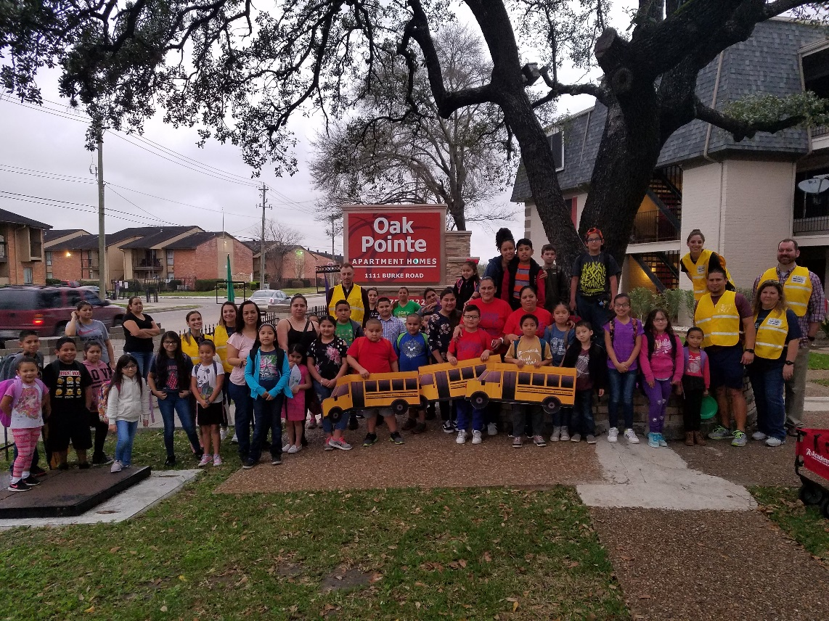
Engagement
Walk to School Days - https://www.youtube.com/watch?v=C8K3qqGBMsU&feature=youtu.be
Notes:
Katie C

Slide 12
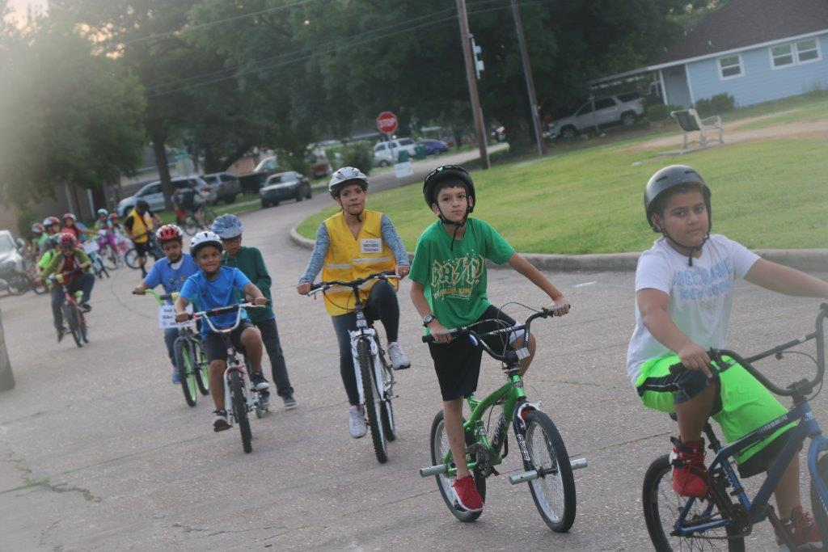
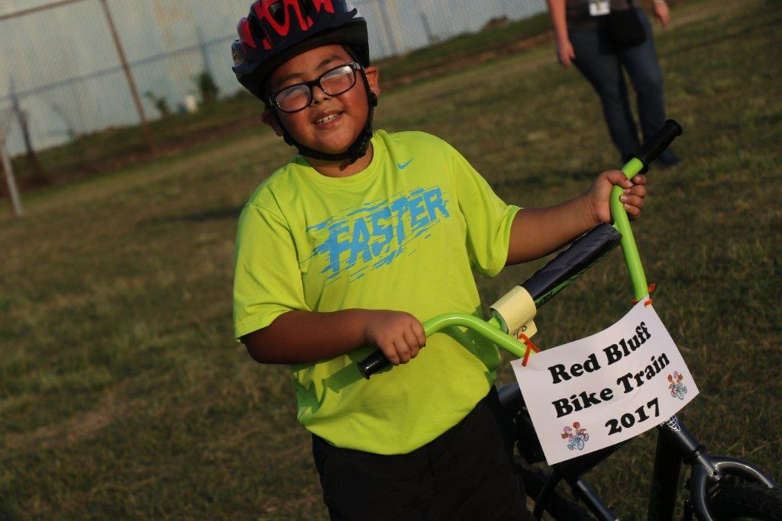
Engagement
Bike to School Days – https://www.youtube.com/watch?v=Ri03XvQMr9g
Notes:
Katie C

Slide 13
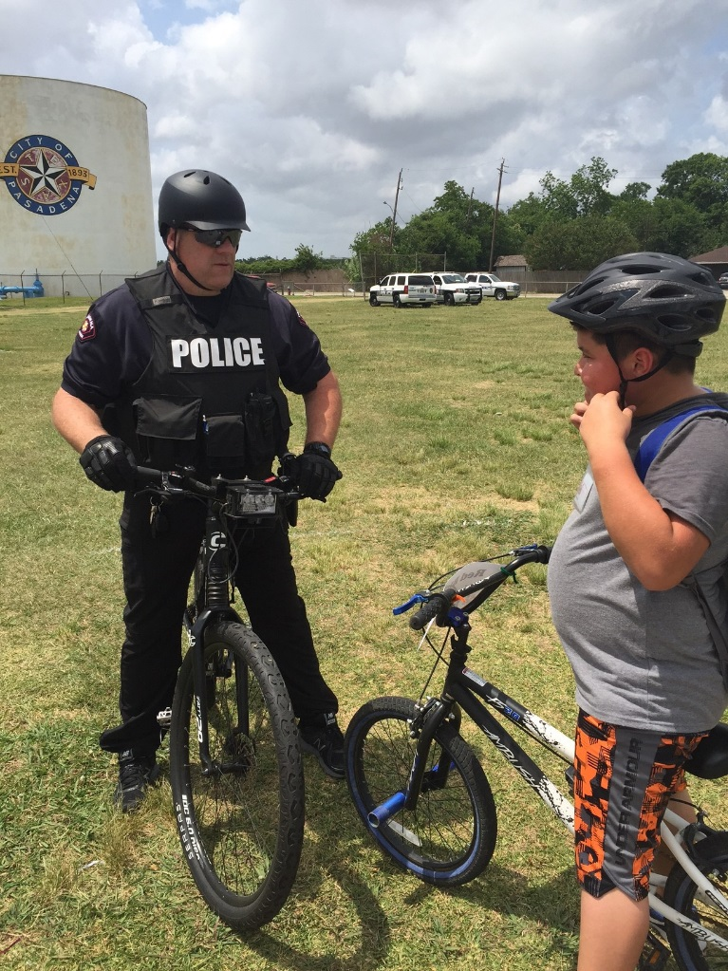
Enforcement
Notes:
Katie C

Slide 14
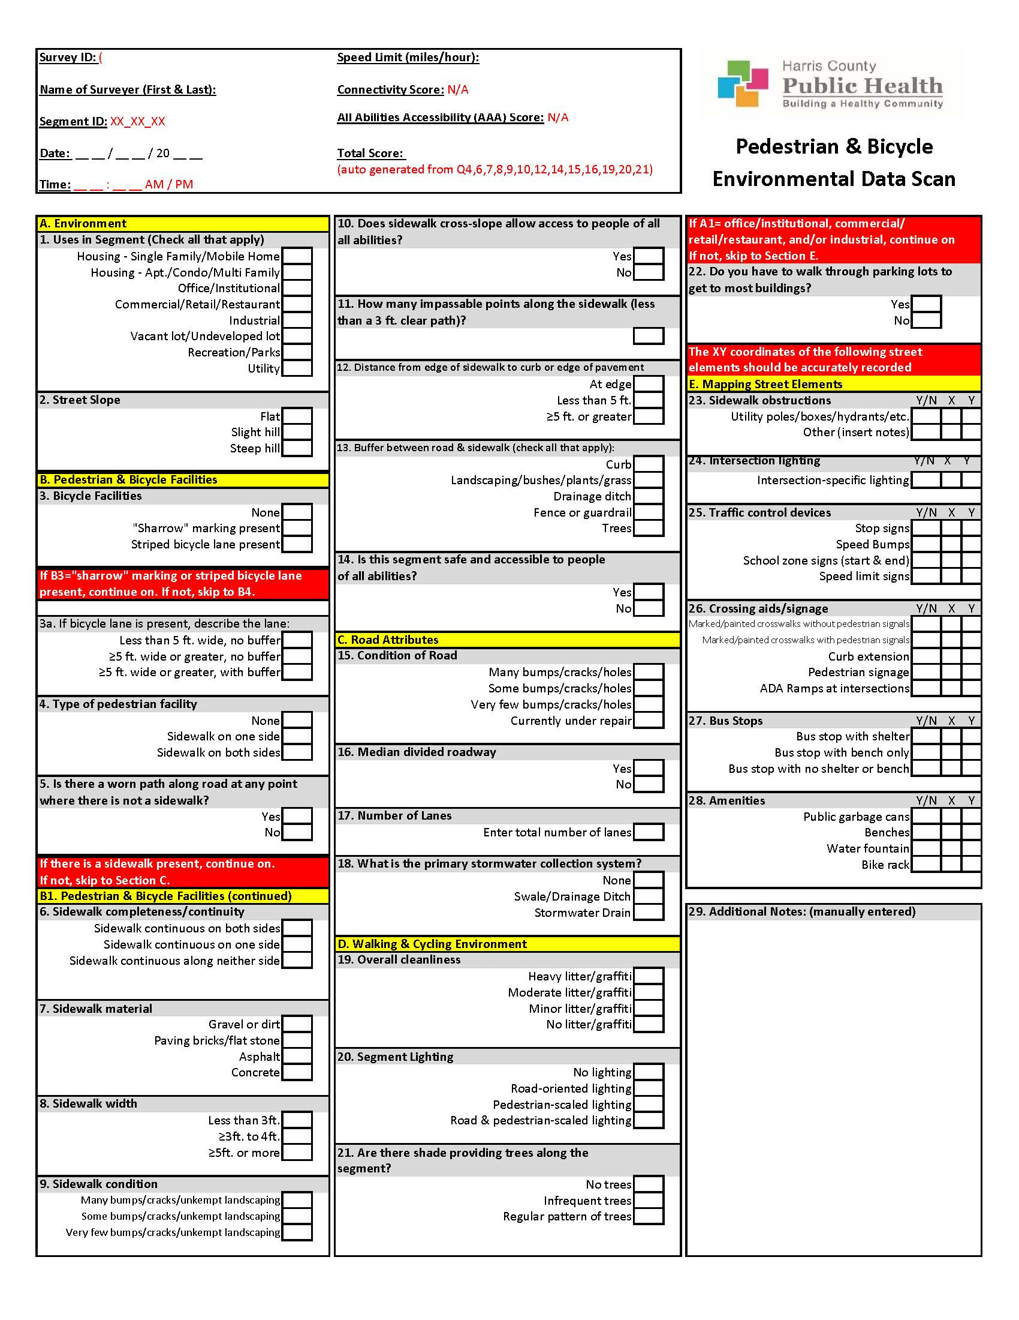
Evaluation
Notes:
Katie C
Built Environment and Food Access Assessment (2013)
Environmental Scans (2017)
Parent Perception Survey

Slide 15
The E’s of SRTS | Who can help with this?
Education Inform of the benefits of SRTS and how to remove barriers to walking/biking | Police department Advocacy groups Regional transportation organization
Engagement Showcase that walking and biking to school is fun and easy | School staff Community resources Grassroots initiatives
Enforcement Promote laws and rules to make walking and biking safe | Police Department Animal Control Safe Kids Coalition
Engineering Improve the built environment to make it safer to walk and bike | City Planners Public works Developers/Property Owners Funders
Evaluation Conduct assessments that tell us what works, what doesn’t work, and what is needed | Academic institutions Departments of public health Traffic engineers

Slide 16
Safe Routes Pasadena Partners
Safe Routes to School is supported by the Pasadena Vibrant Community. The Pasadena Vibrant Community is an initiative of The University of Texas MD Anderson Cancer Center made possible by an investment from and collaboration with Shell Oil Company.
Notes:
Katy O
Pasadena Independent School District
Harris County Public Health: Healthy Living Matters Initiative, Built Environment Program
City of Pasadena: Planning, Parks & Recreation, and Police Departments
The University of Texas MD Anderson Cancer Center

Slide 17
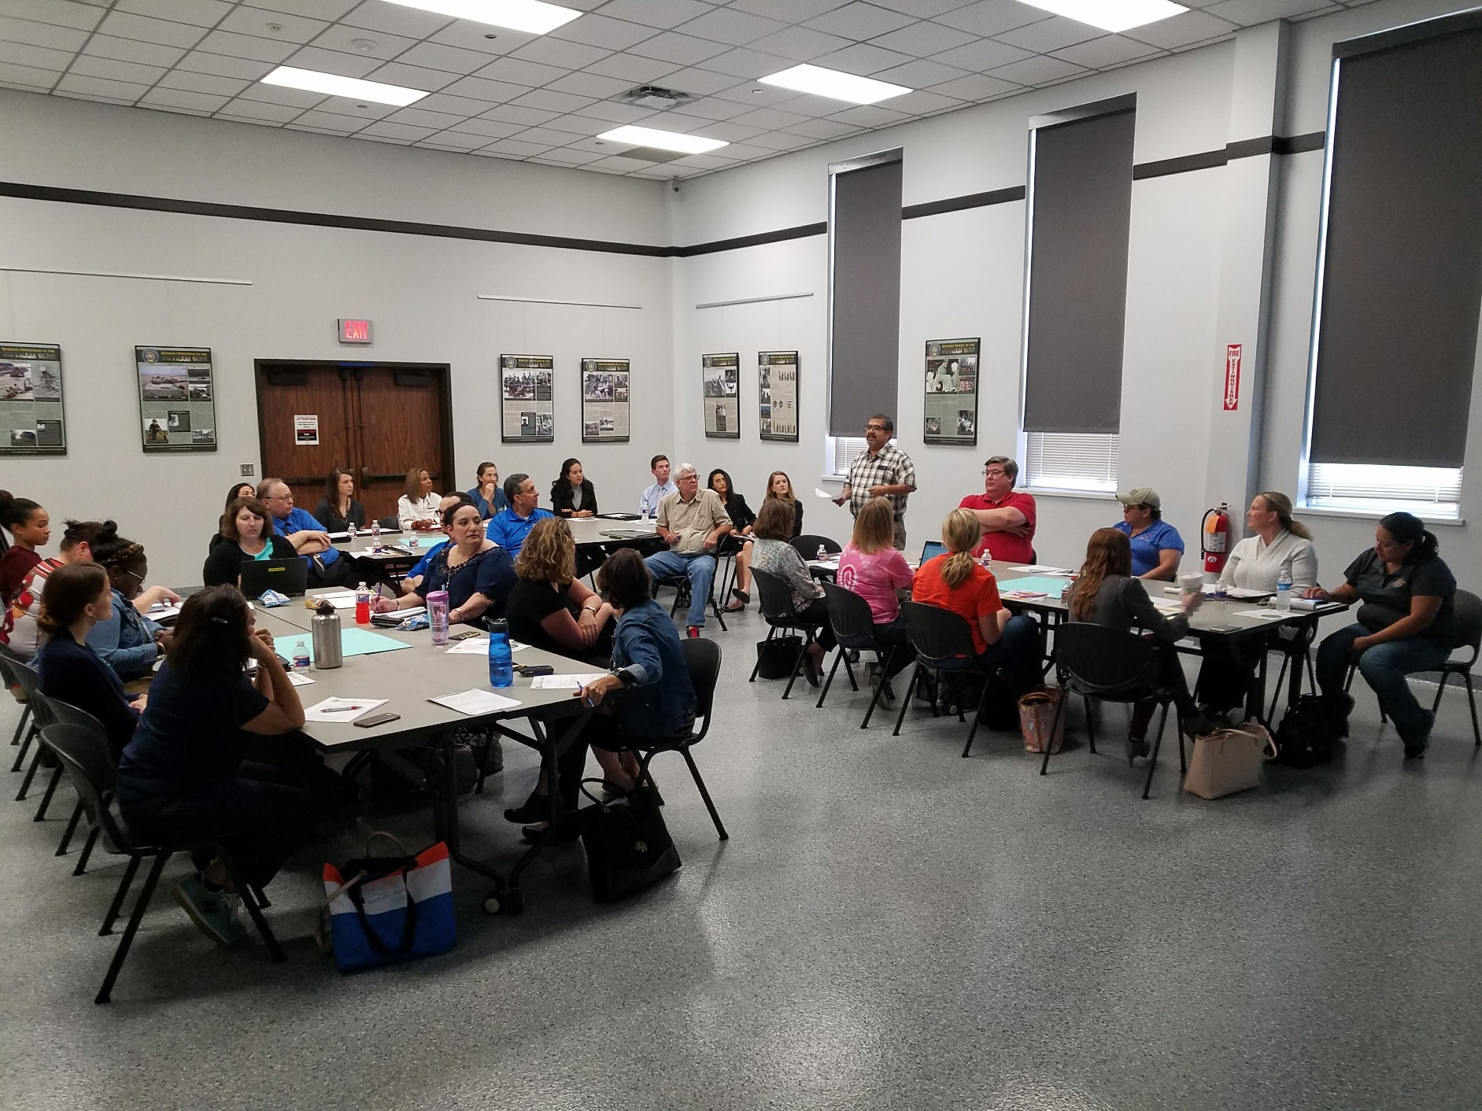

Slide 19
Objectives
Attendees will:
Identify key stakeholders to include when working on Safe Routes to Schools
Review examples of successful strategies for each pillar of SRTS
Review lessons learned from our work developing the SRTS plan and implementing practices around the 6 E's

Slide 20
Questions?

