Slide 1


Slide 2
What is Families Leading Change?
A Family-led Statewide Grassroots Movement to Improve Education
Local Communities and at the State Level.

Slide 3
Our Goals
Creating a Broad Statewide Steering Committee
Lifting Up a Menu of the Great Things Already Happening Across the State
Training Parents on Leadership Skills and the Education System- Even Basic Communication to Schools!
Conducting a Mini-Grant Process
Training Parents in Policy & System Change on a Local or State level

Slide 4

What problems are we trying solve?
We want to see more families involved in meaningful change in their local schools
We want to have more families' voices heard at the state level when decisions about education are being made
We know policy is just a piece of paper…Change is made only when the people move into action.

Slide 5

Our Mini Grant Teams:
Parent , Student, & Family Led projects
53 Grants Statewide
29 WV Counties

Slide 6
How do I…
Run for School Board
Help Create An Entrepreneurial School
Recommend Alternatives to Discipline
Start a Circle of Parents Group
Advocate for Community Schools
Support School Based Mental Health
Expand Breakfast and Lunch Programs
Initiate and Create a Policy

Slide 7
What Would You Change if You Were Governor of Your State?
Question:

Slide 8
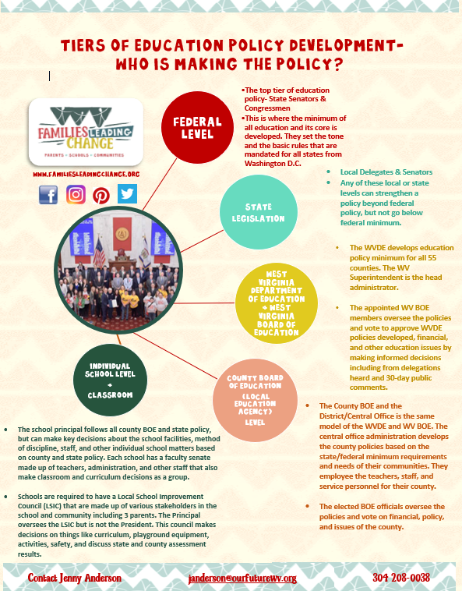
Who is making our policy?

Slide 9
How did we create change?
Try This WV- Community
Families Leading Change- Schools
Types of Change We Look At Impact:
System
Policy
Environmental
What are the possible Economic Changes
Mini Grants and Resources: Know the Policy!
WV Parents 4 Wellness Network Website

Slide 10
Our Policy Resume
Feed to Achieve
Move to Improve
Shared Use
*WV School Nutrition Policy 4321.1
*WV Shared Table
Working on Now for 2019:
Mental Health in Schools
WV Summer Feeding For All
We Put Parents & Students at the Table

Slide 11
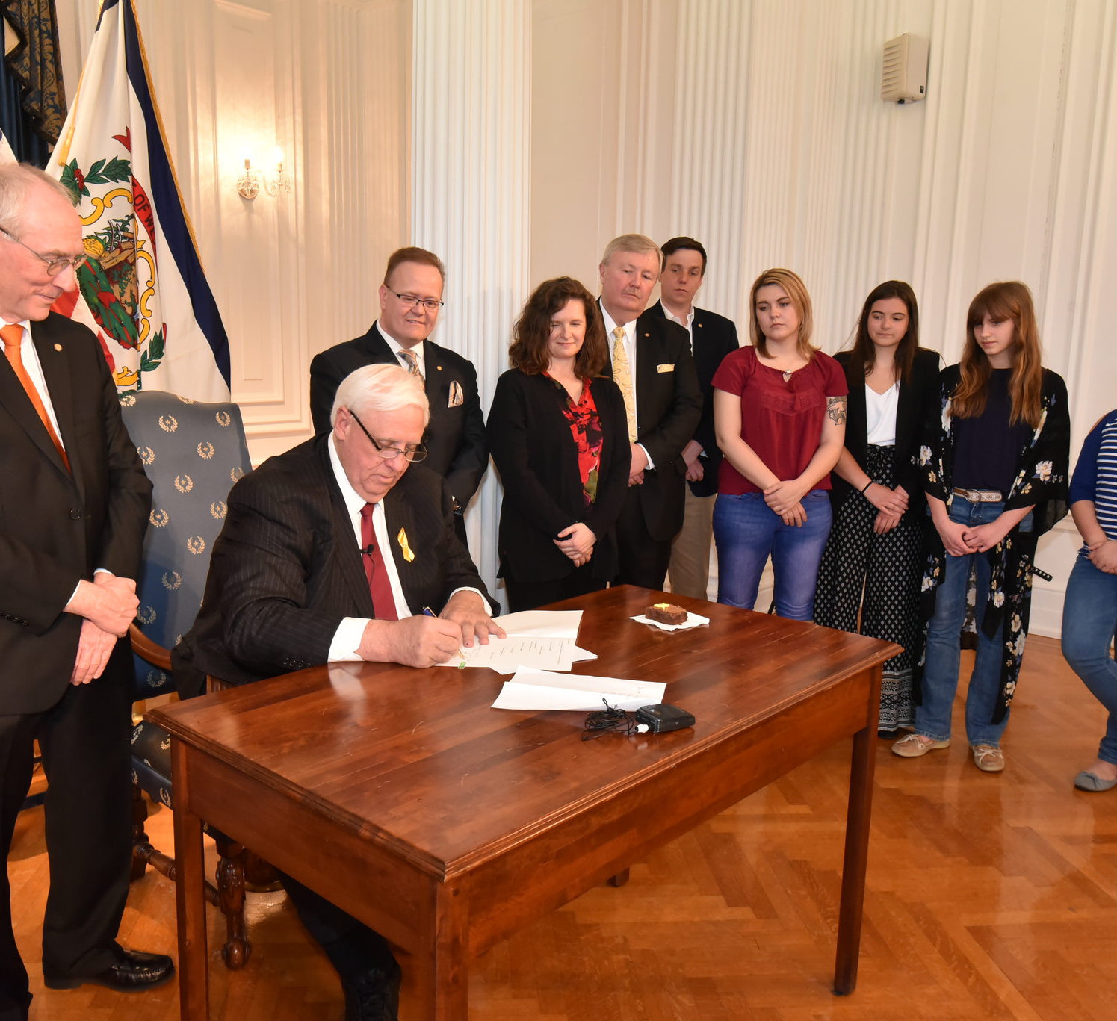
WV Shared Table

Slide 12
Step One
You have an idea that fuels and creates change. It doesn't have to be earth shattering or a policy for world peace kind of idea. It starts with an observation in your community.
Survey the need
HEAR your folks concerns, understand and empathize, and most importantly
Feel the passion and motivation rise up inside you to help create that change.
#BeTheChange

Slide 13
Step Two
Research the subject of the policy. See what you can find any policy guidelines that already exist on the subject on a national, state or local level.
Look for articles, news stories, or documents on the subject. There may not be anything out there and you may just be a pioneer, but chances are there is something out there that is relevant to your policy.
Start compiling a binder to tell a story.
Find individuals, groups, and organizations that are already advocating for your policy. Contact them if you have any questions or join forces!!.
Lastly, create a one page goal sheet with bullet points that breaks down your overall goals and smaller goals that you are trying to achieve.

Slide 14
Step Three
Organize & Mobilize!!

Slide 15
Build Relationships
Get others to join. Be strategic by going for the easiest supporters first. People are more likely to join you if they have personal contact with you. Spread your idea through any/all of the following avenues:
As a group identify who else you know who might be interested and what groups your group has access to that might support you
Talk to people on the street and collect contact information from supporters
Post your idea on forums online and set up a website/blog where people can join you
Use local media (don't forget about community television, radio, and papers which are great for launching an idea you can't get in the mainstream media).
Give people concrete steps from your action plan of how they can help. Start with easy things that a lot of people will do, and gradually invite them to become more involved until a few will want to be leaders with you and your initial group.

Slide 16
Policy Activity!!!
Identify what it is you care about. Write down "the problem"
Identify who you know who also cares about this problem.
Identify who may “push back”
What’s the Pitch for the Solution?

Slide 17
Q & A

Slide 18

We ask parents & students:
Imagine you had $2,000

Slide 19

How to keep in the FLC Loop…

Slide 20
Jenny Anderson
304 208-0038 janderson@ourfuturewv.org
Families Leading Change
Summit and Fun Fest
October 26th & 27th
Fayette County

