Slide 1
Illinois Catch Onto Health Consortium: A Whole Community, Whole School, Whole Child Strategy for Southern Illinois
Jeffrey Franklin
Illinois Delta Project Director

Slide 2
Healthy Southern Illinois Delta Network
Mission: Transforming Southern Illinois into a Region that Supports and Enhances Healthy Living
www.HSIDN.org
Goal:
Create infrastructure leading to policy, systems & environmental changes for a healthy southern Illinois.
Prevent and control overweight/obesity related chronic disease.
Reduce tobacco use and eliminate exposure to secondhand smoke.
Promote high impact clinical preventative services.

Slide 3
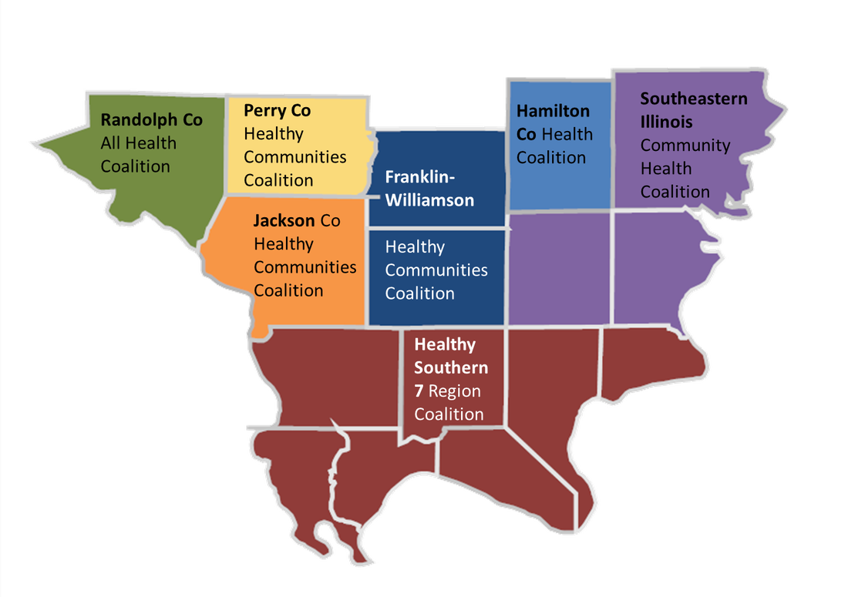
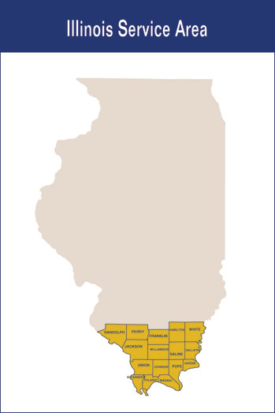
Illinois Delta Network Illinois CATCH on to Health Consortium

Slide 4
Illinois CATCH on to Health Consortium
Vision
ICHC will build sustainable school environments that positively impact the health of children and the communities in which they live
Mission
Illinois CATCH on to Health Consortium is dedicated to providing children with the knowledge and skills to make healthy choices for a lifetime.

Slide 5
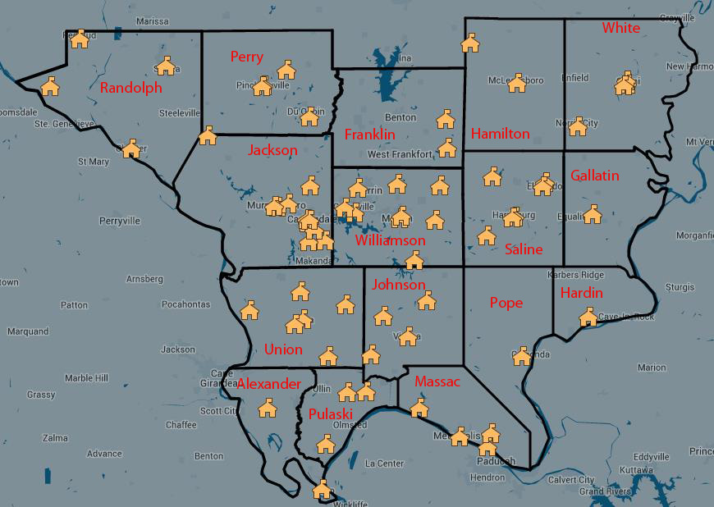
Working Together To Improve Southern Illinois
Over 70 schools in the southern 16 counties have implemented at least one component of CATCH
Notes:
Jeff please add number missing above
____ are CATCH schools

Slide 6
Table 1: County Health Rankings (2014) – Health Outcomes and Factors – Southern Illinois Delta Counties
POOREST HEALTH OUTCOMES |  | POOREST HEALTH FACTORS |  | POOREST HEALTH BEHAVIORS |  | POOREST CLINICAL CARE |  | POOREST SOCIAL AND ECONOMIC FACTORS |  | POOREST PHYSICAL ENVIRONMENT
Alexander | # 1 | Alexander | # 1 | Alexander | # 2 | Hamilton | # 1 | Alexander | # 1 | Randolph | # 3
Gallatin | # 2 | Pulaski | # 2 | Saline | # 3 | Hardin | # 3 | Pulaski | # 2 | Johnson | # 4
Franklin | # 3 | Hardin | # 5 | Massac | # 5 | Gallatin | # 5 | Hardin | # 7 | Pulaski | # 8
Saline | # 4 | Saline | # 8 | Pulaski | # 7 | Pulaski | # 9 | Franklin | # 9 | Gallatin | # 9
Pulaski | # 5 |  |  |  |  | Pope | # 10
Massac | # 6
Hardin | # 9

Slide 7
Table 2: County Health Rankings (2014) – Health Behaviors and Clinical Care – Southern Illinois Delta Counties
SMOKING * *(BRFSS Round 5) | OBESITY | PHYSICAL INACTIVITY | DIABETIC SCREENING
Number and Percent of Southern Illinois Delta Counties Worse Than Adult National Benchmark
16/16 100% | 16/16 100% | 16/16 100% | 14/16 88%
National Benchmark 13% | National Benchmark 25% | National Benchmark 21% | National Benchmark 90%
US Median 21% | US Median 30% | US Median 28% | US Median 84%
Illinois 18% | Illinois 27% | Illinois 23% | Illinois 85%
So. IL. Delta Counties Range 15.2% - 27.5% | So. IL. Delta Counties Range 28% - 34% | So. IL. Delta Counties Range 23% - 32% | So. IL. Delta Counties Range 79% - 91%
http://www.countyhealthrankings.org/sites/default/files/resources/2013%20National%20Benchmarks.pdf, retrieved March 2016.

Slide 9
Illinois Delta Region Obesity Rates - 2014

Slide 10
Obesity: the impact
Health
Fiscal
Social
Quality of Life
Life Expectancy
Emotional
Psychological

Slide 11
Obesity: Academic Impact
Lower standardized test scores
Increased absence and tardiness
Increased behavioral problems
Poor emotional functioning
Inability to concentrate
Decreased psychosocial functioning
Increased anxiety and depression
Vulnerability to bullying

Slide 12
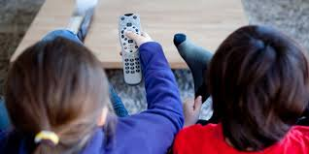
Growing up in an Obesogenic Environment
Regardless of weight status, most American children are:
Poorly Nourished
Physically Inactive or Underactive
Sleep Deprived

Slide 14
We believe in these Basic Assumptions
Behavior change is influenced or determined by the environment –
because environments value and reward certain behaviors.
&
To address the obesity problem we need to affect an environmental change – to create an environment that teaches, reinforces and rewards physical activity and healthy eating habits.
Notes:
Script: We just got through talking about specific things related to what you do to create a healthy learning environment for kids. The reason we are emphasizing environment is because CATCH operates under the basic assumption that behavior is influenced by the environment; because environments are set up to value and reward certain behaviors.
Would you all agree with this basic assumption, that our behavior is influenced by our environment? <Acknowledge that you’re getting agreement from participants.>

Slide 15
What is CATCH?
CATCH stands for Coordinated Approach To Child Health (formerly known as the Child and Adolescent Trial for Cardiovascular Health)
It is part of a Coordinated School Health Program designed to prevent sedentary behavior, poor dietary choices, and tobacco use through changes at the elementary school level

Slide 16
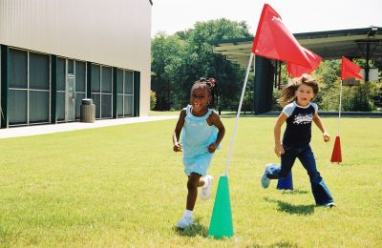
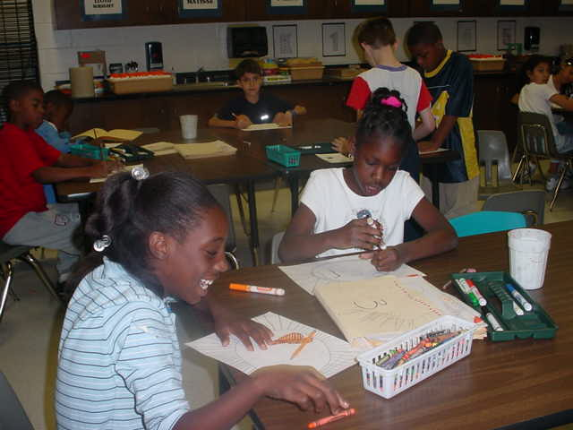
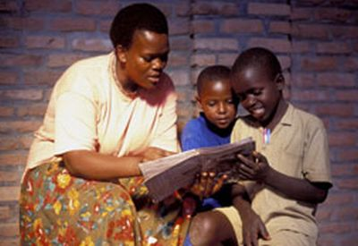
The CATCH Components
Classroom Curriculum
Physical Education
Child Nutrition
Family

Slide 17
What are the Core SE Competencies?
Recognizing one’s emotions and values as well as one’s strengths and limitations
Making ethical, constructive
choices about personal and social behavior
Managing emotions and
behaviors to achieve
one’s goals
Self-awareness
Self-management
Responsible decision-making
social &
emotional
learning
Social awareness
Relationship
Skills
Showing understanding and empathy for others
Forming positive relationships, working in teams, and dealing effectively with conflict
Graphic: CASEL

Slide 18
Strategies for Success
Formation of School Wellness Committee – Meets on a regular basis
Capacity Building
Policy, Systems, and Environmental Focus
Social Determinants of Health
CDC’s School Health Index Assessment
Develop Action Plan – Wellness Policy Development
Staff Wellness Programs
Curriculum & Equipment Purchase
Family Wellness Events – Community Involvement Strategy
Lesson Modeling
Bullying Prevention / Social and Emotional Learning On-going Newsletters
Student Involvement

Slide 19
Strategies for Success
Pre-Kindergarten Implementation
Leverage funding
After-School Component
Professional Development Opportunities
C.A.T.C.H. (Coordinated Approach to Child Health)
Mental Health First Aid (Youth and Adult)
Signs of Suicide
Physical Education
School Lunch Rocks (Professional Development for School Chefs)
Community Engagement – i.e. Forums
Farm-to-School / Local Farmer Engagement
Summer Youth Programming

Slide 20
What does the research say?
Brains after sitting quietly
Brains after 20 minute walk
ROI: Studies show children scored a full grade-level higher in reading comprehension after physical activity than after a period of rest
Average composite of 20 student brains taking the same test
Research/scan compliments of Dr. Chuck Hillman University of Illinois: Hillman, C.H., et al. (2009) The effect of acute treadmill walking on cognitive control and academic achievement in preadolescent children. Neuroscience. 159(3):1044-54.
Notes:
Physical activity – which can be maximized through physical education – also improves aspects of brain function related to academic performance in school. These images demonstrate the differences in brain activity, as indicated by the red/yellow areas, for 20 students while taking the same test.
The brain image on the left is a composite image of students who sat quietly before taking the test; the brain image on the right is the same 20 students taking the test after a 20 minute walk. You see that the brain on the right is much more “lit up”, indicating that the student is ready to learn.
In fact, students who regularly are scheduled for daily PE directly before the courses where they’re struggling most academically (math, literacy), have been shown to demonstrate growth a full grade-level higher than their peers. Now imagine what their brain would look like after an Enhanced P.E. class!

Slide 21
Enhanced PE
Goal
All Illinois K‐12 school students will participate in daily, high‐quality physical education (PE) in order to promote academic achievement and realize the lifetime benefits of exercise and fitness.
Enhanced PE
Increasing the amount of moderate‐to‐vigorous physical activity (MVPA) that students receive during P.E. class to at least 50% of class time.

Slide 22
Enhanced pe & catch
Enhanced PE:
Leads to better learners, better behavior in the classroom, and better student health.
Changing policies, practices, and curricula so that students spend more time in moderate to vigorous physical activity (MVPA) during each class.
Schools will see a return on investment on the dollars and time dedicated to P.E. and physical activity.
CATCH
Has researched-based curriculums and equipment to create healthier students and better learners.
Emphasizes wellness policies and committees, completion of the School Health Index, SOFIT evaluations, etc.
Schools have a designated CATCH trainer who will conduct follow-up interviews with staff, conduct evaluations and share results with school staff.
CATCH is a method to helps meet the Enhanced PE Standards

Slide 23
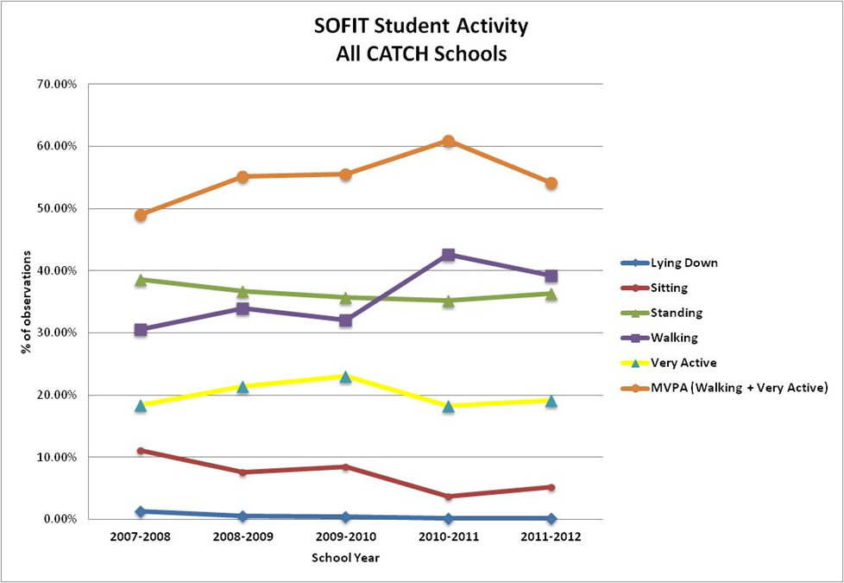
School report cards

Slide 25
Conclusions and Recommendations
WSCC model enhances school connectedness, student health, staff and family wellness, and educational outcomes.
CATCH demonstrated that behaviors such as eating foods high in saturated fat and physical inactivity can be changed.
A coordinated school health program can be implemented in schools & it is possible to broadly disseminate a coordinated program.
Notes:
Just a couple of concluding thoughts/remarks: coordinated school health program is possible and it’s something that can enhance not only students’ health, but the school environment and other factors, too.
CATCH is a program that works, we can change kids’ behavior if we coordinate our efforts in delivering healthy messages to the kids.

Slide 26
For More Information
Jeff Franklin
SIU Medicine - CRHSSD
jfranklin@siumed.edu
618-453-1251

