Slide 1



This presentation was supported by Grant/Cooperative Agreement Number 5 NU58DP005488-03-00 from the Centers for Disease Control and Prevention. Its contents are solely the responsibility of the authors and do not necessarily represent the official view of the Centers for Disease Control and Prevention. The findings and conclusions presented in this publication are solely those of the authors and do not represent the official position or policies of the US Department of Health and Human Services, Centers for Disease Control and Prevention; nor does the mention of trade names, commercial, or organizations imply endorsement by the U.S. Government.

Slide 2

Nutrition – Physical Activity – Screen Time – Farm to ECE
Environment – Practices – Site Based Policies

Slide 3

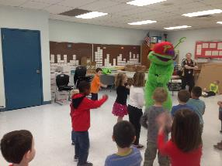
WV Healthy Children Project
Targets 2-5 year olds in family childcare homes & facilities childcare centers, and Pre-k/Head Start programs
Overall Goal:
To achieve policy, environment and systems changes for young children, their caretakers and their families

Slide 4
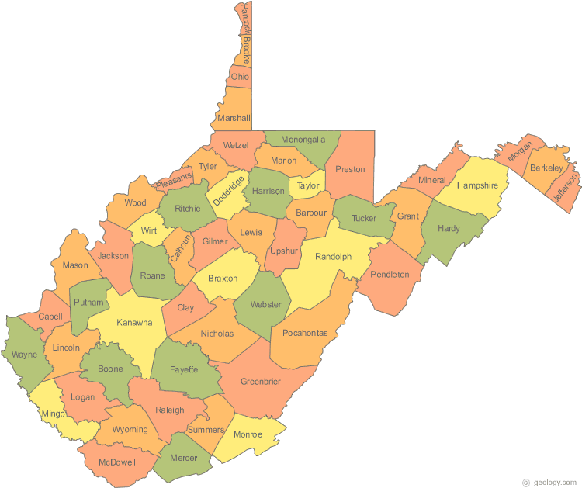
WV Healthy Children Project
3 rural WV counties
  Barbour, Gilmer, Pleasants
  Adult obesity rates > 40%

Slide 5
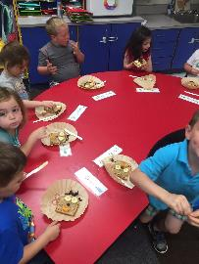
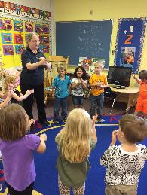
Early Childcare’s Role
60% of children 5 years and younger are in some type of non-parental care 35 hrs per week or more.
Childcare settings should use best practices to shape children’s health behaviors.
Notes:
with more than 40% spending more than 35 hours there each week
child care serves as a home-away-from-home and has the potential to positively influence their health.
Early childcare educators serve as role models for healthy eating and activity, they are the providers of food and outdoor play time, they are educators, and most importantly, they are advocates for healthy children.
This makes the child care environment a unique and important setting for interventions to prevent child obesity.

Slide 6
County Needs Assessment
37 Key Informant Interviews
3 Parent Focus Groups (26 parents)
  Barriers that were uncovered:
    Family commitments, travel time and limited community resources
    Low knowledge and skills in food preparation among adults
    Suboptimal communication about existing opportunities was identified as an issue amenable to change

Slide 7
Figure 1. Themes and Levels of the Social Ecological Model

Slide 8
ECE Provider Needs Assessment:
Farm to ECE
Current Practices
88% educated children about where food comes from
68% cooked/prepared food with children
50% served some locally grown food
Top Concerns
Cost
Purchasing difficulties
Few contacts with local farmers
Lack of prep facilities/equipment
Inadequate storage space for local foods
Food safety

Slide 9
What’s Needed to Advance
Farm to ECE activities
Supplies to get started – curricula/lesson plans, recipes, cooking equipment
Grants/financial assistance
List of local farmers to connect with
Examples of other similar work/programs

Slide 10
Early Care & Education Interventions
Go NAP SACC (self-assessment)
  Best practices (Nutrition, Physical Activity, Outdoor Play & Learning, Screen Time)
    Goal Setting
    Support and Technical Assistance
I am Moving, I am Learning Training & Refresher Trainings
  Classroom Curriculum Enhancement ideas and Indoor and Outdoor Play Resources

Slide 11
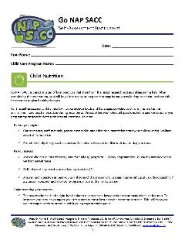
Nutrition and Physical Activity
Self-Assessment for Child Care
(Go NAP SACC)
Best practices
  Nutrition
  Physical Activity
  Outdoor Play & Learning
  Screen Time
Improve practices, policies, and environments
Notes:
Go NAP SACC is based on a set of best practices —
recommendations that stem from the latest research and guidelines in the field
Programs use Go NAP SACC to improve their practices, policies, and environments and meet these best practices.

Slide 12
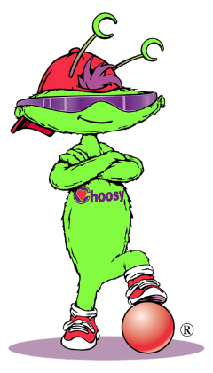
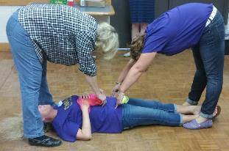
Choosy is our Health Hero!
Choose
Healthy
Options
Often and
Start
Young
I am Moving I am Learning
School readiness with movement
Increase time for moderate-
vigorous physical activity
Improve structured movement
Promote healthy food choices
Notes:
Training and refresher training
Healthy Habits System – tools to integrate IMIL concepts into all learning domains

Slide 13
Human Role Models
Raise your hand if you had 0 sugary beverages this past week.
Keep your hand raised if you ate at least 5 fruits and vegetables every day this past week.
Keep your hand raised if you exercised every day this past week.
Keep your hand raised if you watched less than 2 hours of TV every day this past week.

Slide 14

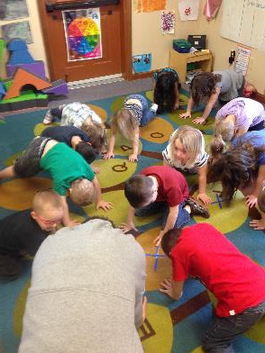
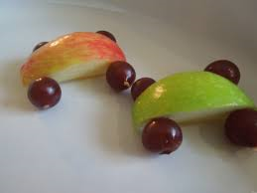
Choosy In-Class Activities

Slide 15
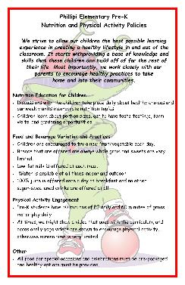
Policy Handbooks
Training and Technical Assistance was provided to providers on what should be included and how to develop a PA & nutrition policy for their site.
Providers completed:
  Nemours Child Care Wellness Policy Workbook
Site specific written policy developed from the workbook

Slide 16
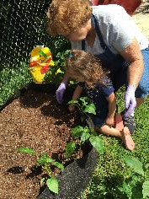
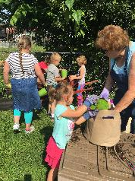
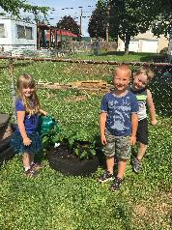
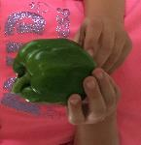
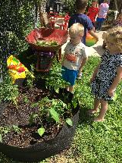

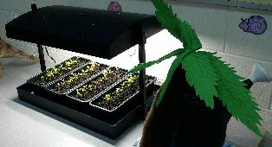
Farm to ECE:
They Will Eat What They Grow

Slide 17
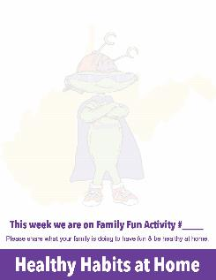

Family Engagement

Slide 18

Choosy
Challenge Health Messages
Give Fun and Consistent Messages

Slide 19
Advisory Committees
One per county
8-10 members each: met ~quarterly
Variety of sectors: education, health, faith-based, local government
Oversaw mini-grant process: facilitated implementation of other activities

Slide 20
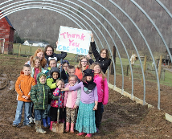
Why?
Focus groups and interviews revealed need for increased opportunities for physical activity for young families, healthy lifestyle education programs, and access to healthy foods
What?
Community Projects - Three one-year funding cycles engaged 15 organizations in 28 projects with funding of $800 to $4000 each (total $65,000)
Who?
5 public schools, 1 private school, 1 church, 2 nonprofits, 2 libraries, 1 childcare center, 2 city parks, 1 conservation group
So What?
Permanent environmental improvements
Community collaboration focused on children’s health
$120,978 + funds leveraged from other grants, etc.
Community Projects:
1 natural playscape
5 age-appropriate playground equipment
2 walking trails
4 garden-based learning/high tunnels
2 outdoor water fountains
3 outdoor pavilions/learning centers
4 community program/events

Slide 21
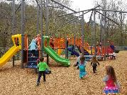

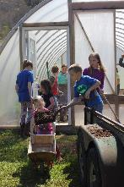
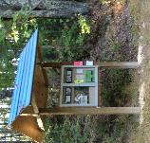
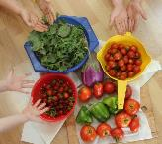
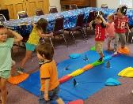
Projects Activate Children, Families & Whole Communities

Slide 22
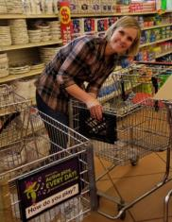
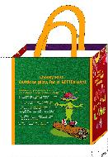
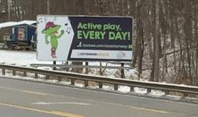
Consistent Messaging

Slide 23
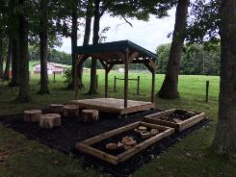
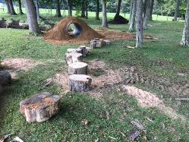
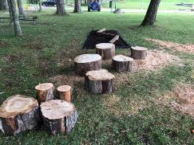
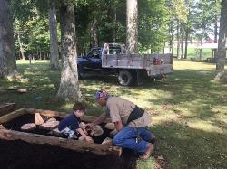
Natural Playscapes

Slide 24
Evaluation:
Measuring Reach & Impact
Reach & Retention
Assessing the School/Childcare Environment
  Environment Policy Assessment and Observation Tool (EPAO)
  Go NAP SACC - goal attainment and BP responses
  I am Moving, I am Moving Practice Survey
Assessing Parent Practices

Slide 25
ECE Reach & Retention
Reach:
PreK/HeadStart: 11/11
Childcare Centers: 3/4
FCCH&F: 11/33
Retention:
PreK/HeadStart: 8/11*
Childcare Centers: 2/3
FCH&F: 7/11
*school consolidation

Slide 26
ECE Provider Demographics
Educational Attainment
  20% - High School
  23% - Bachelor’s
  30% - Master’s
Age
  26% - 24-34
  33% - 35-44
  23% - 45-54
  16% - 55+
100% Female
97% White

Slide 27
EPAO
Total Scores
No significant differences in total nutrition or PA scores across 3 observation points
Subscale Improvements*
Whole grains & low fat meats
High sugar/high fat foods
Staff behaviors – nutrition
Portable and fixed play equipment
Staff behaviors - PA
* Non significant but in positive direction

Slide 28
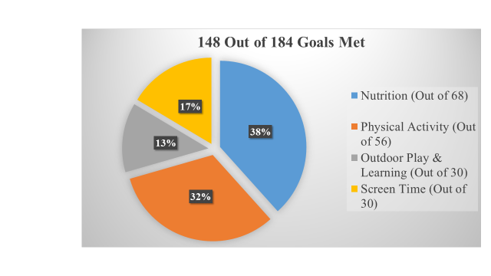
Go NAPSACC Goals

Slide 29

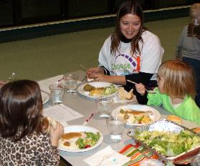
Examples of Goals
Teachers/staff will not eat or drink unhealthy foods in front of children
Increase amount of indoor/outdoor PA to 75 minutes daily
Create indoor play space for activity in inclement weather
Children will help with garden and eat veggies at lunch/snack
Increase physical activity with Choosy music
Add PA policy to center handbook
Send note home to encourage children to bring water bottles
Develop written policies pertaining
to screen time

Slide 30
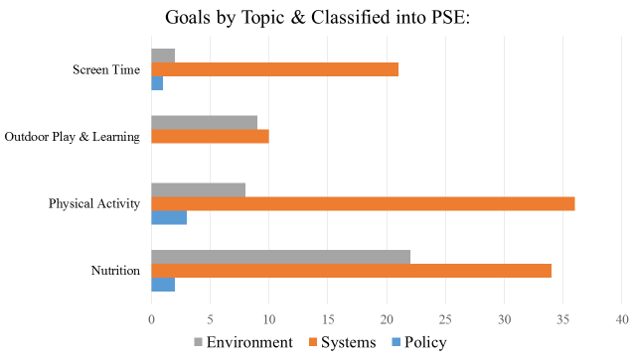
Goals – PSE changes

Slide 31
FCCH&F Best Practices
Nutrition
Vegs offered >2x/day
Vegs rarely/never cooked with meat fat/margarine
High fiber foods >2x/day
100% fruit juice <2xweek
Providers eat/drink same food/bev as children
Children cued to drink H₂0
Family education
PA
PA used during daily routines
Prof development completed >2x/year
Family education

Slide 32
FCCH&F Best Practices
Outdoor Play & Learning
Garden grows food for meals/snacks
Prof development completed >2x/year
Family education
Screen time
< 30 minutes/none daily
Always educational & commercial free
Prof development completed >2x/year

Slide 33
School-Center Best Practices
Nutrition
Dark green+ vegs offered >1x/day
Vegs rarely/never cooked with meat fat/margarine
Fried/prefried meats/fish <1x/week
Children cued to drink H₂0
Family education
PA
Prof development completed >2x/year
Family education

Slide 34
School-Center Best Practices
Outdoor Play & Learning
Path for wheeled toys > 5’ wide
Family education
Screen time
Family education

Slide 35
IMIL Best Practices
PA
Teachers help children learn/practice basic motor skills using self-regulation approach
Teachers are active participants when leading songs/activities with children
Teachers intentional about providing opportunity for children to experience movement vocab with their bodies
Nutrition
Teachers use music to help reinforce healthy nutrition behaviors
Teachers document healthy nutrition choices children make

Slide 36
IMIL Best Practices
Family Engagement
Shares ideas/examples with families to increase PA at home
Includes and welcomes families to participate in their child’s classroom activities that focus on health & physical development

Slide 37
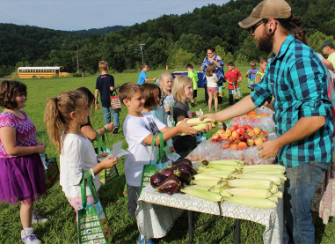
Farmer Perspectives
Following the markets, farmers were sent surveys about their participation. About 50% of the farmers participating in the markets responded to the survey.
Benefits
“Connecting with future shoppers and adults who were current or potential shoppers at my regular market. Educating kids about fresh foods in season, earning extra income”.
Barriers
“Transporting tables, containers for marketing, keeping produce at correct temperature during transport and when set up at the market”.
Unanticipated Benefits
“Several kids, after they came to the market, had their parents bring them back. Some were looking for cucamelons. Others looked for pears and potatoes. It was a positive thing that the parents brought the kids with them”.
Interested in… | Agree/ Strongly Agree
Hosting regular markets at schools | 61%
Hosting regular markets at childcare centers | 56%
Working with schools/childcare centers on gardening – | 56%
Selling products directly to schools/childcare centers for meals | 61%
Piloting CSA to school/childcare | 72%

Slide 38
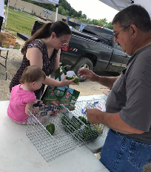
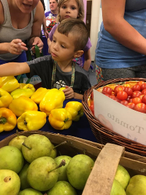
Farm to ECE Parent Evaluation
A majority of parents agreed or strongly agreed with the following statements about their child:
Ate the produce purchased with the Kids Coupons (91%)
Is more excited about eating fruits and vegetables since participating (77%)
Talks about fruits and vegetables more since participating in the project (71%)
Can identify more fruits and vegetables (78%)
Was excited about the market (95%)

Slide 39
Choosy Health Challenge Parent Survey
Read all/most of the post cards to child (78%)
Completed all/most of activities on post cards (56%)
Very likely to now sit down together for a meal (89%)
Very likely now to have conversations during meal time (89%)
Very likely now to turn off electronics during meals (62%)

Slide 40
Comments like these make Choosy smile!
My son is more willing to try new things since meeting Choosy. He doesn’t always like them but at least he’s trying.
[child’s name] will give us Choosy statements at meal time-he loves the music.
Loved some of the ideas. [child’s name] was excited by meals that were his favorite color and rainbow.
Choosy program is amazing. We enjoyed the family time and being active together.

Slide 41
Lessons Learned from NAPSACC and IMIL Hybrid
Early Childhood Educators are receptive to training, resources, support.
  They want a variety of resources that can be adapted for their classroom.
NAPSACC and IMIL intervention strategies provide practical info, skills, and resources.
IMIL helped to bring NAPSACC best practices to life.
The more the better, don’t be restricted by interventional silos.

Slide 42
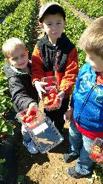
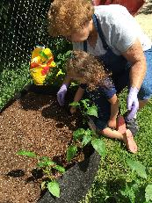

Questions?
This presentation was supported by Grant/Cooperative Agreement Number 5 NU58DP005488-03-00 from the Centers for Disease Control and Prevention. Its contents are solely the responsibility of the authors and do not necessarily represent the official view of the Centers for Disease Control and Prevention. The findings and conclusions presented in this publication are solely those of the authors and do not represent the official position or policies of the US Department of Health and Human Services, Centers for Disease Control and Prevention; nor does the mention of trade names, commercial, or organizations imply endorsement by the U.S. Government.

