Slide 1
Effective Use of Social Media for Advocacy
Steve Kelder, PhD, MPH
Brooks Ballard, MPH

Slide 2
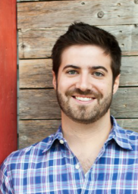
About Us
Steve Kelder, PhD, MPH
Co-Director, Michael & Susan Dell Center for Healthy Living
Associate Regional Dean, UTSPH Austin Regional Campus
Beth Toby Grossman Distinguished Professor in Spirituality and Healing
Professor, Division of Epidemiology, Human Genetics, and Environmental Sciences
Twitter: @DrSteveKelder
Brooks Ballard, MPH
Communications, Michael & Susan Dell Center for Healthy Living
Twitter: @BrooksBallard

Slide 3

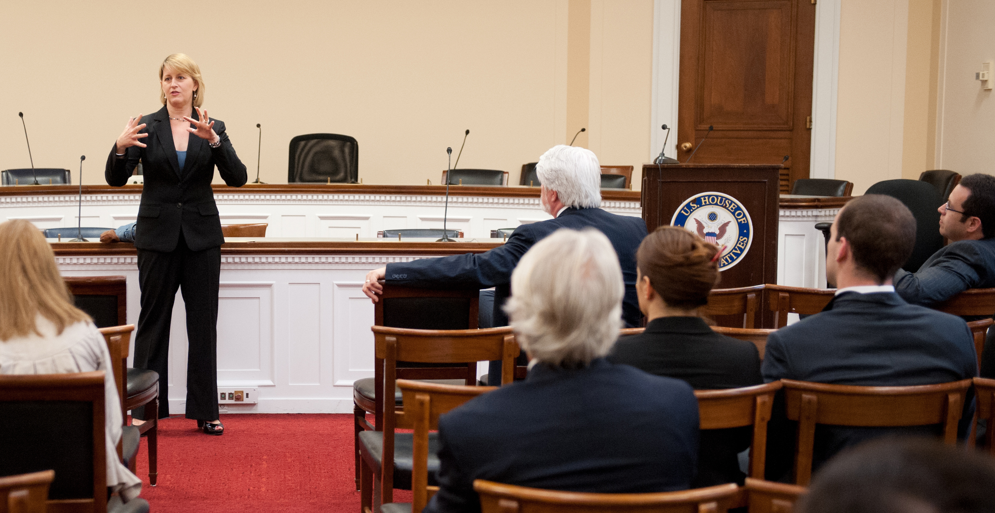
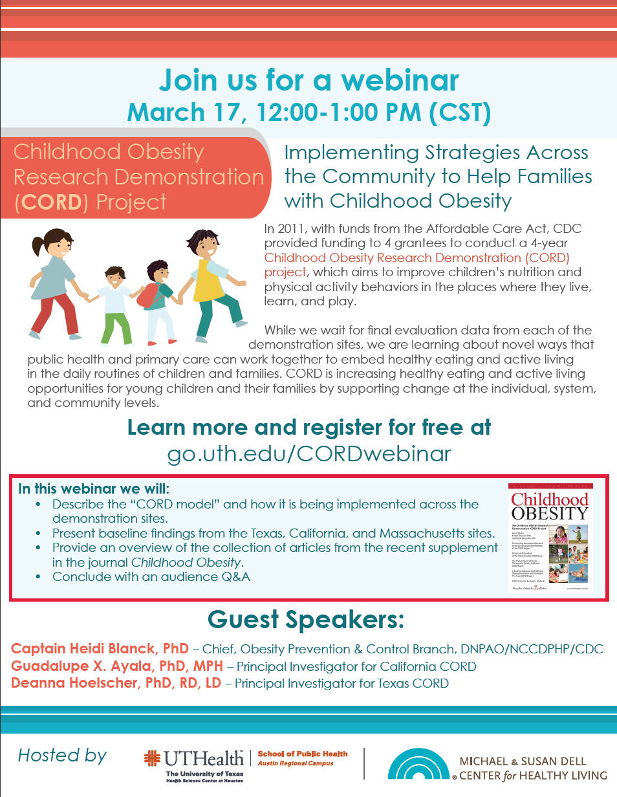
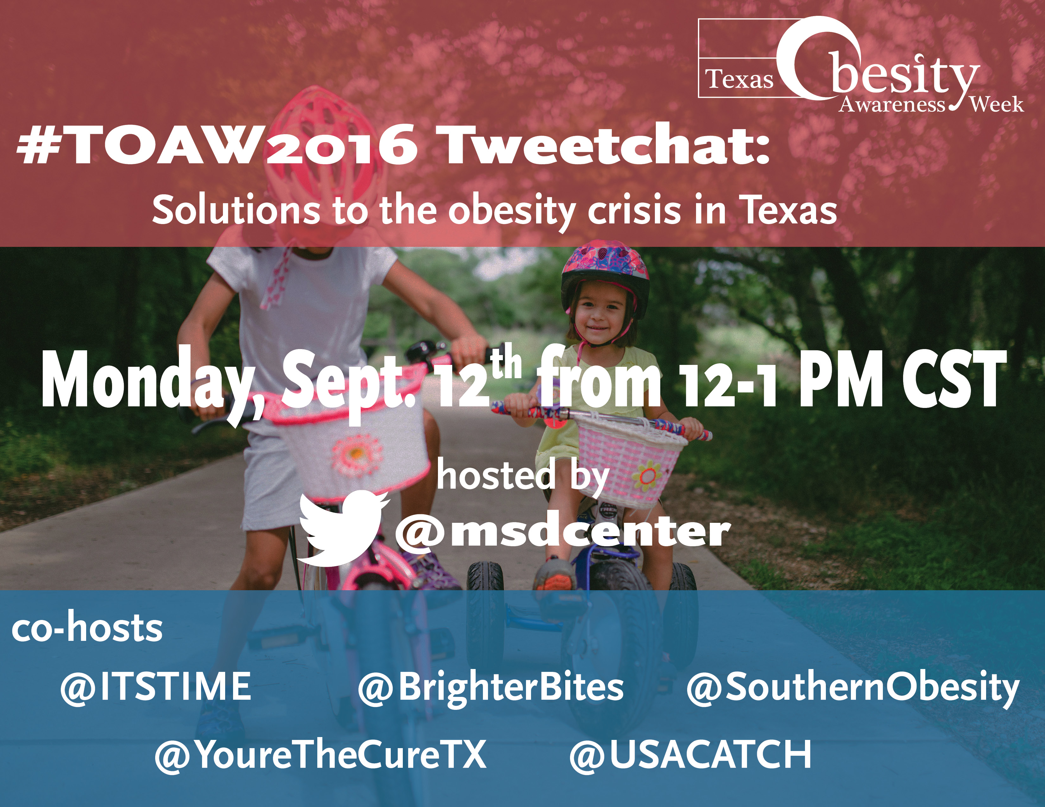
What do we mean by “health advocacy”?
Promotion of health and access to health(y) services and opportunities
  Ex: Health messages, resources, information, policies, programs, and best practices

Slide 4
How does social media fit into health advocacy?
Brief background on how social media has changed advocacy practices
How social media is being used in advocacy
  Public education/Awareness
  Events
  Promoting (organization) values & goals
  Dialogues
  Calls-to-Action

Slide 5
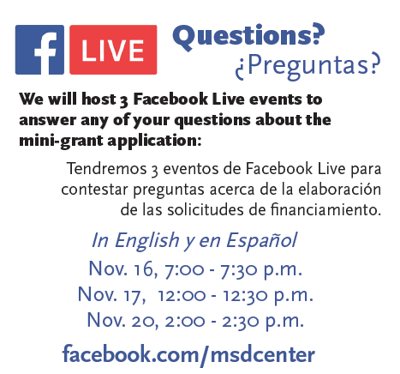

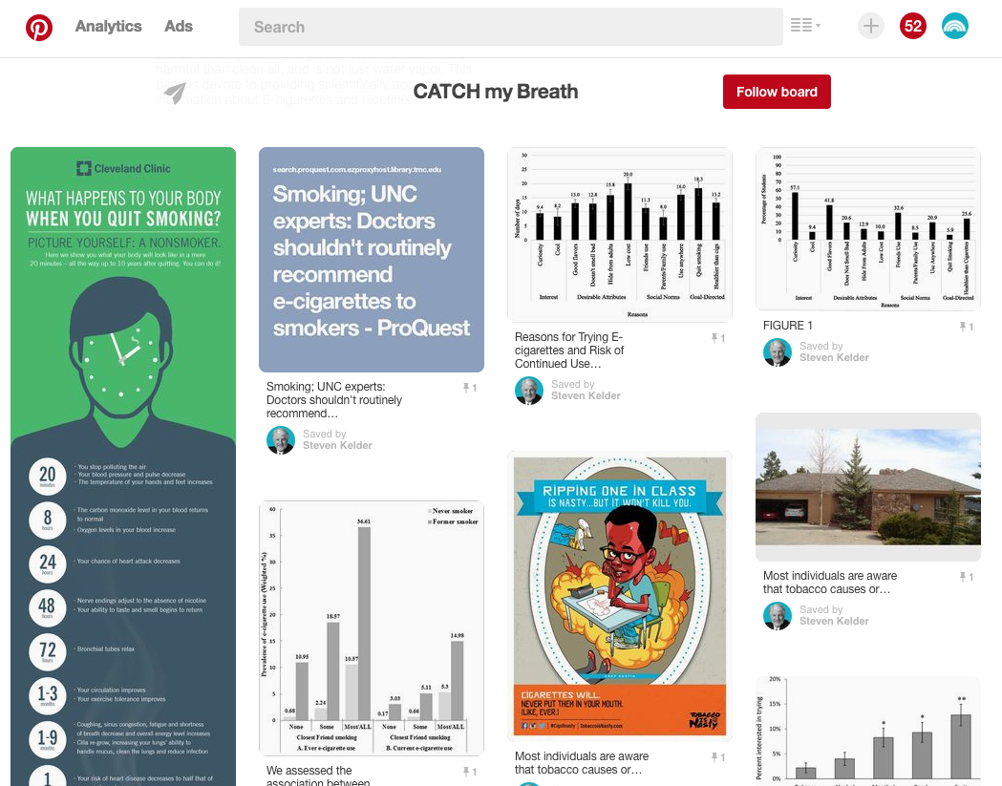


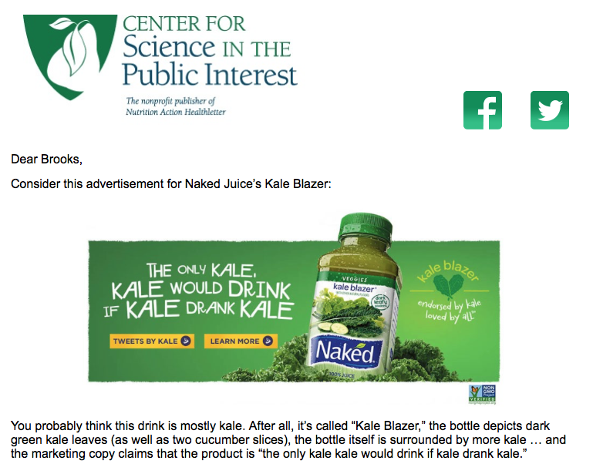
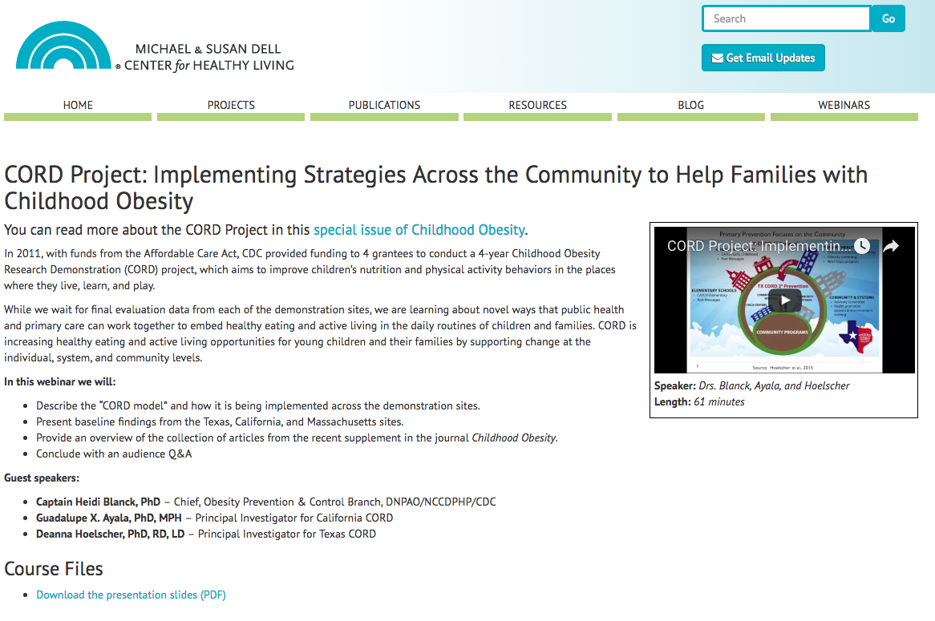
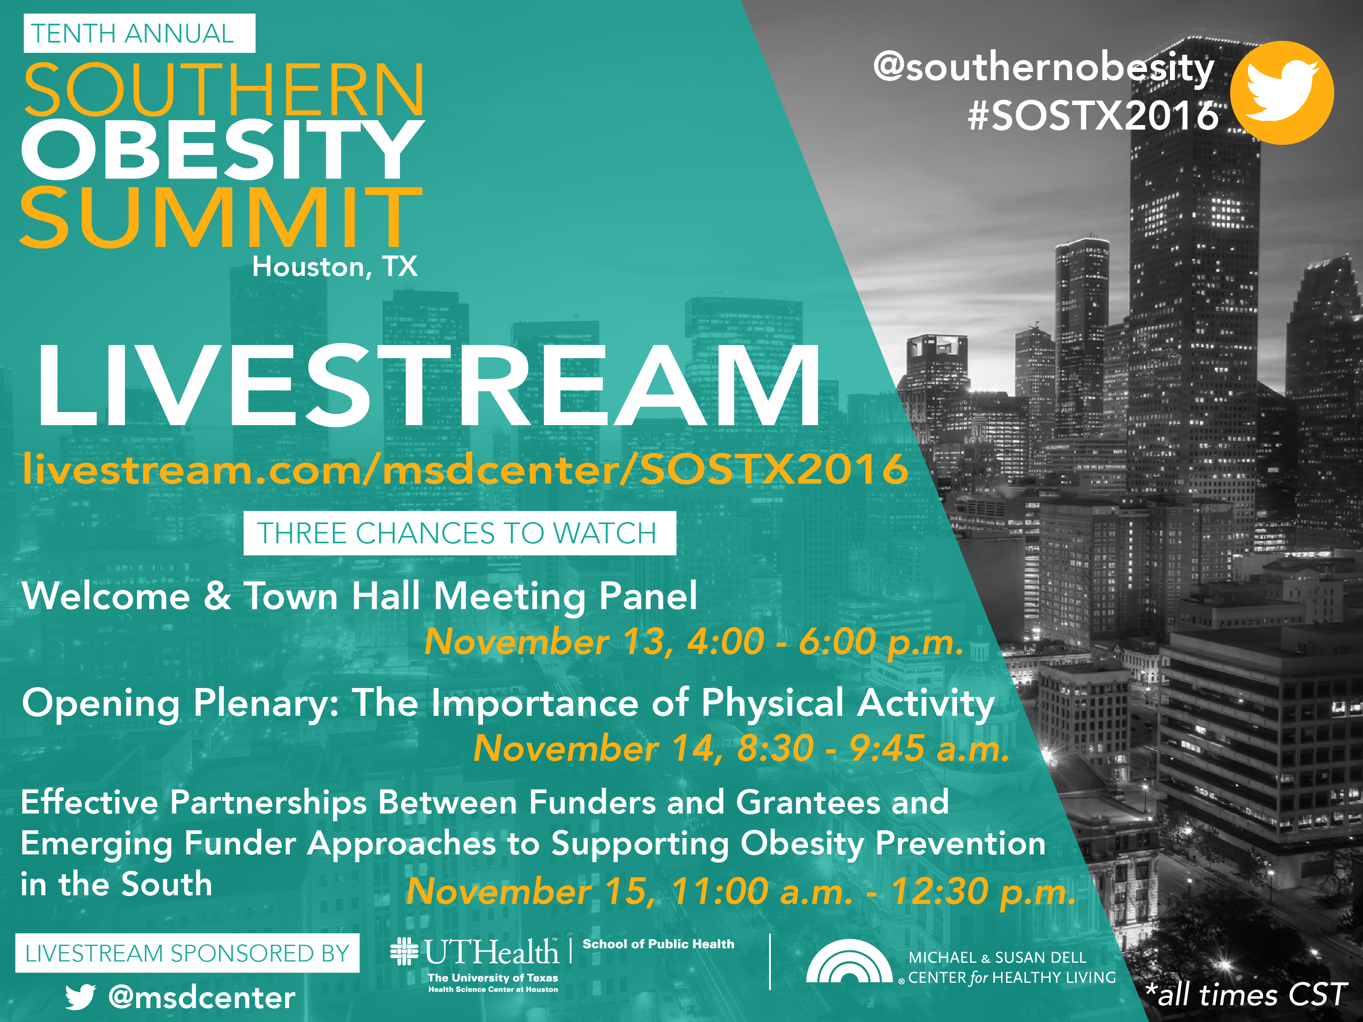

How does social media fit into health advocacy?
Notes:
Allows for flow of information and galvanization around issues and solutions in a way that was very difficult in the past. Health advocacy in the web 2.0 era takes many forms:
Awareness/education with appealing infographics
Pinterest boards as place to collect
Education and Webinars
Presentations that can be archived on YouTube
Calls-to-Action with email marketing
Social media shares a community building
Live-streaming from events
Interaction with communities
via Facebook Live
Tweetchats

Slide 6
Why does Steve Kelder use social media?
I can’t afford advertising or public relations
Public health is important, yet misunderstood
Children need advocates
Today, I can easily reach @ 500 people per day
Give a man a fish; teach a man to fish….
Did twitter work for Donald Trump?

Slide 7


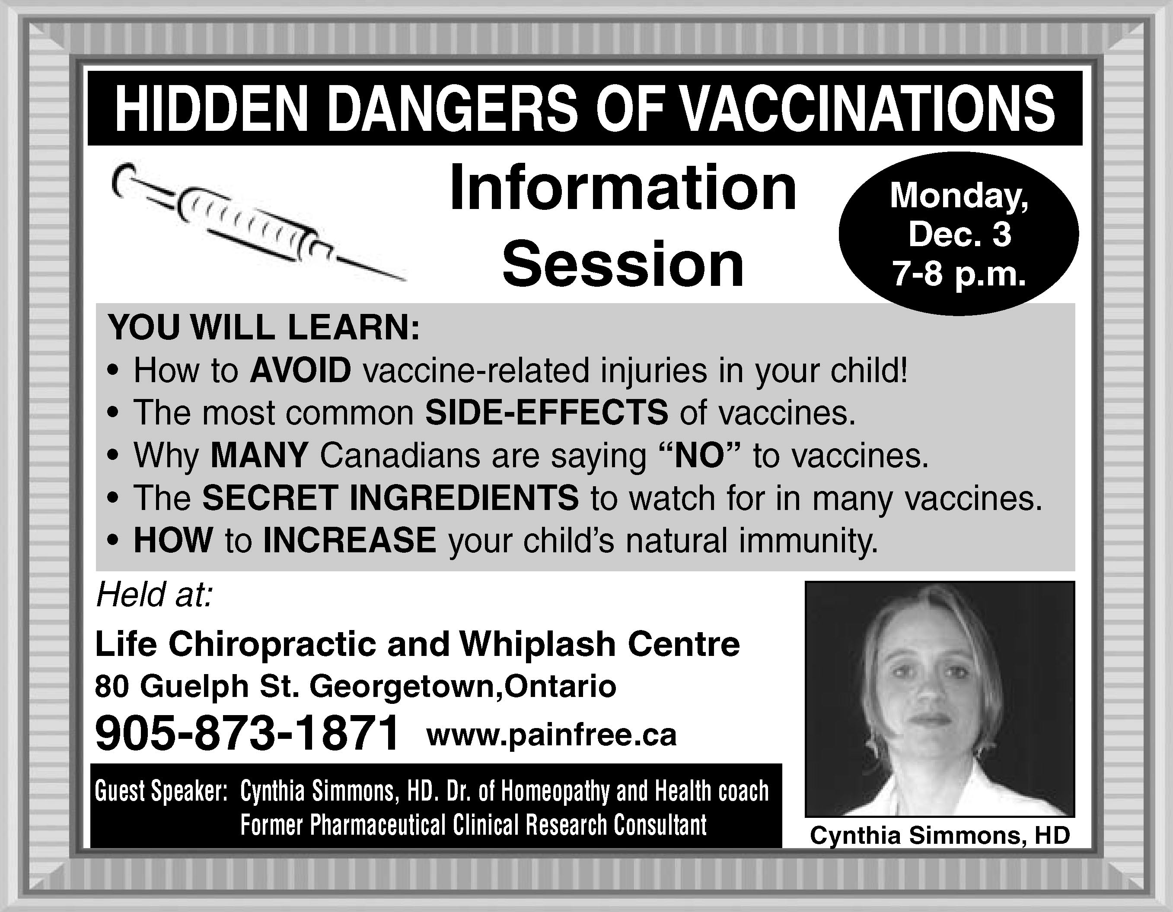
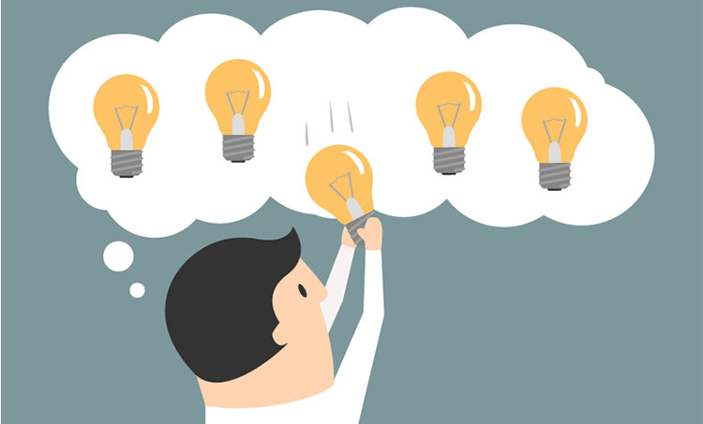
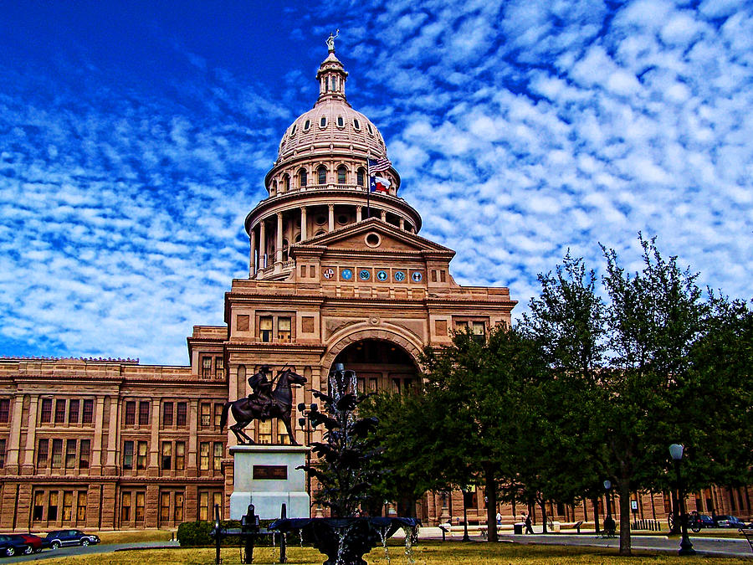
What is the purpose?
Notes:
Accelerate the flow of information and increase the impact of your work.
Create awareness and understanding of research findings.
Build a community around a health topic.
Increase adoption of best practices.
Inform policy decisions.
Combat misinformation.
Post-fact era

Slide 8
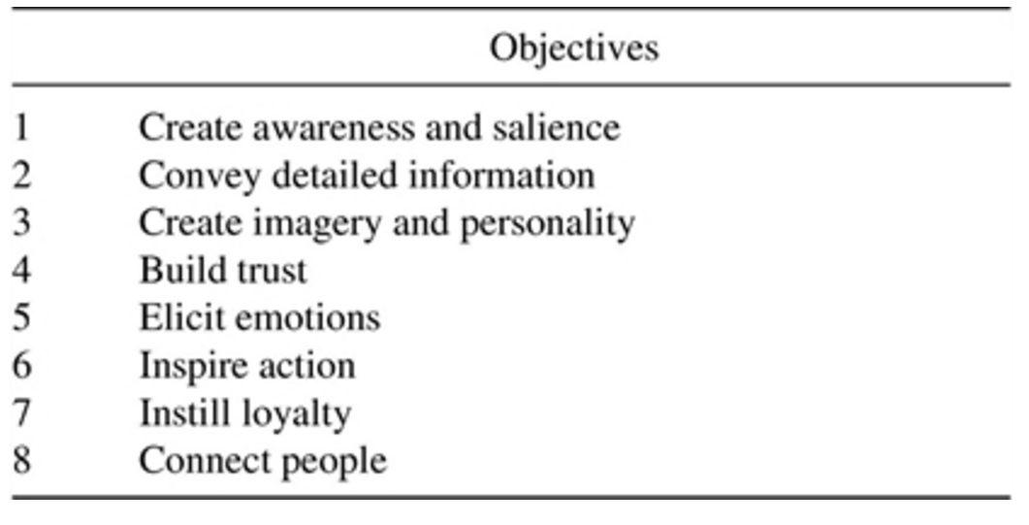
Keller KL. Unlocking the Power of Integrated Marketing Communications: How Integrated Is Your IMC Program?. Journal of Advertising. 2016 Jul 2;45(3):286-301.

Slide 9
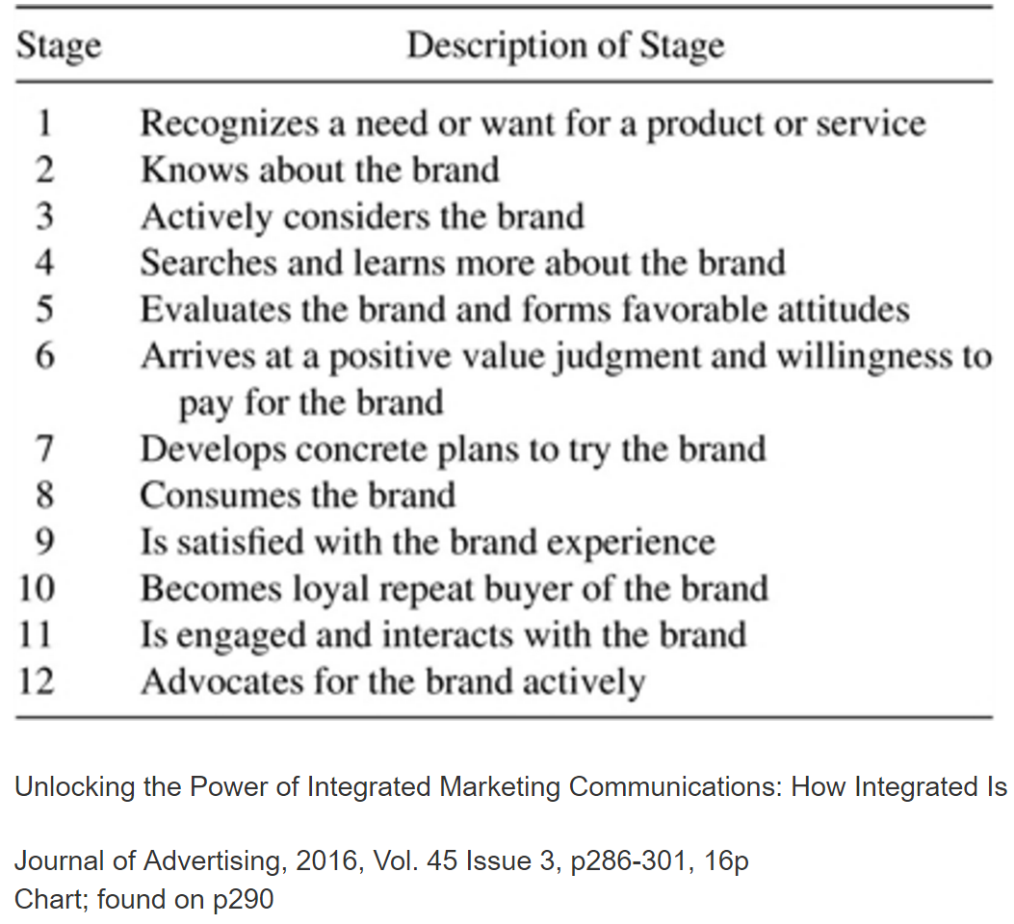

Slide 10
Research questions……
Sender – Message – Media Mix – Receiver
  Copywriting & Artwork
  Color
  Frequency
  Time of day
Batra R, Keller KL. Integrating Marketing Communications: New Findings, New Lessons, and New Ideas. Journal of Marketing. 2016 Nov;80(6):122-45.

Slide 11
Social Media Challenges and Concerns for Families Pediatr Clin N Am 63 (2016) 841–849 9 http://dx.doi.org/10.1016/j.pcl.2016.06.009
Social media is everywhere and used by adults and children.
Social media can have a positive impact on child development in terms of fostering communication, socialization, and learning.
Social medial can have a negative impact on child development with such issues as bullying, sexting, and inappropriate content contributing to additional issues.
Social media can have positive and negative issues on family health and needs to be used within a family with attention and care with a focus on the ages of the children at home.

Slide 12
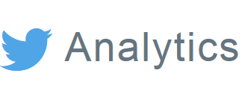

Not a goal unto itself!
Our goal is to use social media to drive utilization & awareness of tools and resources on our website
&

Slide 13
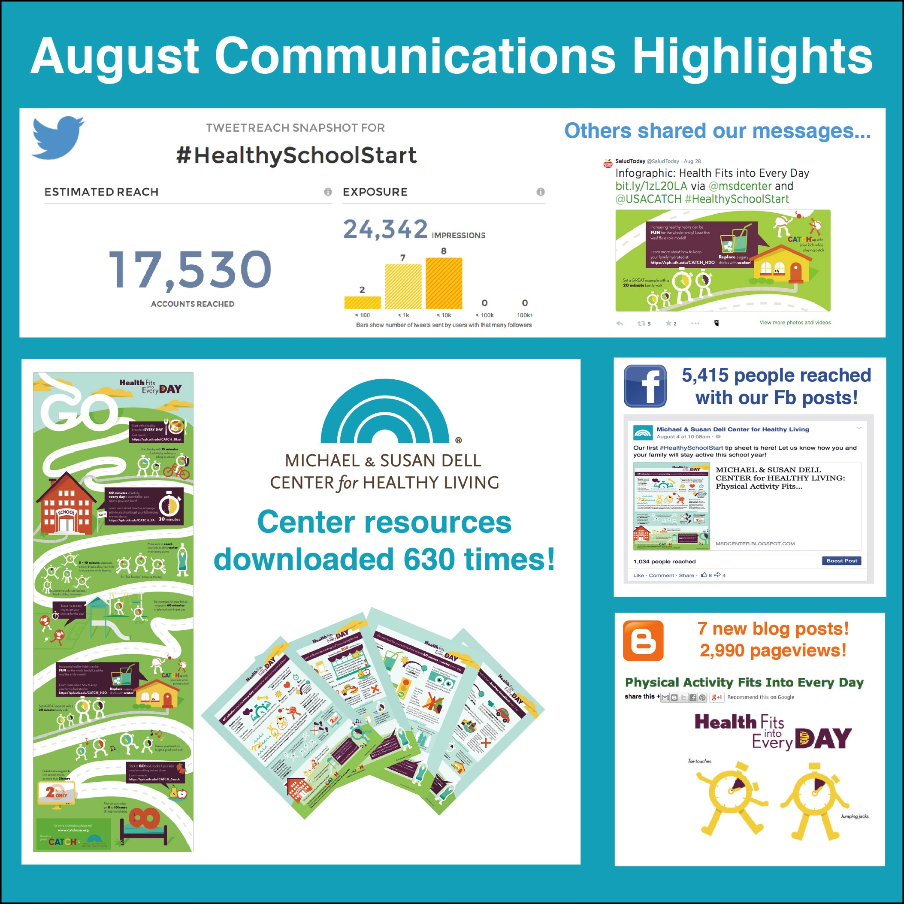
Connecting Communications to Larger Goals

Slide 14
Case study: #TOAW2016

Slide 15
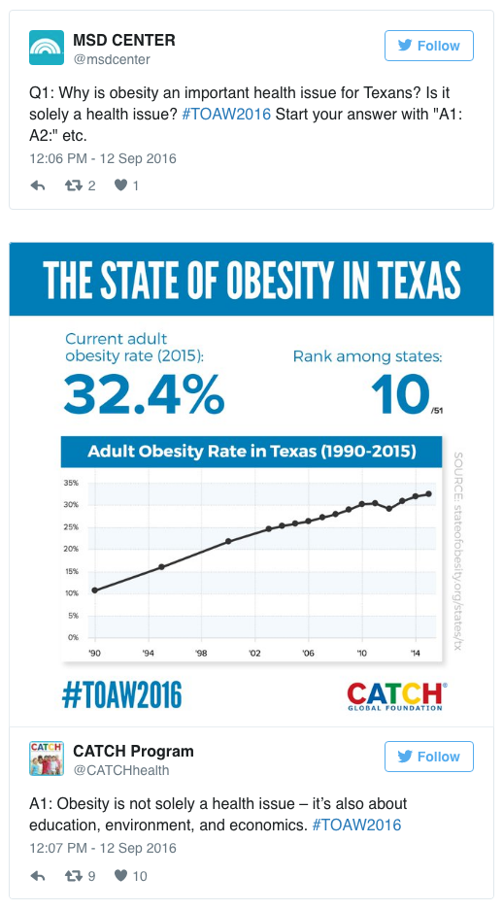
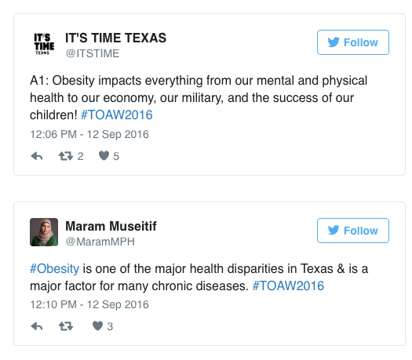
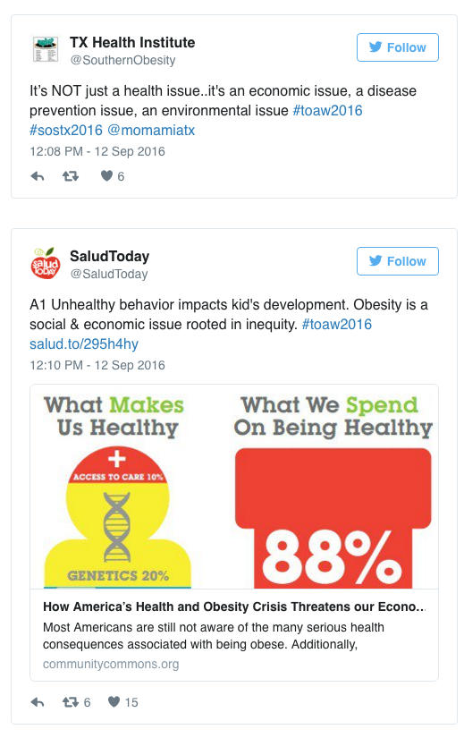
Case Study: #TOAW2016

Slide 16
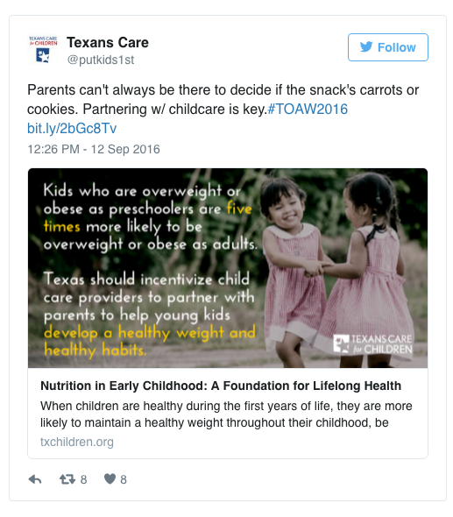
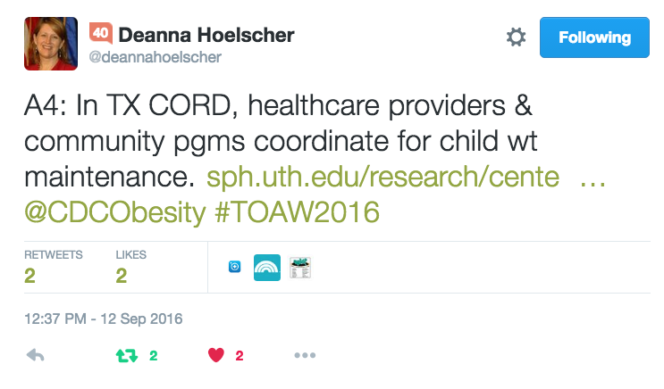
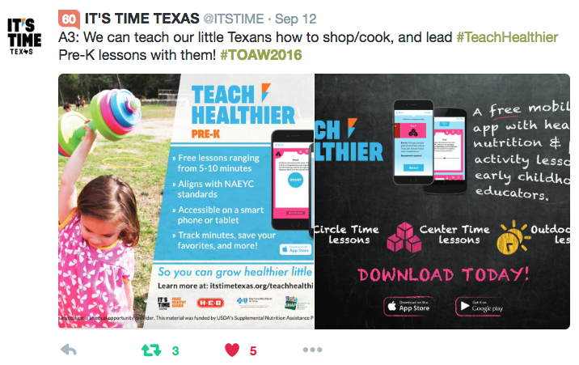
What worked: #TOAW2016
Notes:
The most successful tweets have things in common (next slide).

Slide 17
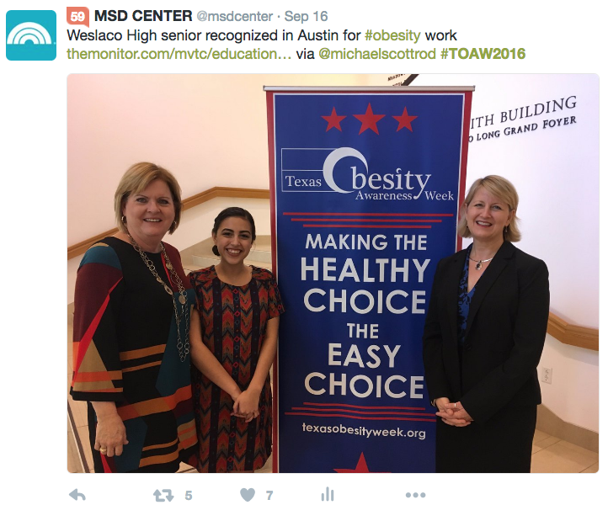
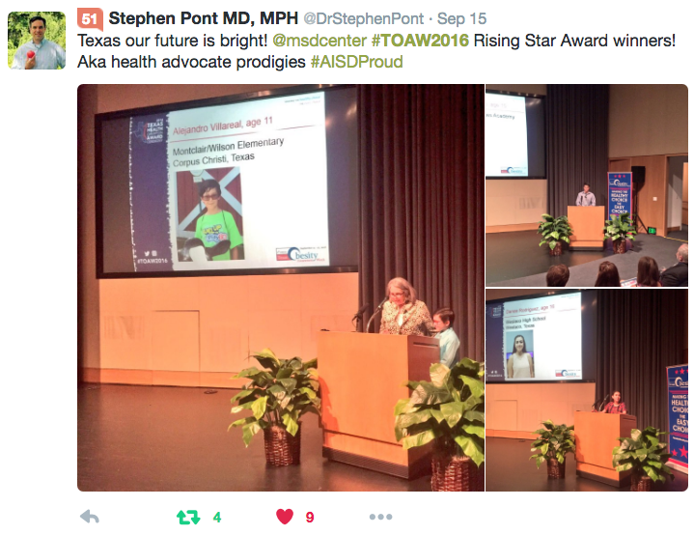
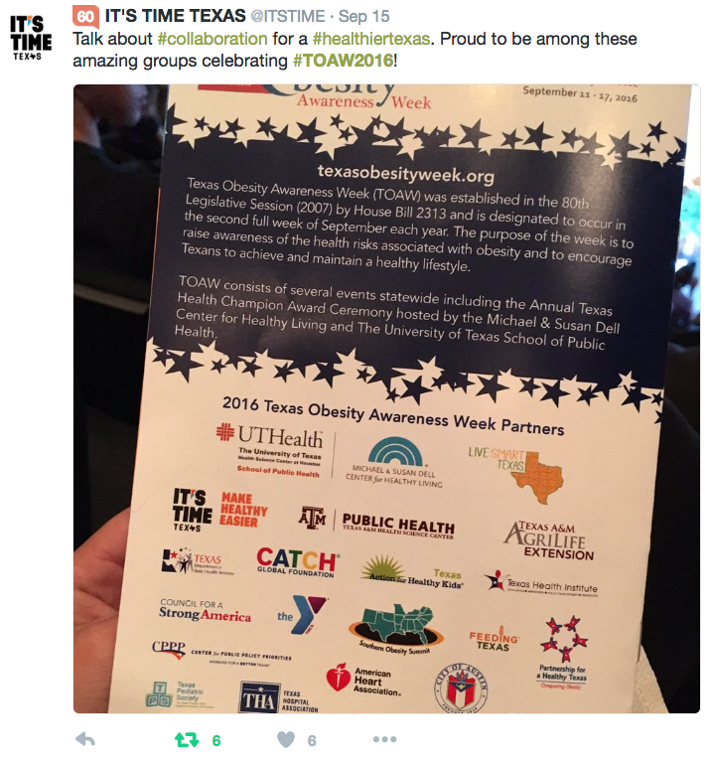
Extending the conversation

Slide 18
Best practices
Reach across sectors
Advance your/organization’s cause
Grow a community
Monitor and adapt
Notes:
Find common ground with partners across sectors
Ex: #nutrition vs. #obesity; #nutrition might speak to more sectors
Most effective types of hashtags: Public education, values & goals, branding, and call-to-action
Longer, contain photos, trusted/established accounts with large follower base
Videos and hyperlinks
Adjust or adapt to what your audience likes/RTs
Create a hashtag that is likely to advance organization’s cause
Grow a community around your hashtag
Own-able by audience but not too generic (e.g. #nutrition vs. #EatWell #FoodRight #NourishU)
Monitor with tools like Hashtracking

Slide 19
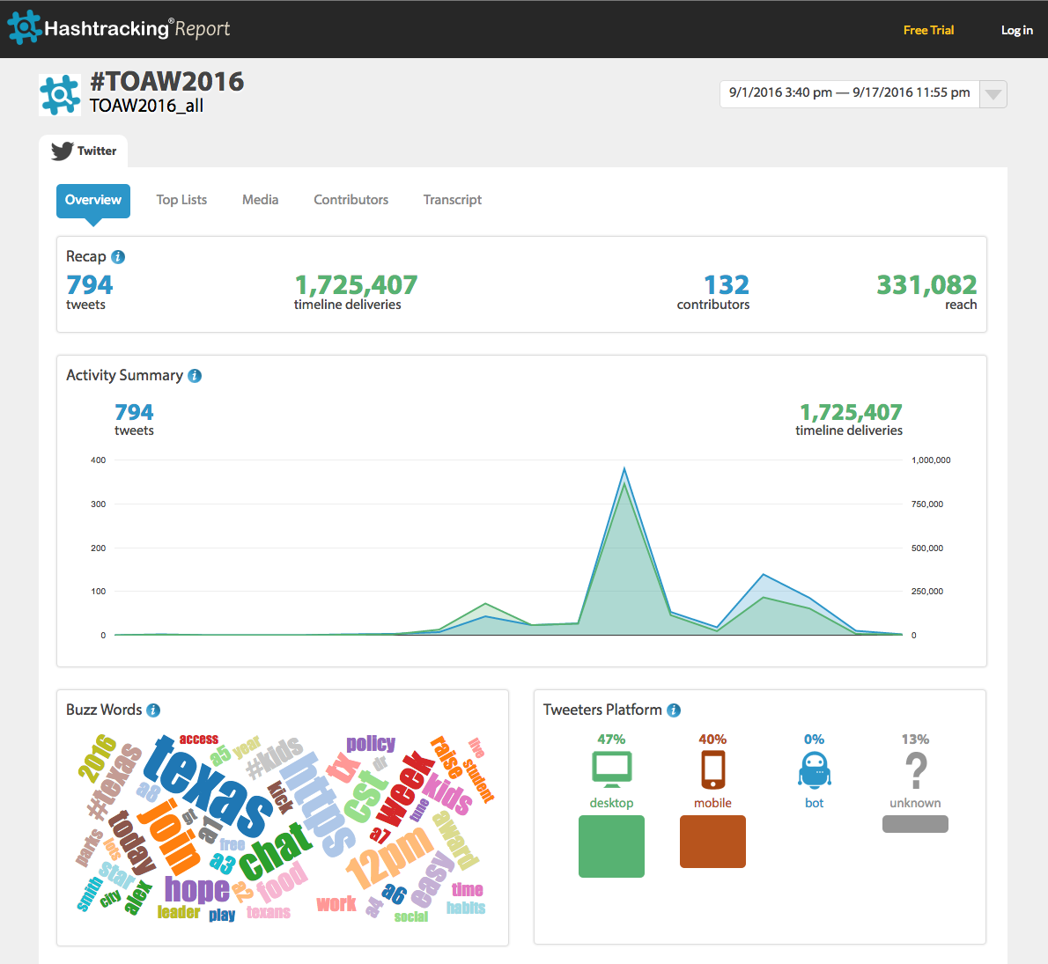
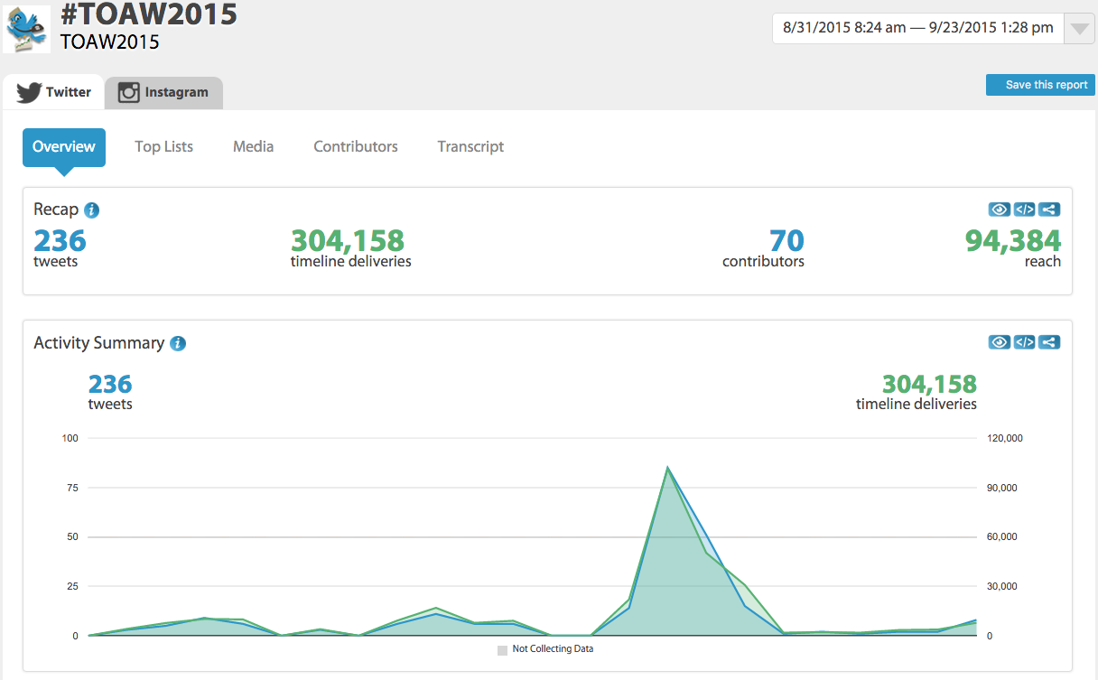
Case study: #TOAW2016

Slide 20
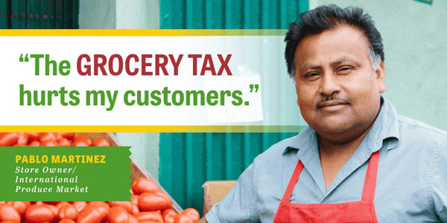
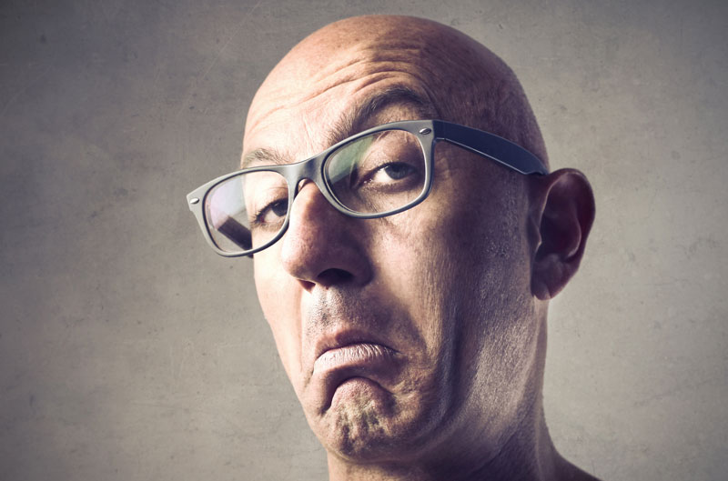
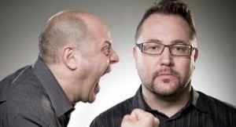
Dealing with Detractors
Types of detractors
  Skeptics
  Opposition
  Trolls

Slide 21
Dealing with Detractors
Know when NOT to engage
  Block offensive or insulting users
Keep a cool head; never insult people or their thoughts/beliefs/experiences
  Correct the record with facts
Detractors can make your messages stronger

