Slide 1

S.C.A.L.E
Sustainable Change and Lifestyle Enhancement
A Weight Loss Model For Impoverished, Medically At-Risk Adults
Angie Settle, DNP, APRN, BC, FNP, CEO

Slide 2
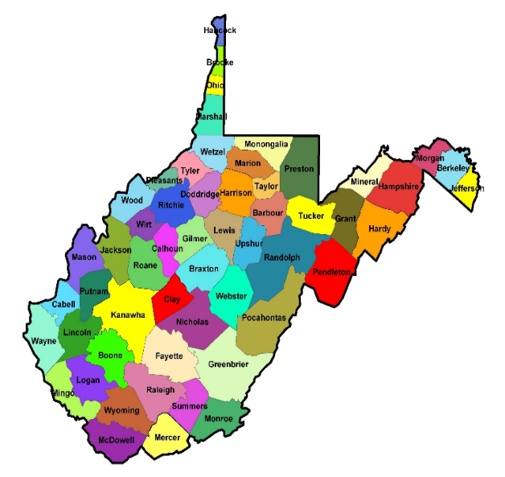

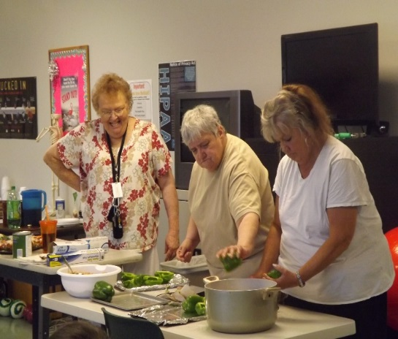
WV Health Right, Inc.
SCALE
Cardiovascular Health Need
WV ranks 1st in the country for heart attack/stroke
2nd in the nation for obesity
Clinic serves 26,000 uninsured and underinsured
Clinic serves 34 south central counties
Southern counties have highest rate of CVD/poverty in the state
Program Goals (funded by
To improve health status and reduce cardiovascular risk factors in obese patients via:
personal coaching
group support
nutritional education
improved diet and regular exercise
sustained weight loss
(50 patients with obesity year 1; 100 patients in year 2;
100 patients in year 3; and 50 year 4)

Slide 3

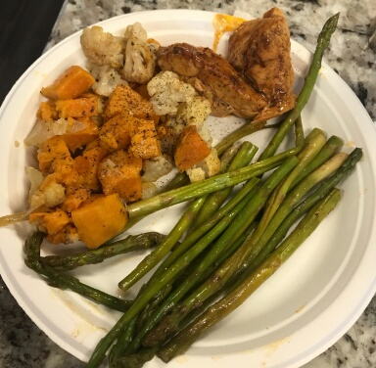
WV Health Right, Inc.
SCALE
Program funding provided by
Program Approach
Key Program Strategies
(Based on Transtheoretical Model/Stages of Change)
1. Encourage healthy behavior
2. Access to healthy foods
3. Healthy cooking techniques
4. Access to individualized exercise program
Innovative Approaches
Personal coaching
Peer support
Patient-centered/individualized program
Incorporates motivational interviewing for readiness for change
Incentives (gas cards, bus passes, cash prizes)

Slide 4
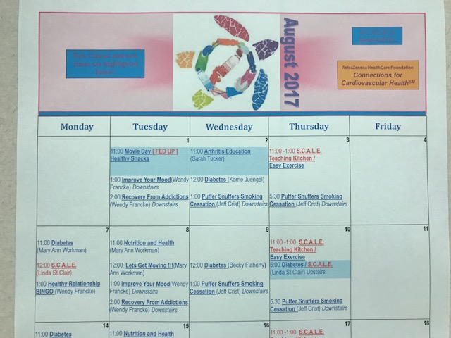
WV Health Right, Inc.
SCALE

Slide 5
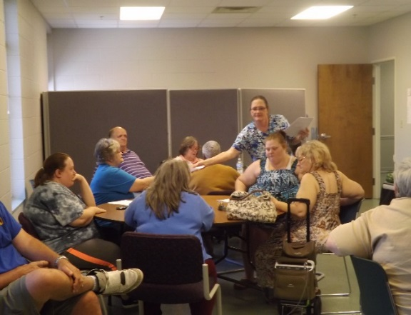
WV Health Right, Inc.
SCALE
Impact
96% lost weight (avg. 11.75 lbs.)
Clinical/Physical: About 50% had reduced b/p, decrease of LDL 2+ points, increased HDL, decreased triglycerides, reduction in A1c, decrease in hospitalization
Behavioral: 100% scored higher post-test on healthy cooking/eating habits & CVD knowledge, 92% engaged in regular weekly exercise
Comparison group “Not ready for change”: Worsened or remained unchanged for 90%
Sustainability & Dissemination
Volunteers, grants, community partnerships, community stakeholders
National Association of Free & Charitable Clinics (NAFC) national summit, national webinar, state rural health conference, two lunch and learn activities planned in the spring, toolkit on website
Challenges Overcome
Motivation
No “one size fits all” approach
Keeping focus on small goals
No quick fix (“marathon not a sprint”)

Slide 6
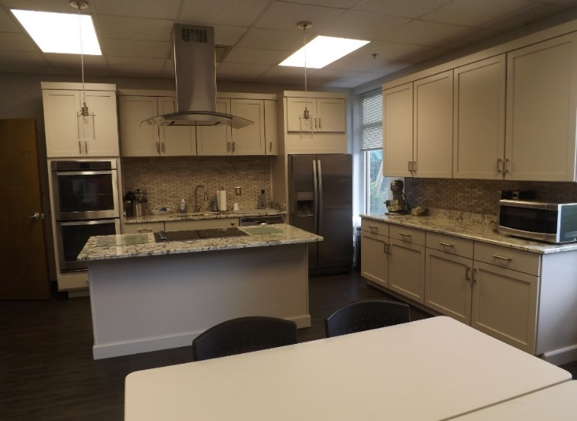
WV Health Right, Inc.
SCALE
Effective Practices to Address Challenges
Incentives a must
Individualization is key
Integration of exercise into all classes
Baby steps/setting achievable goals
Lessons Learned
Incentives, incentives, incentives (Did I mention incentives??)
Personal/individualized coaching is key
Family fun days important to involve support system
Current Challenges
Keeping it fresh/new ideas
Modifications for regional “comfort” food

