Slide 1
Evolution of Shape Your Future: Optimizing an Impactful Message Through Testing and Evaluation
Lindsey Funk lfunk@thevibrand.com
Account Manager
VI Marketing and Branding
Notes:
Introduction - VI, TSET
The Oklahoma Tobacco Settlement Endowment Trust (TSET) is a state grant making trust devoted to preventing cancer and cardiovascular disease Oklahoma’s leading causes of death.
In 2000, Oklahoma voters approved a constitutional amendment that created TSET to invest payments from the MSA.
The interest from these payments funds programs to improve the health of Oklahoma.
TSET funds several statewide public health education interventions including:
Tobacco Stops With Me brand which focuses on the impacts of smoking and secondhand smoke in Oklahoma,
Oklahoma Tobacco Helpline – a helplne for smokers that provides quit coaching and free NRT
Shape Your Future which we will be discussing today.

Slide 2
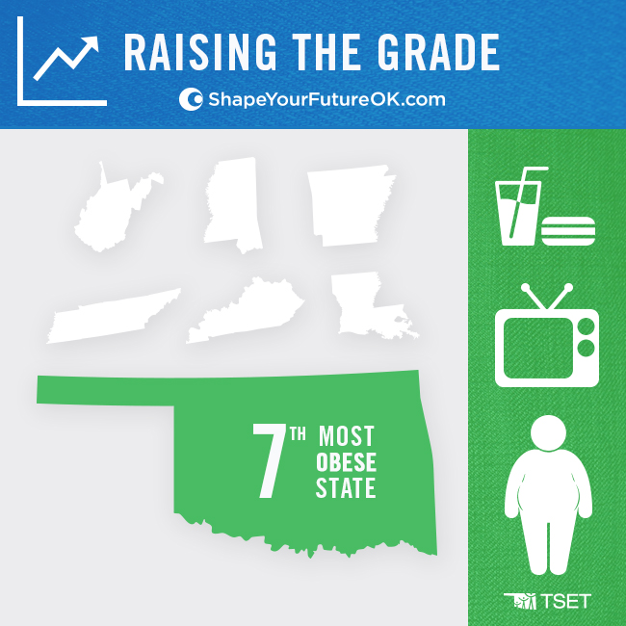
Notes:
Oklahoma Health Ranking – 7th most obese state when we were launching this campaign now 8th – we recently surpassed Kansas.
Overall health status – rank 45th nationally
One of the highest childhood obesity rates in the U.S. - 1 in 3 children between 10 and 17 are overweight or obese
Low physical activity and fruit and vegetable consumption, along with a high prevalence of smoking and obesity, contribute to the state’s leading causes of death.

Slide 3
Shape Your Future
Integrated marketing campaign created to combat obesity in Oklahoma
Encourages Oklahomans to Eat Better, Move More and Be Tobacco Free
Notes:
TSET in conjunction with the Oklahoma State Department of Health created Shape Your Future in 2011
A public health education intervention that encourages Oklahomans to eat better, move more and be tobacco free.
This campaign supports various on-the-ground grants to communities and disparate populations across the state.
The SYF campaign aims to reduce preventable death by educating families about small steps to create healthier behaviors.
Target: Oklahomans, age 18-54, low socioeconomic status and specifically moms or food preparers.
Goal: Improve the health of Oklahomans
Objectives:
Reduce adult obesity prevalence from 32.5% in 2013 to 29.5% in 2020 (OHIP 20/20)
Reduce adolescent obesity prevalence from 11.8% in 2013 to 10.6% in 2020. (OHIP 20/20)

Slide 4
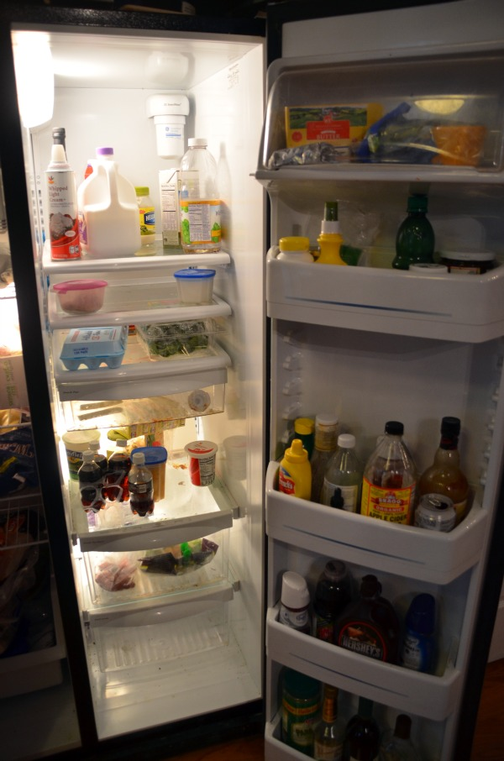
Initial Research (Pre-campaign)
Qualitative, custom online digital research among twenty-five 18-54 year-old Oklahomans.
Established the role of healthy lifestyles in Oklahomans’ day-to-day lives and uncovered barriers to healthy eating and being active.
Notes:
How we got there:
Pre campaign research included - Qualitative, custom online digital research among twenty-five 18-54 year-old Oklahomans. This was more involved with participants having open discussions with our moderator submitting picture of their refrigerators and discussing their daily amounts of physical activity.
This research established the role of healthy lifestyles in Oklahomans’ day-to-day lives and uncovered barriers to healthy eating and being active.
Barriers to health
Primary and secondary research revealed that, while information exists to educate parents, the amount of information can overwhelm and make a healthy lifestyle feel unattainable
Secondly a healthy lifestyle seems difficult - don’t have the time to add physical activity into their day or the money to buy healthy food which is often perceived as more expensive.
To address these barriers SYF focused on 2 simple messages and introduced the healthy habits campaign. Simplifying the message families could better retain the information and feel more confident in adopting healthy habits.
Fill half your plate with fruits and veggies
60 minutes of physical activity every day for kids and 30 for adults

Slide 5
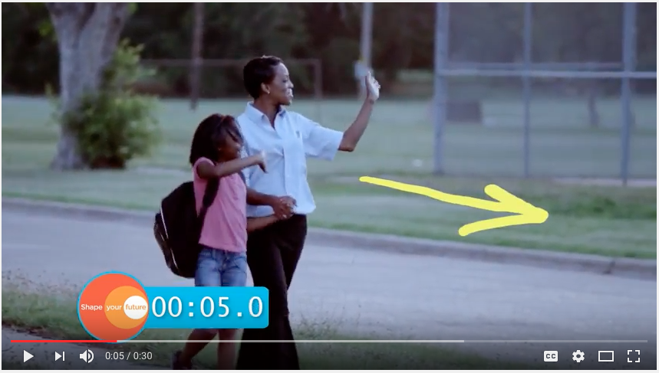
Telestrator

Slide 6
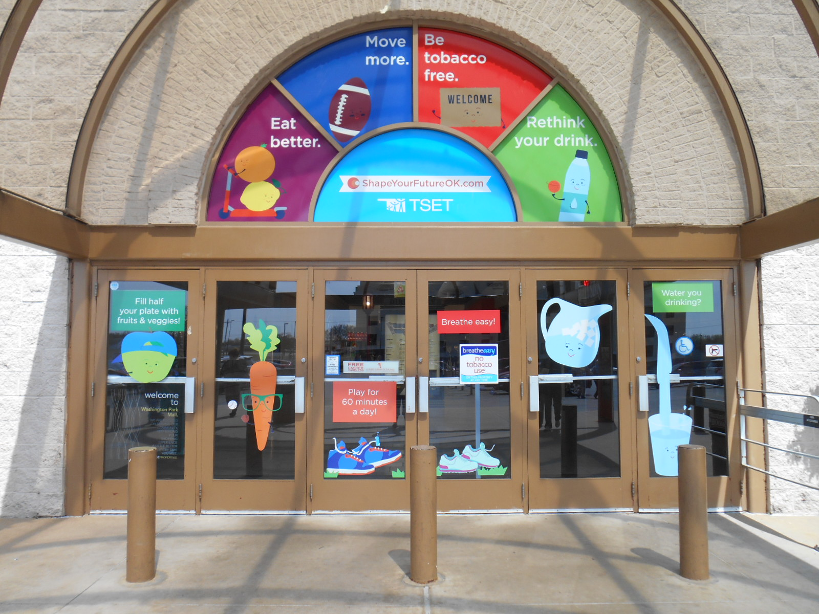
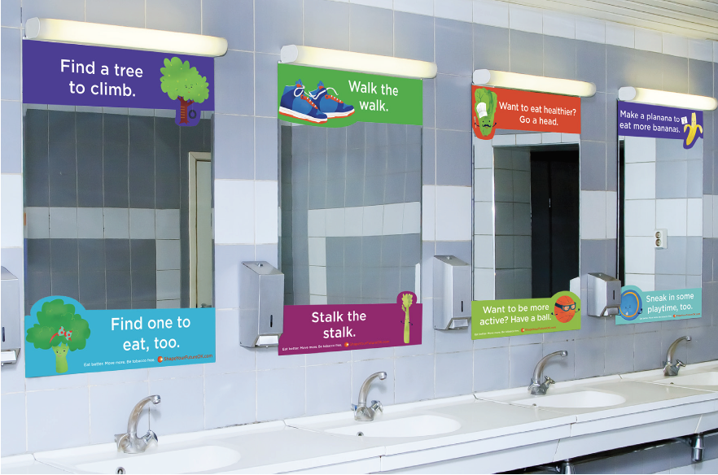
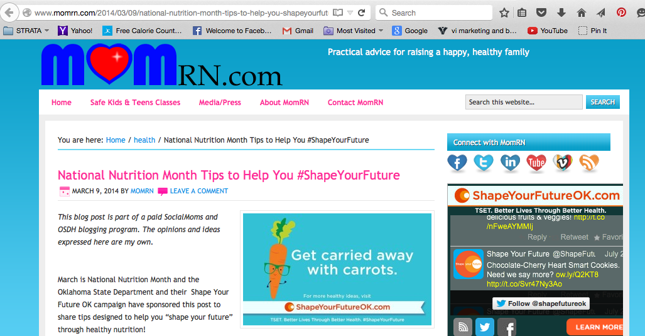
Healthy Habits
Physical Activity TV Spot
Notes:
-Campaign is fully integrated and has elements for
Traditional Media – TV, radio, print, outdoor
Non-traditonal – Digital, social, SEO
Sponsorships, partnerships, community events, PR tactics – press releases and offered interviews with TSET/OSDH staff
The media buy had a statewide reach with a primary target of mothers and low-socioeconomic status families, with a secondary target of all adult Oklahomans (approximately 2.7 million people.)
Mall - To help us better reach some of our families in rural communities – SYF took our characters into local malls in smaller communities. Initial survey proved to be positive with 82% saying the signage encouraged them to eat more fruits and veggies. 84% said the messaging encouraged them and their families to exercise more. Follow-up surveys are planned for this Fall. Write up results. Entrance signage, floor graphics, bathroom signage, wall and escalator/stair/elevator graphics, table tents
Website - Hub of all Shape Your Future content and call to action on all materials leads to the site. Important to keep it relevant and fresh.
Digital - Banners, pre-roll, sponsored posts
Thunder, Universities

Slide 7
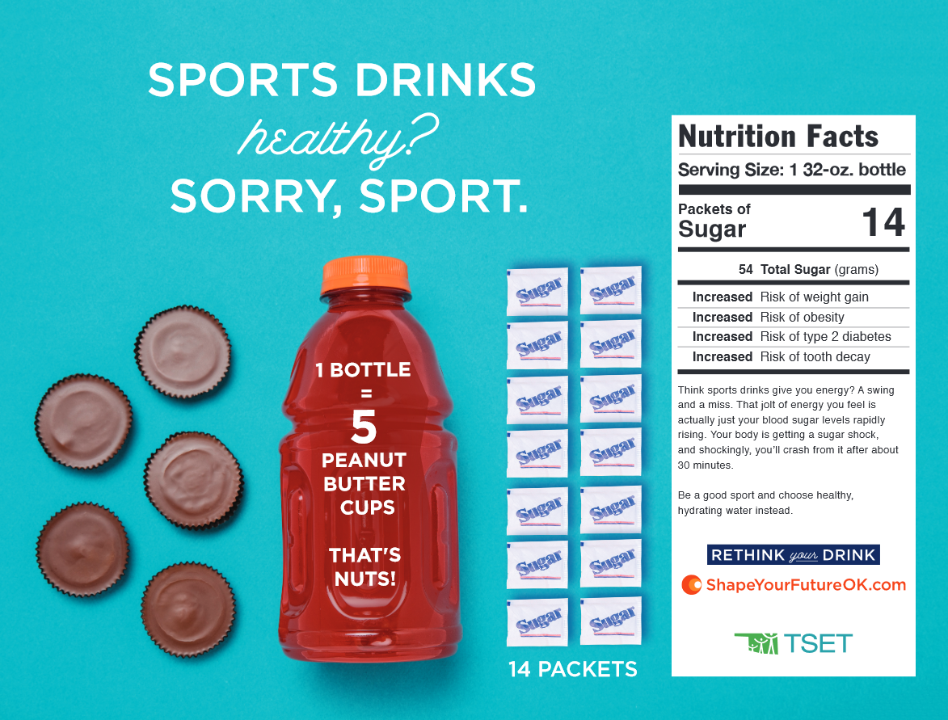
Rethink Your Drink
Notes:
The majority of young adult Oklahomans ages 18–34 drink at least one sugary drink per day—more than any other state in the United States.
Utilizing the CDC rethink your drink tagline and creating a campaign around that.

Slide 8
Evaluation Methods
Exposure
Awareness
Engagement
Impact
Media tracking surveys
Assess exposure to and awareness of the SYF campaign
Cross-sectional surveys
Track changes in knowledge, attitudes, and behaviors
Notes:
Evaluation Methods:
Opportunity to improve campaign strategies
Demonstrate accountability for investment
Assess sustainability and effectiveness of long-term campaigns
Contribute to the evidence base
TSET has consistently used a theoretical base to support campaign development, implementation and evaluation.
Also perform post testing – focus groups, online surveys and TSET utilizes partners for some of their message and concept testing. Utilized a local obesity clinic to test the radio spots and assessed their feedback to make adjustments.
Cross-sectional Survey
The SYF Cross-sectional Survey gathers information on Oklahoman’s knowledge, attitudes, and behaviors regarding physical activity, nutrition, and overall wellness. Survey respondents (n=1000) are Oklahoma adults with children living in their home. Cross sectional informs next steps and phases of the campaign and gathers lessons learned.
The SYF Media Tracking Survey measures awareness and exposure to the SYF campaign messages as well as receptivity to the campaign message. Survey respondents (n=500) are Oklahoma adults with children living in the home. Gives us insight to adjust during our media flights.
Findings:
Opportunity to improve campaign strategies
Demonstrate accountability for investment
Assess sustainability and effectiveness of long-term campaigns
Contribute to the evidence base
TSET has consistently used a theoretical base to support campaign development, implementation and evaluation.

Slide 9
Conclusions and Resources
Focusing on short, key messages helps the target retain the message and feel that a healthy lifestyle is attainable.
Resources:
ShapeYourFutureOK.com
Materials available on CDC CHMC
Lfunk@thevibrand.com
Notes:
Focusing on short, key messages helps the target retain the message and feel that a healthy lifestyle is attainable.
integrated campaign reaching the target at multiple touchpoints helps the target remember the message
Characters
Next steps:
Providing the “how”
Content – how to fill half your plate - recipes, how to get your 60 - easy physical activities

