Slide 1
Health Empowers You Christi Kay President Shannon Williams Project Director For more information Visit: www.healthmpowers.org Southern Obesity Summit November 14, 2016
Notes:
The purpose of this presentation is to discuss the evidence linking healthy eating, physical activity and physical fitness to improved academic achievement. Today I would like you to reconsider the drink that you provide your child as well as provide you with some information about why we need to strengthen muscles and bones.
This school is working with HealthMPowers to improve the nutrition and physical activity behaviors of students and staff. HealthMPowers is a non-profit organization located in Atlanta. The handout that I will give you at the end of the presentation will have their address if you want to learn more about the organization.
The Centers for Disease Control and Prevention in Atlanta has identified evidence that helps all to understand that education and health for students must go hand-in-hand in order for students to succeed.¹⁻²
Centers for Disease Control and Prevention. (2014) Healthy Kids. Successful Students. Stronger Communities . Retrieved 5/25/16 from http://www.cdc.gov/healthyyouth/health_and_academics/pdf/health-academics-ppt.pdf.
Centers for Disease Control and Prevention. The Association Between School-based Physical Activity, Including Physical Education, and Academic Performance. Atlanta, GA: U.S. Department of Health and Human Services; 2010.

Slide 2
Project Overview
Purpose:
Target Population
Demographics
Funding Source

Slide 3
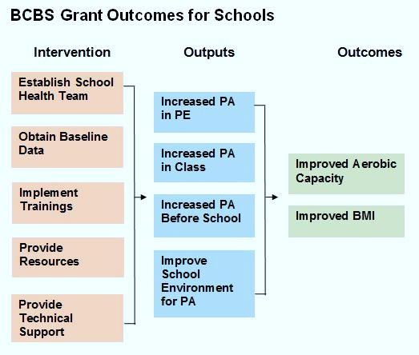
Intervention Framework

Slide 4
Outcome: Physical Activity Knowledge

Slide 5
Output: MVPA in PE

Slide 6
Output: Physical Activity in School

Slide 7
Output: Teacher Report of Classroom PA

Slide 8
Outcome: Aerobic Capacity

Slide 9
Outcome: BMI
 | Healthy Change |  | Maintained |  | Unhealthy Change
 | Number | Percent | Number | Percent | Number | Percent
All Students | 531 | 32.0 % | 861 | 51.8 % | 270 | 16.2 %
All Boys | 306 | 34.2 % | 438 | 48.9 % | 151 | 16.9 %
All Girls | 225 | 29.3 % | 423 | 55.2 % | 119 | 15.5 %

