Slide 1
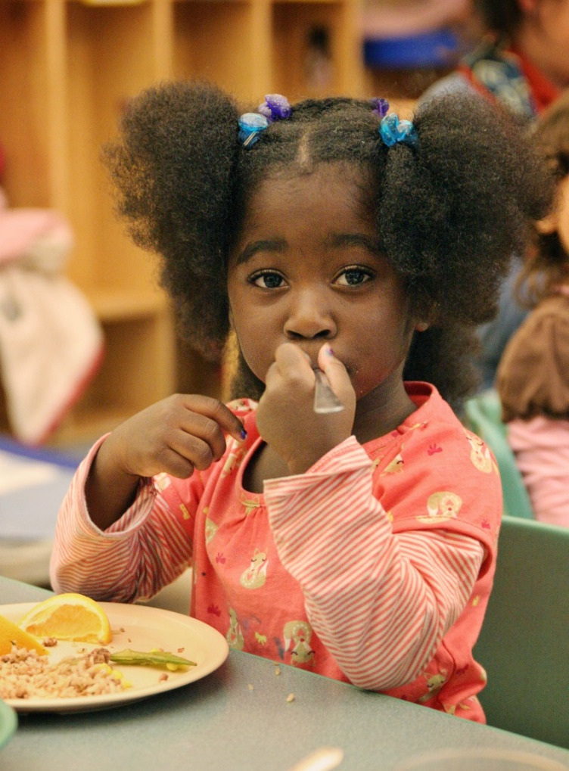
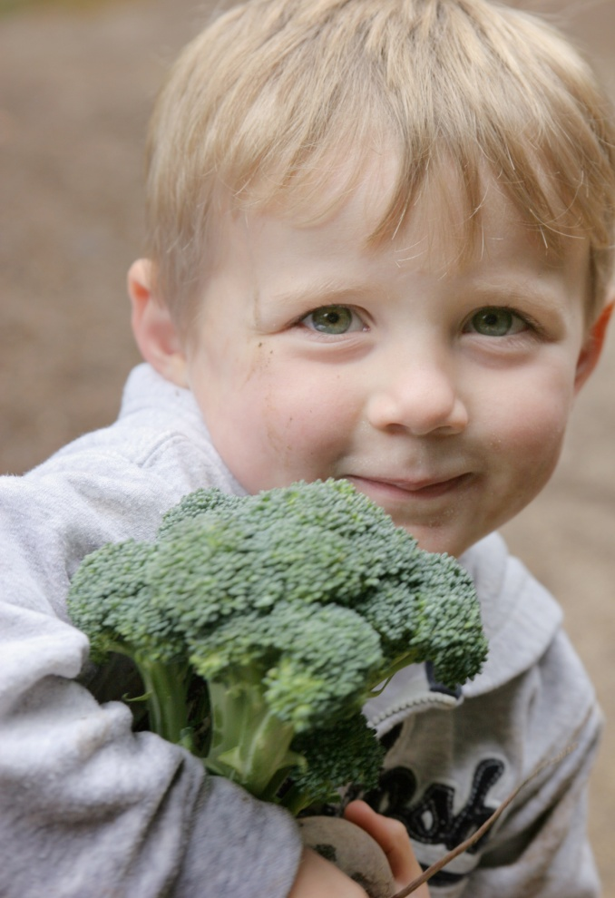
Building Consensus for Food Culture Change in Early Care and Education Centers
Eliza Paul
Rainbow In My Tummy® Director
Verner Center for Early Learning
2016 Southern Obesity Summit Houston TX

Slide 2
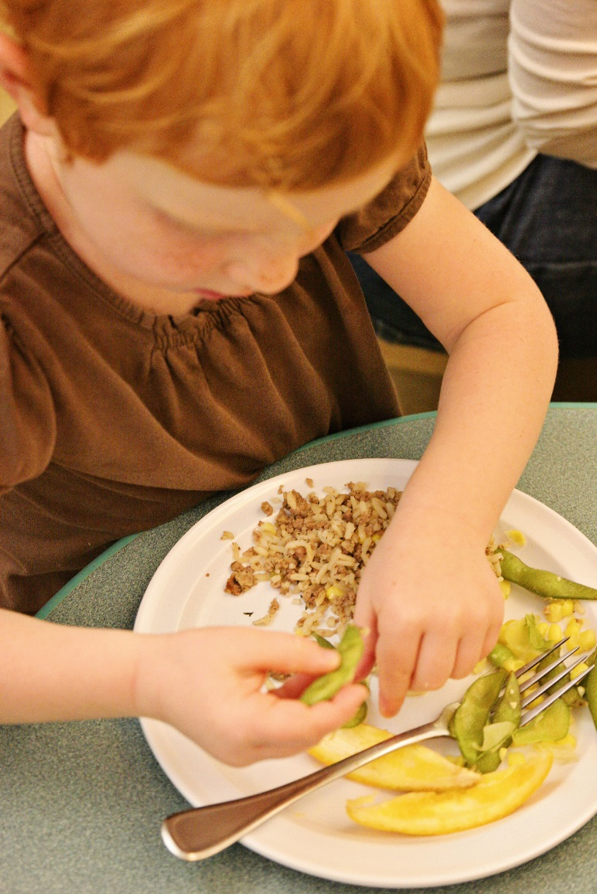
What makes a healthy food culture?
Healthy food is widely accepted and is the norm.
Health/nutrition is integrated into everyday activities and center environments.
Healthy choices are modeled and enjoyed by adults.
Families, staff, and key stakeholders expect and require that nutrition and health are integral to center policies and practices.

Slide 3
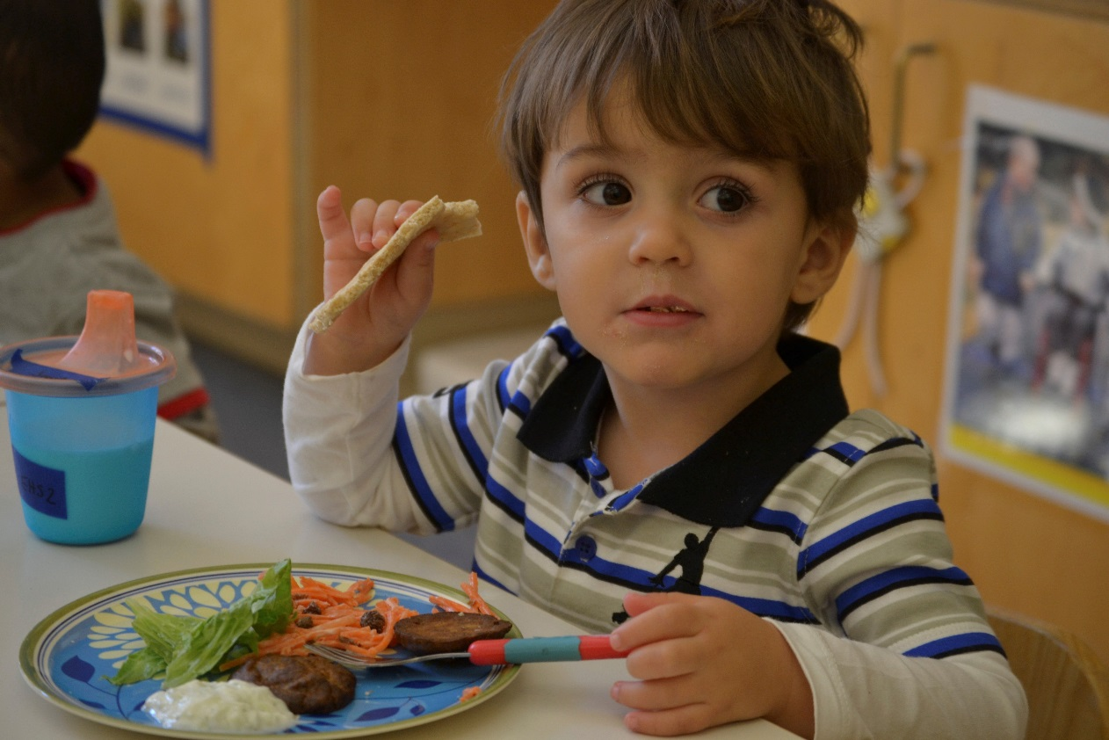
Benefits of a healthy food culture
Exposes children to a diversity of foods.
Fosters independent food choices.
Establishes a positive community of eaters.
Cultivates food awareness.
Integrates food into a broader ecology of education.

Slide 4
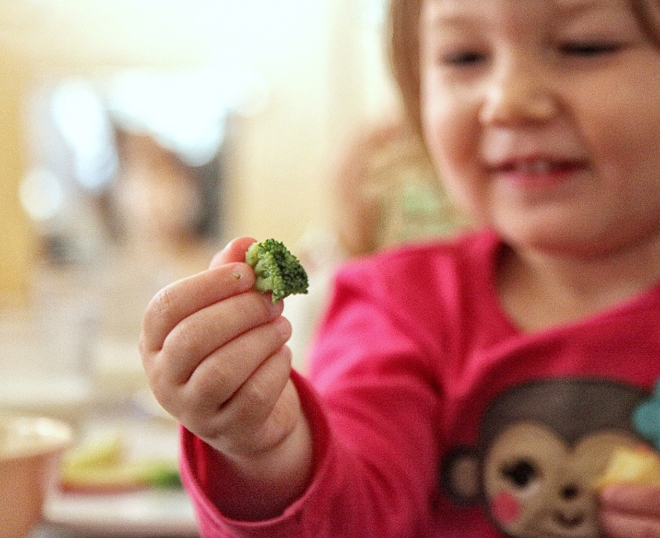
Analyzing readiness for change
Qualities of centers that successfully implement food culture change:
Vision of caring for the whole child
Responsibility for making changes
Planning for action
Teamwork for change
Continuous assessments
Continuous learning
Belief in the importance of change!

Slide 5
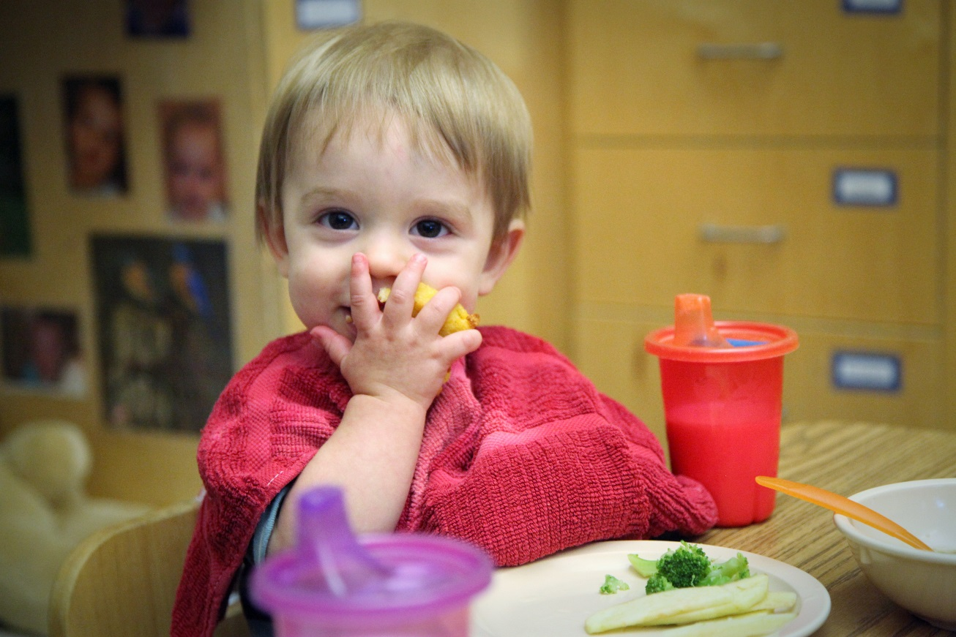
Key steps to building consensus
Communicate early and often!
Establish Food Policy Councils.
Have ongoing individual and group meetings with:
Kitchen staff
Teachers
Administrative staff
Parents
Center leadership support must be strong and consistent.

Slide 6
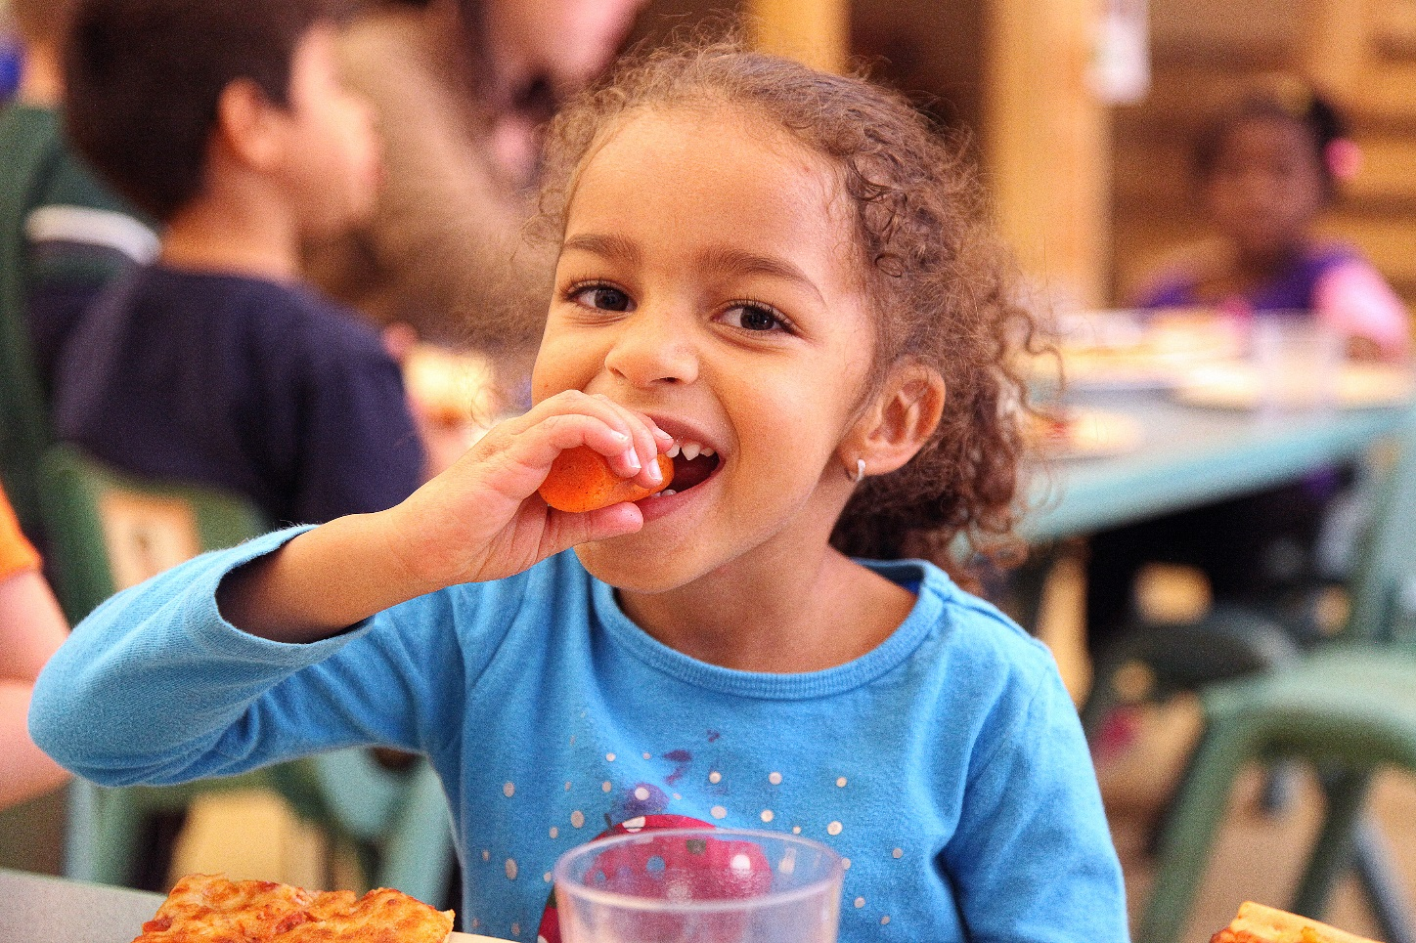
Common challenges & how to avoid them
Challenges:
Pushback from parents
Pushback from kitchen staff
Pushback from teachers
Pushback from children
Strategies for success:
Engage, engage, engage
Start slow

Slide 7
A realistic timeline for change
Slow and steady wins the race.
6 months of consensus-building is ideal before scale-up.
Implement step by step, classroom by classroom, meal by meal.
Expect 2-3 years of concentrated effort before healthy food culture becomes “just what we do.”

Slide 8
For more information and resources about building a healthy food culture, contact us:
info@rainbowinmytummy.org
828-298-0808
www.rainbowinmytummy.org

