Slide 1
Moving Beyond the ‘Tried & True’
Building A More Robust Live Smart Texas Coalition
Mike Lopez, MUP
Steering Committee Member, Texas A&M AgriLife Extension

Slide 2
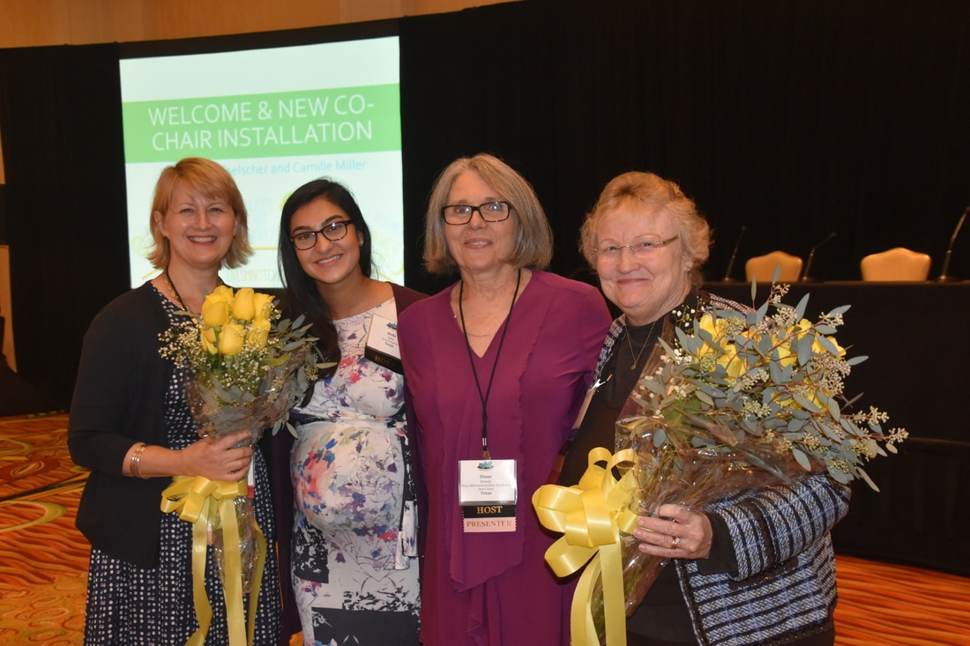
Who we Are
Coalition of organizations and individuals who work together to address the state’s obesity epidemic, especially in children
Notes:
Founded in 2007
Members represent interdisciplinary sectors including: policy/advocacy, education, government, academia/research, professional associations, and local community groups
Approximately 200 members statewide

Slide 3
What we do
Connect and build relationships with others to reduce obesity rates in Texas | SOS Texas State Meeting Partnership for a Healthy Texas
Access opportunities to engage in collaborative research and community partnerships | Texas CORD Texas Grow! Eat! Go! Transforming Texas: Healthy People in Healthy Communities Texas Childhood Obesity Prevention Policy Evaluation Project
Share best practices with and learn from the experience of other coalition members | Texas Health Champion Award Ceremony Shaping Policy for Health Workshop
Create a united obesity prevention policy agenda | Partnership for a Healthy Texas 2013 Texas Health Perception Survey
Share and bring resources to address concerns that affect every region of Texas | Quarterly Newsletter Quarterly Webinars

Slide 4
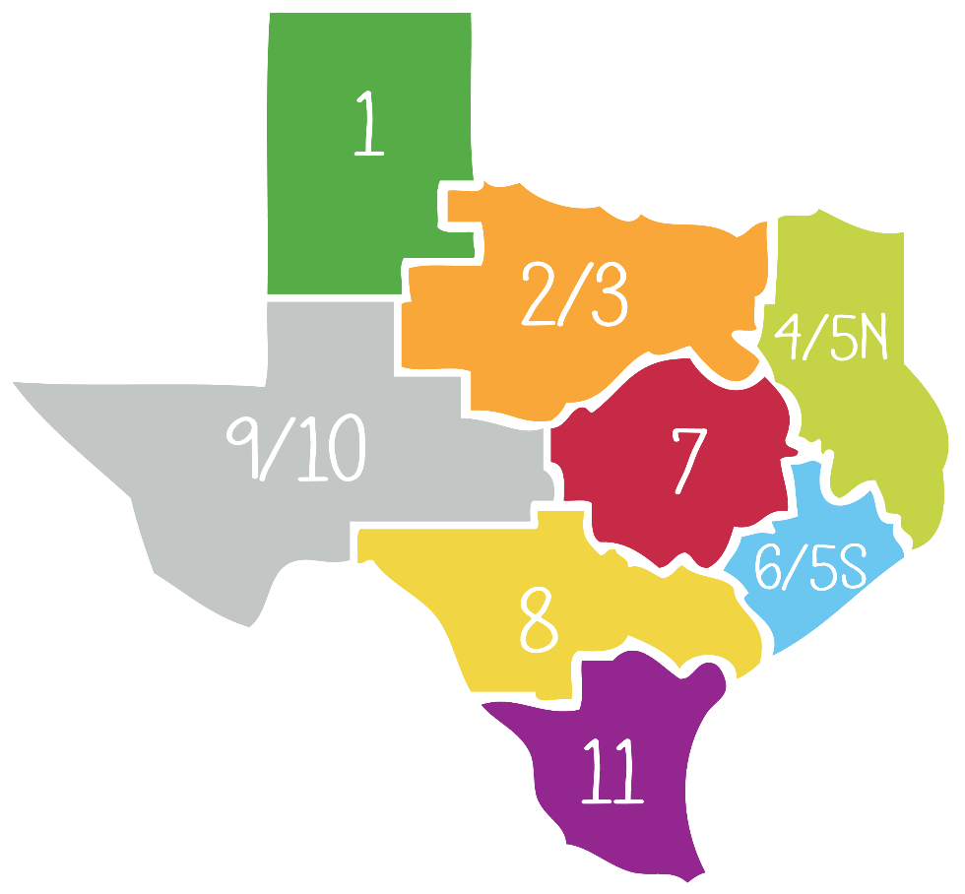
How we Operate
Leadership provided by:
Co-Chairs:
Drs. Diane Dowdy & Leah Whigham
Steering Committee:
members from state-level organizations
Regional Representatives
8 Health Service Regions
Notes:
State-level orgs include: UTHealth School of Public, Texas A&M School of Public Health, Texas A&M AgriLife Extension Service, Texas Action for Healthy Kids, Texas Association of City and County Health Officials, Texas Department of State Health Services

Slide 5
How we communicate
Co-Chairs
Steering Committee
LST Membership
Notes:
When we started LST – our communication with members was very linear
The Co-Chairs and Steering Committee would meet monthly and discuss challenges and successes related to obesity and create a plan on how to solve the issue.
Then the Steering Committee was responsible for disseminating the plan to the LST membership

Slide 6
How we communicate
Co-Chairs
Steering Committee
Statewide Organizations
Regional Representatives
LST Membership
State Org Members
Region Members
Notes:
Now – we still have meetings between our co-chairs and steering committee to discuss how to support our communities as they work to combat childhood obesity.
but – we had determined in 2015 that our steering committee was too Austin centric and we weren’t doing the best job of including those outside Central Texas
SO – we added Regional Representatives to the steering committee so each of the Health Service Regions is represented and we can learn more about what is working and where we can improve
AND – with the addition of the Regional Representatives, we are able to increase the communication between the membership and the steering committee – it is no longer a one-way street

Slide 7
How we sustain
Funding / Support
Active Leadership Engagement
Leverage Obesity Prevention Efforts / Events
Notes:
Funding
Michael & Susan Dell Center at the UTHealth School of Public provides financial support for the support personnel and the LST website
Several organizations provide donations and in-kind support to the yearly Texas Health Champion Ceremony which is co-sponsored by the Center for Healthy Living and LST

Slide 8
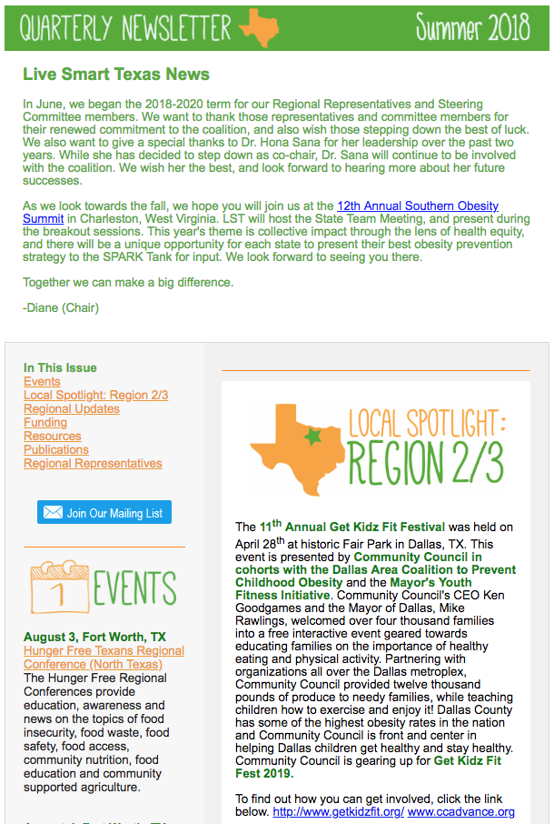
What’s next
Clearinghouse
Communication / Social Media
Special Events
Notes:
Clearinghouse – create and maintain a clearinghouse of Texas-related obesity information and resources; all items will be reviewed by LST leadership before posting to make sure only evidence-based information is being provided; it will be a one-stop shop for any organization working to prevent child obesity in their community
Communication – using several tools to get information out to our members in a timely manner: twitter, newsletter, webinars
Special Events – cohost the Texas Health Champion Award Ceremony each September and lead the State Team meeting each year at SOS

Slide 9
Thank You!
To Connect with Us
@LiveSmartTexas
www.livesmarttexas.org
LiveSmartTexas@uth.tmc.edu

