Slide 1
A Physician and Policy Maker’s Prescription for Improving Health Outcomes
Senator Ron D. Stollings, MD, FACP
Southern Obesity Summit, Charleston, WV
October 23, 2018

Slide 2
Welcome/Thank You
Physician begins with “PH”
Policy Maker’s Perspective: Health, Education, and the Economy
Bending the Healthcare Cost Curve—
Three numbers: 20%, 5%,1%

Slide 3
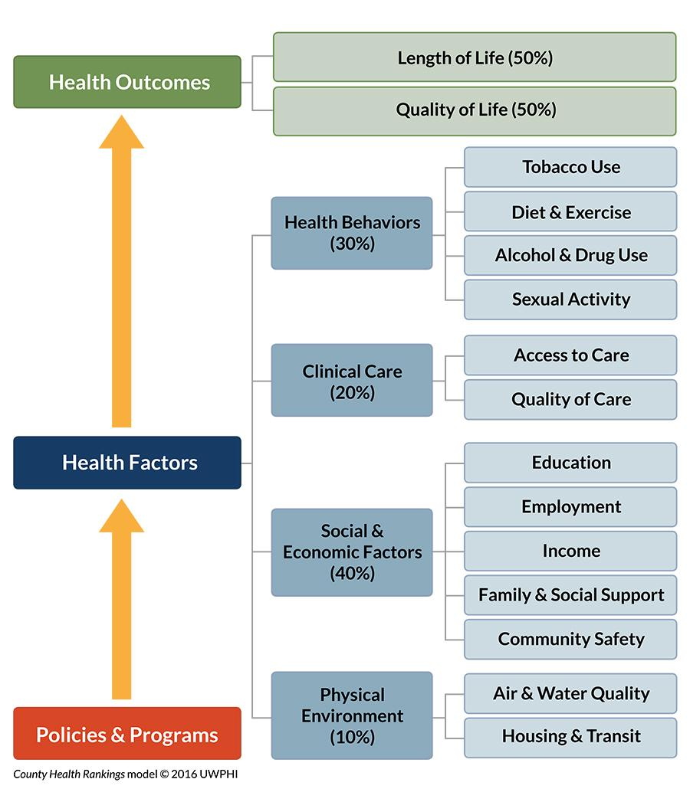

Slide 4
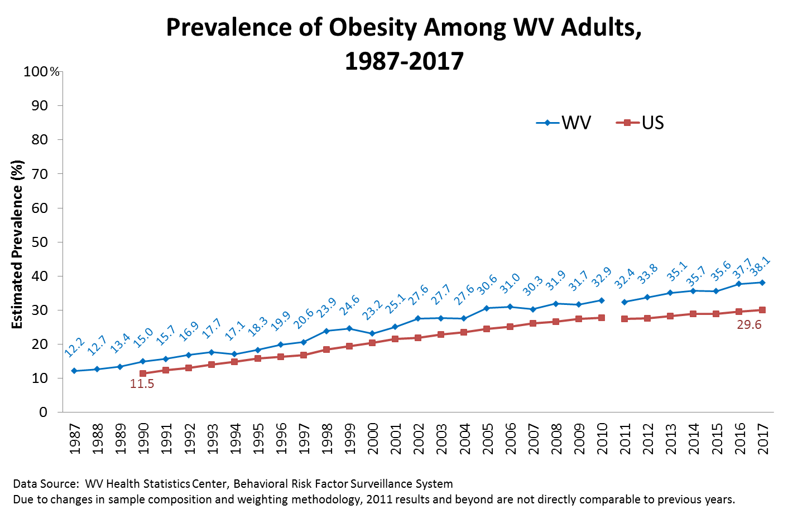

Slide 5
Health status of our patients
Selected Chronic Disease Risk Factors and Chronic Conditions
West Virginia BRFSS, 2014
West Virginia ranked the highest in the nation in the prevalence of heart attack among adults at 7.4%.
The prevalence of obesity in West Virginia was 35.7%, the 2nd highest in the nation.
More than one-fourth of adults (26.7%) currently smoke cigarettes every day or some days, which ranked West Virginia the 2nd highest nationally.
More than one in 10 West Virginia adults had diabetes (14.1%), which ranked West Virginia the 4th highest nationally.
More than one-fourth of West Virginia adults (28.7%) participate in no leisure-time physical activity or exercise, which ranked West Virginia 5th highest in the nation.

Slide 6
Body Mass Index-Related Health Costs Predicted from 2010--2030

Slide 7
5 Percent
In 2012, the Trust for America’s Health (TFAH) and Micro Health Simulations conducted an analysis to examine how much the United States could save in health care costs if obesity rates were reduced by five percent.
The analysis found that the country could save $29.8 billion in five years, $158.1 billion in 10 years and $611.7 billion in 20 years.

Slide 8
Reducing the prevalence of obesity in West Virginia by just 1%
May save West Virginia over $52.6 million per year annually

Slide 9
Rx
Invest in evidence-based policy, system and environmental changes to improve health.
My challenge for each of you is to take away from this summit “one thing” to improve your health, as well “one thing” your organization and community or state can do to improve health.

Slide 10
Thank You!

