Slide 1
Brandy Bowlen, RN School Nurse Epps Island Elementary

Slide 2
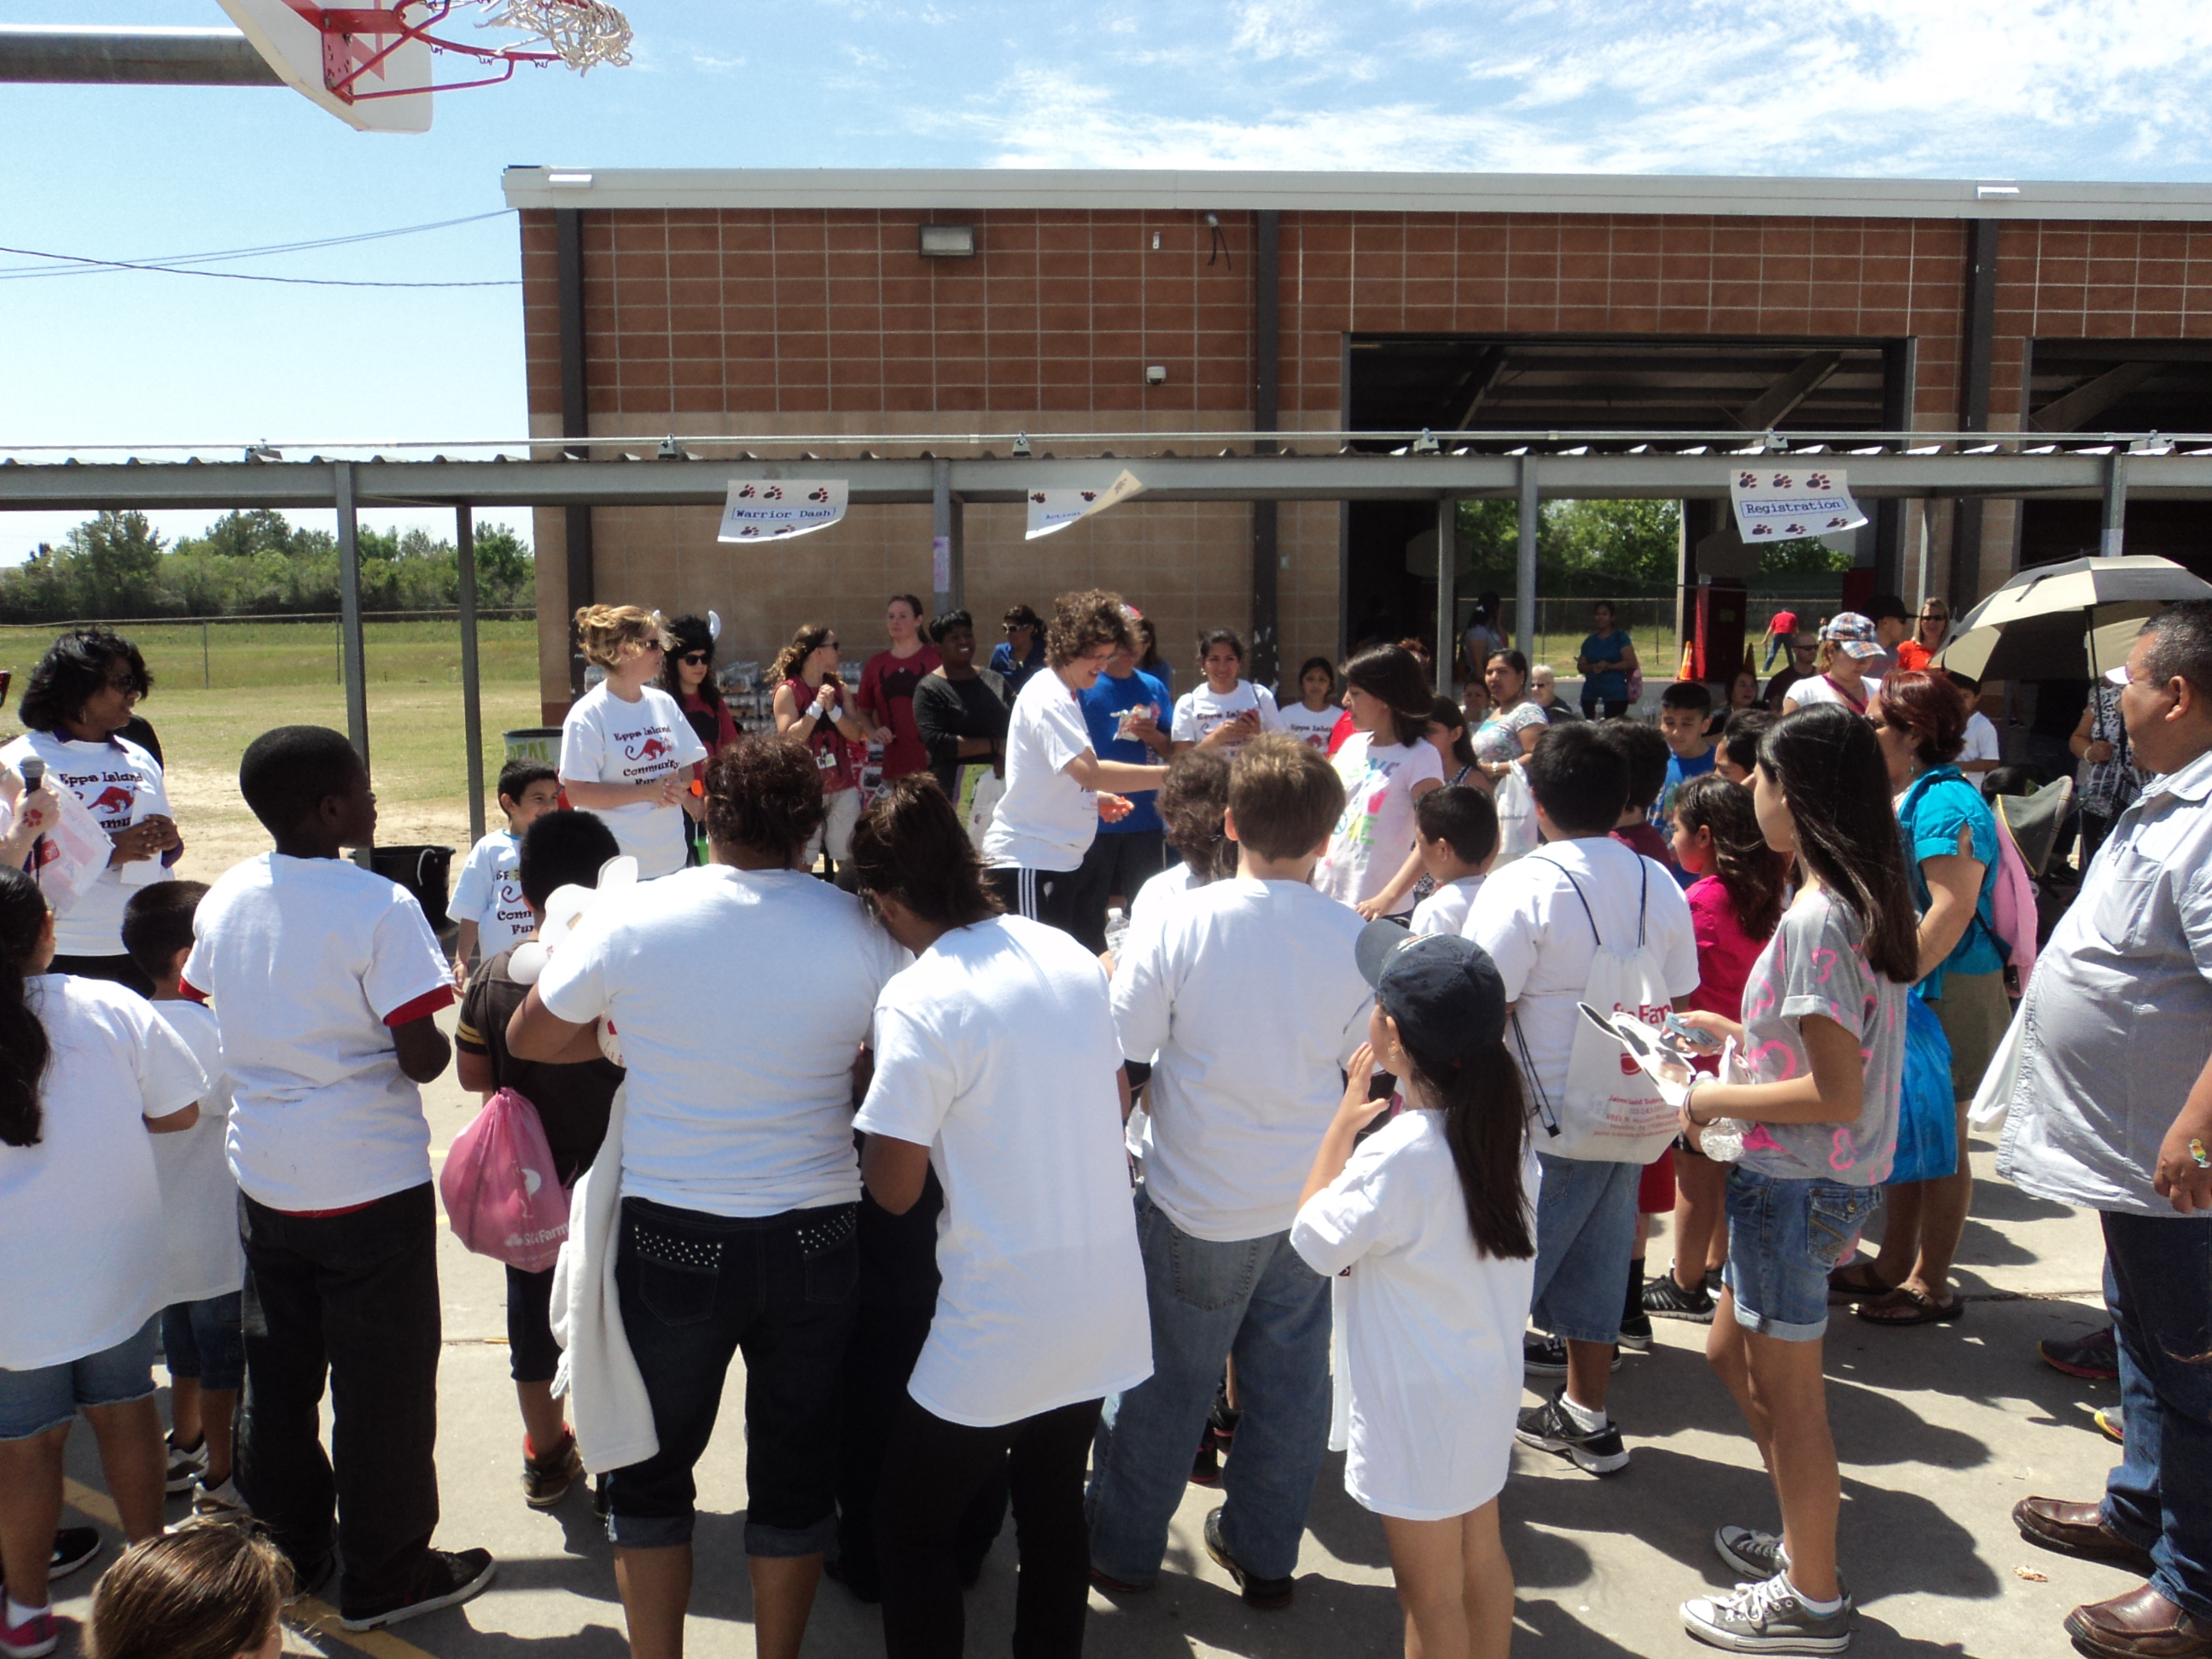
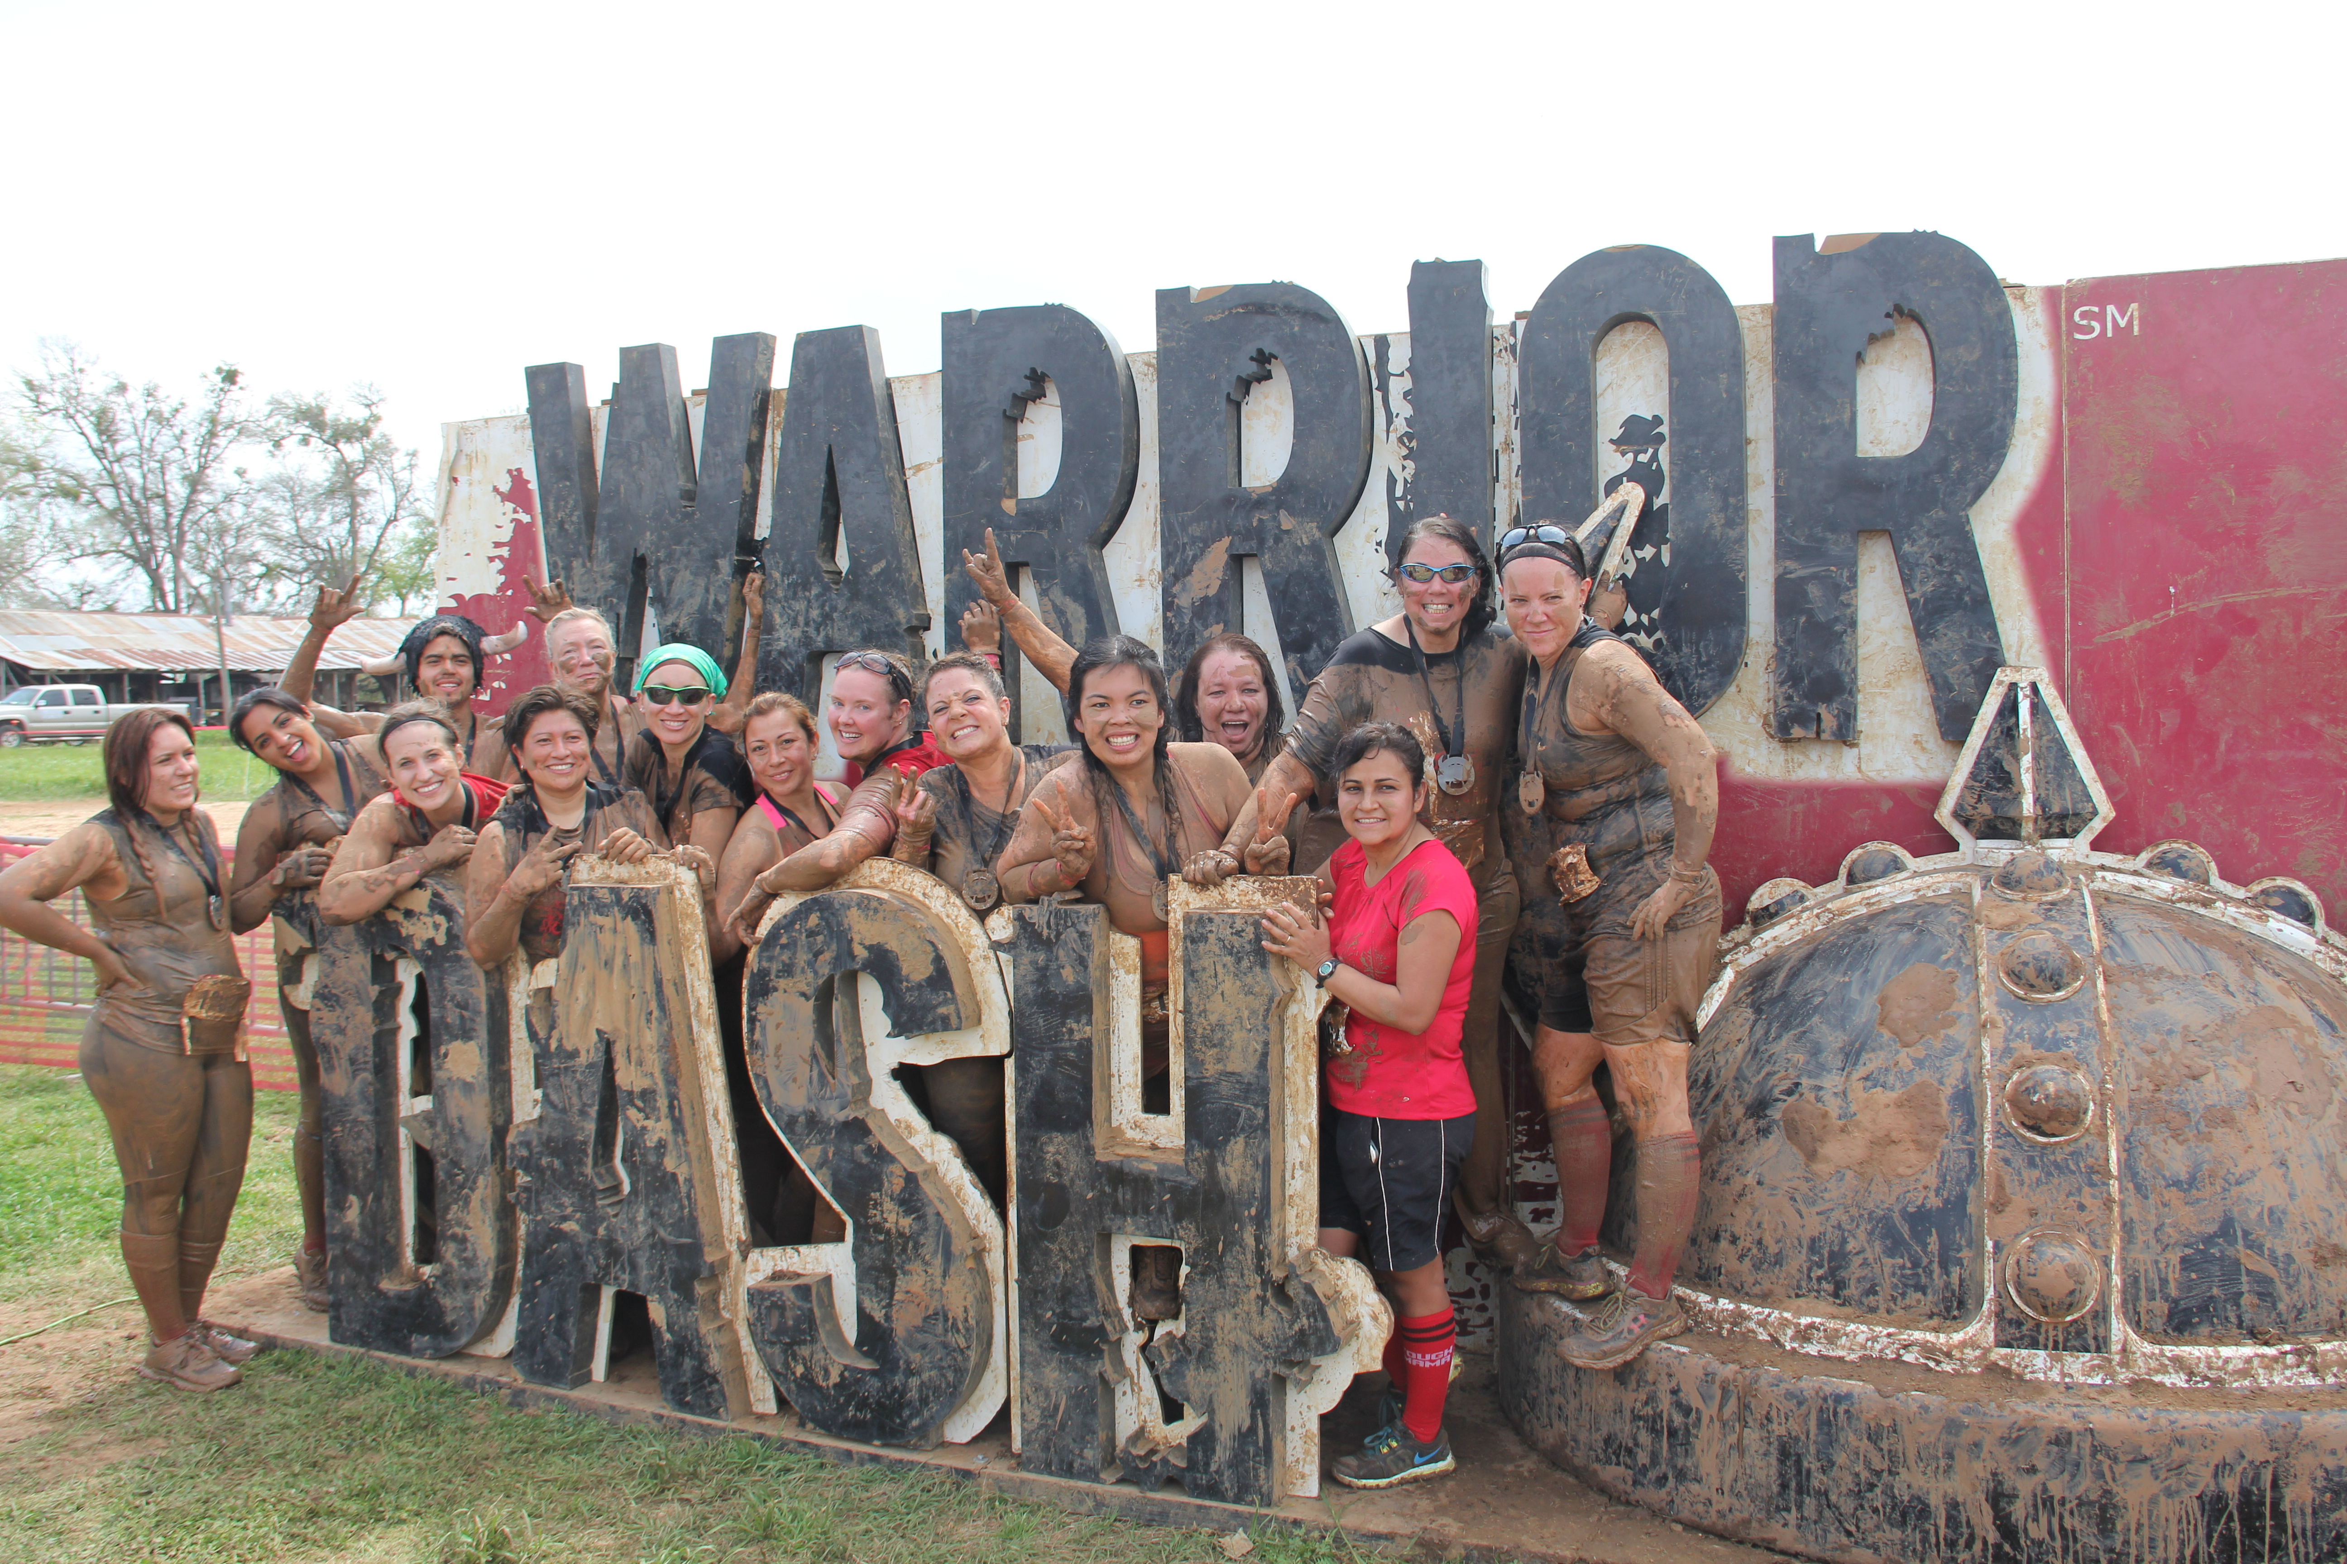
It’s a start
2011
Nurse walked, parents walked
2012
2013
$5500 grant funds
Agri Life Extension parent classes
1st Community Day
$2500 NASN Scope Grant
Pre K My Plate classes (6 weeks)
2nd annual Community Day
Zumba and Insanity classes for staff, 5 employees ran Obstacle race
Biggest Loser for parents
Blender Bike
Join for Me
Girls on the Run (45 students)
3rd Community Day (400 participants)
15 employees participated in Obstacle races
Notes:
In 2011, my second year as a school nurse, (and to be clear… I did not set out to “change the community” because that’s too big for me) I decided to step out of my comfort zone.
I took an NASN Scope childhood obesity prevention training. I decided to write a grant because… Why not? My kids need this. I came up with an idea, wrote it and won! Realizing that it takes an entire community to influence the health and education of a child I decided to initially target Pre-K students and their parents initially. We had 6 classes in the afternoon where the kids were taught My Plate concepts while the parents were in a separate area learning about 6 different topics including counting calories, reading nutrition labels, making healthy substitutions, and workout activities which can be done at home to name a few.
I encouraged the staff to start a walking group after schools on the track, and the parents watched and followed. Lead by example…
Our 1st Health and Fitness Community Day came about where I invited the school staff, families and many community partners.
You can see that in 2012 my little program continued because… why not? This time I also found many free resources.
Each year my “Little program” got bigger. More parents would come, more staff would participate and more community partnerships would form. I developed lasting relationships with community partners who continue to support our school and my students. I have health resources who have actually reached out to me to ask if they can attend one of our events!

Slide 3
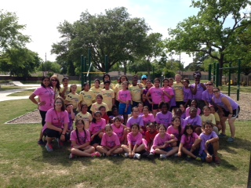
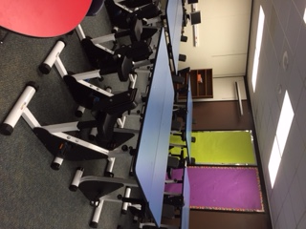
The following years…
2014
2015
KEF Grant $25,000 for Kinesthetic Reading Lab
$2500 grant funds,
Girls on the Run
4th Community Day
YMCA Yeehaw
15 + employees participate in Obstacle Race
Epps Island Health Shorts videos
5th annual Health and Fitness Community Day
Kinesthetic Classroom Collaborative,
Girls on the Run- 30 girls
Notes:
In 2014 some very special developments occurred:
1- We created Epps Island Health shorts- a video series which are 3 minutes or less and use real Epps Island students to discuss health concerns including hand washing, covering your cough, calories in soda, and drink more water. These short videos were shared during PE time.
2- 45 girls and 8 staff coaches participated in Girls on the Run and showcased all their achievements on bulletin boards in the hall.
3- kids began coming to me to show me their shirts from races that they were running with their parents outside of school!!
4- I created a program with the YMCA which I will talk more about in a minute.
In the 2015-2016 school year some amazing things happened! I decided to expand scope. I wrote a grant for $25,000 for a classroom set of pedal desks and books for a kinesthetic reading lab. I became fascinated by the subject and joined the Kinesthetic Classroom Collaborative in the Houston Metro area (many school districts who practice action based learning come together to share ideas). I am the only nurse in the Collaborative currently and the first. I’ll be taking 4 other staff members from our school to a training this summer to become certified to teach Action Based Learning theories and activities!

Slide 4
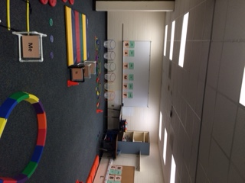
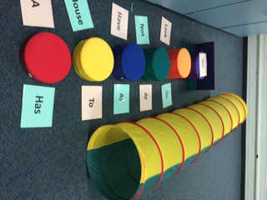
What’s Next?
2016
Girls on the Run- 15 girls
6th Annual Health and Fitness Community Day
K-1st Action Based Learning lab
New grants for mobile seating

Slide 5
Need more information? Email me! bbowlen1@kleinisd.net

