Slide 1
Making Cent$ of Health Care Costs
Understanding health care cost drivers and what YOU can do about it
Jack Towsley
Divisional Senior Vice President, Health Care Delivery
Blue Cross and Blue Shield of Texas
Southern Obesity Summit
Monday, November 14, 2016

Slide 2



OUR PURPOSE
To do everything in our power
to stand with our members
in sickness and in health
INTEGRITY
RESPECT
COMMITMENT
CARING
2

Slide 3
What the Experts Are Saying
“If you want to keep costs under control, it’s not about managing health care premiums…it’s about managing the underlying health care costs.”
– Sandy Praegar, Kansas Insurance Commissioner
“The two primary drivers of growth in health care spending are medical prices and utilization.”
– Centers for Medicare and Medicaid Services
“…a definite shift in negotiating strength toward providers, resulting in higher payment rates and premiums.”
– The Center for Studying Health System Change
“Further regulating premiums without addressing the underlying medical cost drivers would be like capping the prices auto makers can charge customers, but letting the steel, rubber and technology manufactures charge the auto makers whatever they want.”
– America's Health Insurance Plans

Slide 4
Understanding Health Care Costs

Slide 5
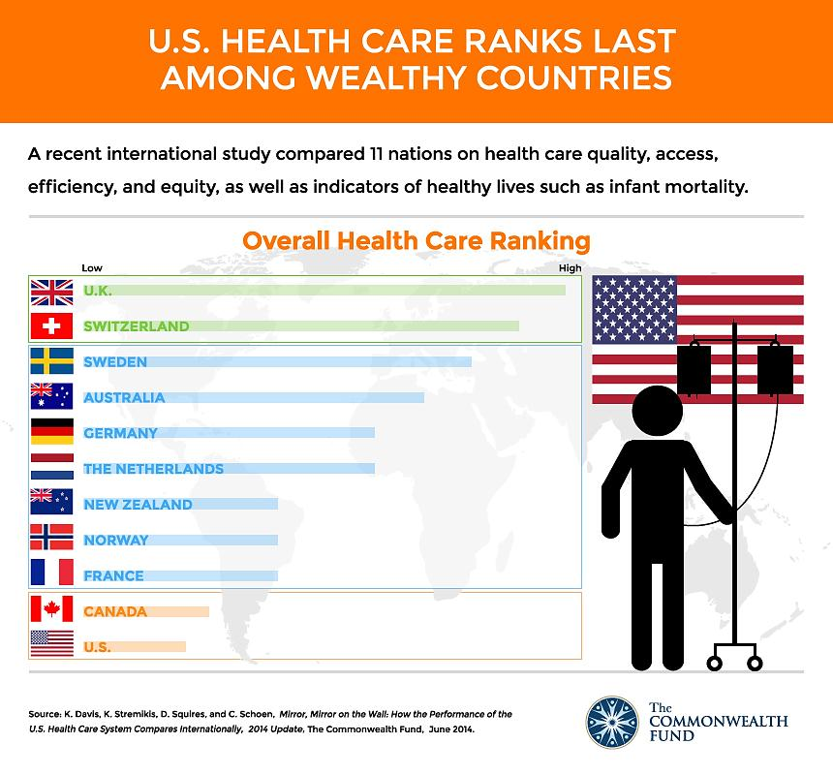
State of U.S. Health Care
The state of U.S. Health Care
Average: 10.4%
Source: 2014 International Profiles of Health Care Systems. The Commonwealth Fund. January 2015.

Slide 6
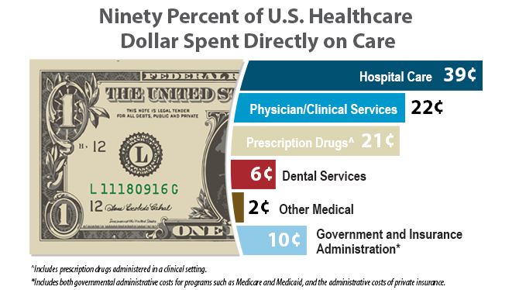
A look at the premium dollar
Sources: National Health Expenditure Data, Centers for Medicare and Medicaid Services, Agency for Healthcare Research and Quality (AHRQ), and IMS Institute

Slide 7
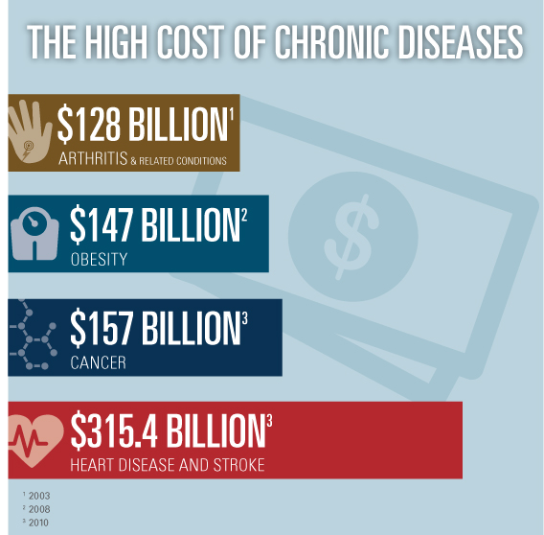
CHRONIC DISEASE
Source: Centers for Disease Control and Prevention

Slide 8
Top 5 Most Expensive Chronic Conditions
Health Conditions
Oncology
Musculoskeletal
Heart
Respiratory
Diabetes

Slide 9
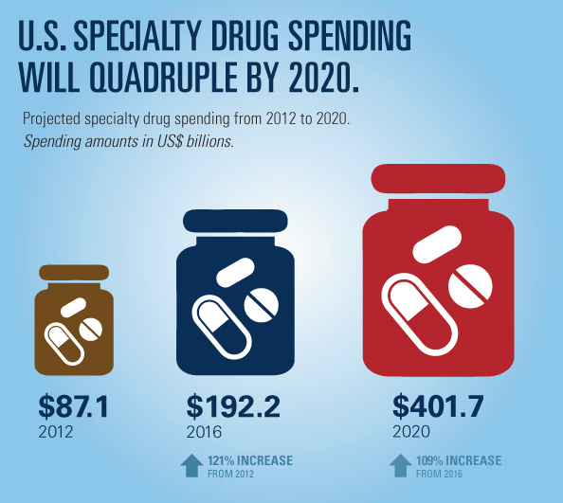

Pharmacy
Source: PwC Health Research Institute, Medical cost trend: Behind the numbers 2015, June 2014, analysis based on data from CVS Caremark

Slide 10
Cost-SHIFTING And Taxes
Lower payments by Medicare and Medicaid force providers to charge health insurers more to make up the difference, resulting in a typical family paying more in premiums.
*Milliman, Hospital and Physician Cost Shift: Payment Level Comparison of Medicare, Medicaid and Commercial Payers, December 2008
**PriceWaterhouseCoopers (2009) Potential Impact of Health Reform on the Cost of Private Health Insurance Coverage ***Kaiser Family Foundation, Employer Health Benefits 2009 Annual Survey

Slide 11
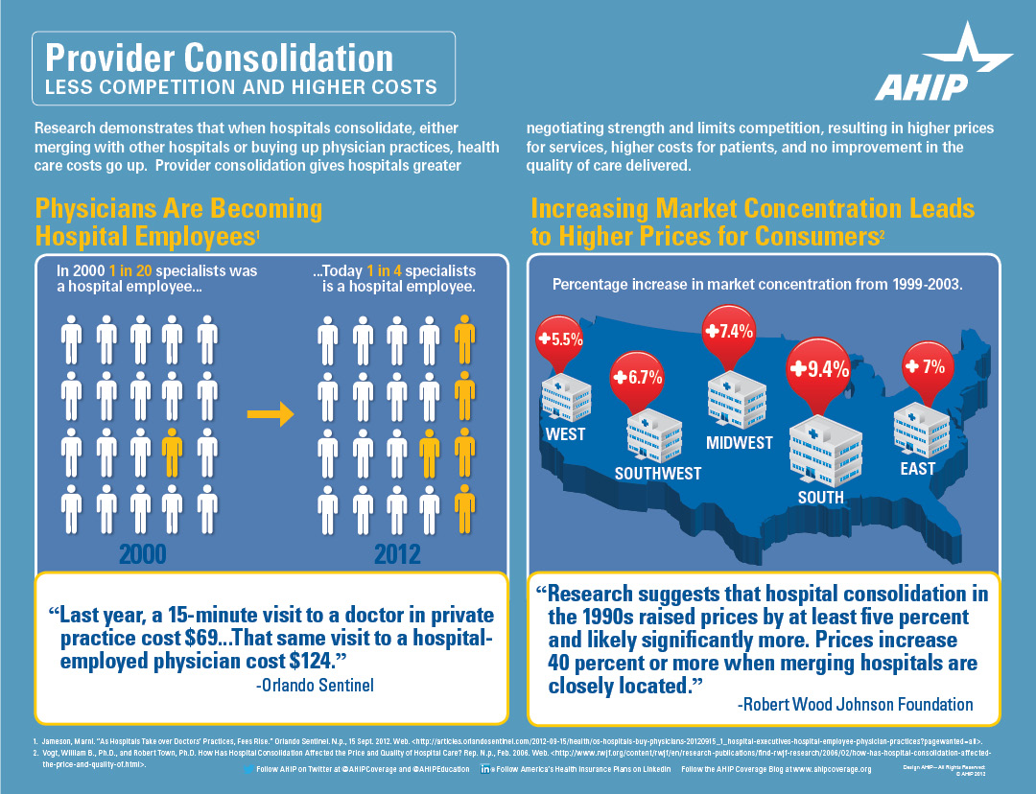
Provider consolidations
Texas example:
Surgery center acquisition
$1.3 million impact
Same service
No improvement guarantee
Acquisition of 9 other facilities resulted in additional $6.8 million

Slide 12
Maximizing Your Health Care Dollar

Slide 13
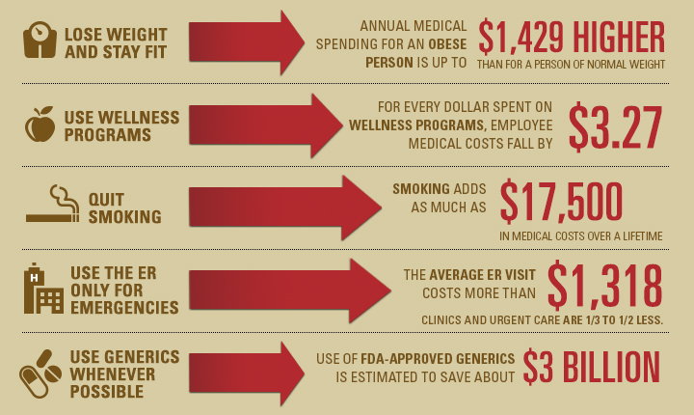
Simple steps you can take
Source: Blue Cross and Blue Shield Association

Slide 14
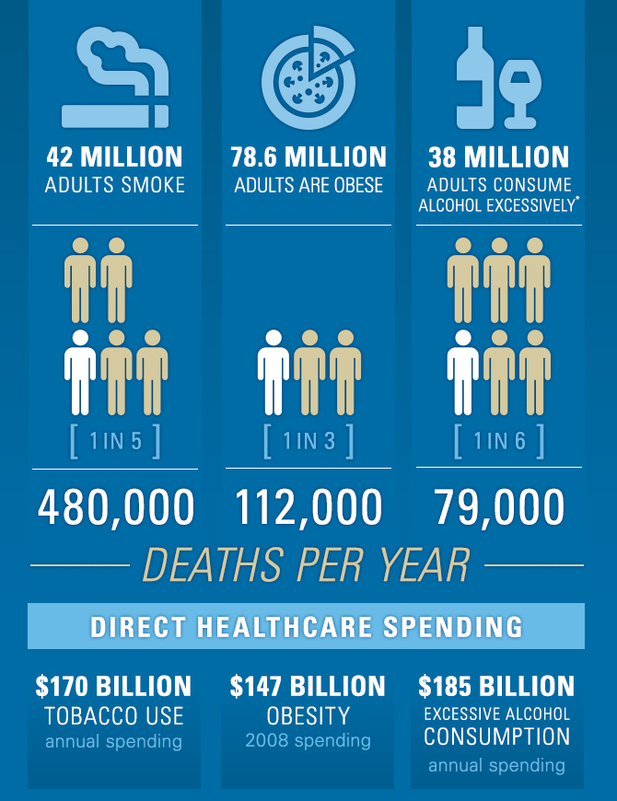

How we live affects health care costs
Source: Centers for Disease Control and Prevention

Slide 15

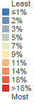
OBESITY PREVALENCE
Source: BCBSA Community Health Management Hub

Slide 16

Diabetes prevalence
Source: BCBSA Community Health Management Hub

Slide 17
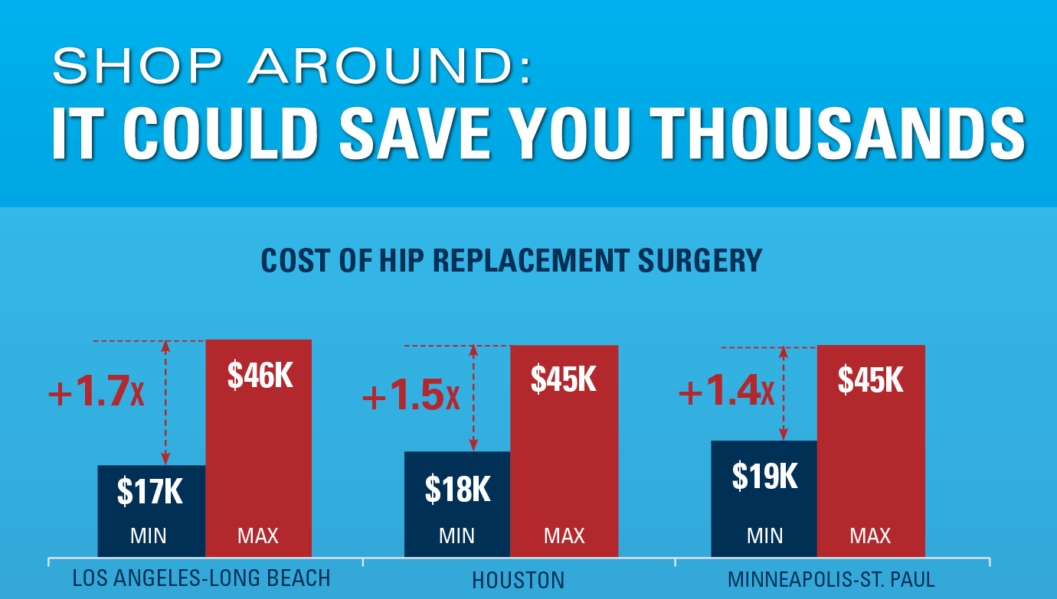
SHOPPING AROUND CAN SAVE MONEY
Source: Blue Cross and Blue Shield Association

Slide 18
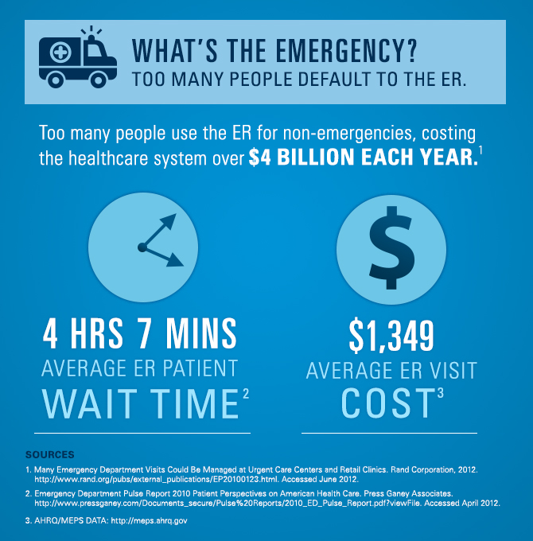
WHERE YOU GO MATTERS
Notes:
What's the Emergency?
Recognizing which health conditions aren’t true emergencies and are best treated by going to a local urgent care facility rather than the emergency room can help you save your time and money, and reduce overall healthcare costs.
Many Emergency Department Visits Could be Managed at Urgent Care Centers and Retail Clinics. Rand Corporation, 2012. http://www.rand.org/pubs/external_publications/EP20100123.html
Emergency Department Pulse Report 2010 patient Perspectives on American Health Care. Press Ganey Associates. http://helpandtraining.pressganey.com/Documents_secure/Pulse%20Reports/2010_ED_Pulse_Report.pdf
AHRQ/MEPS DATA: http://meps.ahrq.gov

Slide 19
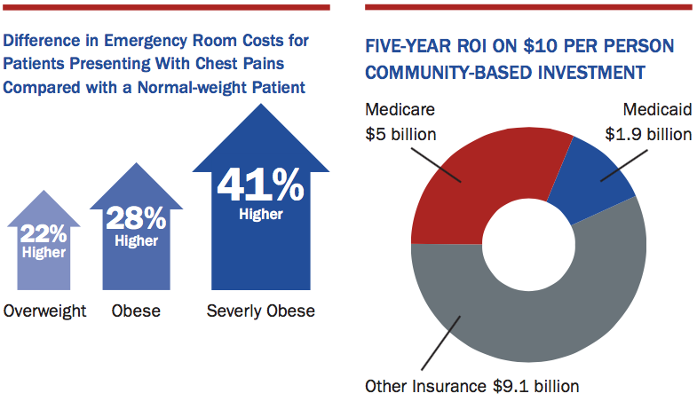
OBESITY’S IMPACT IN THE EMERGENCY ROOM
Source: State of Obesity.
Notes:
Source: State of Obesity. http://stateofobesity.org/healthcare-costs-obesity/

Slide 20
Freestanding Emergency Rooms
REAL ERs
OR
JUST REAL
EXPENSIVE?

Slide 21
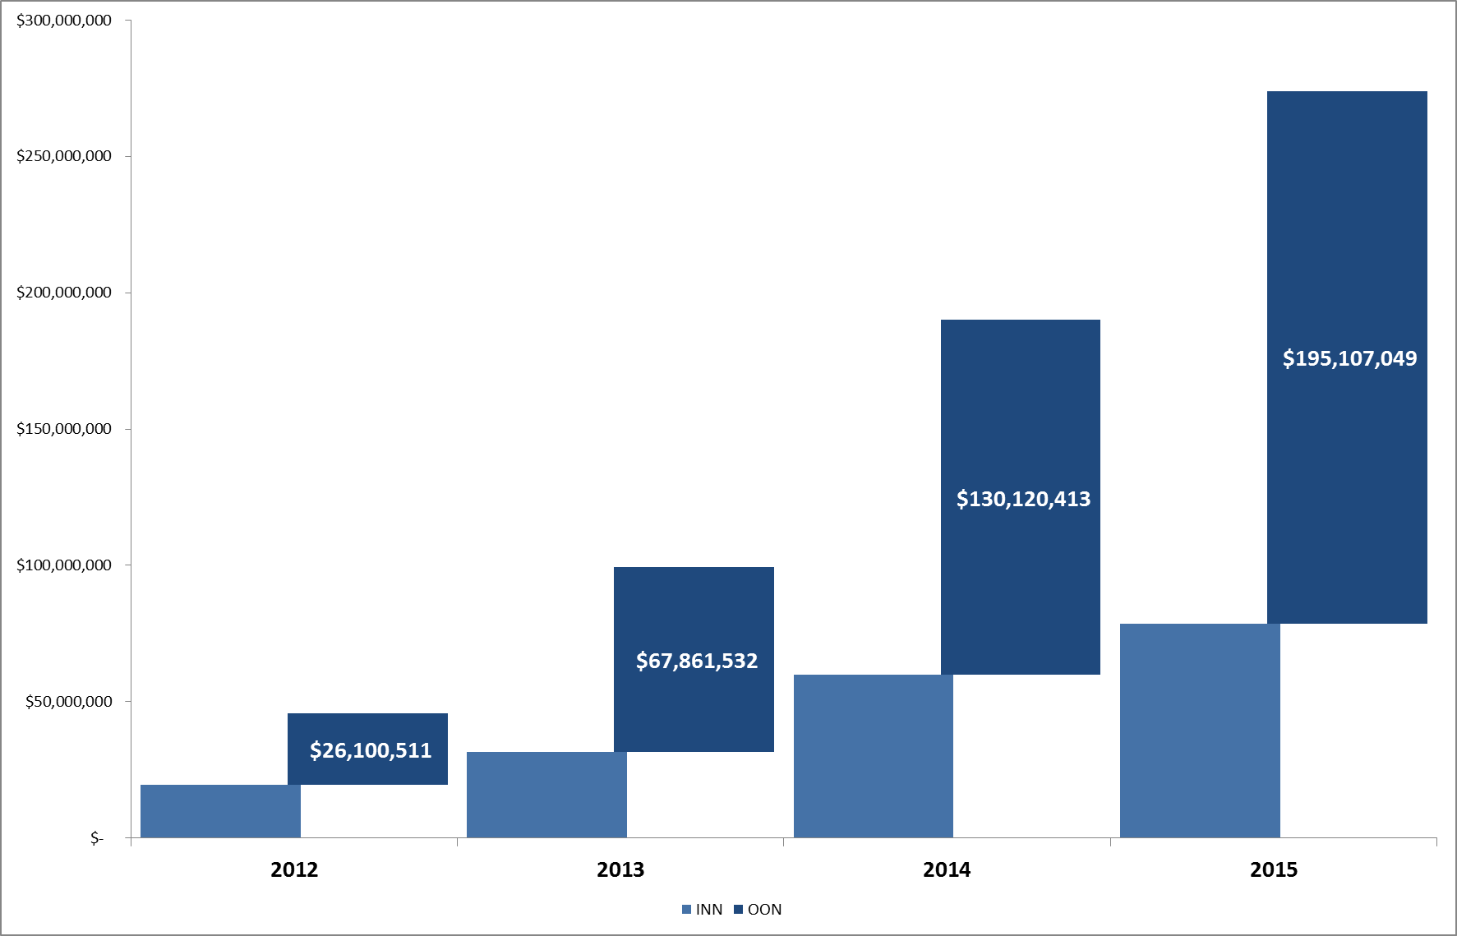
Freestanding ER Cost by Network
$300M
$250M
$200M
$150M
$100M
$50M
Out of network costs
are exceeding any rational explanation.

Slide 22



A Dangerous Wave OF EVENTS
Legislative Environment
Access, Convenience, Confusion
More Locations, Increasing Cost

Slide 23
Access, Convenience, Confusion
Texas is a fast growing state.
Free Standing ERs offer shorter wait times and have longer (24/7) hours of operation than physician offices, urgent care or retail care locations
New patients lack relationships with PCPs, and the free-standing ERs are a convenient solution.
Locations are not always clearly labeled. Misleading advertising draws in unassuming consumers, looking for an urgent care center or retail clinic.
Forbes 2015 Fastest Growing Cities

Slide 24

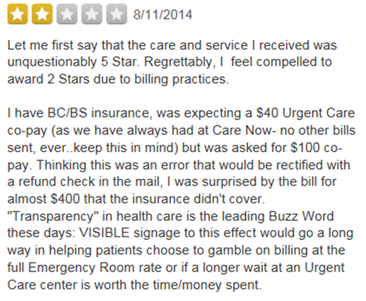
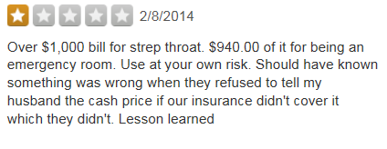
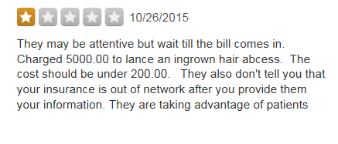
What are the patients saying?

Slide 25
Where You Go Matters – Top 10 Dx
Average Cost to Treat (per claim)
Diagnosis | Hospital ER | Freestanding ER | Urgent Care Clinic | Retail Clinic
Headache | $2,214 | $2,472 | $170 | $80
Urinary Tract Infection, Site | $1,987 | $1,579 | $151 | $66
Other and unspecified, Site | $2,527 | $2,729 | $158 | $77
Acute Bronchitis | $1,298 | $1,611 | $175 | $77
Acute Upper Respiratory Infection | $872 | $1,127 | $162 | $82
Dizziness and Giddiness | $2,696 | $3,026 | $167 | $70
Acute Pharyngitis | $888 | $1,331 | $166 | $86
Nausea with Vomiting | $2,257 | $2,126 | $169 | $77
Unspecified Essential Hypertension | $1,872 | $2,024 | $142 | $63
Lumbago | $1,482 | $1,814 | $159 | $66
Notes:
Source: Diagnosis were pulled from NYU

Slide 26
Patterns in Severity
Free Standing Emergency Department (FSED)

Slide 27
Is there an access issue?
Access is not an issue.
Houston and Dallas-Fort Worth are near the top in the nation.
American Medical Association Physician Master File

Slide 28
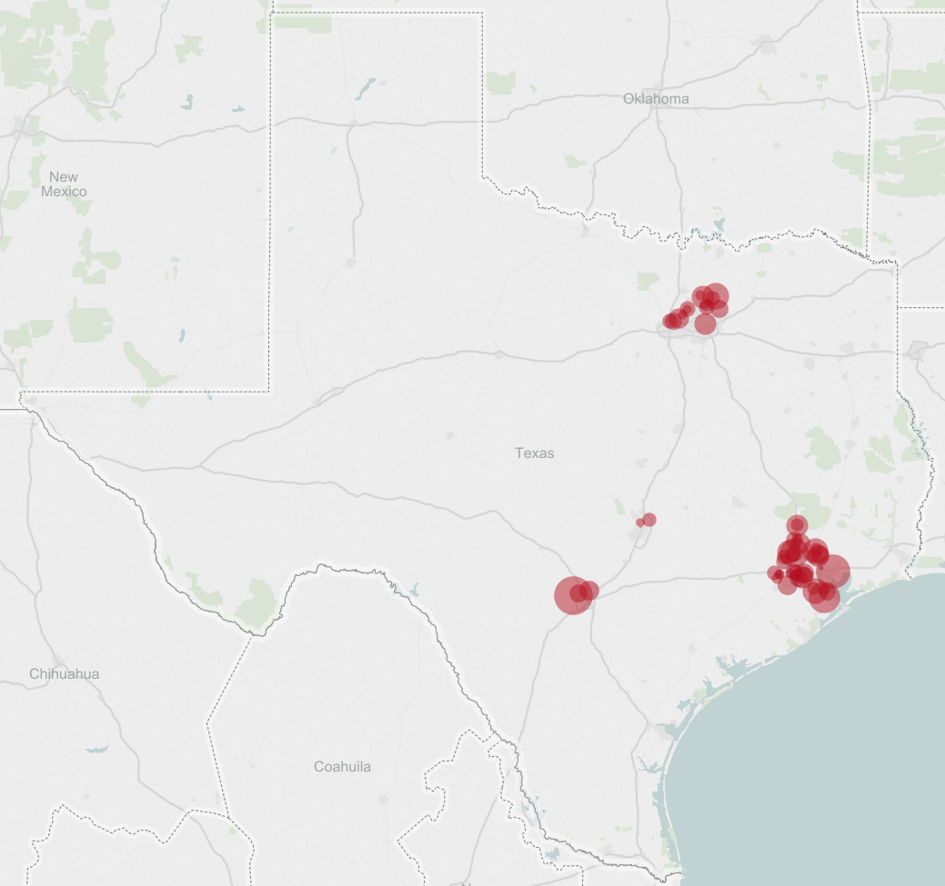
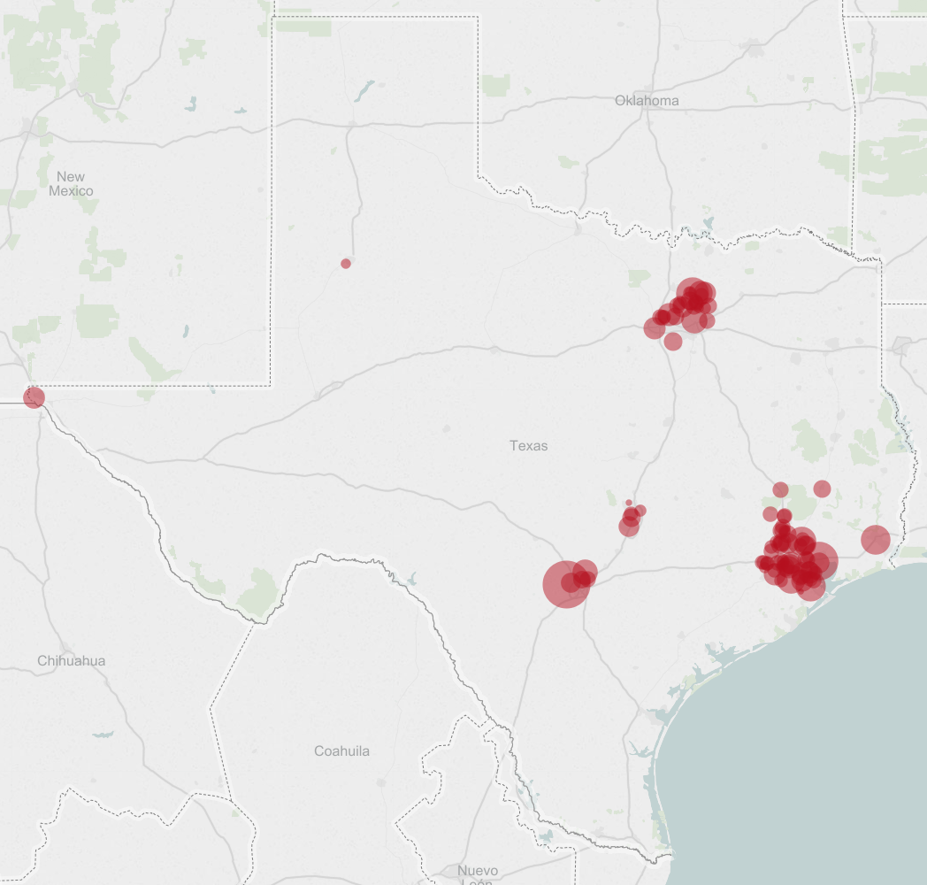
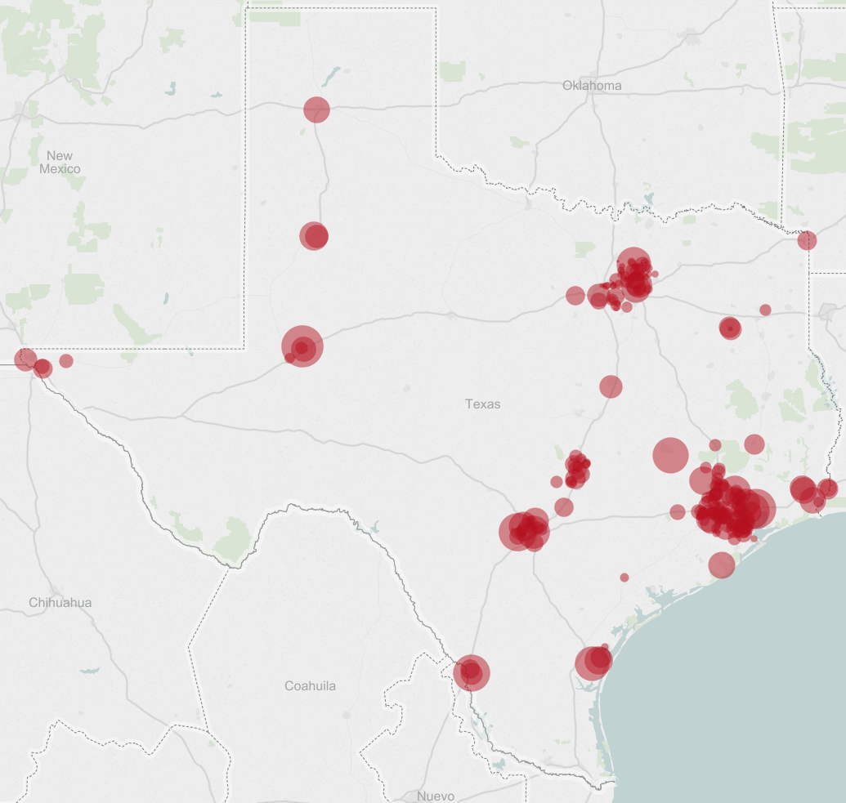
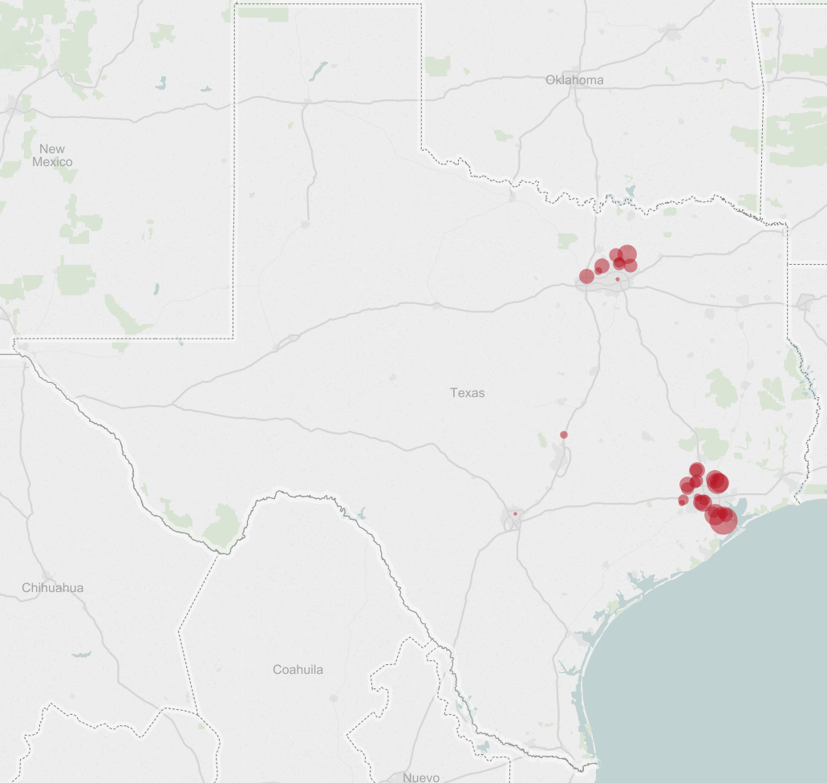
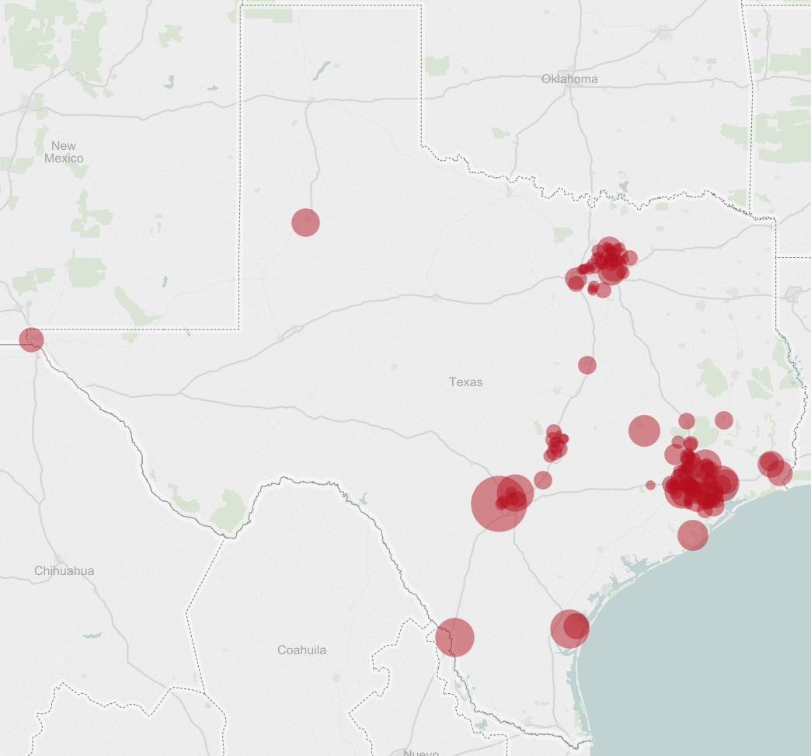
Growth in locations

Slide 29
Identifying Solutions in Our Communities and Our Workplace

Slide 30


BUILDING SAFE PLACES TO PLAY

Slide 31

MARATHON KIDS

Slide 32
PROPOSED SOLUTIONS TO FREESTANDING ERs
Provider Relations & Contracting
Review/access contracts with urgent care providers for non-emergent services
Pursue new/expanded retail clinic partnerships for non-emergent care
Clinical Operations
Expand educational campaigns to softly steer towards the appropriate care facilities
Benefit Design
Explore further benefit tiering to direct members towards urgent care providers and retail clinics
Explore partnership with InQuickER to direct members to right care at the right place
Define approach for managing the emerging trend of freestanding ERs
Expand use of telehealth services to guide members to appropriate sites of service
Healthcare Policy
● Define approach for managing the emerging trend of freestanding ER facilities
● External collaborations with academic institutions, advocacy groups and other stakeholders
Education
● Fliers, editorials, videos, newsletter articles, etc.

Slide 33

Evolution of health care
<10% population with health insurance
70% population with health insurance
Medicare & Medicaid
Health Maintenance Organizations (HMO)
Preferred Provider Organizations (PPO)
Consumer Directed Health Plans (CDHP)
Accountable Care Organizations (ACO)
1940s
1950s
1960s
1970s
1990s
2000s
2010s

Slide 34

Redefining Value in Health Care
quality
Achieve better outcomes
Increase safety
Improve satisfaction
Value
$
cost
Reduce avoidable medical spending
Decrease total cost of care

Slide 35
Sustainable Solution: Physician-Centric strategy
The physician centric strategy empowers and incentivizes physicians to work toward “wins” for each of the key stakeholders, including the potential to:
Enable cost savings for members
Offer market differentiation and leadership
Provide long-term utilization control
BCBSTX
Aligned
incentives
Aligned
incentives
Empower independent physicians
Offer financial and operational support
Improve care delivered to patients
Provide access to transparency tools
Physician Centric Strategy
Physicians
Members
Aligned
incentives
Aligned
incentives
Improve care experience and coordination
Lower health care costs
Employers
Lower health care costs through independent network offerings
Improve employee health outcomes

Slide 36


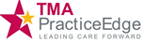

OUR ACCOUNTABLE CARE ORGANIZATIONS
Dallas/Ft. Worth
Catalyst Health Network
National ICN, Inc. (Tenet)
PPHC Commercial LLC ACO
Texas Health Resources (THR)
TXCIN
USMD Physician Services*
El Paso
National ICN, Inc. (Tenet)
East Texas
East Texas Regional Accountable
Care Collaborative, LLC
Kerrville
Hill Country Accountable Care Organization, LLC*
Houston
Houston Regional Accountable
Care Organization, LLC
Memorial Hermann Accountable Care Organization
National ICN, Inc. (Tenet)
Platinum Physician Associates
Renaissance Physician Organization
The University of Texas Medical Branch at Galveston*
Village Practice Management
San Antonio
National ICN, Inc. (Tenet)
UPSA ACO, LLC
Austin
Austin ARIA
Southwest Provider
Accountable Care
Laredo
Seven Flags ACO LLC*
Rio Grande Valley
National ICN, Inc. (Tenet)
Bridges to Excellence
participation occurs statewide.

Slide 37
Key Takeaway Items
The U.S. health care system is the most
expensive in the world.
Many factors impact health care costs, including our own personal behaviors and the growing use of emergency rooms.
BCBSTX is working to identify solutions to maximizing your health care dollar and better incentivizing physicians.
37

