Slide 1
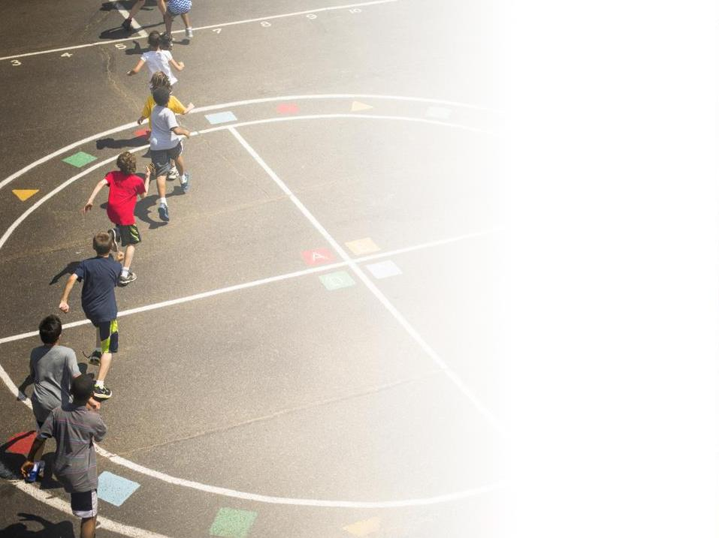
Physical Education and Physical Activity
Moving Youth Towards an Active Future
Dr. Jayne Greenberg,
President’s Council on Fitness, Sports and Nutrition
Miami-Dade County Public Schools
Houston, Texas
November 14, 2016
Notes:
Thank you (NAME) for the kind introduction.
I am excited to be here at the Arizona AHPERD conference to talk with you about the importance of bringing physical activity back to America’s schools.

Slide 2
PCFSN PROGRAMS & CURRENT EFFORTS
Notes:
History of Council
State of the Nation
Current Efforts
Role of Partners

Slide 3
CAN WE AGREE ON 3 PREMISES:
All students should have daily physical education.
All kids should have access to 60 minutes or more of daily physical activity.
Active Kids Do Better.

Slide 4
Regarding Physical Education Can We Agree That:
Schools should provide it.
Physical Education teachers should deliver it.
Parents should demand it.

Slide 5
WHY SCHOOLS ?????
Because kids spend more than half of their waking hours there.
More if they engage in the school breakfast program or stay for after-care/sports/community education
7:00 a.m. – 6:00 p.m.

Slide 6
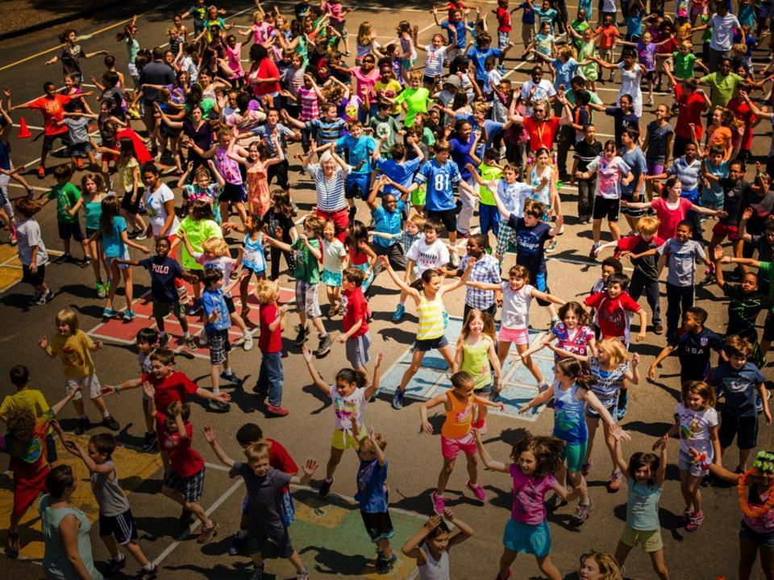
50 Million Kids in the US Attend Public Schools

Slide 7
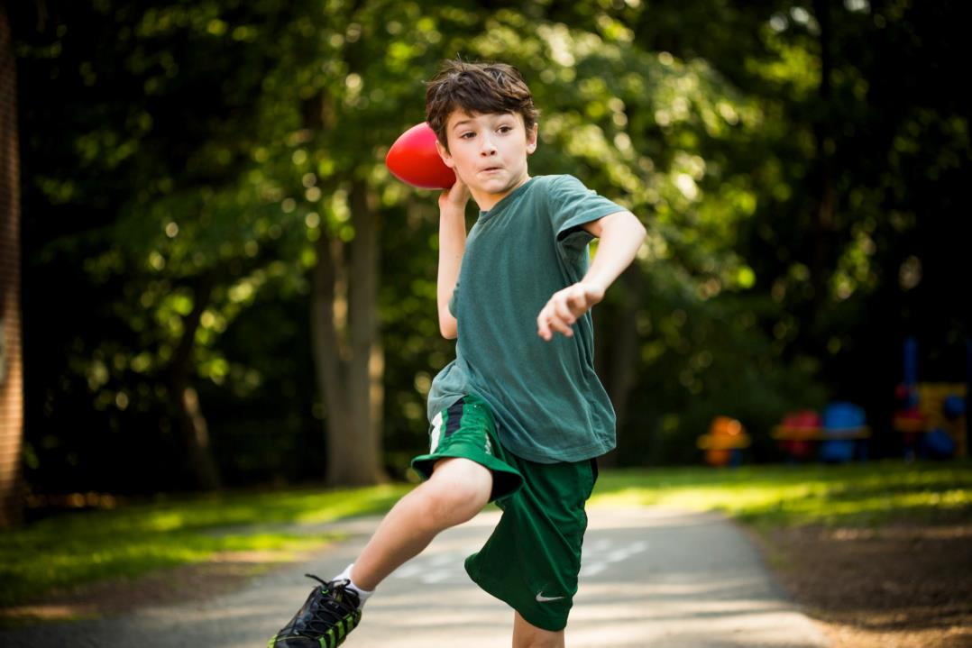
They Love To Move
Notes:
And what we know is that children are innately designed to move!

Slide 8
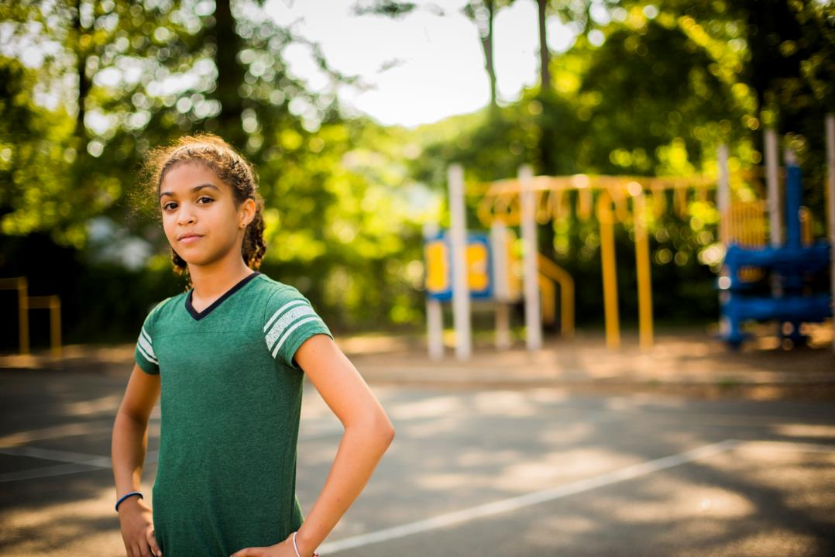
2 out of 3 kids today are physically inactive.
Notes:
As a Council, we certainly have a lot of work to do! As we know, the jarring reality which we face is in the US is that over the past three decades, childhood obesity rates have tripled and only one out of every kids are physically active each day.
This leads to almost one in every three children in our nation is considered either obese or overweight. Undeserved populations are at greater risk for being overweight or obese.

Slide 9
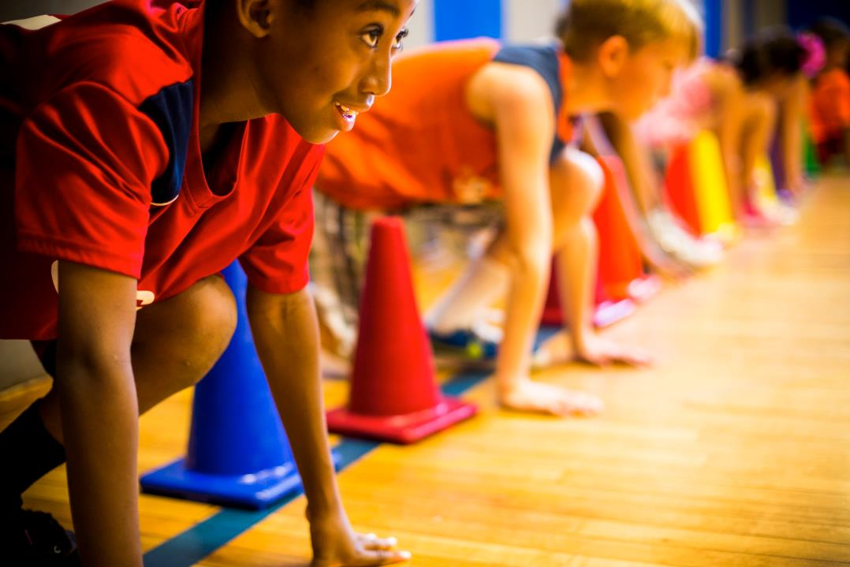
Active Kids Do Better
The insight
Notes:
But again back to what we know is…active kids do better!!

Slide 10
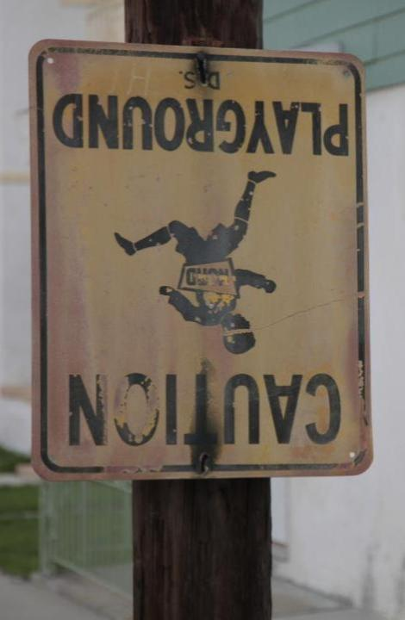
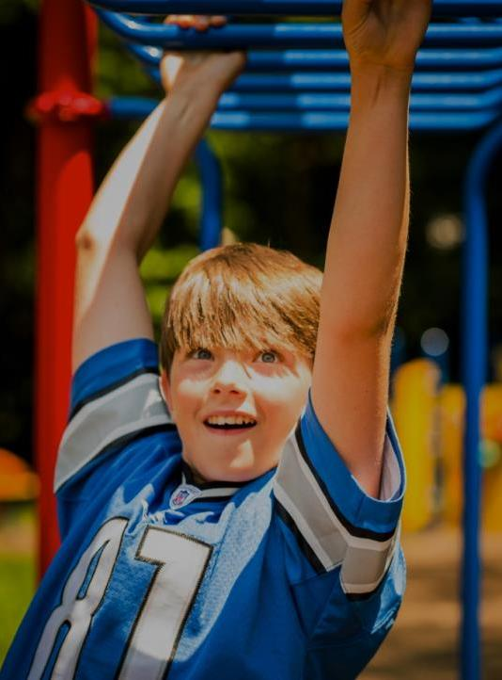
Physical activity not a priority
Active
Schools
From
To
Students moving before, during & after school
Notes:
Lets Move Active Schools, empower schools to offer opportunities that will allow children and adolescents the chance to engage in the recommended minimum of 60 minutes of physical activity per day where they live, LEARN and play.

Slide 11
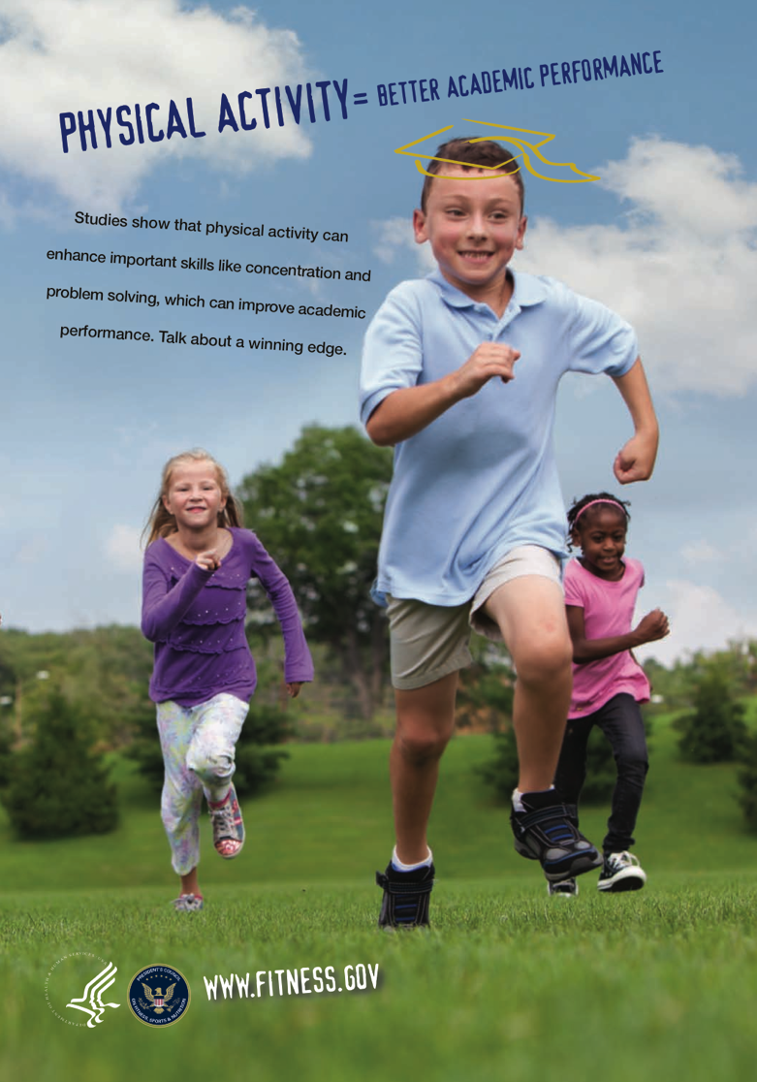
Importance of Physical Activity
Children and adolescents need at least 60 minutes of physical activity per day.
Regular activity helps to :
Build strong bones and muscles,
Decrease the likelihood of developing obesity and risk factors for disease,
Reduce anxiety and depression,
Improve academic performance,
Increase concentration and attention, and,
Improve attendance, discipline, and classroom behavior.
ACTIVE KIDS DO BETTER!
Notes:
But, as we also know, the research is clear… regular physical activity can help to….
Build strong bones and muscles,
Decrease the likelihood of developing obesity and risk factors for disease,
Reduce anxiety and depression,
Improve academic performance,
Increase concentration and attention, and,
Improve attendance, discipline, and classroom behavior.
Bottom Line: Active Kids Do Better

Slide 12
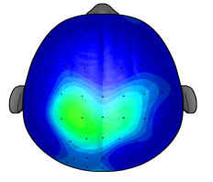
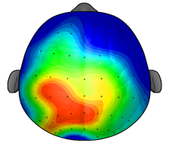
Link between Physical Activity and Cognitive Function, and Academic Performance
Single sessions and long-term physical activity participation improve cognitive performance and brain health.
Children who participate in vigorous or moderate-intensity physical activity benefit the most.
3
µV
8
After 20 minutes of Sitting Quietly
After a 20 minutes of Walking
Notes:
More specifically, studies have found:
Children respond faster and with greater accuracy to a variety of cognitive tasks after participating in a session of physical activity.
Children who participated in 30 minutes of aerobic activity cognitively outperformed children who watched television for the same amount of time.
This is exciting and compelling research that we need to share far and wide.

Slide 13
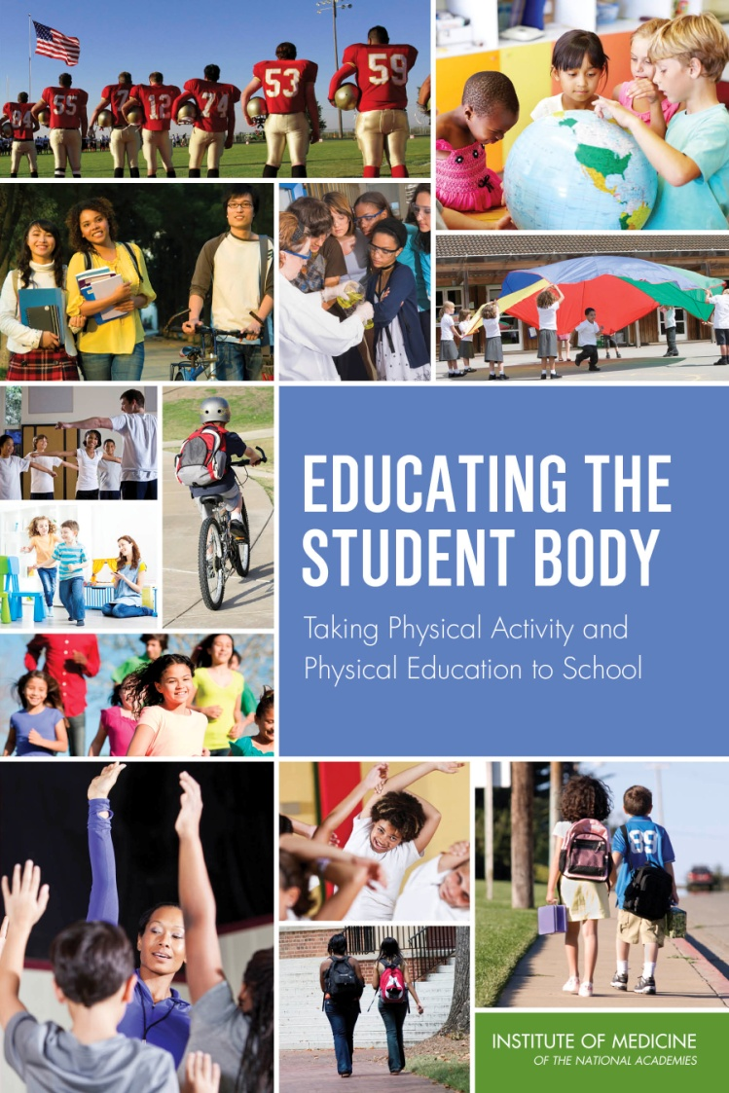
Educating the Student Body: Taking Physical Activity and Physical Education to School
IOM Report released May 23, 2013
Provides six recommendations for district and school administrators, teachers, and policy makers at the state and federal levels
Notes:
Why did the IOM do this report and what was the committee asked to examine?
Why schools?
Schools have for many years provided critical health services to children and adolescents such as nutrition, health screening and immunizations.
And because young people spend much of their time in school, the school environment is often viewed as key in teaching, encouraging, and providing opportunities for them to be active.
Recommendations:
Based on the totality of this evidence, six key recommendations for strengthening and improving programs and policies for physical activity and physical education in the school environment were developed.
These recommendations are equally important, with no one recommendation taking priority over another.
For these recommendations to be fully realized, all will need to receive equal attention and coordinated action from stakeholders.

Slide 14
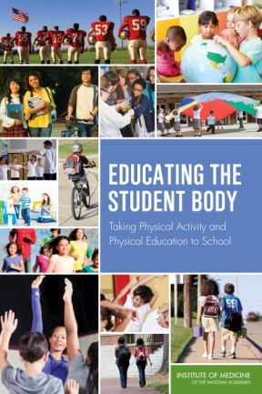
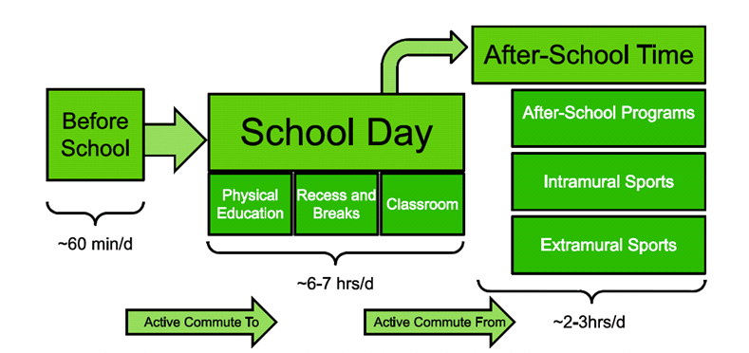
Taking a Whole-of-School Approach
Notes:
Before getting into the recommendations, explain what “whole of school” means and the approach that was taken to making the recommendations.

Slide 15
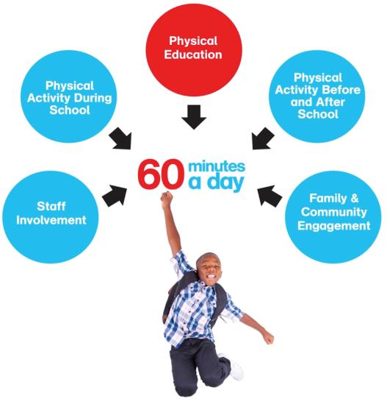
Notes:
After signing up, LMAS equips school leaders and teachers with a roadmap that ensures a coordinated, holistic effort.
The roadmap identifies the programs, initiatives and resources needed to create an Active School based on the Centers for Disease Control and Prevention (CDC) Comprehensive School Physical Activity Program (CSPAP).
The CSPAP calls for integration of physical activity in…
Physical Education. Provide effective physical education that is fun and inclusive. This includes the proper use of the new fitness assessment, known as the Presidential Youth Fitness Program.
Physical Activity During School. Create active classrooms. Include physical activity bursts in lessons.
Physical Activity Before & After School. Offer students opportunities to begin and end their day with physical activity.
Staff Involvement. Emphasize physical activity as a priority for the whole staff.
Family & Community Engagement. Connect with the community. Make your school the center for physical activity.
Through a simple process, to LMAS guides schools to success in these five areas.

Slide 16
SO WHAT HAS CHANGED FROM PREVIOUS CONVERSATIONS
EVERY STUDENT SUCCEEDS ACT (ESSA)
OPPORTUNITY FOR FEDERAL FUNDING
Title I for Low Income Schools
Title II for Professional Development
Title IV, Part A Block A
School Districts must spend this money on supporting a well rounded education, safe and healthy student programs, and technology
Elimination of Carol M. White Physical Education Grants
Funds will begin to flow in July 2017
DEVELOP IMPLEMENTATION PLANS – MAKE SURE YOU ARE PART OF THE PROCESS

Slide 17
EVERY STUDENT SUCCEEDS ACT
Physical Education and Health Education – Well Rounded Education
VISIT: WWW.SHAPEAMERICA.ORG FOR UPDATED INFORMATION AND RESOURCE TOOLS

Slide 18
School Environment
Notes:
Now, I wanted to take a moment to step back as we look at the overall picture to ensure that kids are moving more.
As you may recall, a few moments ago, I highlighted the work of the Department of Health and Human Services through the Physical Activity Guidelines.
As a result of the mid-course report and the five key settings, we identified the school environment is the most evidence based setting to increase physical activity.
As many of you may know, in the US, there are over 55 million youth enrolled in US public and private schools. Each student spends on average about six to seven hours each day within the school walls.

Slide 19
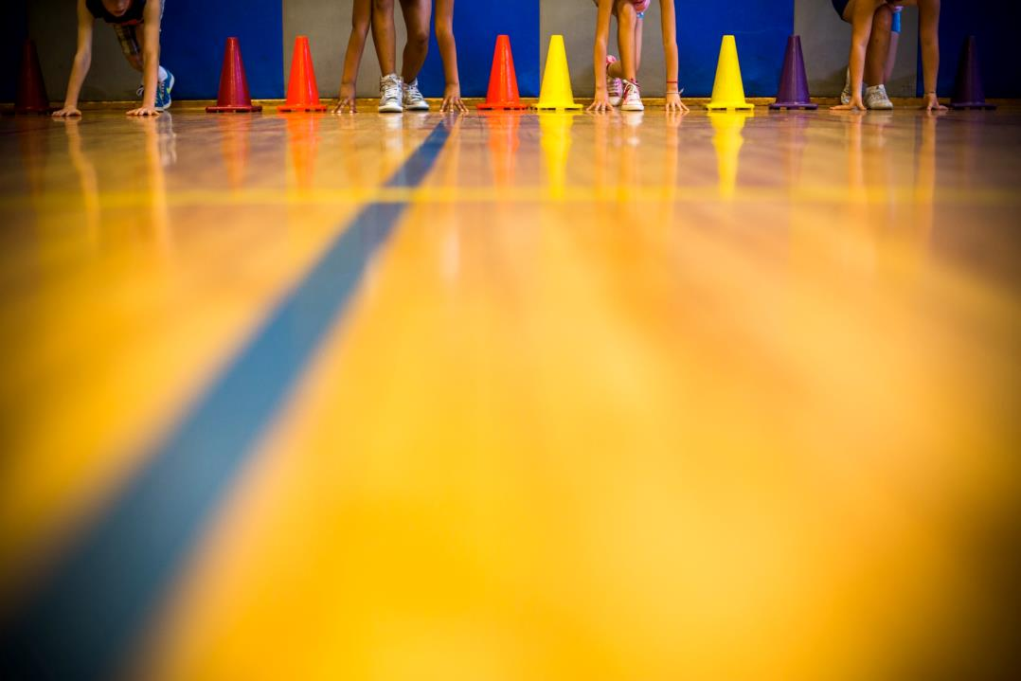
What is Let’s Move Active Schools?
Notes:
Recognizing the opportunity for improvement, government, public and private sector organizations have teamed up to support the efforts of administrators, teachers and parents to help bring physical activity back into America’s schools.
Early this year, First Lady Michelle Obama in partnership with the President’s Council on Fitness, Sports and Nutrition, the Alliance for a Healthier Generation and AAHPERD (the American Alliance for Health PE Recreation and Dance) launched.
This program is a comprehensive program that empowers school champions, such as P.E. teachers, classroom teachers, principals, administrators, and even parents, to create active environments that enable all students to get moving AND reach their full potential.
Active schools, follow the Whole of School approach and incorporate physical activity opportunities before, during and after school.
The Five areas (based on the Center for Disease Control and Prevention’s Comprehensive School Physical Activity Program) calls for integration of physical activity in… Physical Education, Physical Activity During School, Staff Involvement, Physical Activity Before & After School and Family & Community Engagement.
The program guides champions through a simple Six Step process, which I will show you in just a moment!
Throughout the process, participating schools will have access to free opportunities to get students moving and will be directed to Activation Grants, Professional Development, and Technical Assistance to help guide them through this experience.

Slide 20
Let’s Move! Active Schools
A physical activity and physical education solution to ensure
60 minutes of physical activity is the new norm for schools.
Notes:
To build upon this evidence and the very important yet simple concept that ACTIVE KIDS DO BETTER. Last year, in Chicago, the First Lady, the President’s Council and numerous other organizations, launched Let’s Move! Active Schools, which is a program designed to help make being active a way of life for our kids. And it’s about showing our kids that being active is fun.
Supporting the principals outlined in the Midcourse Report, Let’s Move! Active Schools is a physical activity and physical education solution to ensure 60 minutes of physical activity is the new norm for schools.
Ultimately, Let’s Move! Active Schools, part of the First Lady’s Let’s Move! initiative, helps schools develop a culture in which physical activity and physical education are foundational to academic success.

Slide 21
Change Starts with Champions
Notes:
Now before wrapping up today, I wanted to take a step back to look at the big picture. Everyone has a role to play, and anyone can become a Champion! From encouraging your school to join or actively leading your school’s wellness committee, every effort (big or small) is integral to the process. We need school leaders, teachers, parents and community members to work together to get our nation’s kids moving again.
In Miami… Talk about M-DCPS experience with LMAS and impact

Slide 22
Activate
Change
Deliver
the conversation to get physical activity prioritized in schools
champions to initiate Active Schools
early positive experiences to kids via Active Schools
Notes:
We need to
Change the conversation to get physical activity prioritized in schools
Activate champions to initiate Active Schools
Deliver early positive experiences to kids via Active Schools
Now the great news is that as physical educators, you have been doing all of these things BUT we need to continue to work together to emphasize the importance of physical activity and physical education. Our collective voices can inspire change.

Slide 23
SO WHAT HAVE WE DONE: MIAMI-DADE COUNTY PUBLIC SCHOOLS
DEMOGRAPHICS:
4TH LARGEST SCHOOL DISTRICT IN U.S.
356,000 + STUDENTS
OVER 125 LANGUAGES AND DIALECTS SPOKEN

Slide 24
WELLNESS CENTERS

Slide 25
HMS FULL SAIL (OpSail 2000)

Slide 26
Sailboats and Kayaks

Slide 27
Kayaking from Coconut Grove Sailing Club to Surrounding Islands

Slide 28
Snorkeling for Conservation
STUDENTS LEARN TO RESPECT THE MARINE LIFE AND VEGETATION
STUDENTS LEARN HOW WEATHER CONDITIONS IMPACT THE TOPOGRAPHY OF THE OCEAN FLOOR AND BISCAYNE BAY

Slide 29
Project Adventure Miami Style

Slide 30
TECHNOLOGY BASED INDOOR FITNESS TRAIL FOR RECESS

Slide 31
NEW DDR
WIRELESS

Slide 32
LEARN TO SWIM

Slide 33
GOLF COURSE

Slide 34
Evidence-based strategy
Notes:
The Let’s Move! Active Schools framework is based on the Centers for Disease Control and Prevention’s (CDC) Comprehensive School Physical Activity Program (CSPAP). As well, Let’s Move! Active Schools adopted the physical activity focuses of the CDC's School Health Index for its online assessment tool, making it easier for schools to implement evidence-based policies and practices. The streamlined assessment is designed to be each school's annual benchmark for physical activity and physical education.
After completing the easy 9-question assessment, Active Schools will deliver each school a customized action plan. The action plan identifies areas of opportunity and strengths to provides recommended strategies) that make sense for the school’s current environment.
The recommended strategies include:
(Slide change)

Slide 35
PRESIDENTIAL YOUTH FITNESS PROGRAM (PYFP)
EVERY STUDENT ENROLLED IN PHYSICAL EDUCATION ARE PRE- AND POST-TESTED ON FITNESSGRAM
PROFESSIONAL DEVELOPMENT PROVIDED
2016-2017 SCHOOL YEAR – 47% OF STUDENTS PASSED 5 OF 6 ASSESSMENTS
FOCUS IS ON STUDENT FITNESS – NOT CHILDHOOD OBESITY
STUDENTS ARE NOT GRADED ON THEIR FITNESS SCORES
TEACHERS ARE NOT EVALUATED ON STUDENT FITNESS ACHIEVEMENT

Slide 36
Inclusion is key! COMMIT TO INCLUSION
Notes:
One other important aspect that I wanted to touch on, is the need to be inclusive with all of our efforts as well.

Slide 37
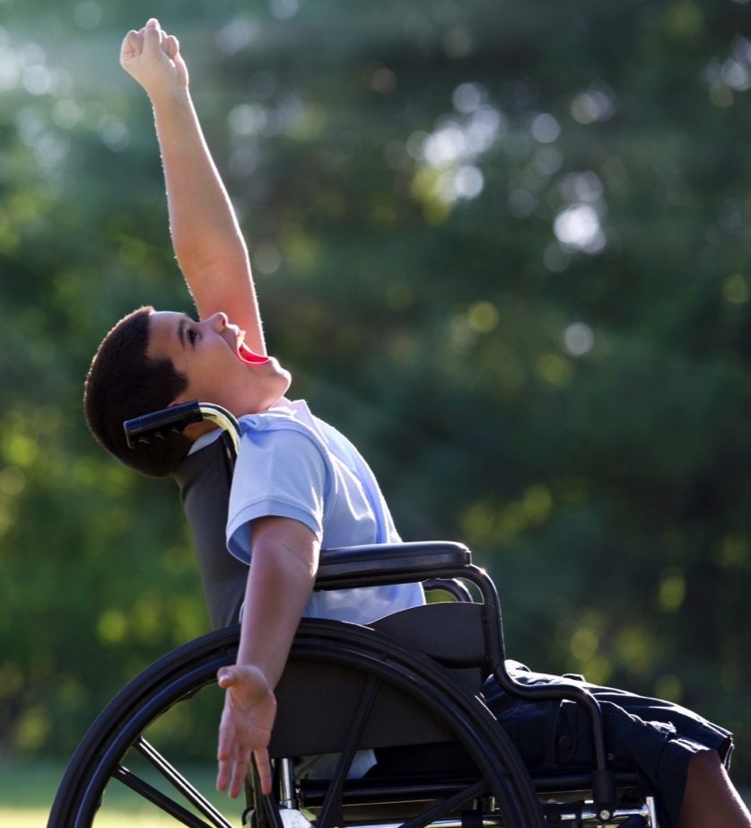
I Can Do It! You Can Do It!
National mentoring initiative for children and adults with disabilities
Addresses the need for equal access to physical activity, recreation and sports opportunities
Partners with schools, colleges/universities, and other community-based settings
Promotes individualized physical activity and healthy eating goals
Recognizes participants with PALA+
Provides comprehensive toolkit to support program coordinators and participants
Notes:
In addition to physical education and the Presidential Youth Fitness Program, I would like to take a moment to highlight another key aspect of our work within schools, which is to ensure that all students regardless of ability have opportunities to be physically active.
Many people don’t really focus on inclusion, and how such a simple word can make all the difference in the lives of millions of Americans.
I believe wholeheartedly that all people should have access to daily physical activity and be able to live a healthy lifestyle across their lifespan.
As the District Director of Physical Education and Health Literacy for Miami-Dade County Public Schools, I think about inclusion every day.
So what exactly is inclusion and why is it important? According to experts in the field of disability, the definition of inclusion is “to transform communities based on social justice principles in which all community members are presumed competent; are recruited and welcomed as valued members of their community; fully participate and learn with their peers; and experience reciprocal social relationships.”^{[1]}
We know that lack of participation in physical activity is a serious public health concern for all Americans, but even more so for the approximately 56 million Americans with a disability who are at three times the risk of developing serious health problems associated with a sedentary lifestyle, like heart disease, stroke, diabetes, and cancer.[2]
Regular physical activity can provide people with disabilities the strength and stamina required to participate in all aspects of life actively and successfully.
Nearly half of all adults with disabilities get no aerobic physical activity compared with one in four adults without disabilities. And typically, children and adolescents with a disability engage in very little school-based physical activity, and more sedentary recreational activity. Additionally, obesity rates for children with disabilities are 38% higher than for children without disabilities.[3]
These patterns of inactivity in childhood can also translate into unhealthy habits into adulthood.
While there will always be a need for specialized health promotion interventions targeting specific disability groups, there is a critical need to promote more inclusive programming to create a brighter future for all Americans.
Everyone has a role to play and we all can make a difference in the lives of others. The question I have for you is: When you think of inclusion, what does it mean to you? What role does it play in your life?
Miami-Dade County Public Schools has been implementing ICDI for ten years now.
Participation in the ICDI program promotes the positive, physical, social, psychological, and ethical values necessary to achieve lifelong, healthy lifestyles in an inclusionary environment. Mentors and mentees alike gain reciprocal benefits through participation, enabling independence, productivity, integration and inclusion into the community.
The strength of the I Can Do It, You Can Do It! program involves the strong commitment of community-based organizations to work cooperatively with schools in providing recreational opportunities for students with disabilities. The ICDI program is a community-based solution to encourage every adult and child with a disability to move more.
ICDI is a national mentoring program of the President’s Council that seeks to partner with community-based entities or schools to provide more accessible opportunities for youth and adults with disabilities to lead healthy, active lifestyles.
Research has shown that the mentor-mentee approach is very successful when working with individuals with disabilities—especially for a sense of self-sufficiency and feeling empowered to participate in physical activities.
ICDI provides increased access to and support for Americans with disabilities by…
Promoting and providing opportunities for greater participation in physical activity and sports
Encouraging weekly healthy eating goals to be set and met
Providing quality mentors to help mentees develop social and team-building skills
Fostering positive self-confidence among mentees
ICDI partners with organizations who have a vested interest in addressing the needs of those with disabilities through the I Can Do It Advocate process.
HIGHLIGHT MIAMI’S INVOLVEMENT and true impact (test scores and attendance rates)
Now to show you the true impact, let’s watch this video.

Slide 38
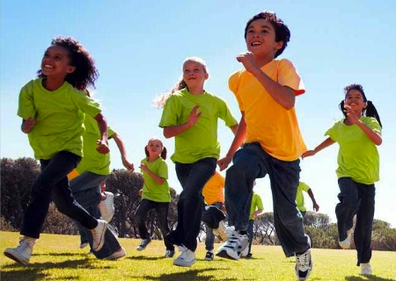
Moving Youth Towards
a Healthier Future
Notes:
The Council is very excited to be continue our work with schools and school districts across the country to provide them with opportunities to re-engineer physical activity back into our everyday lives.
We know it’s our responsibility to continue to create opportunities for the next generation to be active, whether that’s within the school walls or at home….make no mistake about it, each and every opportunity is integral to ensure the health of America’s kids
I am confident that if we all put in the time and energy and the imagination, we'll be able to give all of our children the tools they need to lead the happy, healthy lives they truly deserve.
Remember, the time is now and we have the momentum … (PAUSE)… change is truly happening across America and the world!

Slide 39
PCFSN PROGRAMS & CURRENT EFFORTS
Notes:
History of Council
State of the Nation
Current Efforts
Role of Partners

Slide 40
Dr. Jayne Greenberg
Presidents’ Council on Fitness, Sports and Nutrition
www.fitness.gov | @FitnessGov
Notes:
Thank you!

