Slide 1
Promoting child health in the out-of-school-time setting: Co-learning and participatory action with the Central Texas Afterschool Network
Andrew Springer, DrPH Heather Atteberry, MPH
Associate Professor Center Coordinator
Michael & Susan Dell Center for Healthy Living - UTHealth School of Public Health-Austin
Southern Obesity Summit, Houston, Texas, November 2016

Slide 2
Background
Ecological Model of Active Living (Sallis et al., 2006¹):
Settings & Environments (policy, social/org., information, built)
Must move beyond schools in order to impact obesity & related behaviors^{2,3}
Central Texas Afterschool Network (CTAN)*
2013: 34 organizations & >60 program sites in central Texas (~12,000 children)
*(2015 to present: Learn All The Time)
Formation of CTAN child health committee
~10 members (6 organizations)
Exploration of OST program policies for:
physical activity, healthy eating, SEL
CTAN BOOST Grant: St. David’s Foundation
CTAN BOOST Team
Angel Toscano (ITS TIME TEXAS) (Chair)
Eric Imhof (Camp Fire Central Texas)
Edna Parra (DVISD)
Sarah Rinner (Creative Action)
Michael Thielvoldt (TX Agrilife)
Andrew Springer, Heather Atteberry, Lauren Toppenberg, Kelli Lovelace & Kelsey Herron (UTHealth School of Public Health)

Slide 3
CTAN BOOST Initiative
Aims
Identify recommended policies* and best practices for promoting activity, healthy eating & SEL in OST context.
Provide co-learning & best practice workshops on child health promotion for OST program providers (n=10 sites).
Evaluate the effects on increasing children’s physical activity, healthy eating and OST social cohesion.
1.) Physical Activity
30 mins (half day)/ 60 mins (full day):
2.) Healthy Eating/Snacks
Water, 100% fruit juice, and low or nonfat milk; no SSB
Fruit or vegetable: >=1 day/wk
3.) Soc./Emotion. Learning
Programs support an inclusive and cooperative environment
4.) Staff Social Support
Staff model healthy behaviors and positive interpersonal skills:
Encouraging PA and healthy eating
Creating a positive program culture that promotes sense of belonging & social cohesion w/peers & staff
*Based on: Nat’l Afterschool Association, IOM, Alliance for Healthier Generation, Austin ISD SEL, TXPOST

Slide 4
Methods
Community-Based Participatory Research
Collaborative approach with CTAN & OST program sites (intervention)
“Participatory Learning & Action” approach
Design: Nonequivalent group pre/posttest (Sept-Nov 2015 & April/May 2016)
Sample
16 OST program sites/site coordinators from central TX (10=interv.; 6=comparison)
3rd-5th grade students (221=int; 52=comp.)
Measures
OST Site Coordinator Interview
35-items= policies & practices
MVPA SOFIT-R: Activity Time
Student survey (SPAN⁴; Supportive Social Relationships Scale⁵)
Analysis: Descriptive analyses & t-tests (SPSS)
Identify Policies
Asset Mapping
(Spring 2015; n=20 OST leaders)
OST Recruitment
(Spring/Summer 2015)
Participatory Learning (n=10 sites)
Comparison (n=6 sites)
3 workshops (Fall 2015)
Flow of Project Activities

Slide 5
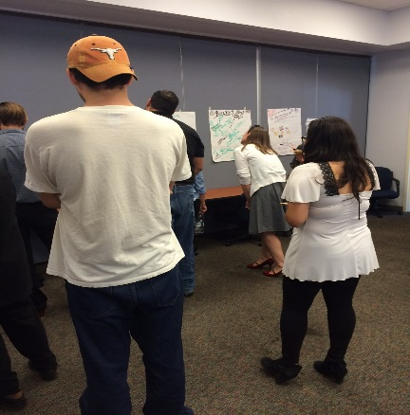
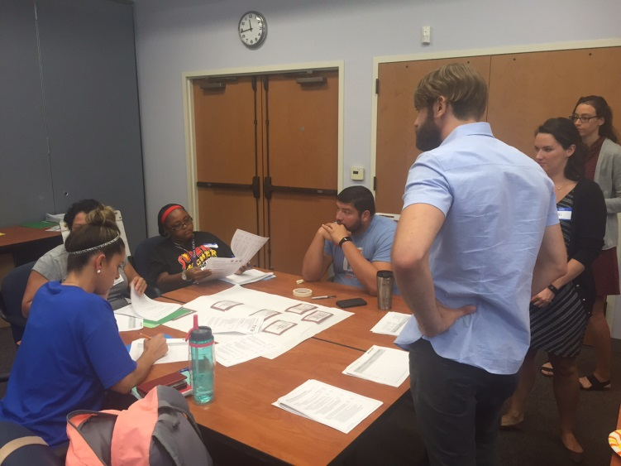
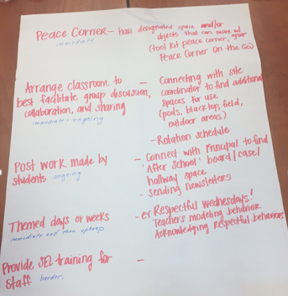
CTAN BOOST Workshop 1
Action Planning in the Out-of-School-Time Setting
Creating the BOOST Action Plan for Child Health
Exchange current OST policies/practices
Review and discuss Menu of Options
Develop Action Plans to take back to sites
Ice-breakers & sharing back
Jigsaw for Child Health: Best Practices for Physical Activity, Healthy Eating, and SEL
Review OST programs’ current assets
Identify and share best practices

Slide 6
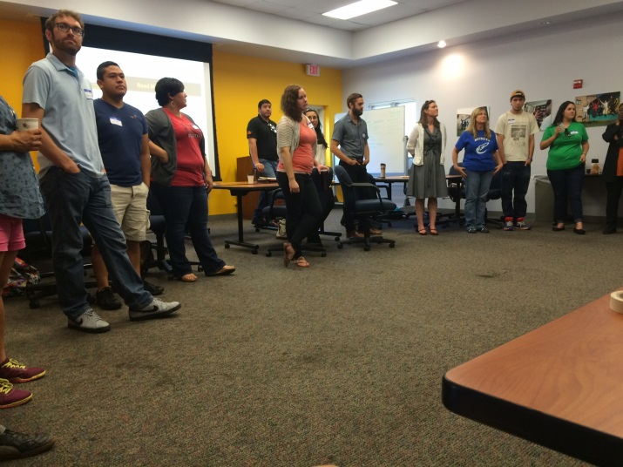
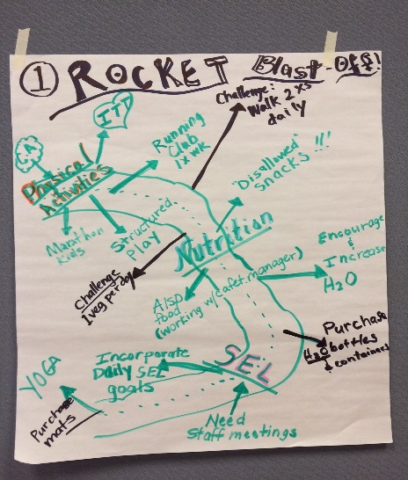
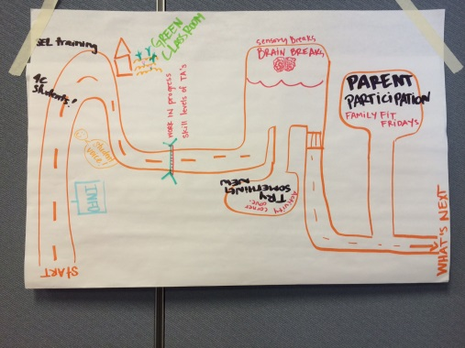
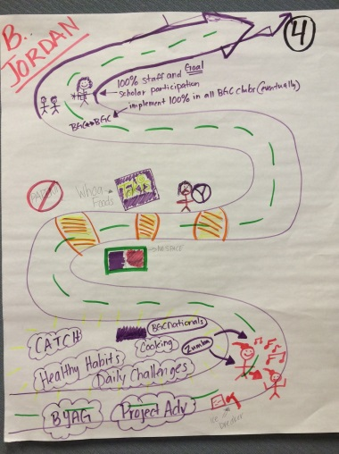
CTAN BOOST Workshop 2
Road Maps: Updating Action Plans & Sharing Best Practices
Road Map to Healthy Children: OST Route 66
Highlights of Activities: What activities are you doing? What is going well?
Road Blocks: What is challenging for implementing actions? Challenges for promoting child health in OST?
Destiny & Goals: Where you are headed? What are your goals? When that road ends- what does that look like for your children? For your staff?
Then: Gallery Walk! Hang your road maps and browse your colleagues
Vote with your Feet!
At my OST site…
We have a strong initial plan of action
My frontline staff understands and knows their role in plan of action.
I have begun implementing my plan of action.
Implementing my PA/HE/SEL portion of plan of action has been easy.
My children are excited about doing this.
OST Road Maps…

Slide 7
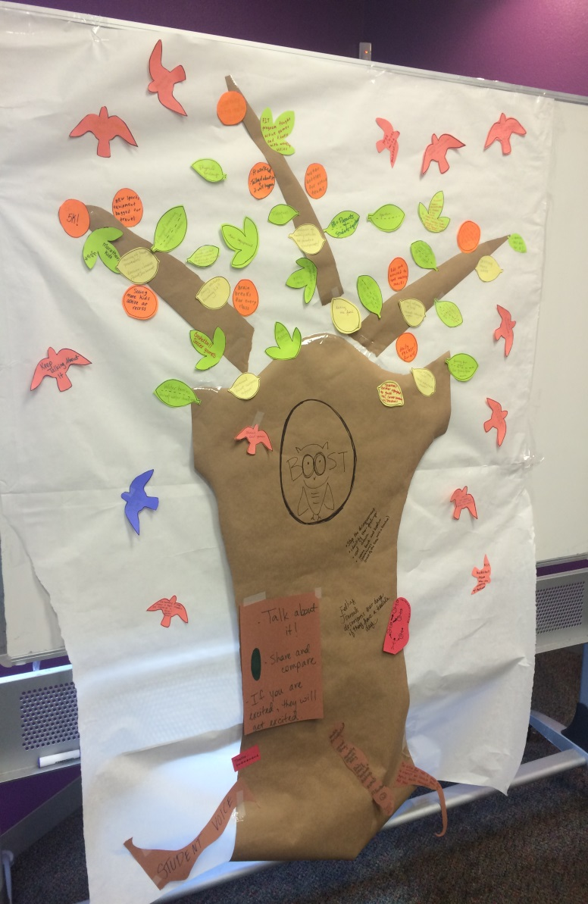
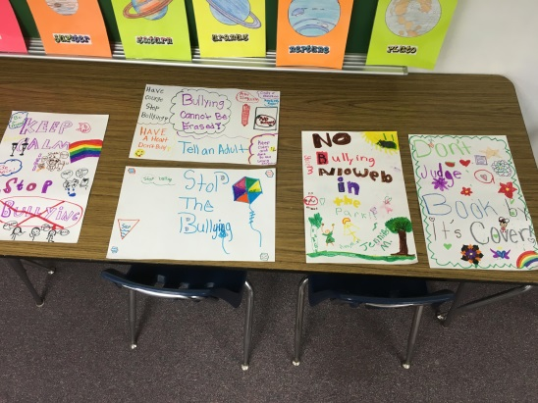
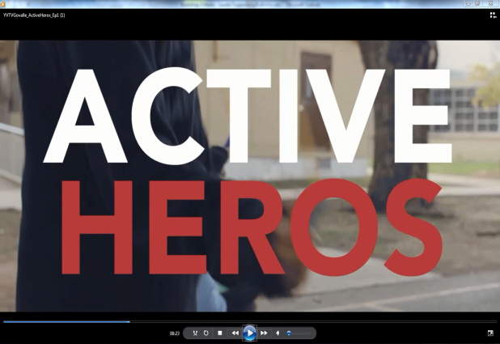
CTAN BOOST Workshop 3
Evaluate and Celebrate!
Presentation & assessment of OST activities & practices implemented
Celebration of accomplishments
Reflection Tree
Participatory Evaluation Discussion
Did anyone see any commonalities across the trees?
Was there anything your colleagues added that you forgot about?
Is there anything you would do differently next time you create or implement an action plan?
Reflection Tree Key
Roots = processes Leaves = activities/practices
Fruit = outcomes Birds = future plans

Slide 8
Initial Findings
OST Site Coordinator Interview (Posttest) (n=16)
Student Outcomes
(n=147 int; n=37 comp.)
 | Intervention (n=10) | Comparison (n=6) | Exceed?
Recess mins. (difference pre/post) | Mean: 20.1 (+6.2 mins) | Mean: 22.5 (+1 min.) | No
Structured PA mins. (difference pre/post) | Mean: 51.6 (-3.2 mins.) | Mean: 47.5 (-13.3 mins.) | Yes
Structured PA days | Mean: 4.0 | Mean: 3.2 | Yes
Policy: extended sitting | 40% | 16.7% | Yes
Policy: withholding PA | 20% | 0% | Yes
PA training to staff | 80% | 50% | Yes
Serve FV snack(weekly) | 70% | 83% | No
100% Fruit Juice | 100% | 16.7% | Yes
 | Statistical Difference?
MVPA recess | N/S
PA | N/S
FV | N/S
Soda | N/S
OST social cohes. | p=.001 *Inter.
Student connect. | p=.001 *Inter.
OST Satisfac-tion | p=.001 *Inter.
Healthy eat programming | 20% | 0% | Yes
Posted “agreements”/ behavioral expectations | 70% | 0% | Yes
Train staff SEL (2/more) | 60% | 50% | Yes

Slide 9
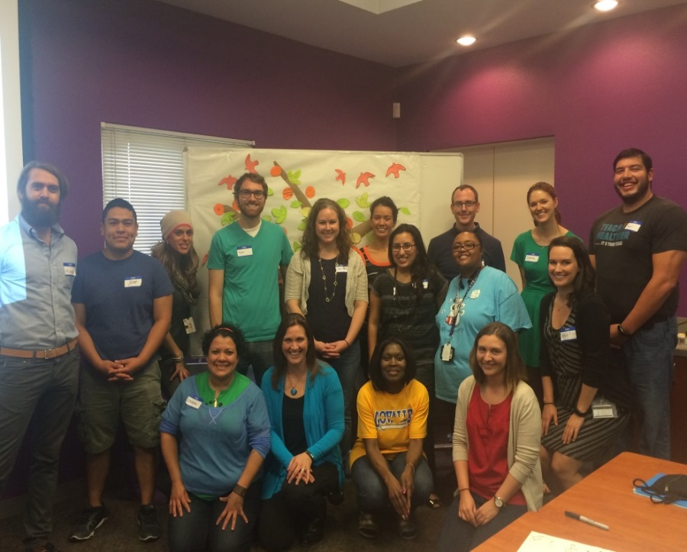
Lessons Learned & Recommendations
OST action planning workshops: potential for increasing policy buy-in, OST-specific actions, and cross-OST site support for health promotion.
Balance between proscriptive (efficient?) and empowerment approach (buy-in?)
Beets et al¹: Frontline Staff!
Springer & Evans⁶: Environmental Assets
Importance of clear behavioral/ environmental outcomes
Align strategies w/outcomes. Diversity of strategies a challenge for measurement…
Timeframe! Organiz. change takes time…
Consider complexity of OST setting:
Diversity of organizations (vendors, hosts)
Who is the right decision maker for policy?
Evaluation & diversity of schedules/settings
CTAN BOOST Team
Contact: andrew.e.springer@uth.tmc.edu
Funder: St. David’s Foundation
http://ctanafterschool.com/BOOST/
References: 1. Sallis et al. An ecological approach to creating active living communities. Annual Review of Public Health, 27, 297-322.
2. Beets et al., Translating Policies Into Practice: A Framework to Prevent Childhood Obesity in Afterschool Programs. Health Promot Pract 2013 14: 228
3. Wiecha et al. A toolkit to promote fidelity to health promotion interventions in afterschool programs. Health Promotion Practice 2012
4. Penkilo et al. Reproducibility of the School-Based Nutrition Monitoring questionnaire among fourth grade students in Texas. J Nutr Educ Behav 2008; 40:20-27.
5. Springer et al. Reliability and validity of the Student Perceptions of School Cohesion Scale. BMC International Health and Human Rights 2009; 9:30.
6. Springer & Evans. Assessing environ. assets for health promotion plan. HPP 2016
Notes:
“The BOOST initiative has reminded me of the importance of healthy lifestyles for not only the students we serve, but the staff and adults that students are led by and look up to as well…
I have cut out sodas completely and I make sure to always encourage water breaks and drinking water from the fountains along with the students…
There is an ever-increasing amount of group games and ways to play being created by the students and instructors…I am not sure if it is a direct result, but behavior issues and removed students have dropped since the BOOST initiative has picked up speed ….” -LEAD Program Specialist, Del Valle ISD.

